Slide 1
Tacoma Power 2024 IRP Public Workshop
May 8, 2024

Slide 2
Welcome

Slide 3
Agenda
TIME | TOPIC | LEAD
1:00 P.m. | Welcome | Ahlmahz Negash
1:10 P.M. | About our power supply | Leah Marquez-Glynn
1:20 P.M. | About our IRP | Rachel Clark
1:30 P.M. | Preliminary IRP Findings | Rachel Clark
1:45 P.M. | Review options to fill our gaps | Rachel Clark & Ahlmahz Negash
2:10 P.M. | Next Steps | Ahlmahz Negash
2:20 P.M. | Meeting adjourned.
2:20-3:30 P.M. | Informal discussion: IRP team will stay on to respond to more technical questions for those interested. | IRP Team

Slide 4
About our Power Sources

Slide 5
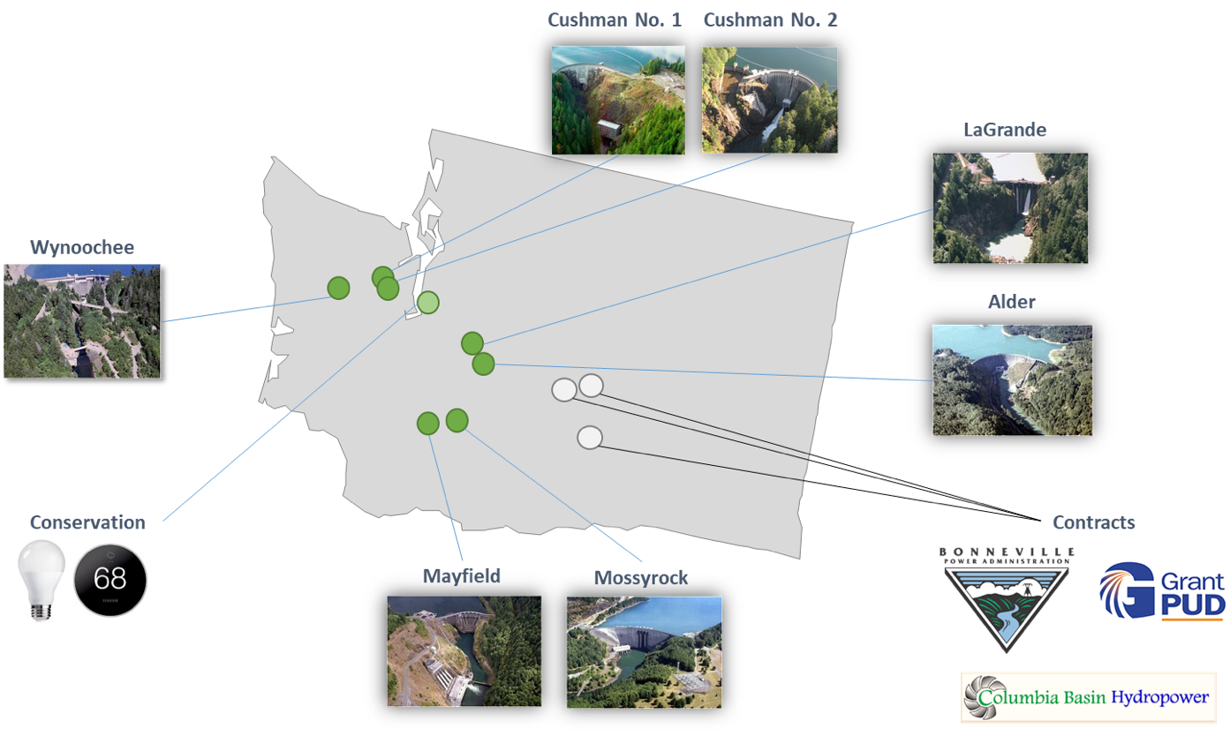
Our power sources
Cushman Hydroelectric Project
Wynoochee River Project
Nisqually River Project
Cowlitz River Project
Notes:
Our power supply consists of the output from four hydroelectric projects that are owned by Tacoma Power and power that the utility purchases from other parties. The largest amount of purchased power comes from the Bonneville Power Administration.
The four hydro electric projects that Tacoma owns are Cowlitz and Nisqually in the Cascades and Cushman and Wynoochee in the Olympics.
Conservation has been the only resource Tacoma Power has acquired in many years
Note:
At our largest project (Cowlitz) we have less capacity than we used to. The United States Geological Survey (USGS) revised its earthquake predictions for the Cowlitz River basin. Although the probability of a large earthquake is very low, the updated predictions showed an increase to the potential impact a quake could have on just the spillways of Mossyrock Dam — not to the dam structure itself. So, to reduce this risk and protect public safety, we are holding Riffe Lake’s elevation to about 30 feet lower than full (778.5 feet). The drawdown began in 2017.
Our objective is to bring Riffe Lake back to full pool. We are working hard to make progress on identifying potential seismic risks to any other parts of the dam, as well as possible seismic retrofits, but this is a long and complex process.
The IRP assumes that lake levels are restored by January 2030, but there is significant uncertainty around the exact date of restoration. As a result, we run a sensitivity analysis in which lake levels are not restored within the study period. This will help us understand the potential implications of a worst case scenario outcome. This sensitivity analysis in no way implies an intention on the part of Tacoma Power to not restore lake levels.

Slide 6
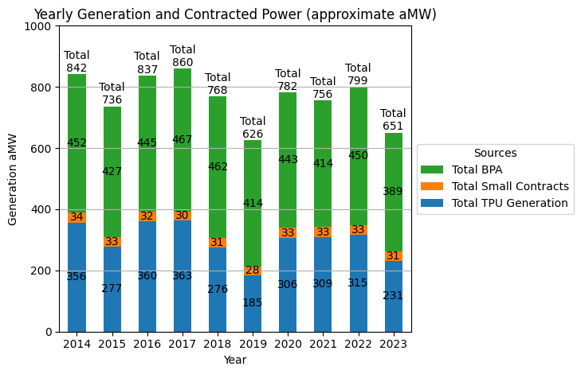
Our generating portfolio over the last decade
  Approximately 40% of our power comes from Tacoma Power-owned hydropower
  Most of the remaining 60% comes from power we purchase from BPA
  The amount of power we have available depends on water conditions
Bad water year
Notes:
The output from Tacoma’s hydroprojects is highly variable from year to year based on the weather.
In a good water year, we have more energy than we need. In a bad year, we have just enough.
The largest source of variability in our power supply is due to inflow variability.
About 40% of our power comes from our Tacoma-owned hydroprojects
We get about 60% of our power from the Bonnevile Power Administration.

Slide 7

Our contract with Bonneville Power Administration (BPA)
About BPA
  Federal power marketing agency for 21 US Army Corp of Engineer Dams, 10 Bureau of Reclamation Dams, Columbia Generating Station (nuclear) and several small wind generation contracts
  Has a federal mandate to sells power at cost to public utilities
  Offers a variety of power products that utilities can choose from
About our contract with BPA
  Current contract expires September 2028
About the next contract
  We are expected to sign a contract by December 2025
  Many contract terms will not be settled before completion of 2024 IRP
Notes:
BPA is a large and important component to our power supply.
BPA is the federal power marketing agency for many Corps of Engineer Dams and Bureau of Reclamation Dams, along with the Columbia Generating Station and some wind contracts.
The power we purchase from BPA is very reasonably priced because it is sold at-cost. It is also largely carbon-free, like our own resources.
We plan to renew the BPA contract, but which product we select is still unknown. Many of the product details are still under development by BPA.
Contract terms are set by BPA, with a stakeholder input process. But ultimately we have to take or leave their terms

Slide 8
About our Integrated Resource Plan

Slide 9

About our Integrated Resource Plan (IRP)
An integrated resource plan is:
  A plan for providing reliable and low-cost power in an uncertain future
  Required by Washington State law (19.280 RCW)
  Updated every two years
  Consistent with Tacoma Public Utility Board’s guiding principles
Our last IRP was completed in 2022, and the current IRP is due September 1, 2024
Link to IRP webpage: https://www.mytpu.org/about-tpu/services/power/integrated-resource-plan/
Notes:
For those of you less familiar with integrated resource planning, an IRP is a long-term that plan we conduct at regular intervals to ensure that we have enough power resources to meet customer needs for many years to come under a variety of different conditions.
Our IRP looks out over a 20-year but gets updated every 2 years. Our last IRP was completed in 2022.
And not only do WE think that it’s very important to do this kind of planning, but the state of Washington does as well. It is required by state law that we update our IRP every two years,
and get it approved by you, our governing body (which, in our case is the Tacoma Public Utilities Board),

Slide 10
Overview of IRP Process
Needs Assessment
Analysis & Selection of a Strategy
Action Plan
Do we have enough resources to meet our load under most conditions?
Which set of resources best meet our needs, risk tolerance and values?
What are our next steps?
IRP BASICS
Notes:
Our general IRP process looks something like this.
We take a look at our current situation and assess whether we expect to have enough power resources in the future
And then we use some pretty complex modeling to analyze how well different power resources or strategies are able to fill any gaps
And identify the best match for our utility
Finally, we spell out next steps in an action plan.
Today, we’ll be focusing on background and the needs assessment piece of the process
And discuss which strategies we plan to be analyze in the second step

Slide 11
If you are sure of tomorrow, there is no fool greater than you!
Mehmet Murat ildan
Notes:
So it’s important to keep in mind when planning for the future that the one certainty is uncertainty.
Our job in the IRP is not to predict the future but rather to consider how well positioned we are under a range of possible futures.

Slide 12
Uncertainties we plan to address in our IRP
Weather
Customer demand
Different possible levels of building and vehicle electrification
The grid
Industrial load growth (e.g. data centers)
Multiple different water and temperature conditions
Accounts for climate change
Different levels of demand and supply of energy on the grid
Other risks
What of restoration of Riffe Lake elevation takes longer than planned?
What if key BPA contract terms are different than what we assume?
Notes:
To that end, our modeling takes a lot of different uncertainties into consideration
We consider the year to year variability in ware and temperature conditions.
We consider different possibilities for how customer demand evolves over time.
I will talk a little more about our customer demand scenarios in the next two slides.
We consider different possible scenarios of what the Western power grid looks like over time
And we run a few sensitivities around some of the really important assumptions we have in our model

Slide 13
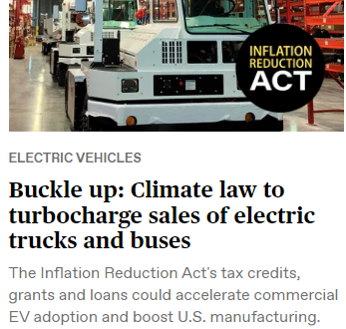
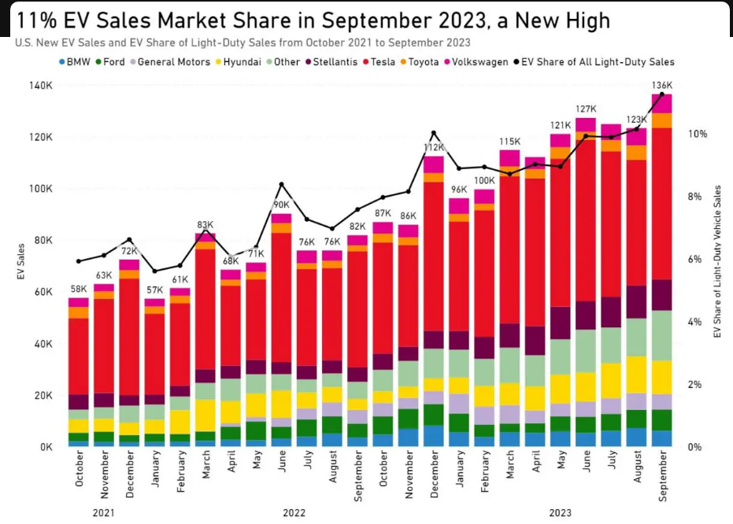
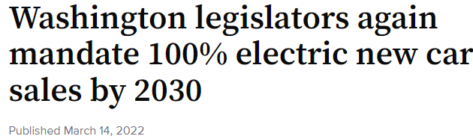
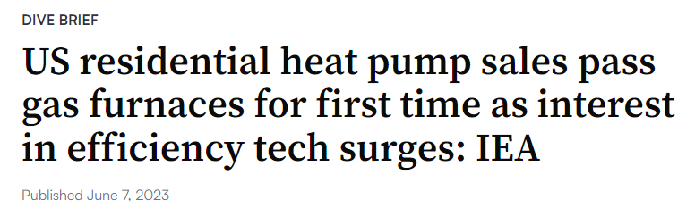
Spotlight on electrification
What is electrification?
Powering things with electricity – replacing an existing nonelectric fuel (heating systems, vehicles, etc.)
Why does it matter for the IRP?
Electrification has potential to add significantly to customer demand
Tacoma Power must be prepared to meet the demand
Notes:
Just for clarity, when I say electrification, what I mean is switching to powering things with electricity instead of some other fuel source (typically natural gas or gasoline).
There is a lot of talk about electrification these days
There are plenty of headlines suggesting that it could really ramp up.
At the same time, there are certainly competing headlines suggesting the opposite – that a switch to electric end uses will take more time than some might think or hope it will.
There is still a great deal of uncertainty as to how electrification will really unfold, but Tacoma Power needs to be prepared to accommodate whatever does happen
but also try to avoid over-building our power supply if electrification progresses at a slower pace than we might have thought.

Slide 14




Tacoma Power electrification study
Addresses multiple segments
Considers multiple realistic scenarios
Projections are currently being incorporated into utility planning processes
Report completed in 2023 and available on IRP webpage
Buildings
Industry
Transportation
Current Landscape
Possible low level of electrification
Anticipated Electrification
Possible high level of electrification
Expansive Policy
Unlikely high level of electrification
Policy Regression
Unlikely low level of electrification
https://www.mytpu.org/about-tpu/services/power/integrated-resource-plan/
Notes:
So in 2023, Tacoma Power conducted a study to develop a set of realistic projections of how electrification might impact customer demand over the next 20 years.
Recognizing that there is a ton of uncertainty around how electrification might grow over time
we worked with a consultant to create a set of plausible scenarios of how electrification might unfold over the next 20 years
and then to turn those scenarios into projections of how electrification might change customer demand.
We tried to make this study pretty comprehensive, so it addresses a number of different things:
Addresses nearly every segments of the economy that might electrify
As I already mentioned, it addresses multiple scenarios. And we really tried to make these scenarios realistic and plausible possible futures, not necessarily the very edge cases that are less likely.
At the end of the day, the study produced hourly projections of how much additional customer demand we might expect to see under each of our 4 scenarios over 20 years And that hourly data is incorporated into our IRP modeling

Slide 15
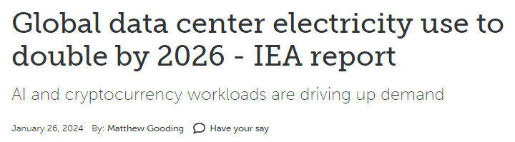
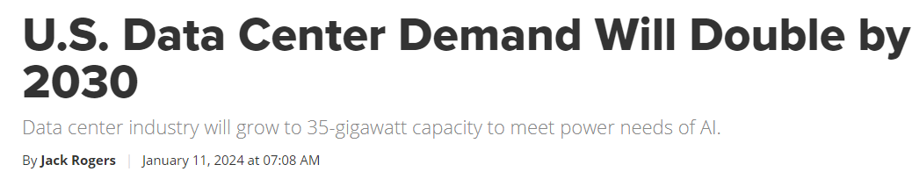
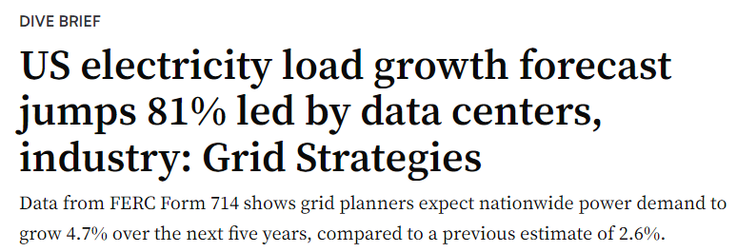
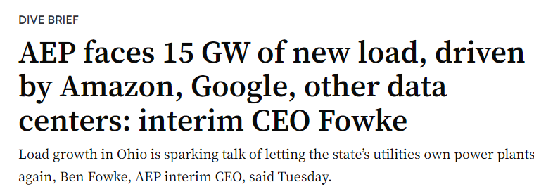
Spotlight on data centers
Why does data center growth matter for the IRP?
Has potential to add significantly to customer demand
Tacoma Power must be prepared to meet the demand
Size and timing of increases in Tacoma Power’s service area is highly uncertain
Notes:
Another source of potential growth in demand comes from the industrial sector, mostly from data centers.
As cloud computing has taken off, many utilities have seen some really large increases in electricity demand from data centers.
Most forecasts project an acceleration of this trend due to increasing computing needs from Artificial intelligence.
The hard part about projecting the impacts of this growth for Tacoma Power is that,
even though we expect industrial demand to grow like crazy globally and in the US over the coming decades,
It’s really hard to predict how much of that demand will hit Tacoma Power and when it might hit if it does.
So what we do to address this source of uncertainty is we consider a scenario where we see more and more data centers come in and add to customer demand over time
And then analyze how many of these data centers we can handle without needing additional power resources.
This will help us track when we are close to a danger zone if and when we start seeing data centers locate in our service area
PAUSE FOR QUESTIONS / COMMENTS ON SCENARIOS WE CONSIDER OR UNCERTAINTIES WE ADDRESS IN OUR IRP MODELING
Note 2001 data center growth concerns

Slide 16
Our resource position
Needs Assessment
Analysis & Selection of a Strategy
Action Plan
Early findings
Notes:
Now let’s talk about that first step of the IRP process – the needs assessment
What we do first is run our IRP model through the scenarios I talked about in the previous slides
to assess whether our current set of power resources are enough to meet customer demand
And if not, what are the situations in which our resources are not sufficient

Slide 17



How do we measure whether we have enough?
Peaking capacity
Ability to meet high demand over many hours
Ability to meet demand over the course of a month
Measured by likelihood of passing WRAP forward showing obligation
Measured by standard loss of load hours (LOLH) resource adequacy metric
Measured by 10th percentile of load-resource balance (LRB) across runs
Ability to meet high demand for a few hours
Sustained capacity
Monthly energy
100 meter sprint
5,000 meter run
Marathon
Notes:
So first things first, let’s talk about how we measure whether we have enough.
For those who are interested in more technical details, we’ve listed the specific metrics we use to measure our position
If you’re less interested in that level of technical detail, don’t worry about the exact metric.
There are a lot of different ways that utilities measure whether they have “enough”,
but our approach is to measure our position in three ways
The first is whether we would be able to meet a big spike in customer demand over a very short period of time.
We call this peaking capacity
So this is really asking whether we have enough machine capacity in place to keep up with a short duration spike.
And I liken this to a short sprint.
In this running analogy, this might be asking, do we have enough muscle to accelerate and run really quickly for a very short distance?
On the other end of the spectrum o the right is whether we are able to meet customer demand on average over the course of the month.
This is really asking whether we have enough fuel (which in our case is water) to meet customer demand over a longer period of time,
In our running analogy, this might be asking, do we have the endurance to make it through a marathon?
Our third metric is something in the middle.
Here we’re asking whether we are able to meet customer demand over an extended period of high demand
And we call that sustained capacity
Here what we’re measuring is a combination of whether we have the machine capacity to meet periods of high demand
AND whether we have the water.
Using our running analogy again,
IF we need to make it through a 5,000 meter run, we can’t run out of stamina (or in our case water) after just 100 meters.

Slide 18


Preview of preliminary takeways
Sustained capacity
We are likely to see shortfalls of sustained capacity by mid to late 2030’s due largely to electrification growth. The timing and scale of the issue depends on the degree of electrification.
BPA product choice matters greatly.
We expect to be in a comfortable energy position even after accounting for electrification
BPA product choice matters little
Industrial load growth (e.g. data centers)
Peaking capacity
Riffe Lake restoration timeline
Energy position
Some peaking capacity risk may exist.
BPA product choice expected to matter greatly
Key sources of risk
Marathon
5,000 meter run
100 meter sprint
Notes:
So here are our big picture findings so far. I want to be up-front and say that there results are preliminary. SO this is what we’re finding so far, but we’re right in the middle of our analysis, and we could find that our results change.
That being said, here’s what we’re finding so far.
First is that over the next 20 years we expect to continue to be in a relatively comfortable energy position (so that’s our “marathon” metric in our running analogy.
This is true regardless of which product we choose when we renew our BPA contract in 2028. And a lot of this is thanks to the fact that, while we expect to see increases in customer demand from electrification, we also are projecting that most of this increase will be offset by other reductions in customer demand thanks to energy efficiency
The second finding, on the other hand, is a little less rosy.
Our preliminary analyses are finding that our sustained capacity position (so our 5,000 meter run in the running analogy) is likely to degrade over time
And pass over our threshold for what we consider to be “enough” by the mid to late 2030’s.
So what this means is that if we were to not take any action to mitigate this problem, we could expect to see significant stresses on our system by the mid to late 2030’s
A lot of this extra stress on our sustained capacity is coming from electrification, so the scale of the problem is highly dependent on how much electrification we see and how quickly it progresses.
The issues we tend to find in our model occur mostly in a small subset of our very worst water years and typically only occur in the winter months, though issues do become a little more common in other years and months in our high electrification scenario.
The good news here is that these issues don’t start showing up until the mid to late 2030’s, so we have time to prepare now.
It’s also important to note here that our finding is not at all uniform across different BPA products, so whether we project an issue or not is highly depend on which BP product we choose
Perhaps a better way to state this is that certain BPA product help us more with sustained capacity than other products do,
and how much a BPA product can help us with sustained capacity is likely to be an important consideration in our decision of which product we choose in our next BPA contract.
Finally, we’re right in the might off our analysis on peaking capacity (so our 100 meter sprint), but our intiial finding is that in some cases there may be a peaking capacity risk. Here also we expect BPA product choice to matter a great deal.
Across all of our different ways of measuring whether we have enough, we tend to find two major sources of risk.
One is from industrial load growth (data centers or other). Depending on their size, a handful of these new customers would likely mean our current power supply would no longer be sufficient to meet customer demand
The other risk we face is a potential delay to our assumed timeline for restoration of Riffe Lake. Leah mentioned in the beginning that it is currently kept lower than we used to be able to fill it. Our models assume that it gets fully restored by 2030, but there is still significant uncertainty as to when exactly it might happen. Our initial analyses find that we may be able to handle a small delay but that our position will be worse if it takes significantly longer to restore Riffe Lake to full pool
PAUSE FOR QUESTIONS

Slide 19
Options for filling the gaps
Needs Assessment
Analysis & Selection of a Strategy
Action Plan
Notes:
So we just discussed that we may have some gaps to fill.
Next we can talk about how we might going about filling those gaps. So this is kind of the first piece of the “Analysis and Selection of a Strategy” part of the IRP process

Slide 20
How might we fill our gaps?
Choose the right BPA product
Add Solar
Add short-duration battery
Add long-duration battery
Help customers save even more energy (conservation)
Help customers shift when they use energy (demand response)
Help even more customers generate their own energy (rooftop solar)
Add pumped storage
Nuclear
Add Wind
Add capacity at existing dams
Purchase supplemental power from BPA at a higher price
Notes:
So there are a lot of different ways we may be able to mitigate some of the risks we talked about in the previous section of this presentation.
First and foremost, a critical piece of our strategy for the future is going to be selecting the BPA product that is best for Tacoma Power and our customers in the next contract. And we are right in the middle of doing that analysis right now. I don’t yet know where we will land on this one.
In addition to selecting the best BPA product to meet customers’ needs into the future, there are other things that we could do
Those include adding a power supply resource of some kind (like wind, solar, storage of some kind or even nuclear power). In some cases this might take the form of a contract with a private developer that is building something. In other cases it might be Tacoma Power that would build the resource ourselves. This is more likely to be the case with some of the battery storage options or even pumped storage.
We could also do more to intervene on the demand side (so on the customer side of the meter) by incentivizing customer to save energy, shift when they use energy or even generate their own energy.
Finally, there are some other things we could do (in the yellow boxes).
Each of the options listed here has different advantages and disadvantages and varies in its ability to meet our needs.
So next we’ll go on to talk about the characteristics that are important to us when we think about these options.

Slide 21
Characteristics we consider
Predictability
Do we know when it will be available?
Dispatchability
Can we control when it is available?
Emissions Profile
How little carbon (or other pollutants) does it emit?
Is it available for a long time during peak demand?
Community Acceptance
Sustained Peak Availability
Winter availability
Will Tacoma Power community or host community welcome it or resist it?
Technology Readiness
Is the technology widely available today? Is it likely to be ready soon?
Cost
Transmission requirement
How easy is it to get the power to Tacoma Power?
Notes:
Predictability:
We like predictability a lot
The more predictable the better because it makes operations smoother.
The more we’re able to just count on the fact that power will be available when we think it is, the easier and less costly it is for us to operate our system
Dispatchability
This is a term we use a lot in the power industry.
What we really mean is “can we control when it is available”?
So, for example, our hydro electric projects would score very high in this dimension
There are limits, but are able to turn them up and down a lot
Sustained peak
As we discussed in an earlier slide, being able to provide power over more than just a few hours is a potential risk for us,
so resources that can provide power for an extended period of time are also desirable
Winter availability
Olaf says it all here. His smile is how we feel about resources that are available in the winter
Because customer demand here in the Tacoma Power area is much higher in the winter, having a resource that produces power in the winter is important
Emissions
Because nearly 100% of our power supply is hydropower, Tacoma Power’s power supply is extremely clean and is responsible for very little carbon emissions. And we’d like to keep it that way if we can. So we strongly prefer options that emit no or very little carbon.
Community acceptance
This is a newer consideration in our IRP analyses, but I think it is a good addition. When selecting a strategy, we need to consider how welcome the actions we’re taking are both in our own Tacoma Power community and in the community where a power resource
Transmission
For those less familia with the power industry

Slide 22
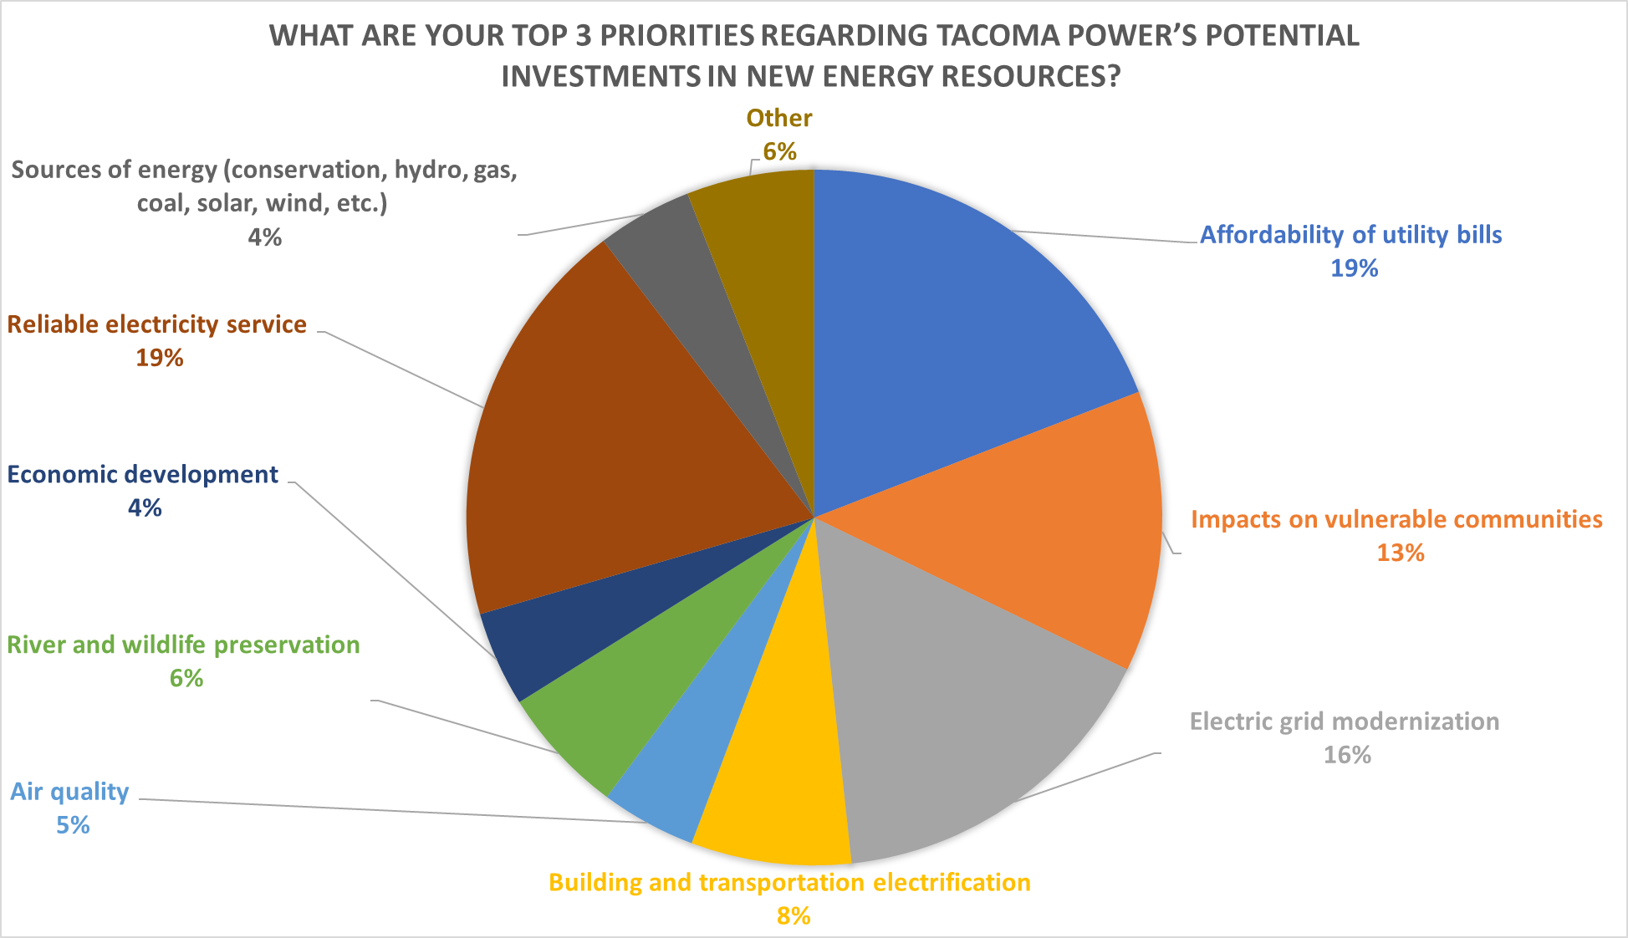
Your Priorities

Slide 23
There are many components to the overall cost of each option
Build cost
Financing costs
Operations and maintenance
Fuel (if it uses fuel)
Transmission
Integration
Social cost of carbon (if it emits carbon)
Plus a few benefits that add value
Avoided costs of complying with WA Energy Independence Act
Expected revenues from selling power at time when we have more than we need
The following slides only address this cost

Slide 24
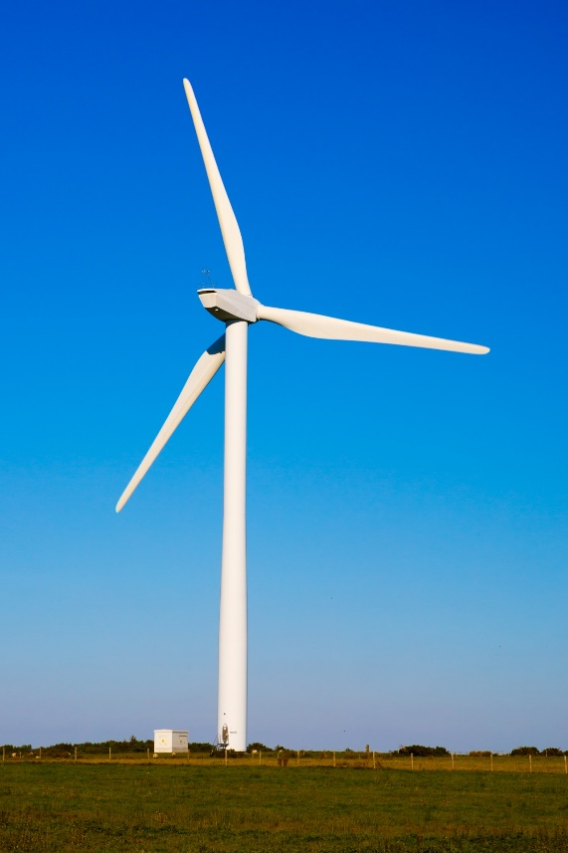
Onshore wind
Predictability
Dispatchability
Sustained Peak
Winter Availability
Emissions
Community Acceptance
Creative Commons image
Build Cost*
  $1,025-$1,700/kW unsubsidized
  Incentives available to offset some of costs
Transmission
Technology Readiness
*Build cost approximate based on publicly available data. Build costs ignore other cost categories (e.g. O&M, etc.)
Notes:
Onshore wind has become what I consider a standard power resource these days.
Advantages:
Renewable
Tends to produce relatively well in the winter
Disadvantages
Perhaps its biggest disadvantage is that it’s highly variable and unpredictable, which makes it more challenging and costlier to manage than some other options

Slide 25
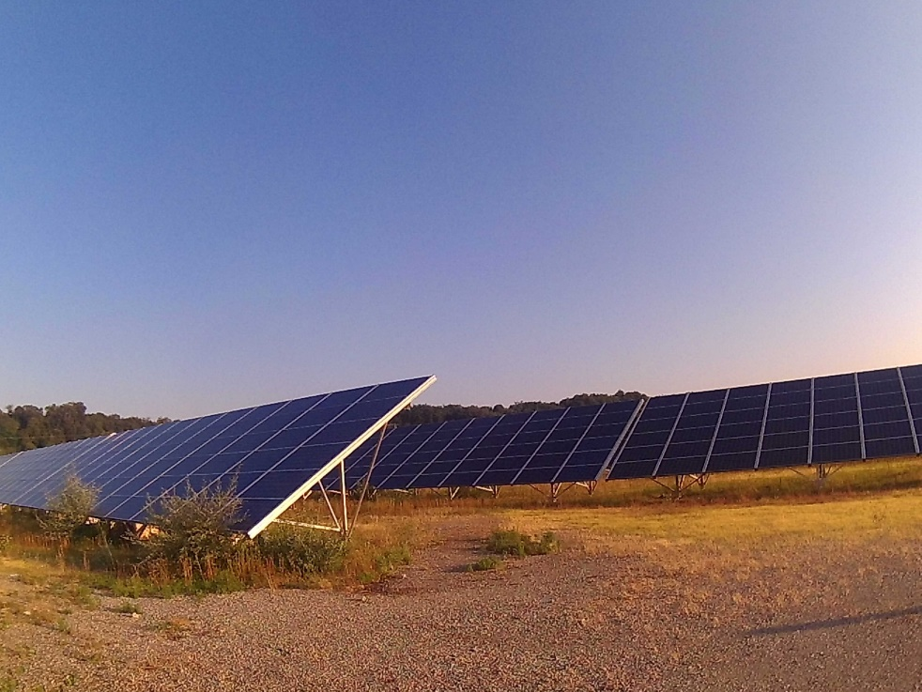
Large (utility-scale) solar
Predictability
Dispatchability
Sustained Peak
Winter Availability
Emissions
Community Acceptance
Creative Commons image
Build Cost*
  $700-$1,400/kW unsubsidized
  Incentives available to offset some of costs
Transmission
Technology Readiness
*Build cost approximate based on publicly available data. Build costs ignore other cost categories (e.g. O&M, etc.)
Notes:
Advantages:
Like wind, it’s renewable
Its output is a lot more predictable than wind
Disadvantage
Biggest disadvantage is that it doesn’t tend to produce at the time when we most need energy, which is winter morning and (in later years of our study) winter evenings

Slide 26
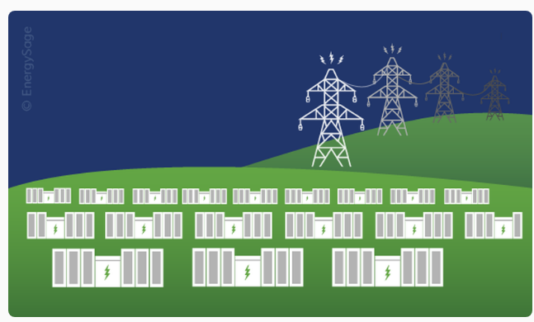
Short duration battery storage
Predictability
Dispatchability
Sustained Peak
Winter Availability
Emissions
Community Acceptance
Image from energysage website:
https://www.energysage.com/business-solutions/utility-scale-battery-storage/
?
Build Cost*
  $1,200-$1,800/kW unsubsidized
  Incentives available to offset some of costs
Transmission
Technology Readiness
*Build cost approximate based on publicly available data. Build costs ignore other cost categories (e.g. O&M, etc.)
Notes:
Advantages:
Also carbon-free (at least when we’re using it)
Can use it when we need it
Disadvantages:
You need energy to charge a battery, so, while it’s very helpful in solving short-duration peaking capacity problems, it doesn’t help with sustained capacity.
It’s worth mentioning at this point that when we actual model potential strategies in the IRP, we can combine options, so we may, for example consider a wind + battery storage options that could perform better than either option alone.

Slide 27
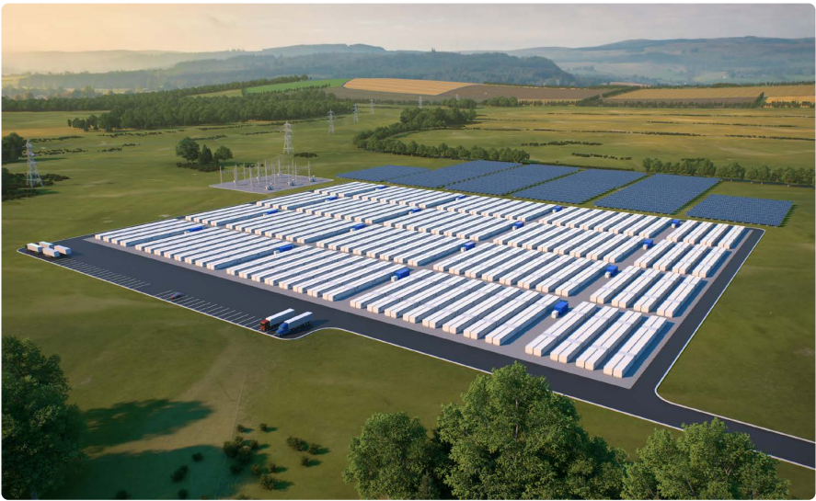
Long duration battery storage
Predictability
Dispatchability
Sustained Peak
Winter Availability
Emissions
Community Acceptance
Image from Great River Energy White Paper submitted to Minnesota Public Utilities Commission
?
Build Cost*
  Projected to be $2,400-$3,400/kW unsubsidized by 2030
  Incentives available to offset some of costs
Transmission
Technology Readiness
*Build cost based on Great River Energy White Paper submitted to Minnesota Public Utilities Commission
Notes:
Long duration energy storage has the potential to

Slide 28
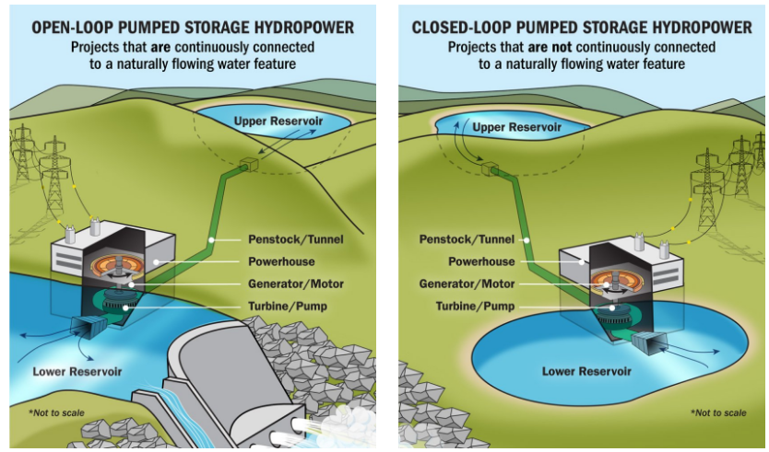
Pumped storage
Predictability
Dispatchability
Sustained Peak
Winter Availability
Emissions
Community Acceptance
?
Image from Department of Energy website: https://www.energy.gov/eere/water/pumped-storage-hydropower
Build Cost*
  $1,000-4,000/kW unsubsidized
  Will vary significantly from site to site
  Incentives available to offset some of costs
Transmission
Technology Readiness
*Build costs are approximate based on publicly available data. Build costs ignore other cost categories (e.g. O&M, etc.)

Slide 29
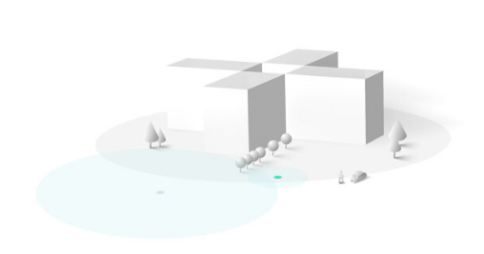
Small modular reactors
Predictability
Dispatchability
Sustained Peak
Winter Availability
Image from Xenergy website (https://x-energy.com/reactors/xe-100)
Emissions
Community Acceptance
Build Cost*
  Projected to be ~$8,000-10,000/kW unsubsidized
  Actual cost highly uncertain
  Incentives available to offset some of costs
?
Transmission
Technology Readiness
*Build costs are approximate based on publicly available data. Build costs ignore other cost categories (e.g. O&M, etc.)
Notes:
Note potential fuel risks in some cases,

Slide 30
Additional conservation/ energy efficiency
Predictability
Dispatchability
Sustained Peak
Winter Availability
Emissions
Community Acceptance
Cost
  Depends on specific conservation measure
  Incentives available to offset some of costs
Transmission
Technology Readiness

Slide 31
Demand response (DR)
Predictability
Dispatchability
Sustained Peak
Winter Availability
Emissions
Community Acceptance
Cost
  Depends on specifics of DR offering
  Incentives available to offset some of costs
Transmission
Technology Readiness

Slide 32
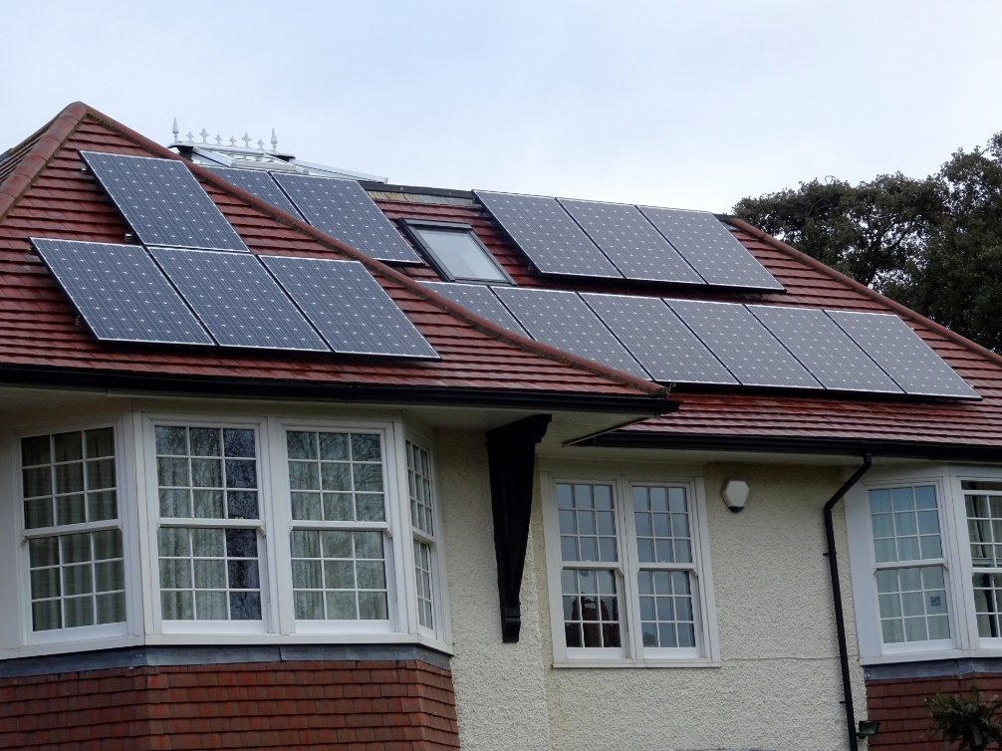
Rooftop solar
Predictability
Dispatchability
Sustained Peak
Winter Availability
Emissions
Community Acceptance
Creative Commons image
Build Cost*
  $2,230-$4,150/kW unsubsidized
  Incentives available to offset some of costs
Transmission
Technology Readiness
*Build costs are approximate based on publicly available data. Build costs ignore other cost categories (e.g. O&M, etc.)
Notes:
Note equity considerations

Slide 33
Other promising options
Adding generation capacity at existing hydroelectric projects, for example:
  Add generator at Mossyrock in conjunction with 2037 relicensing
  Incrementally as part of generator rebuilds
Supplemental BPA power
  Certain BPA products may come with an option to purchase an add-on to help with peak demand
  Details for this option are in flux and will not be solidified in time for 2024 IRP

Slide 34
Discussion & Questions

Slide 35
What’s next?

Slide 36
Next steps after today
Before next meeting
IRP communicates how your comments were incorporated via email
Next meeting
Discuss draft analysis findings, recommendations and draft action plan
After the next meeting
IRP team communicates how your comments were incorporated via email
Finalize strategy and action plan
Seek Public Utility Board approval of IRP
Submit approved IRP to Department of Commerce

