Slide 1
Cowlitz River Fisheries Cowlitz River Fisheries and Aquatic Science Conference
Josua Holowatz - WDFW District 10 Fish Biologist
John Serl - WDFW Cowlitz River Biologist
April 22, 2026

Slide 2
Presentation Outline
Lower Cowlitz Creel Efforts
Cowlitz Winter and Summer Steelhead
Cowlitz Spring and Fall Chinook
Cowlitz Coho
Cowlitz Sea-Run Cutthroat
Electronic Catch Record Card Update
Notes:
Creel-Serl, STH-Serl, Chinook-Holowatz, Coho-Serl, Cutts- Holowatz, eCRC-Holowatz

Slide 3
Acknowledgements
Ethan Cameron, Teresa Fryer, Kale Bentley (WDFW Cowlitz Creel and Broodstock sampling). WDFW Cowlitz Hatchery Complex Staff.
WDFW CRC Unit, BDS Unit
Tacoma Power Adult Facility Crew provided the Barrier Dam Adult Counts for many years. Funding for Creel and Hatchery Production.

Slide 4
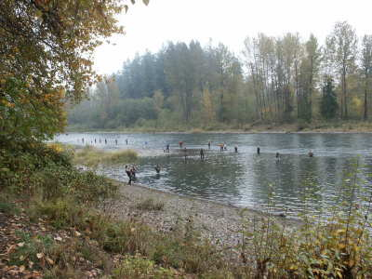

Slide 5
Lower Cowlitz River Fisheries
Notes:
Best fishing times.

Slide 6
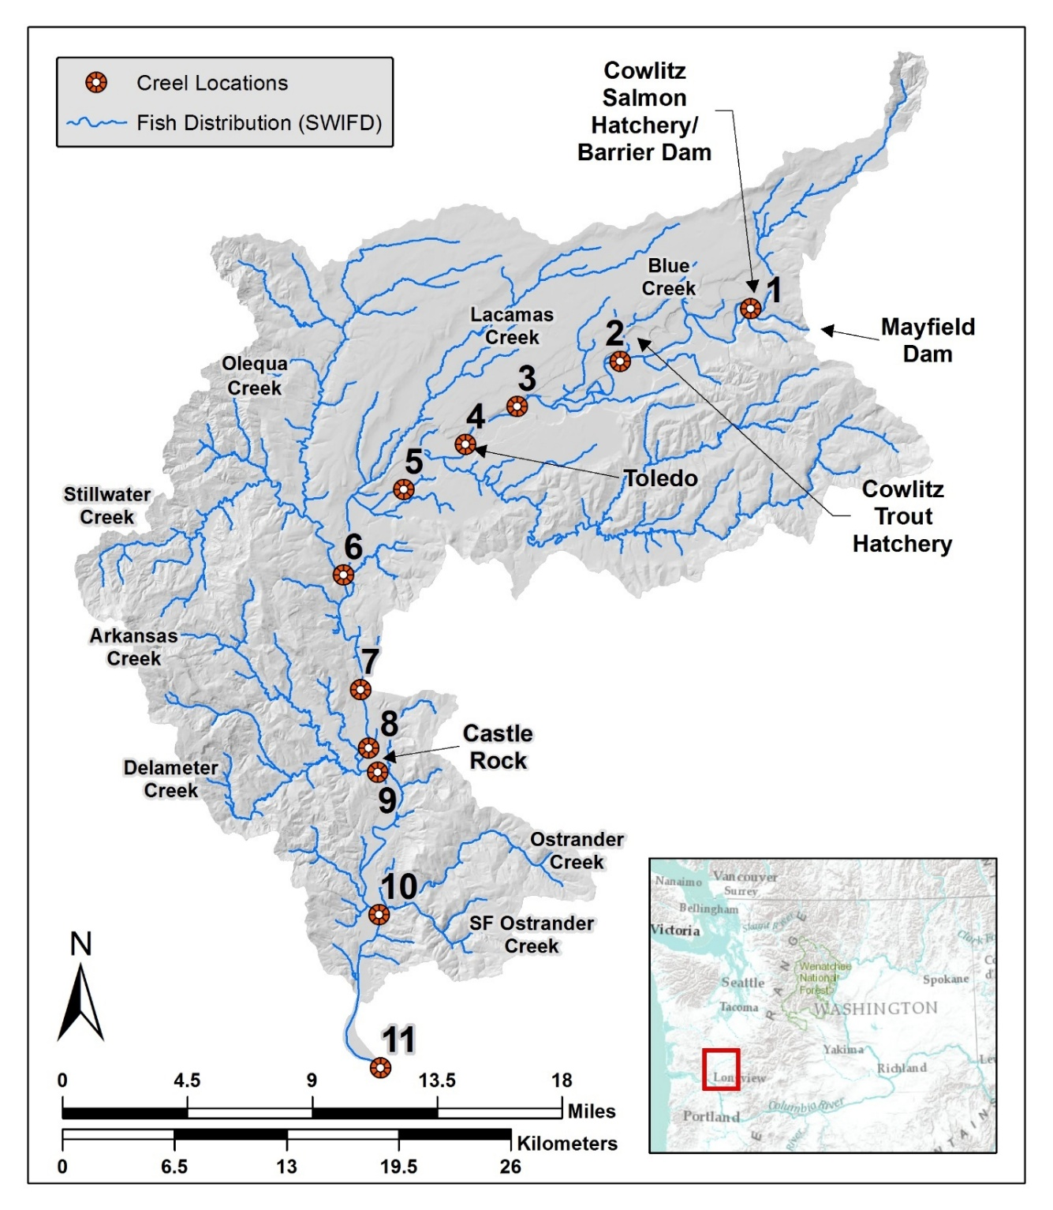
Lower Cowlitz
Active Fishing Areas and Creel
Locations
Notes:
Talk about above and below Toutle. WDFW R5 surveyors sometimes cover below Toutle mouth.

Slide 7
Lower Cowlitz River Creel Surveys
Notes:
There are often more shore anglers interviewed because they are more available to interview during their trip while boats are only available at the end of their trip. Boats hours are higher because boat interviews are at the end of the trip while shore anglers are often mid-trip. The overall goal is to interview 5% +/- of the angler effort.

Slide 8
Lower Cowlitz River Fishery NOR:HOR Handling Rates
Notes:
This is the expected number of Natural fish released for each Hatchery fish caught. Various factors influencing this rate are relative strength of natural runs and timing compared to river conditions. Minimal data on fall Chinook due to recent fishery closures. These are additional fish caught and release, but not harvestable. Kind of like the MGS of fishing. Key information to understand incidental impacts on natural populations. Release .25 NOR per HOR kept. Applly to CRC and mortality to get mortality impacts.

Slide 9
Cowlitz River Fishery Data Sources
Barrier Dam Adult Facility Counts
WDFW Catch Record Cards
WDFW Cowlitz River Creel*
TPU funded, focused on assessing natural origin encounters

Slide 10
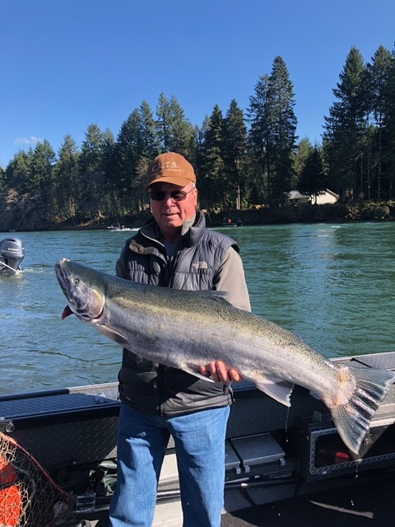
Cowlitz River Winter Steelhead
Notes:
Fishery theme: Provide abundance building in Upper Cowlitz, Tilton. Fishery in lower Cowlitz with expanded run timing. Provide harvest opportunity in all areas. Not much yet in upper Cowlitz but recent changes to the hatchery programs should improve in the long term, also with some catch and release fishery potential. This fishery can provide good fishing but water conditions vary with weather patterns. The populations were derived from the native Cowlitz River stock >50 years ago. These stock still produce some very large individuals. While the lower Cowlitz program is segregated, the upper Cowlitz and Tilton programs are integrated and adaptation is driven by those local conditions.

Slide 11
Cowlitz River Winter Steelhead
Fish Arrive December to June
Best Fishing February to April
Objectives:
Harvest Fisheries
Provide Integrated Adults to Supplement NOR Returns to Upper Cowlitz, Cispus and Tilton Rivers
Notes:
Fishery theme: Provide abundance building in Upper Cowlitz, Tilton. Fishery in lower Cowlitz with expanded run timing. Provide harvest opportunity in all areas. Not much yet in upper Cowlitz but recent changes should improve in the long term, also with some catch and release fishery potential.

Slide 12
Cowlitz River Winter Steelhead
Hatchery Program Smolt Releases
Segregated Lower= at least 308,000
Integrated Tilton= up to 100,000
Integrated upper Cowlitz= up to 236,000
Purpose of Hatchery Programs
Segregated Program = Lower River Harvest
Integrated Programs = Abundance Building in Upper Cowlitz/Cispus and Tilton
Notes:
Sliding scale of hatchery production, up to 50% pNOB using about 10% mining rate. Upper Basin integrated hatchery programs provide fisheries in the lower Cowlitz as well. Lower Columbia fisheries possible but not well documented. Segragated HORxHOR, Integrated HORxNOR

Slide 13
Cowlitz Winter Steelhead Hatchery Production Sliding Adjustments
Lower Cowlitz Segregated
308,500
Tilton River Integrated
100,000
Upper Cowlitz/Cispus Integrated
236,000
Total Cowlitz Winter Steelhead Release
=
+
+
644,500
Notes:
These all provide harvestable fish in Lower Cowlitz fishery. Maintain full production, Use a 10% mining rate and let Tilton and UCR production vary Full program goals would be 50% pNOB for UCR and Tilton and should be achievable when FPS goals are being met and we are moving towards that goal.

Slide 14
Cowlitz Hatchery Winter Steelhead Smolt Production
Notes:
Same production overall but integrated programs are an increasing proportion. All of these fish are catchable in the Lower Cowlitz fisheries. 92K lbs of production

Slide 15
Cowlitz River Adult Steelhead Returns To Barrier Dam
NOR Populations
Notes:
Do we need a graph of total winter steelhead returns by year? Everything combined. About 2500-3000 LC hatchery returns with a few hundred Tilton and UCRB pops and programs

Slide 16
Lower Cowlitz River Winter Steelhead
Barrier Dam arrivals and Lower Cowlitz CRC reported harvest
Notes:
Crc data vs returns. Josua to figure out back to 2015-ish

Slide 17
Cowlitz River Winter Steelhead
Elimination of early winter steelhead (Chambers Creek stock) in 2011 created a harvest gap in the fishery
Aggressive timing shift of broodstock collection curve for lower Cowlitz steelhead program initiated in 2023 has begun to fill seasonal harvest gap
Notes:
Goal: Balance arrival date and spawn date. Goal to provide meaningful early season fishery and improved table quality and additional catchability by fish being available to the fishery longer.

Slide 18
Hatchery winter steelhead catch has evolved: early → bimodal → late
Steelhead Run Timing Shift
Notes:
This graph shows the bimodal catch when both the early and late winter programs were operate and how thing shifted to March and April once the Chamber’s creek stock program was discontinued, leaving a hole in the fishery. January and February had minimal catch/return

Slide 19
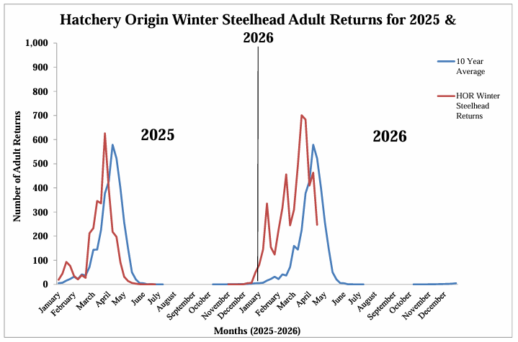
Are We Making Progress? Cowlitz Winter Steelhead Returns to the Barrier Dam Facility www.mytpu.org/community-environment/fish-wildlife-environment/cowlitz-fish-report/
Notes:
2024 and 2025 show a little bit of progress. 2025 should have been the first year of new take the first broodstock return. Now a single, broader return timing.

Slide 20
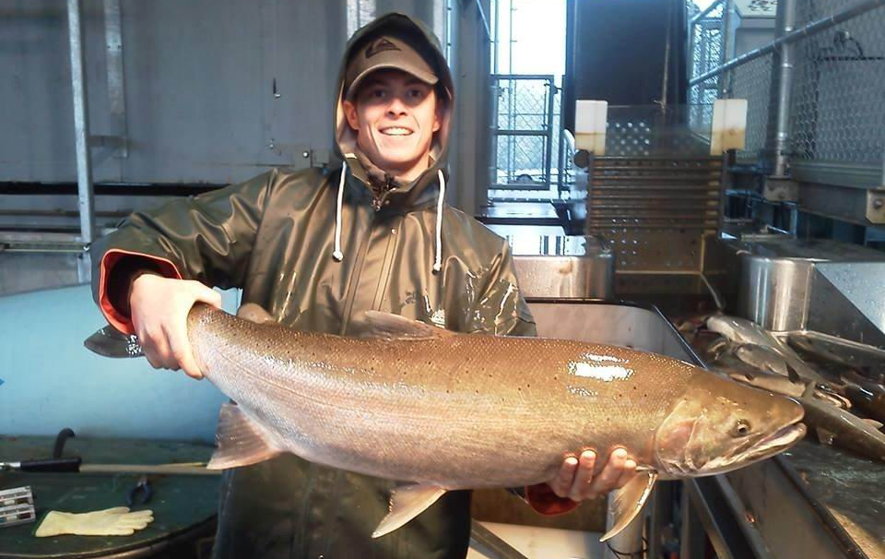
“Typical” Cowlitz Stock Winter Steelhead

Slide 21
Cowlitz River Winter Steelhead
Fishery Theme:
Lower Cowlitz segregated program focused on harvest
Upper Cowlitz and Tilton programs are integrated, focused on abundance building.
Harvest opportunity in all areas with protracted return timing.
Fishery Nuances:
Catch Record Card (CRC) Management period: November-April
Daily limit is 3 adipose clipped over 20” in addition to the daily salmon limit.
Forecasted as part of the lower Columbia aggregate. Contributes to the lower Columbia mainstem harvest.
Notes:
Quality fishery in with expanded run timing. Recent improvements to the Upper Cowlitz hatchery program should improve in the long term. This fishery can provide good fishing, but water conditions vary with weather patterns.
Maybe compare Cowlitz catch to other systems. Reservoirs often maintain fishability through rainy weather. More consistent conditions. Remember Bryce’s point about shift in LC program combined with summer STHD creates a STHD fishery from Dec-Sept. Currently no winter STHD recycling program: give reasons why.

Slide 22
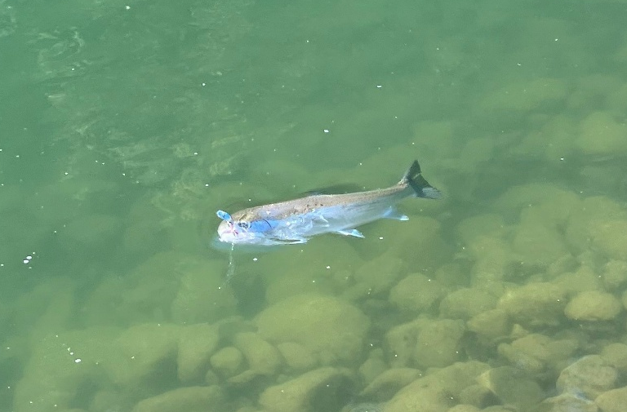
Cowlitz River Summer Steelhead
Notes:
Summer steelhead fishery theme: This segregated hatchery program is intended to provide a reliably productive fishery from May into September. River conditions are typically low and clear with cool water provided by the hydro-system. Catch limit is 3 fish, and fish are recycled to get more fish to anglers. There is almost no natural fish to compete with and limited straying of these fish into tributaries due to low warm waters. These are considered Skamania stock which is an out of basin stock but has had >50 years of adaptation to the local Cowlitz conditions. High harvest rate

Slide 23
Cowlitz River Summer Steelhead
Hatchery Programs
One segregated stock
Release goal is 650,000 smolts
Purpose of Hatchery Programs
Harvest
Peak Fishery from May through August
Recycling to increase harvest (6,600 max), increase opportunity
Notes:
~118K lbs of smolts. But still sufficient surplus

Slide 24
Cowlitz River Summer Steelhead Returns to Barrier Dam
Notes:
John to find- ask Brian G

Slide 25
Cowlitz Summer Steelhead
Arrivals at Barrier Dam and CRC reported harvest
Notes:
Rates may be inflated by recycling and fleet getting a second chance

Slide 26
Cowlitz Summer Steelhead
Fishery Theme:
Segregated program provides harvest fishery
Originated from Skamania stock but has had >50 years of adaptation to the local Cowlitz conditions
Protracted residence in the fishery area results in high harvest rate.
Recycle goal: up to 6,600 to provide additional harvest opportunity.
Fisheries Nuances:
CRC Management period: May-October
Catch limit is 3 adipose clipped over 20” in addition to salmon limit.
Forecasted as part of the lower Columbia aggregate. Contributes to the lower Columbia mainstem harvest.
Notes:
River conditions are typically low and consistent with cool water provided by the hydro-system.
Few NOR to compete with and limited straying of these fish into tributaries due to low warm waters.

Slide 27
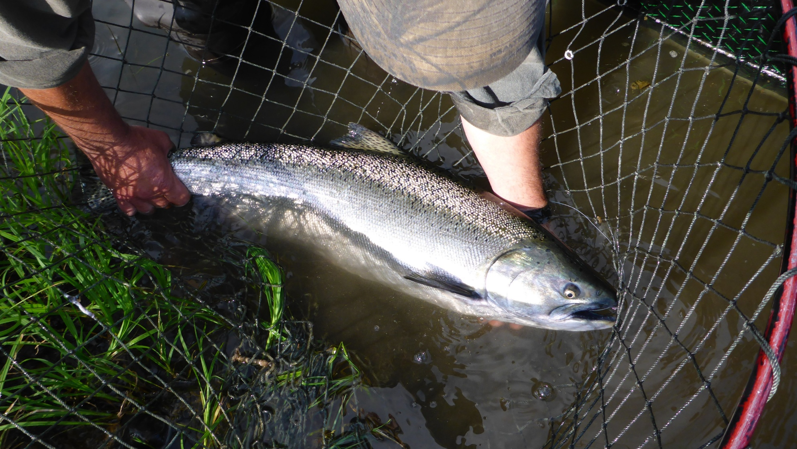
Cowlitz Spring Chinook Salmon

Slide 28
Cowlitz Spring Chinook Salmon
Management Objectives:
Segregated program requires 1,355 for brood.
Upstream transport is based on above hatchery need adult returns.
All NORs are transported upstream.
Segregated hatchery program- 3 sizes at release
5fpp: 700,000 yearling spring rel.
8fpp: 420,000 yearling spring rel.
12ffp: 487,000 subyearling fall rel.
Purpose: Provide harvest opportunity and increase spawner abundance in upper basin
Notes:
Brood need is based on adult in hatchery survival and fecundity
3 sizes are tagged to ID returns by different rearing strategy
Objectives provide opportunity in the lower and upper basins while providing upstream transport and increase spawner abundance. These releases are also available to mainstem Columbia fisheries.

Slide 29
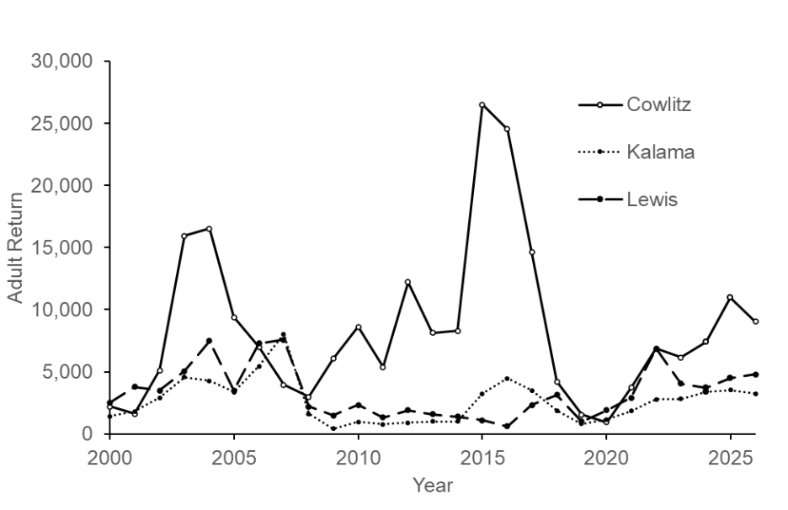
Cowlitz Spring Chinook Salmon
Returns to natal rivers based on run reconstruction
*2026 is preseason forecast
Notes:
Actual returns to the Cowlitz, Kalama and Lewis returns all show variability with some banner Years in the Cowlitz.
Not all programs are sized the same

Slide 30
Cowlitz Spring Chinook Salmon Returns to Barrier Dam
Notes:
These are returns to Barrier Dam and upstream transport. The full blue bars are the HORs that returned to the Barrier Dam. The open blue bars the HORs that were transported upstream. The differences are the fish that were taken for brood.
All NORs go upstream.

Slide 31
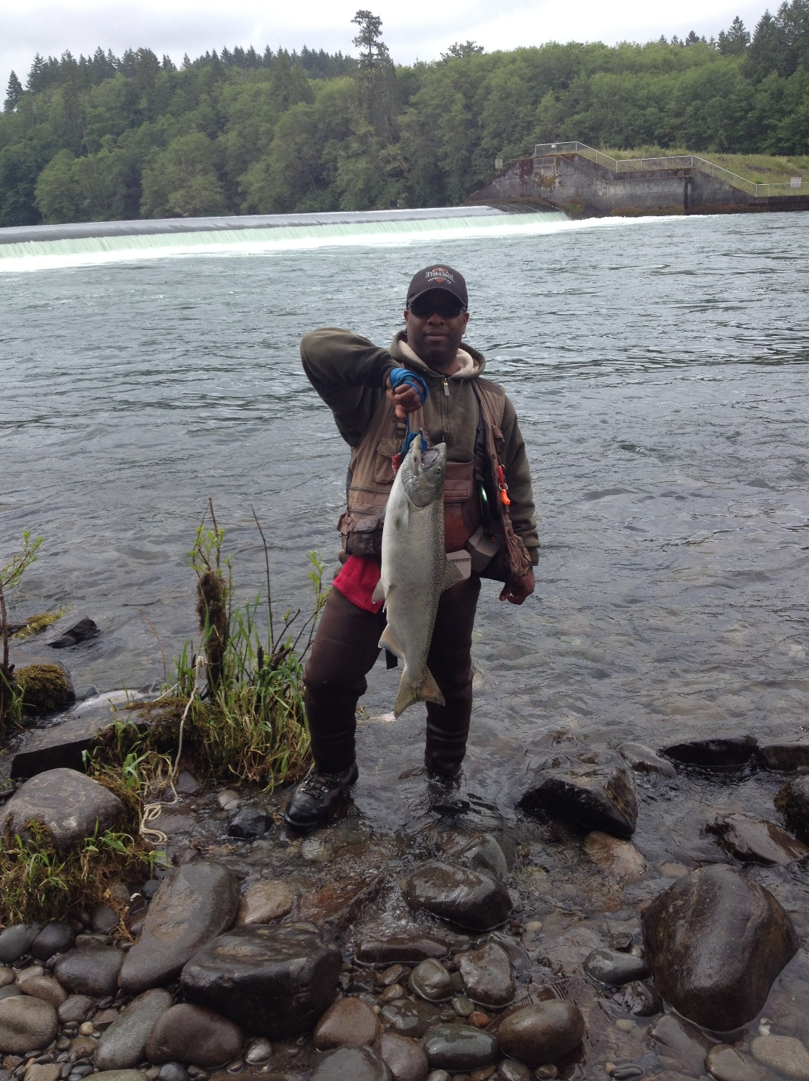
Cowlitz River Spring Chinook

Slide 32
Cowlitz Spring Chinook Salmon As reported through CRC
Harvest rates are influenced by season structure and participation
Lower Cowlitz range ~5%-25%
Upper Cowlitz range 0%-5%
Notes:
Harvest rates can reflect different daily limits, duration of the season and river conditions. Upper Cowlitz may be underutilized.
2024 started out 1 adult required ad plus vent clip effective March 1-May 24 then May 25 1 adult with a adipose clip. Then July 4-July 31 perm rules 2 adults
2013-2018 lower Cowlitz rates were 32-55%
Same period, Upper Cowlitz less than 1- 12%

Slide 33
Cowlitz Spring Chinook Salmon
Fishery Theme:
Stock derived from endemic Cowlitz stocks.
Provides fisheries in the Columbia, Lower and Upper Cowlitz basins.
HORs above hatchery need are transported above Cowlitz Falls Dam for abundance building and harvest.
NORs are transported upstream (Upper Cowlitz/Cispus).
Fishery Nuances:
CRC Management Period: January 1- July 31
Open under permanent rules (2 adults) in the Cowlitz and Cispus Rivers.
Seasons and daily limits are based on preseason forecasts.
Notes:
Season is set prior to the North of Falcon Process

Slide 34
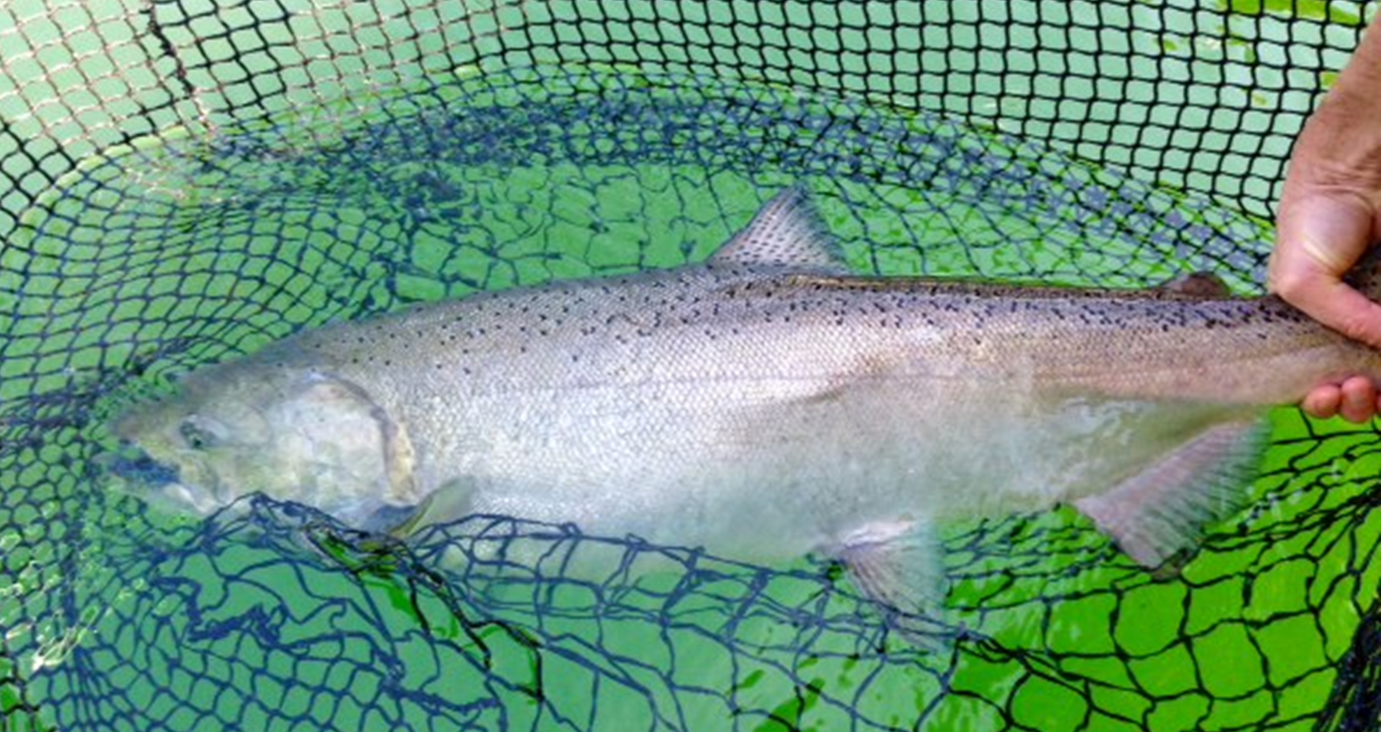
Cowlitz River Fall Chinook Salmon

Slide 35
Cowlitz River Fall Chinook Salmon
Management Objectives:
Purpose: Provide harvest opportunity and increase spawner abundance in the Tilton River.
Integrated program need ~2,400 brood
Tilton NOR (10% pNOB)
Hatchery program (goal): 3.5 million
HORs and NORs above hatchery need are transported to the Tilton River.
Notes:
Fall Chinook are released at Bremmer Rd. Bridge to promote distribution.

Slide 36
Cowlitz Fall Chinook Hatchery Releases
Notes:
Release Goal = 3.5 Million
Recent release numbers reflect challenges to collect adult brood

Slide 37
Cowlitz Fall Chinook Salmon Returns to the Barrier Dam
Notes:
The difference between the Full bars and the open bars are fish used for brood in the integrated program

Slide 38
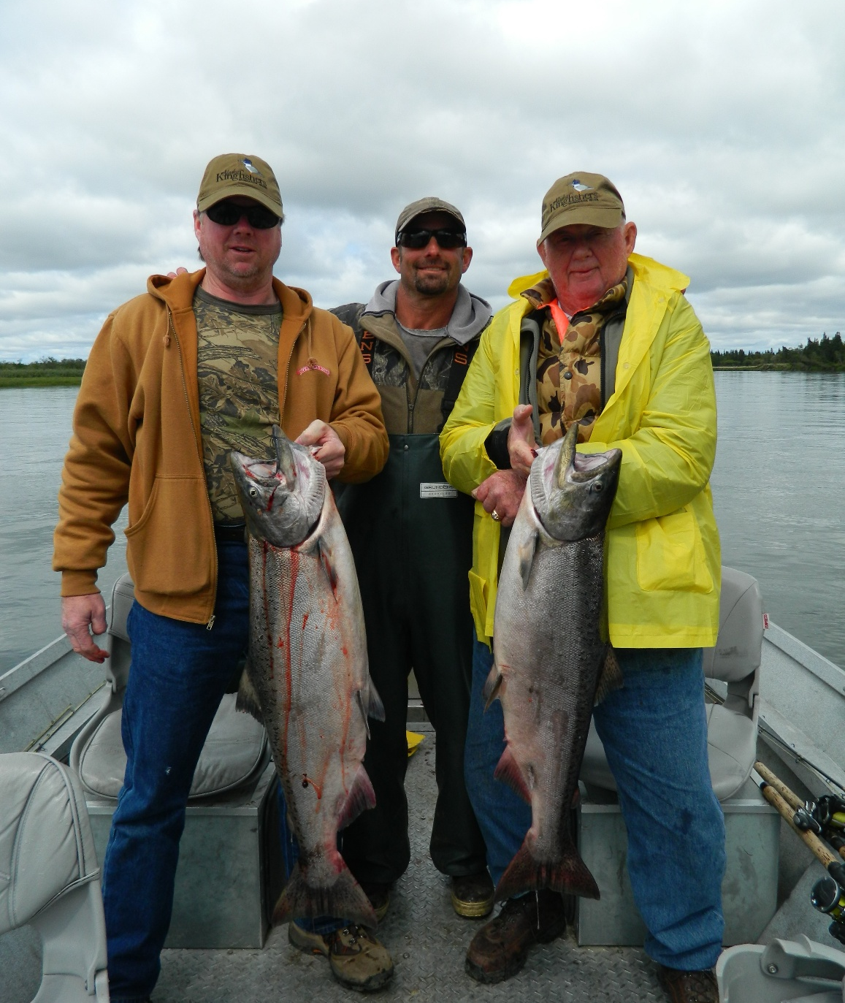
Cowlitz River Fall Chinook Salmon

Slide 39
Cowlitz River Fall Chinook Salmon
Fishery Themes:
Historically, productive hatchery program contributes to ocean, lower Columbia, and Cowlitz River fisheries.
Recent hatchery returns have not allowed for a Cowlitz River fishery.
Fishery Nuances:
CRC Management Period: August 1- December 31
Currently closed under permanent regulations in the Cowlitz and Tilton Rivers.
Modifications based on preseason forecasts can be made through the North of Falcon process.
Notes:
Recent hatchery returns have been very poor.

Slide 40
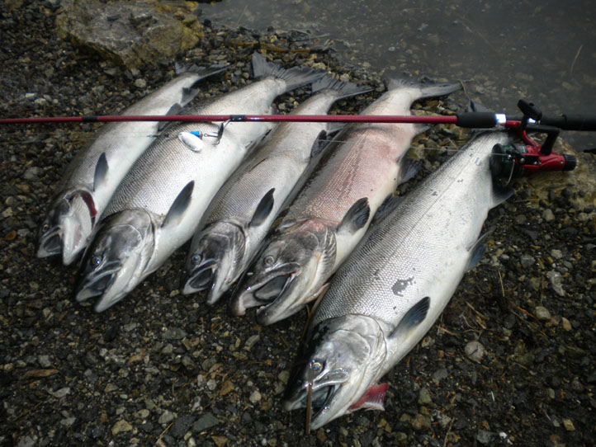
Cowlitz River Coho Salmon
Notes:
Fishery Theme: This native stock coho hatchery program reliably produced good to large returns that feed fisheries in the ocean, lower Columbia, lower Cowlitz, the upper Cowlitz, Cispus and Tilton Rivers. Fall river fisheries can be affected by fall rains but usually are productive. Changed from 2 stocks, seg and int to one int stock. Therefore HORs can be release to all upstream locations. This should reduce the need to surplus. The hatchery program is one stock integrated with the upper Cowlitz population so fish arriving at the Barrier Dam can generally be transported upstream to support spawner abundance and upper basin fisheries. Lake Scanewa provides a somewhat unique lake fishery for coho salmon. Natural origin populations are also fairly robust with 20,000 or more total NOR returns form the 3 populations returning in good years.

Slide 41
Coho Salmon Returns to Barrier Dam Does not include Lower Cowlitz harvest, tributary returns, etc.
Notes:
John to fill in 6 years. Do we need UCR and Tilton distribution? maybe

Slide 42
Barrier Dam Hatchery Coho Returns and Lower Cowlitz Harvest Estimates
= Estimate based on averages

Slide 43
Coho Salmon
Hatchery Program
Smolt release goal 2.1 million
Transitioned to one integrated program
Upstream distribution provides abundance building and fisheries opportunities
Reduces amount of surplus
Notes:
Retention year round
Objectives provide opportunity in the lower and upper basins while providing upstream transport and spawner abundance.
Net Pen program is in its infancy. Juvenile rearing survival is promising, the 2026 return will have first component of these releases. This is part of the Satellite rearing agreement.

Slide 44
Above Hatchery Needs Distribution
Notes:
The AHP plan is for Lake Scanewa gets NOR fish Upper Cowlitz/Cispus gets 40k HOR adults,
Tilton NOR to Bremmer Bridge (HOR 12k to Gust Backstrom) Total of 52,000 adults. We don’t count jacks. In coho transition plan. Few fish go to surplus. Doesn’t always match this distribution when release site are not useable.

Slide 45
Cowlitz Coho Upstream Distribution

Slide 46
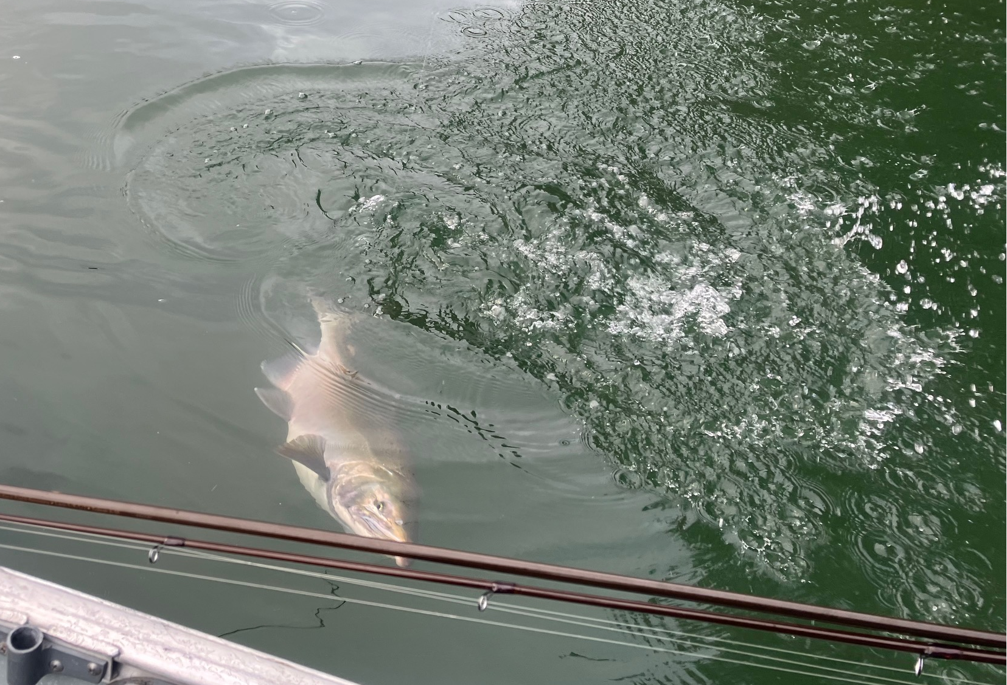
Lake Scanewa Coho

Slide 47
Cowlitz River Coho Salmon
CRC Reported Harvest Lower, Upper Cowlitz and Tilton
Notes:
Josua to pull 6 years

Slide 48
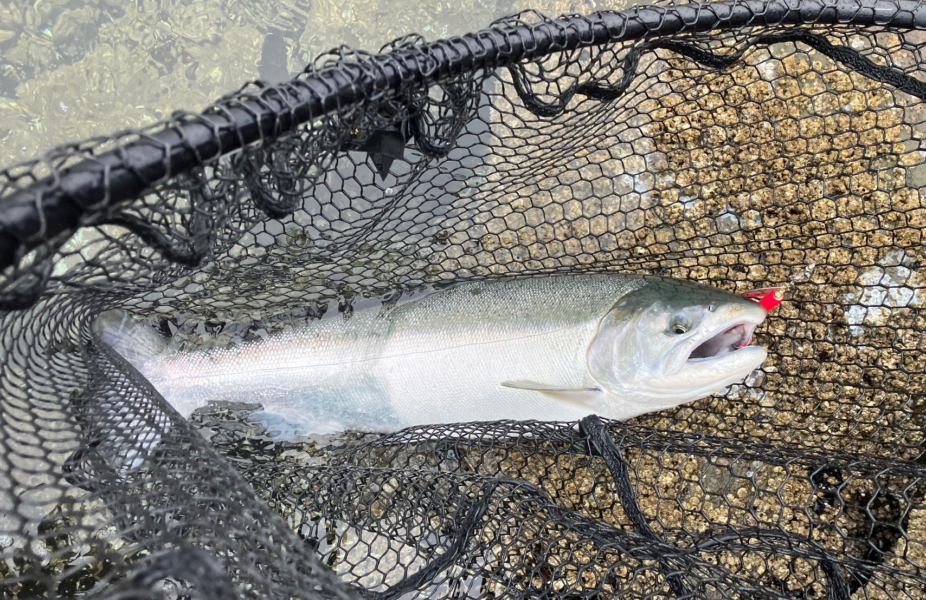
Coho Salmon
Notes:
Wild fish release

Slide 49
Coho Salmon
Fishery Theme:
Cowlitz hatchery program is a major contributor to fisheries in the ocean, lower Columbia, Cowlitz, including the upper Cowlitz, Cispus and Tilton Rivers.
Arrivals to the Barrier Dam above hatchery need can be transported upstream to support spawner abundance and upper basin fisheries.
Less surplus
Fisheries Nuances:
CRC management period: year-round under permanent rule. Seasons and daily limits are based on preseason forecasts and are set through the North of Falcon process.
Currently all Cowlitz Coho fisheries are mark-selective (Adipose clipped).
Daily limit:
Lower Cowlitz 3 adults
Upper Cowlitz 2 adults
Notes:
Fisheries can be affected by flows but are usually productive.
Lake Scanewa provides a somewhat unique lake fishery for Coho salmon. Reduced need for surplus of Coho salmon.

Slide 50
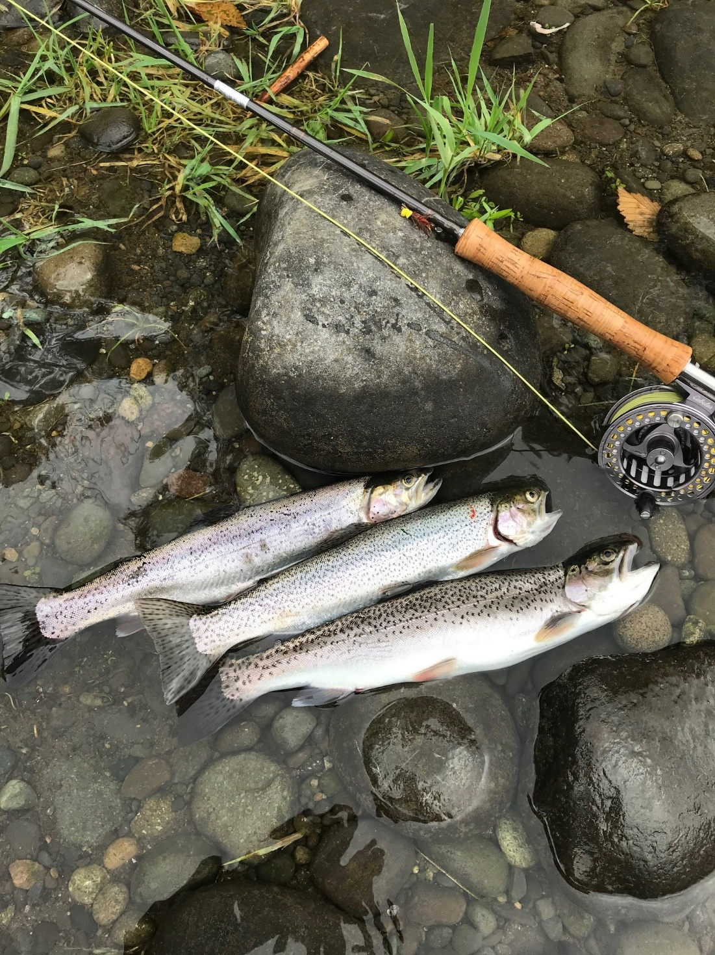
Sea- Run Cutthroat
Photos by D. Houton, LCFF
Notes:
Fishery theme: This is the last hatchery sea-run program in the state of Washington. A relatively low number of smolt are released each year (compared to steelhead) and provides a late-summer and fall fishery. A significant proportion of anglers targeting these fish are fly anglers. While some excess fish are released to Riffe Lake, the upper Cowlitz and Tilton basins only receive retuning natural origin fish.

Slide 51
Sea-Run Cutthroat Trout
One segregated hatchery program
102,500 smolt release goal
No HOR Cutthroat passed upstream, except to Riffe Lake for harvest.
Natural populations:
Lower Cowlitz, Tilton, Upper Cowlitz/Cispus

Slide 52
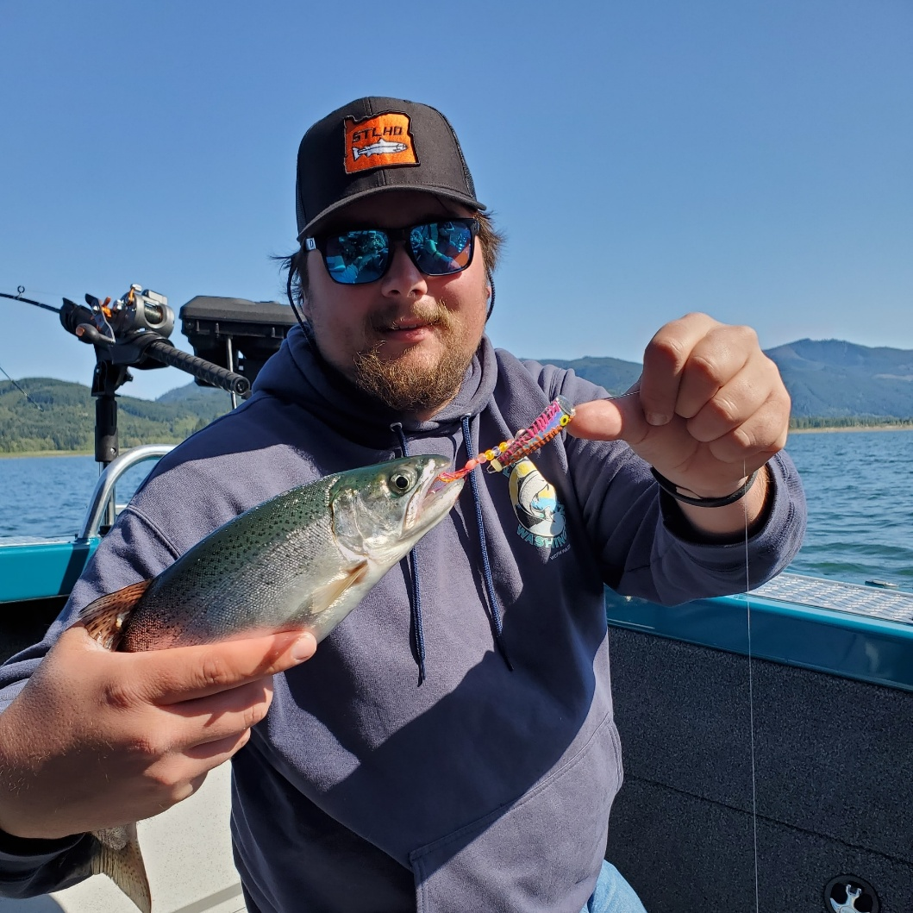
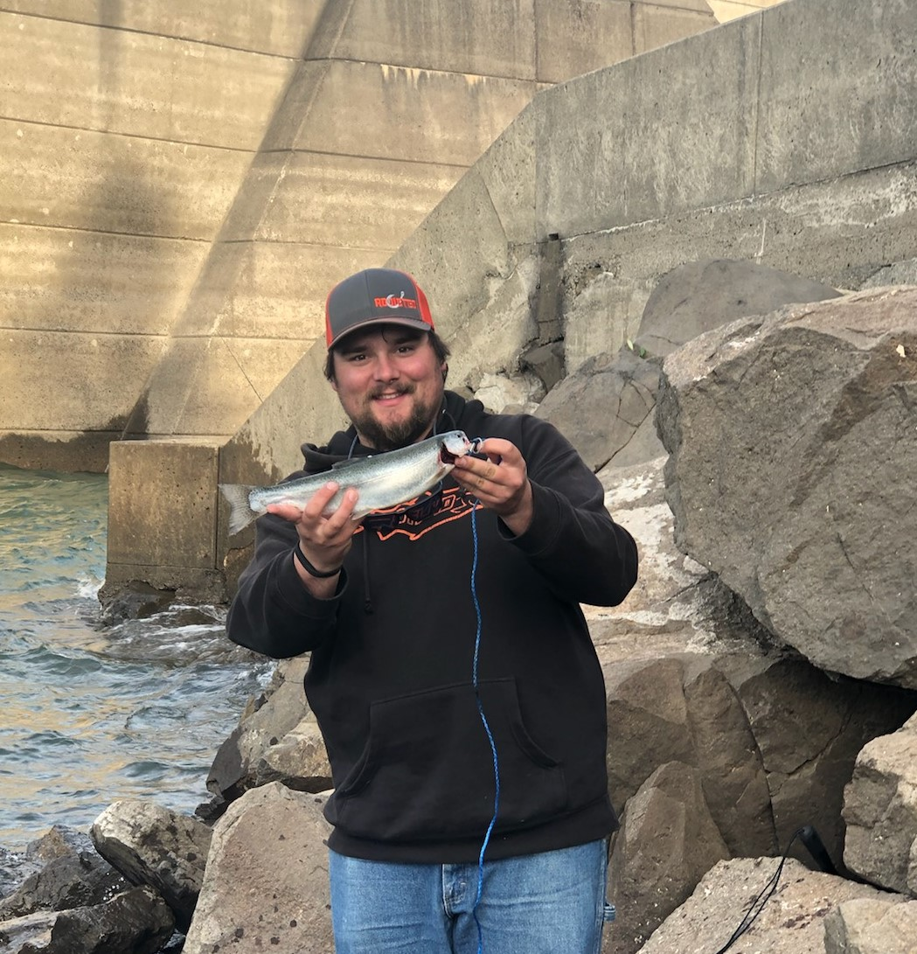
Sea-Run Cutthroat Trout
Riffe Lake Hatchery Cutthroat

Slide 53
Cowlitz Sea-Run Cutthroat Trout Returns to Barrier Dam
Notes:
Consistent program releases but variable adult returns. Mysterious.
NORs are differentially marked to denote origin
Unmarked and dorsal CWT: Tilton
Unmarked and sinus CWT: Upper Cowlitz.
HORs mostly go to Riffe Lake

Slide 54
Sea-Run Cutthroat Trout
Fishery Theme:
Harvest program
Only hatchery sea-run program in the Columbia.
Provides a late-summer and fall fishery.
No CRC reporting
Currently lower Cowlitz cutthroat fisheries are mark-selective
-Catch and release is common
Fishery Nuances: No forecast. Daily limits are in addition to salmon limit. Smaller fish but passionate participation.
Notes:
Peak hatchery returns September-November
We would like to know more about this fishery

Slide 55
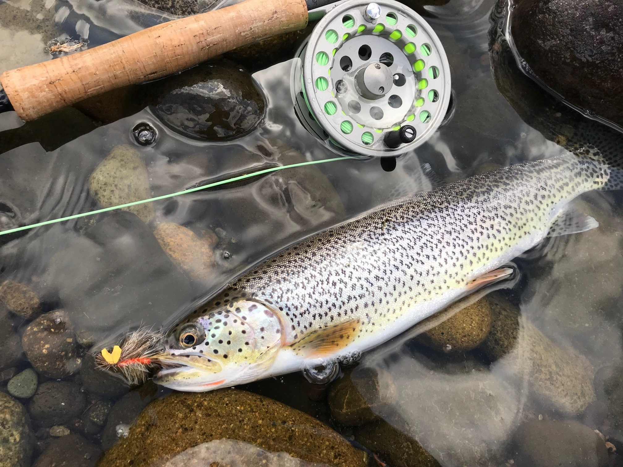
Notes:
From a kind Gentleman with the Lower Columbia Fly Fishers

Slide 56
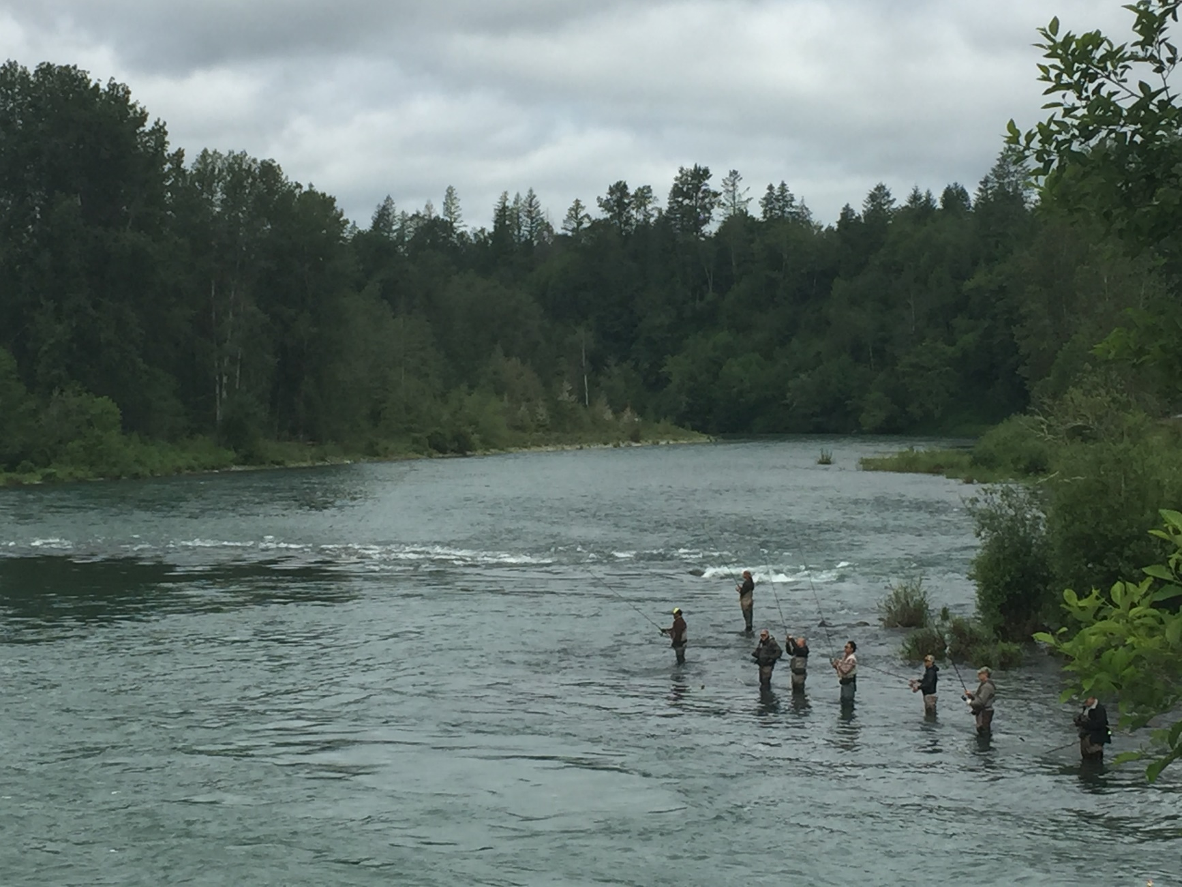
Electronic Catch Record Cards

Slide 57
Electronic Catch Record Cards
New in 2026
Electronic-based license and catch record card (CRC) reporting system
Optional participation for anglers
Durable paper is being discontinued

Slide 58
Electronic Catch Record Card
Digital reporting has advantages:
Less lag time in reporting CRC data
Potential for in-season catch estimates and better in-season management
Convenience for anglers
No annual reporting requirement
Notes:
Will still need to print vehicle access pass for display

Slide 59
Electronic Catch Record Card
New in 2026, Cowlitz Creel surveys are adding two new Creel Survey Questions:
“Are you using paper or electronic CRC?”
Develop a ratio of user types
If yes, and you have harvested a fish, “May I scan your CRC bar code on your phone?”
This will help to test and verify system performance
Notes:
Initial response has been favorable with few refusals.

Slide 60
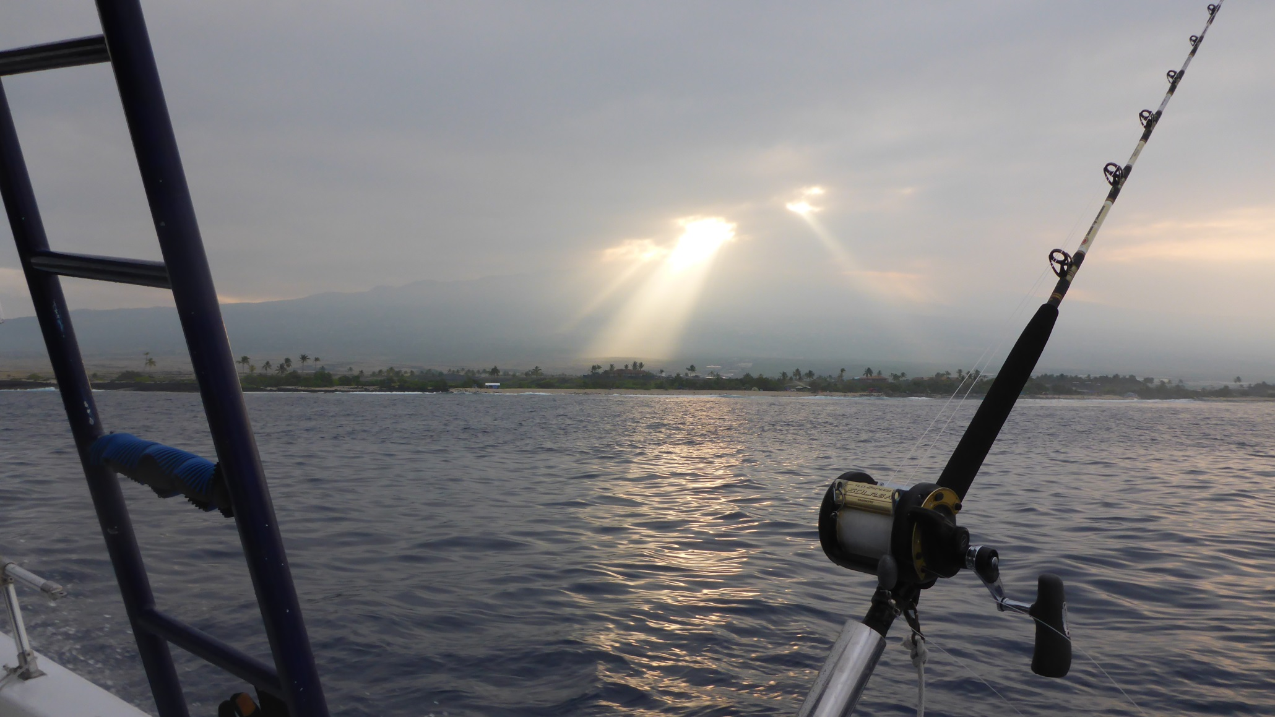
Questions?

Slide 61
Cowlitz River Fall Chinook Salmon Lower Cowlitz vs Barrier Dam
Notes:
Need to put in M-R numbers somehow
Change LC HOR (green) to LC NOR (blue)

Slide 62
Electronic Catch Record Card
Paper license: Self printed
May use a more durable medium like “Rite-In-The-Rain” paper
Suggest storing in a resealable bag
Still have annual reporting requirements

