Slide 1
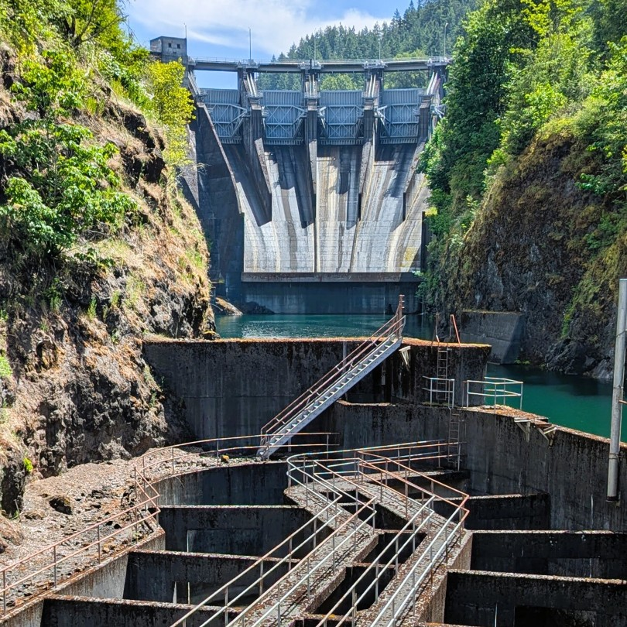
Adaptive Management Through Applied Science –
Fall Chinook Abundance Monitoring
Scott Gibson April 22, 2026

Slide 2

Recovery Phase Goals :
How to assess Lower Cowlitz Fall Chinook Populations:
Juvenile Abundance Monitoring
Returning Adults
  Abundance
  Timing
  Distribution

Slide 3
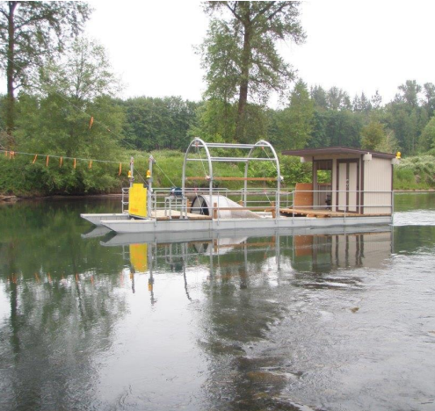
Juvenile Abundance Monitoring
Rotary Screw Trap (RST)
Operations began in late May of 2015
Annual abundance estimates of Chinook, coho, winter steelhead and cutthroat
Outmigration timing

Slide 4
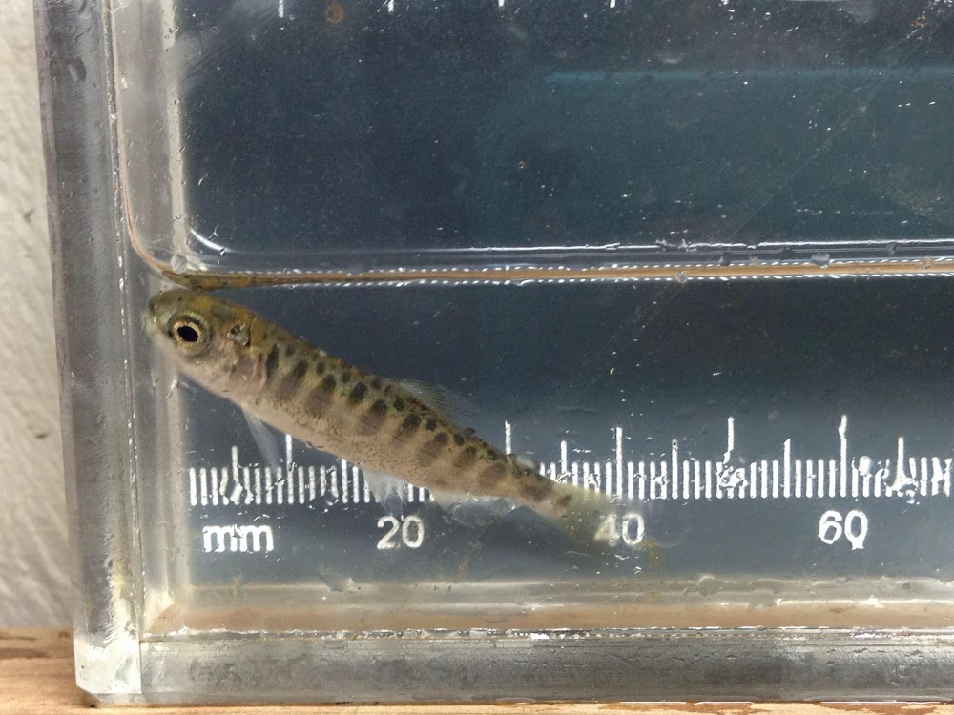
RST Chinook Fry Abundance Estimates:
2015 – N/A
2016 – N/A
2017 – 25,00,000
2018 – 7,247,000
2019 – 8,342,000

Slide 5
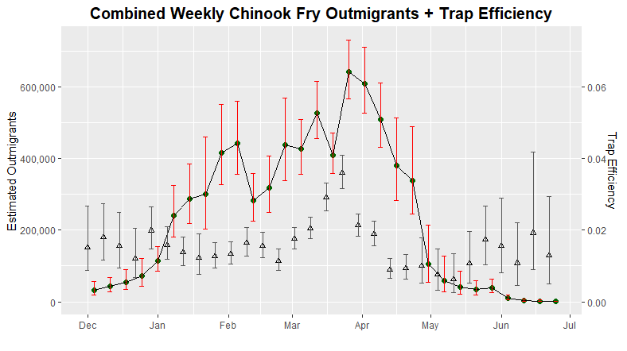
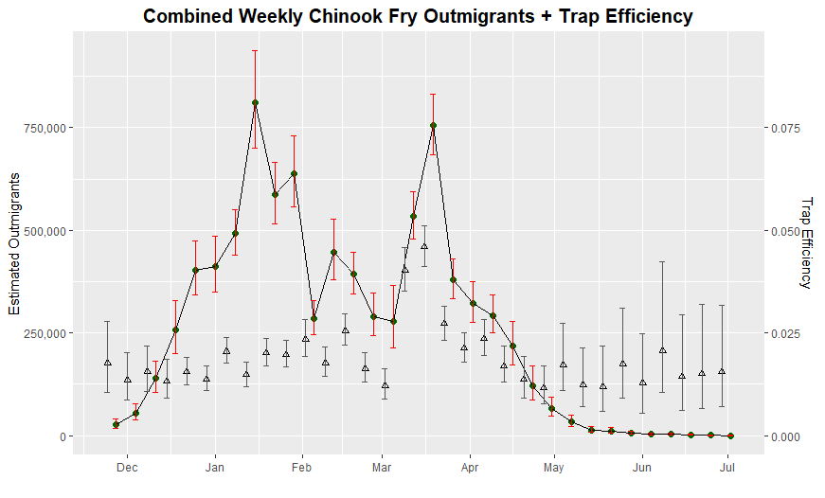
Chinook Fry Migration
2018
600,000
400,000
200,000
0
750,000
500,000
250,000
0
0.05
0.04
0.02
0.00
0.05
0.04
0.02
0.00
Fry begin moving in late November and continue through June.
Peak migration occurring late March
Weekly estimates over 700k during peak migration.
Fish capture ranged from 7,689 in 2015 to 179,834 in 2019.
Estimated Outmigrants Estimated Outmigrants
2019
Trap Efficiency Trap Efficiency
Dec Jan Feb Mar Apr May Jun Jul

Slide 6
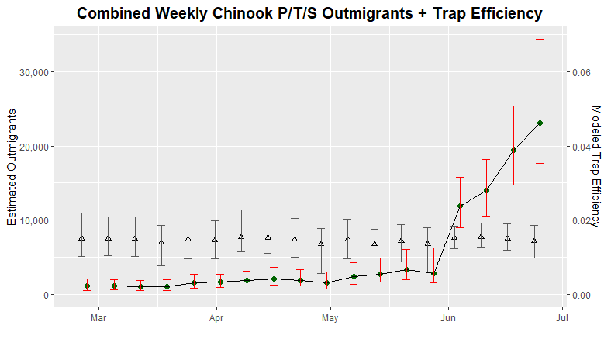
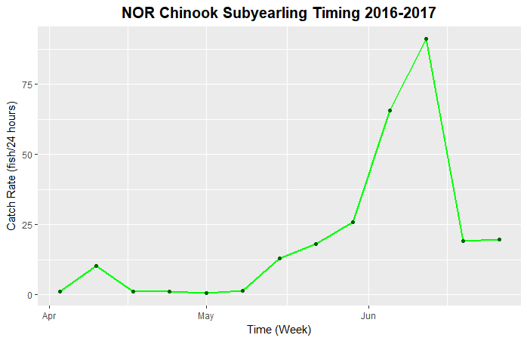
Chinook Subyearling Abundance & Migration
Subyearlings begin moving in late to mid March and continue through June.
Peak migration occurring late June
Weekly estimates of 27,000 during peak migration.
Fish capture ranged from 1,391 – 2,775
Abundance estimates ranging from 96,513 - 359,232
Catch Rate (fish/24 hrs Estimated Outmigrants
Chinook Subyearling Timing
2016-2017
Apr May Jun Jul
Time (week)

Slide 7
Recovery Phase Goals :
How to assess Lower Cowlitz Fall Chinook Populations:
Juvenile Abundance Monitoring
Returning Adults
  Abundance
  Timing
  Distribution

Slide 8
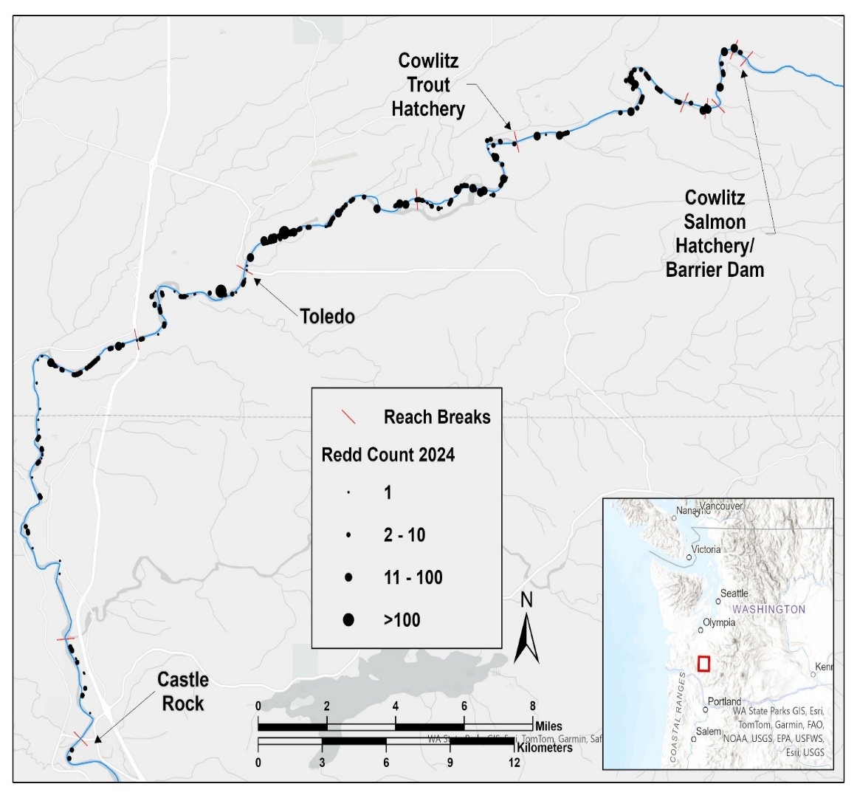
Adult Fall Chinook Distribution
Redds observed from
Castle Rock to the
Cowlitz Salmon
Hatchery
Highest concentration
occurring between
Toledo and the Cowlitz
Trout Hatchery

Slide 9

Identifying Data Discrepancies
Adult abundance estimates:
2016 – 4,021
2017 – 3,695
2018 – 3,553
Chinook fry abundance estimates:
2017 – 25,702,006
2018 – 7,247,689
2019 – 8,342,500

Slide 10
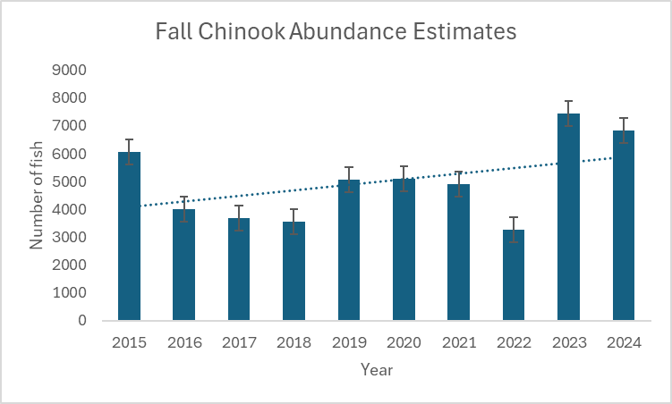
Identifying Data Discrepancies
Adult and juvenile abundance
estimates misaligned
Juvenile estimates
significantly higher than
biologically possible
Average Chinook survival
from egg to fry is ~54%
Average fall Chinook
fecundity in the Cowlitz is
4,100.

Slide 11
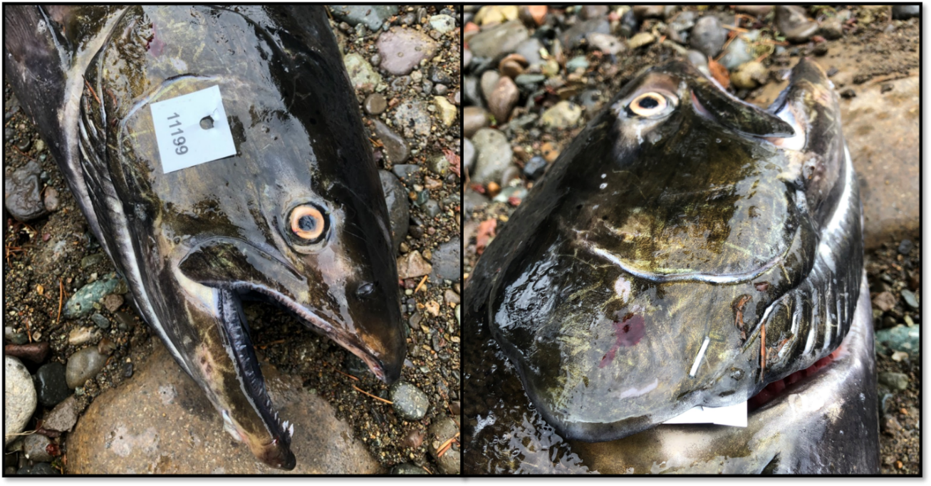
Implementing A New Method
In 2020, WDFW proposed a method for estimating abundance that had proven to be an effective approach in the Lewis River.
Chinook carcasses are collected, tagged and returned to the river and then subsequently recaptured. Estimates are generated using a multivariate, random-walk mark-recapture Jolly-Seber (JS) model

Slide 12

Comparing Methods
Methods Overview:
Peak redd count expansion via aerial surveys
Mark-Recapture of carcasses
via jet boat surveys
Bias-corrected peak redd
count estimates

Slide 13
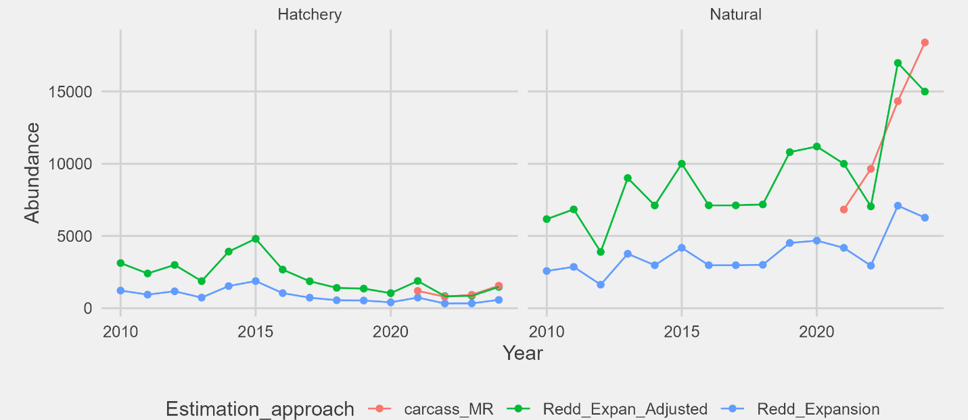
Comparing Methods: Results
2021-2024 mark-recapture estimates were two to three times greater than that of peak redd count expansions.
Natural origin spawner abundance has averaged 12,284 (range 6,886-18,545)

Slide 14
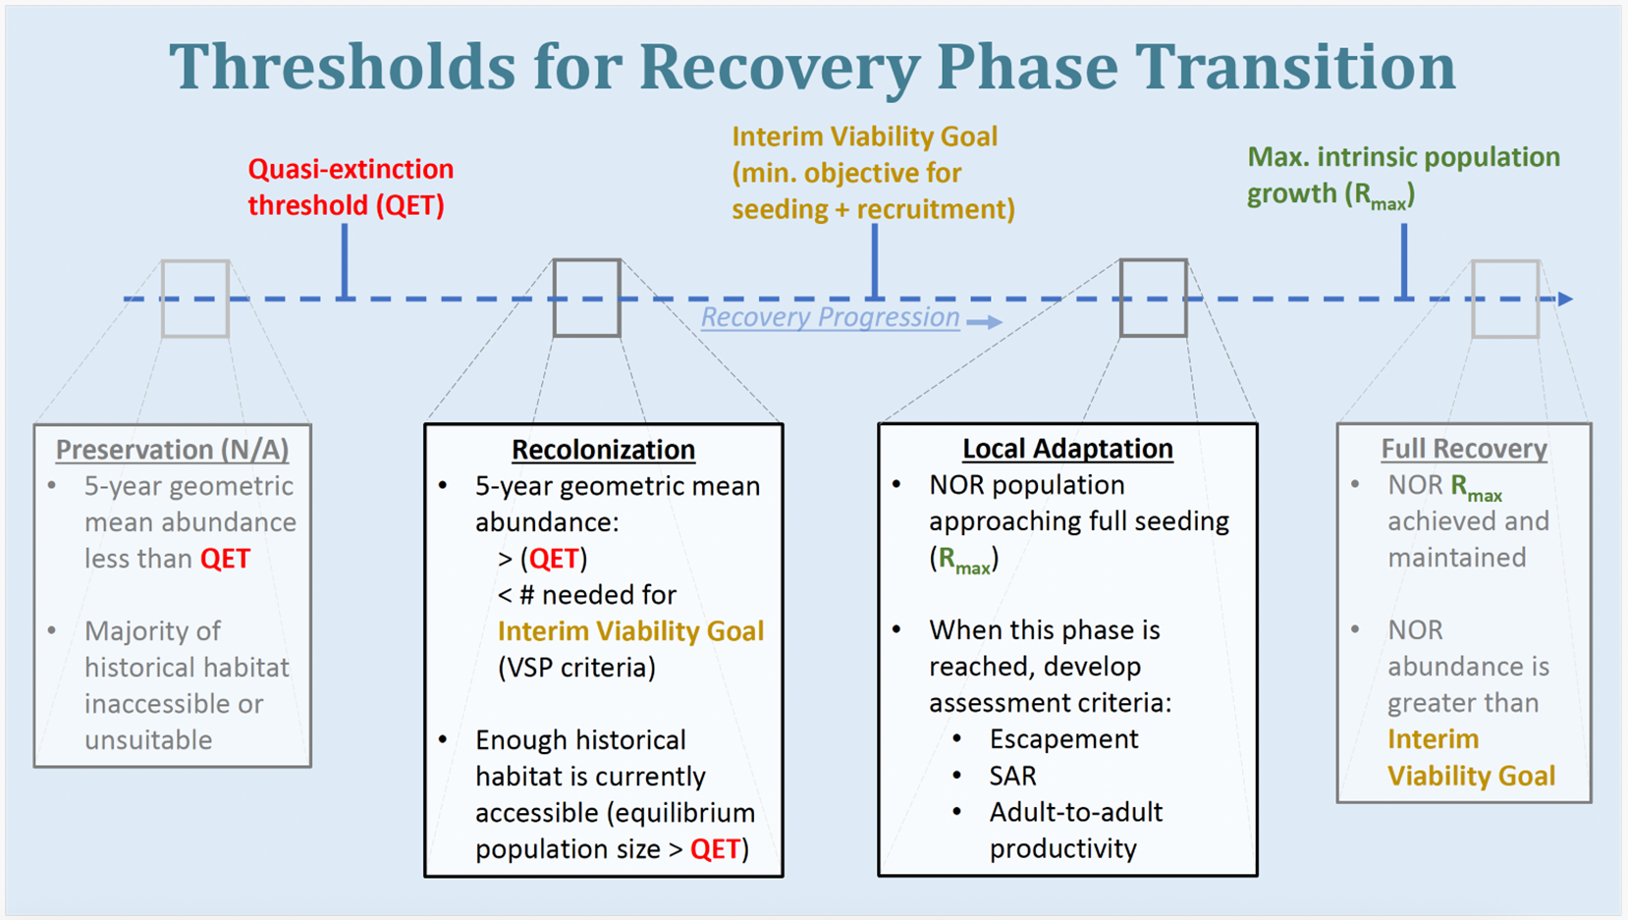

Slide 15
Next Steps for Transition Plans:
Escapement: Set goals for the number of fish required to escape and spawn to maximize long-term, sustainable yield.
Rmax: The maximum intrinsic rate of population increase or the upper limit of a populations productivity.
Adult to adult productivity: calculate how many adult offspring are produced by each spawning adult in a given generation.
pHOS: Calculate % of hatchery origin spawners in nature.

Slide 16
Questions?
Scott Gibson March 3, 2026

