Slide 1
Cowlitz Fall Chinook- Hatchery SAR
Kristopher Warner- WDFW
Biologist- Hatchery Monitoring and Evaluations
2026 Annual Program Review and Cowlitz Science Meeting
Notes:
Hi I’m Kris Warner, I’m part of the west-side hatchery monitoring and evaluations unit with the Washington department of fish and wildlife. I work with folks in the hatcheries that reside on the kalama, Cowlitz, toutle, and elochoman rivers, as well as folks in both the science and management divisions across the region. Today we’ll be discussing and modeling strategy that was applied to cwt recovery data to compare relative survival of hatchery programs across the lower Columbia.

Slide 2
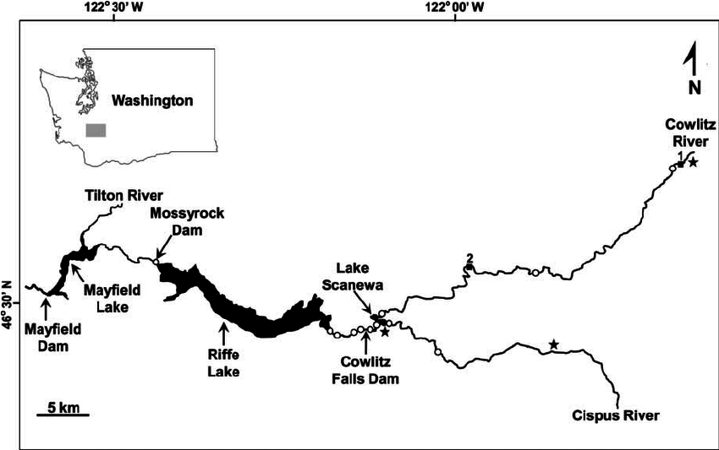
Outline
Today’s presentation will consist of:
Acknowledgements
Background
Problem statement
Methodology
Results
Takeaways and next steps
Notes:
We’ll walk through the process start to finish today, beginning with acknowledging all the folks that made this work possible. We’ll then move onto a bit of a refresher from the last time this analysis was presented at a Cowlitz Science Meeting, including the problem statement this work aims to address, the methodology employed to examine questions surrounding that problem statement, the results of the modeling exercise, and finish with a bit of “where do we go from here”.

Slide 3


Acknowledgements- Thank you!
WDFW
Kevin See
Thomas Buehrens
Phil Sandstrom
Kale Bentley
Ben Cox
Matthew Siskey
Josua Holowatz
Bryce Glaser
R5FPMT & others
TPU
Scott Gibson
Jenise Bauman
Notes:
A big thank you to my colleagues at wdfw including READ NAMES, as well as the conversations and collaborations with Scott, Jenise, and matt at TPU, and the opportunity to present here today.

Slide 4
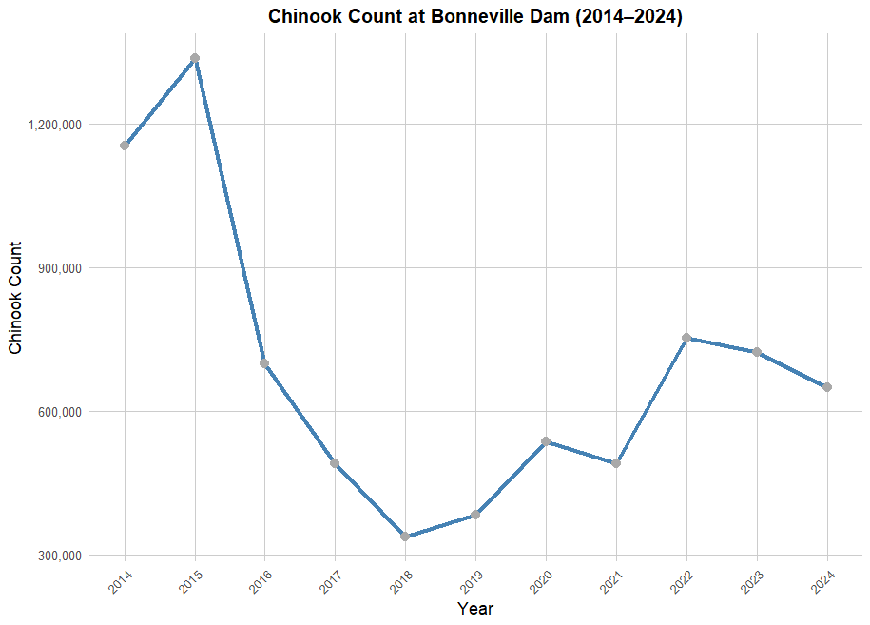
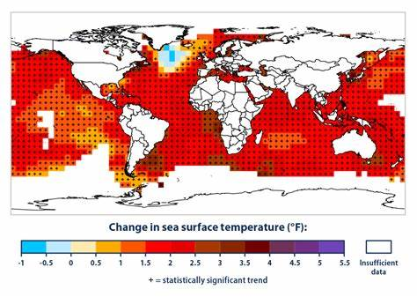
Background
Most Pacific salmon are in decline, multiple factors including but not limited to:
Notes:
Pacific salmon are on average in decline, a trend precipitating from a variety of factors both environmental and anthropogenic. Rising ocean temperatures, modifications to habitats and hydrosystems, hatchery practices and many other factors can all have an impact on these populations.

Slide 5
Background- Cowlitz Salmon Hatchery
Brood Year | Total Released
2013 | 3,153,131
2014 | 3,447,633
2015 | 3,416,089
2016 | 2,894,928
2017 | 3,274,631
2018 | 1,755,813
2019 | 2,311,145
2020 | 3,596,659
2021 | 3,503,839
2022 | 1,187,707
2023 | 964,251
2024 | 1,613,481
Target release of 3.5million (WDFW Future Brood Document)
Since brood year 2013, release targets have been missed by more than 10% six times (Hatchery data)
Chinook fisheries have been modified or closed since 2018/2019 (J. Holowatz)
Impacts upstream goals
Notes:
These declines and low hatchery origin returns have manifested as missed targets in the Cowlitz salmon hatchery. Current release is set for 3.5 million, a goal that’s been short seven of the past 12 years because of brood challenges precipitating from depressed returns. None of these are for example, a catastrophic loss of production within the facility. 2024 releases were 1.6 million, still well below the goal but an improvement over 964k

Slide 6
Problem statement
Notes:
Which brings to the topic of problems and purpose.

Slide 7
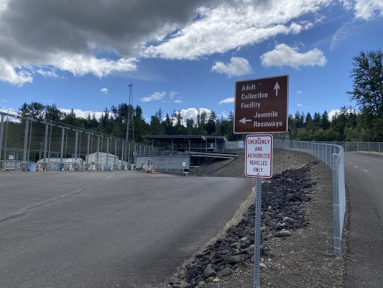
Problem Statement
Hatchery-origin fall Chinook returns to the Cowlitz have been depressed for the past decade.
Is relative return of hatchery Fall Chinook in the Cowlitz disproportionate to other hatchery programs?
Are these observed trends hatchery-specific?
Are these observed trends basin-specific?
Notes:
Cowlitz River Hatchery Fall Chinook returns have been poor for the last decade. We focused exploration around three questions pertaining to this claim. READ THREE SUB BULLETS

Slide 8
Methodology
Notes:
And how do we explore those questions?

Slide 9
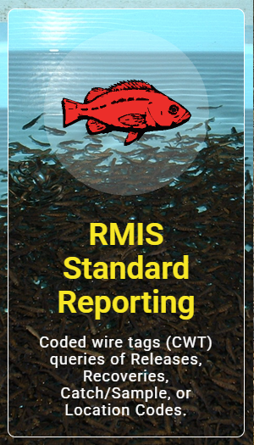

Data Wrangling- Sources
Regional Mark Information System (RMIS) and Salmon Population Indicators (SPI) frontend at data.wa.gov
R used for data extraction, wrangling and analysis
Notes:
Step one is identification, retrieval, transforming, and cleaning data into a usable state for analysis. The data set analyzed entailed coded wire tag recoveries from brood years 2000 to 2020, 2020 being the cutoff to disallow for partially unreported data.

Slide 10
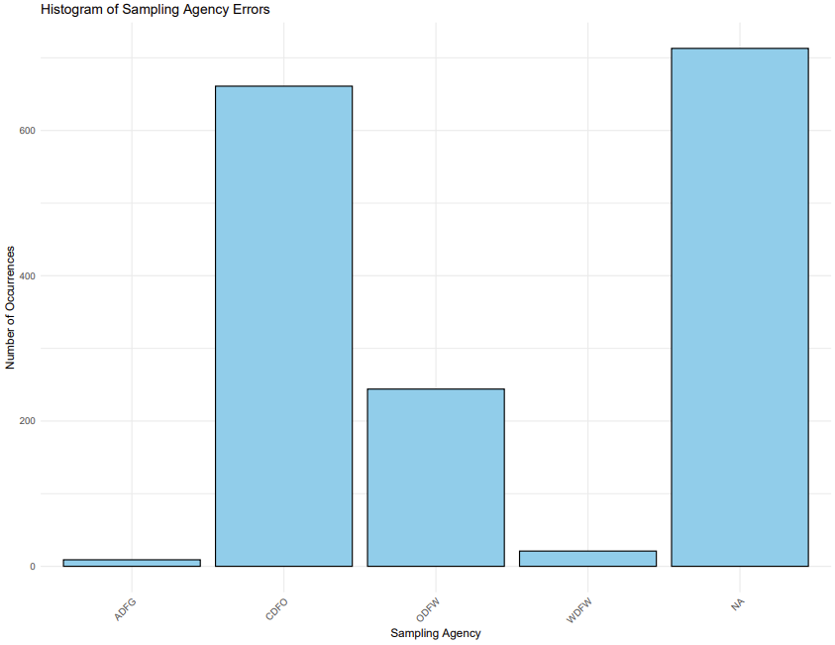
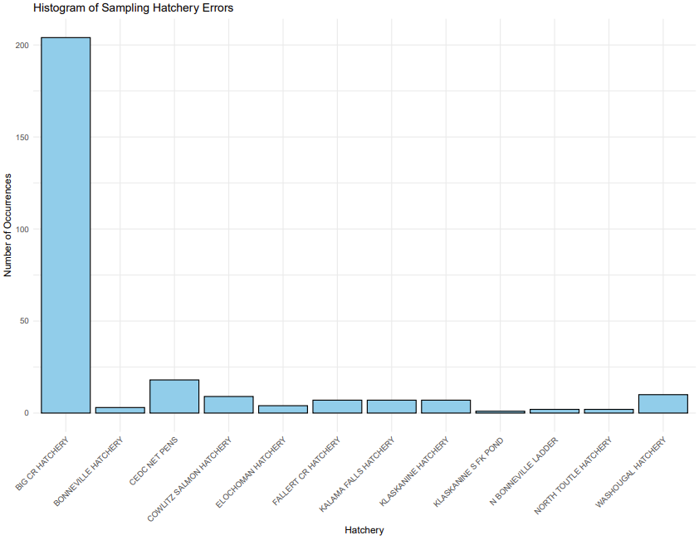
Data wrangling- Analyzed strata
Number of Errors by Agency
Number of Errors by Hatchery
Canada
Big Creek
Hatcheries
Agency
Notes:
To orient us again with the task at hand and comparison across fall chinook programs, the data needed to be systematically revised to allow for the most-fair comparisons. We wanted to avoid any potential introductions of bias. A few such clusters of these inconsistencies can be attributed to common themes, like a specific fishery, or in this case a single hatchery, or a single agency. Call out specific examples here and highlight the axes labels

Slide 11
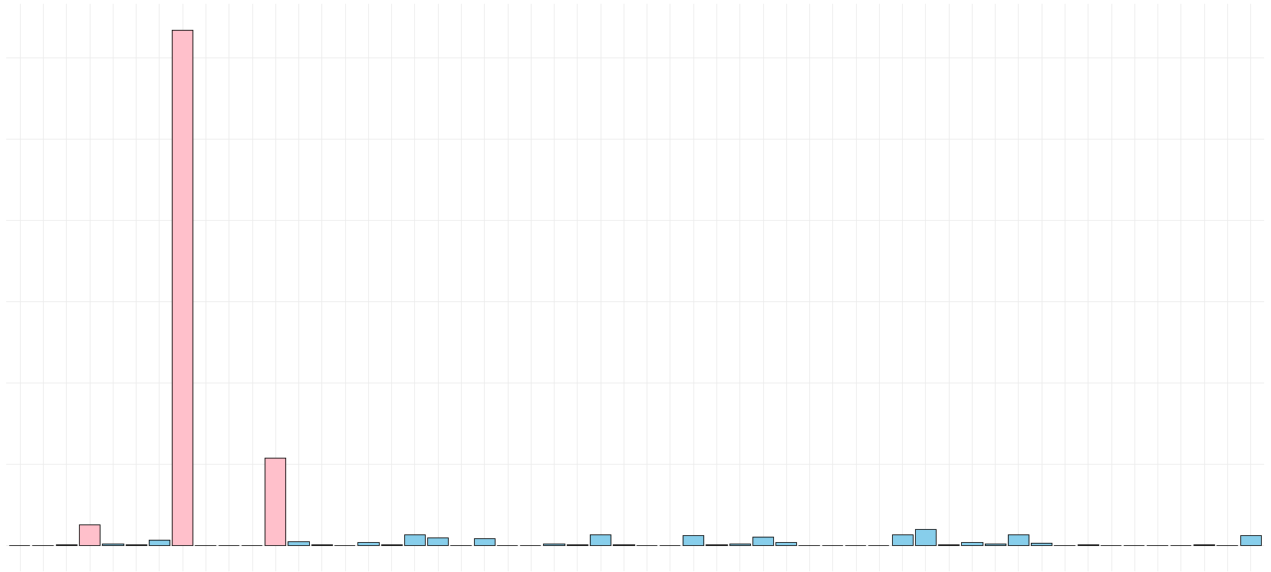
Count of Recovery Records by Management Fishery
30k
20k
10k
0
Escapement
Pink strata included in analysis
Freshwater Net
Buoy 10
Fishery Strata
Notes:
This finally leads us to the strata that were included in the analysis. Freshwater net fisheries, buoy 10, and most dominant- escapement comprising of trap recoveries, hatchery returns, and spawning ground recoveries were the strata used for this comparison

Slide 12
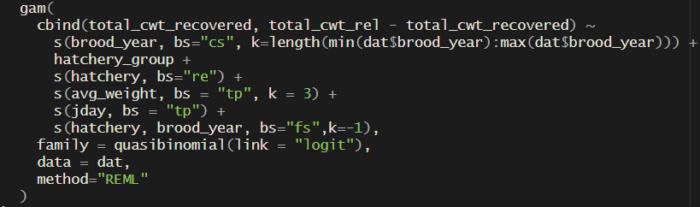
Methods- Generalized additive model (GAM)
Quasi-binomial GAM portioning variance into multiple parts:
Space (hatchery location and basin)
Time (Brood year)
Hatchery practice (size of fish and day of release)
After accounting for these- is there still a difference in the estimated returns of fall Chinook?
Notes:
Which brings us to the data analysis. The model of choice was a generalized additive model, appropriate for examining nonlinear relationships. To get to the questions described earlier, we developed a model that included several effects, allowing us to account for space (hatchery and basin), time (year and interannual variance), and some hatchery practices.

Slide 13
Results

Slide 14
Results- Model Summary
~77.1% deviance explained by the model
Interannual variance most explanatory variable
Cowlitz hatchery origin fall Chinook had a ~65.4% lower probability of observation in analyzed strata
Notes:
In summary the model performed well considering the complexity of the data.

Slide 15
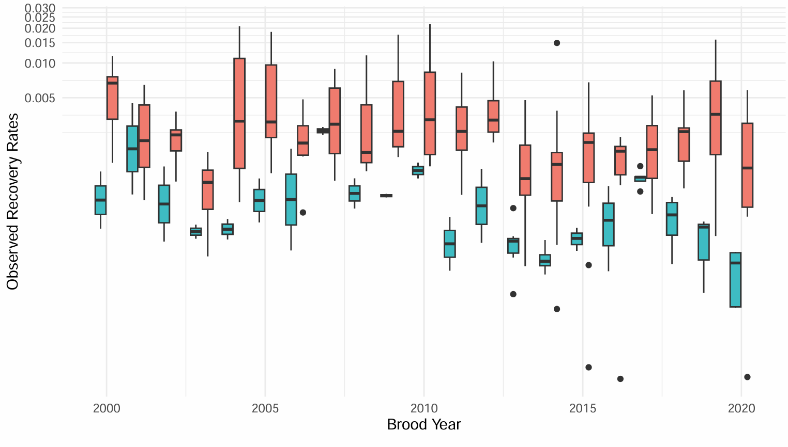

Notes:
This figure allows us to visually assess the previous slide in a more digestible format. There does seem to be some signal when grouping by Cowlitz and all others, but model estimations are much more telling.

Slide 16
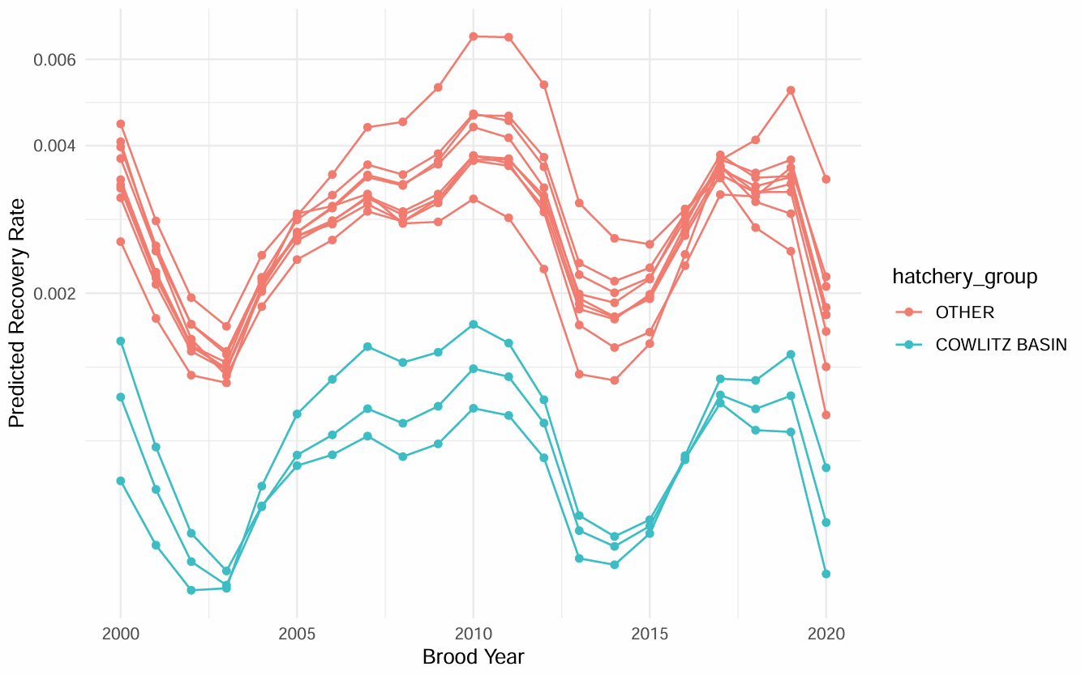
Results- comparing predictions
Notes:
Which brings us to the predicted return rates, our SAR+ . The model appears to capture a basin-level effect, that’s what we see as the separation here between the Cowlitz in teal and all others in salmon. The data supports the previously described variance, you can see there’s a lot of inter-annual variance accounted for, and variation between hatcheries shown by separation and clustering between each line on this figure. With the inclusion of brood year 2020, a clear signal there’s more spread in these non-Cowlitz basin hatcheries, but the Cowlitz aggregate are still depressed by comparison. I’ll call attention to the y-axis not being symmetrical in scale, and that’s for visual clarity, the cowltiz group would be nearly flatlined.

Slide 17
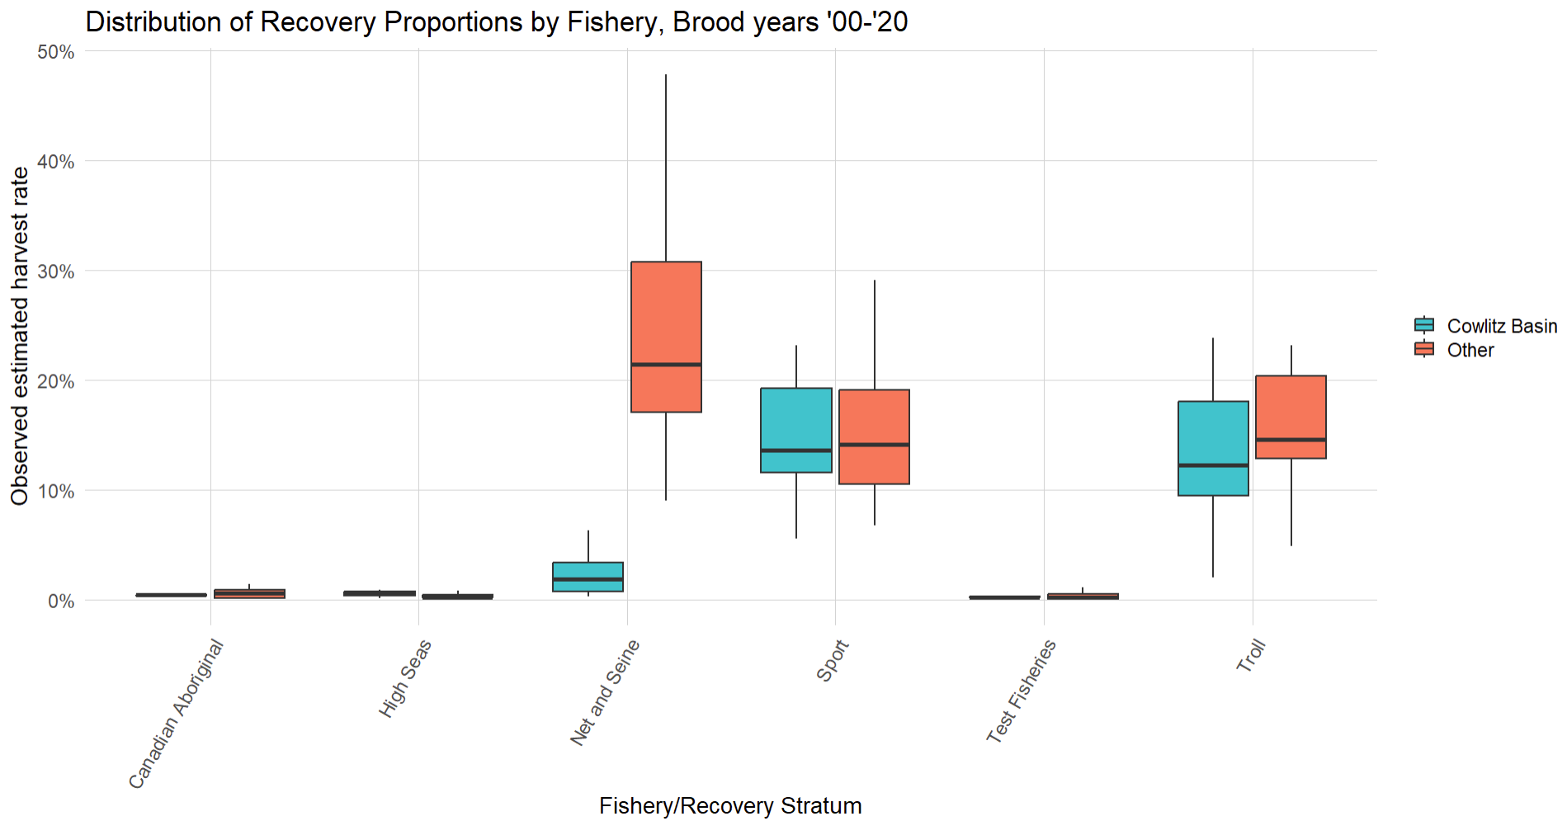

Results cont’d- Observations in Fisheries
Sport
Troll
Fishery/Recovery Stratum
Notes:
This figure is a summary of cwt interceptions in all strata, I want to highlight that even with a depressed return rate, we can see that proportionally Cowlitz fall chinook are contributing to fisheries very similarly to the other programs examined in this exercise in both sport and troll fisheries. It’s a reasonable assumption that any improvements made to aid recovery may result in improvements to the fisheries in-kind.

Slide 18
Takeaways and next steps
We have a framework for examining fisheries interceptions across multiple programs
We plan to adapt and streamline the process for hatchery programs elsewhere
Maintain the analysis with most recent brood years of data, and incorporate/explore other covariates
Ongoing discussions and planning for adaptive management actions that can be taken to shore up the Fall Chinook programs
Notes:
Change to takeaways, expand on next step talking points for each bullet.

Slide 19
Please hold questions until end of joint presentation!
Notes:
And with that I’ll turn it over to Scott Gibson for the second half of the Fall Chinook Presentation

