Slide 1
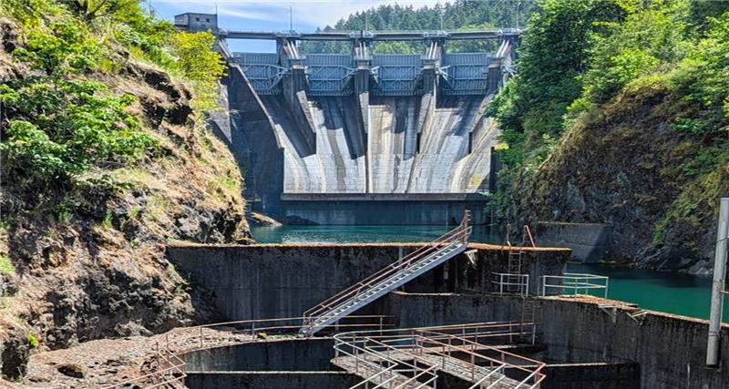
2025 Mayfield Secondary Separator Survival Study
Wyatt Wood – Science and Research Biologist
Tacoma Power – Natural Resources – Science and Research

Slide 2
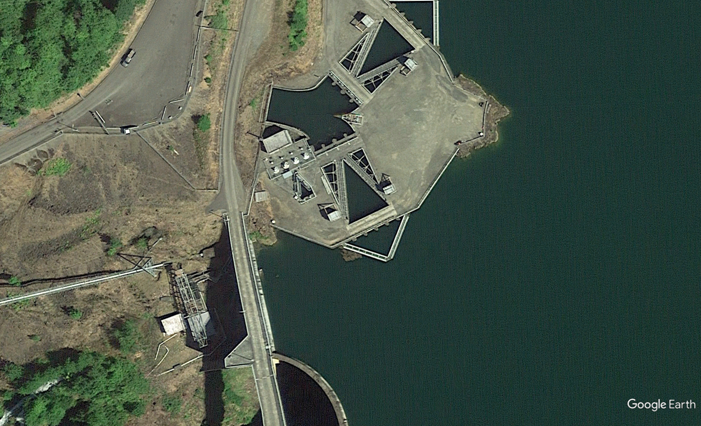
Background I
Counting House and Raceways
Louver Bays
Secondary Separator
Release Pipe
Notes:
First, an overview of the Mayfield Bypass system.
The louver bays serve to guide fish out from the power tunnel and into the secondary separator
The secondary separator is primarily a dewatering structure, utilizing these pumps to remove much of the water gathered into the system through the louver bay downwells
After passing the weir at the end of the separator, fish are guided to the counting house raceways. They are held here until worked up by our facilities staff and released into the tailrace via this release pipe

Slide 3
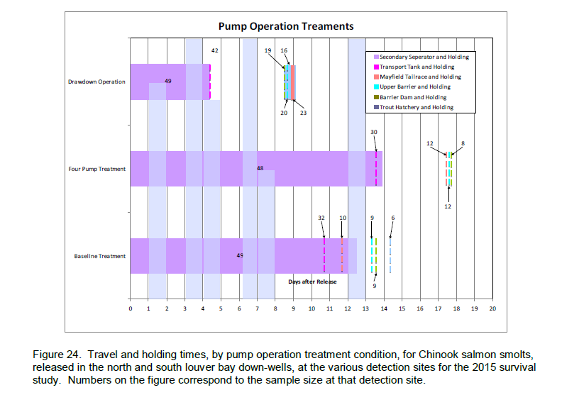
Background II
TPU contracted a survival study by Hydroacoustic Technology, Inc. in 2015
Study investigated survival and travel times of migrating juvenile Chinook in the Mayfield Juvenile Fish Bypass under three operational regimes of the secondary separator
Tacoma has been performing twice weekly drawdowns of the separator since
Notes:
Three operational regimes : continuous operation of all 3 pumps, drawdowns, or normal operation (variably operating 1-3 pumps depending on flow)

Slide 4
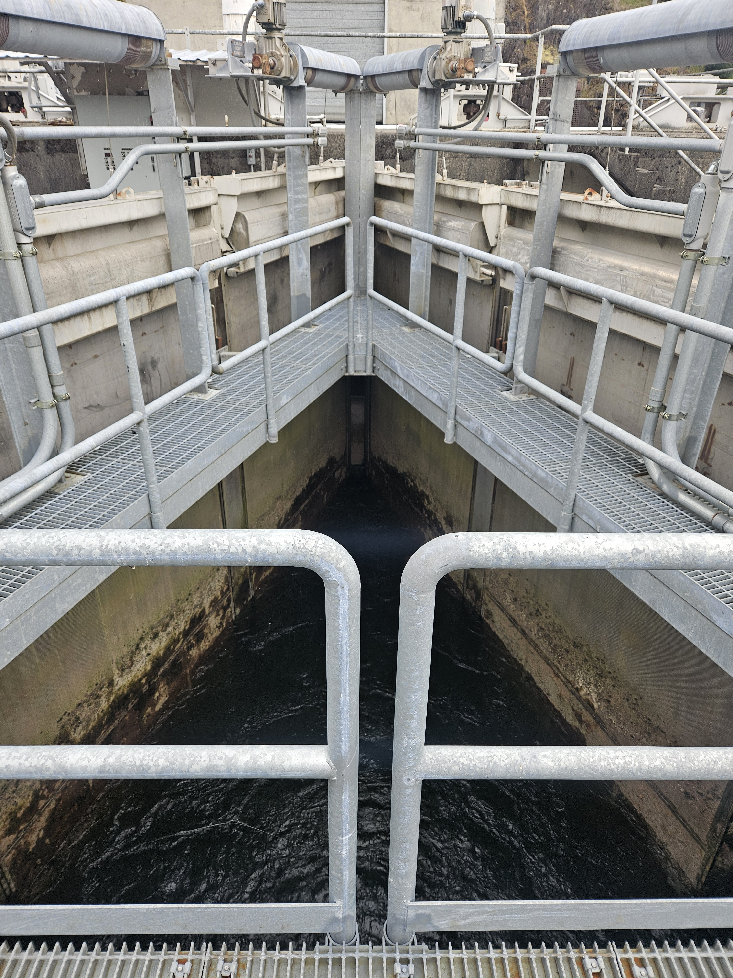
Background III
Chinook seem to benefit from these drawdowns – but can we do better?
Is there a more optimal interval for drawdowns than 2 days?
What environmental or operational factors might influence the benefits of a drawdown?

Slide 5
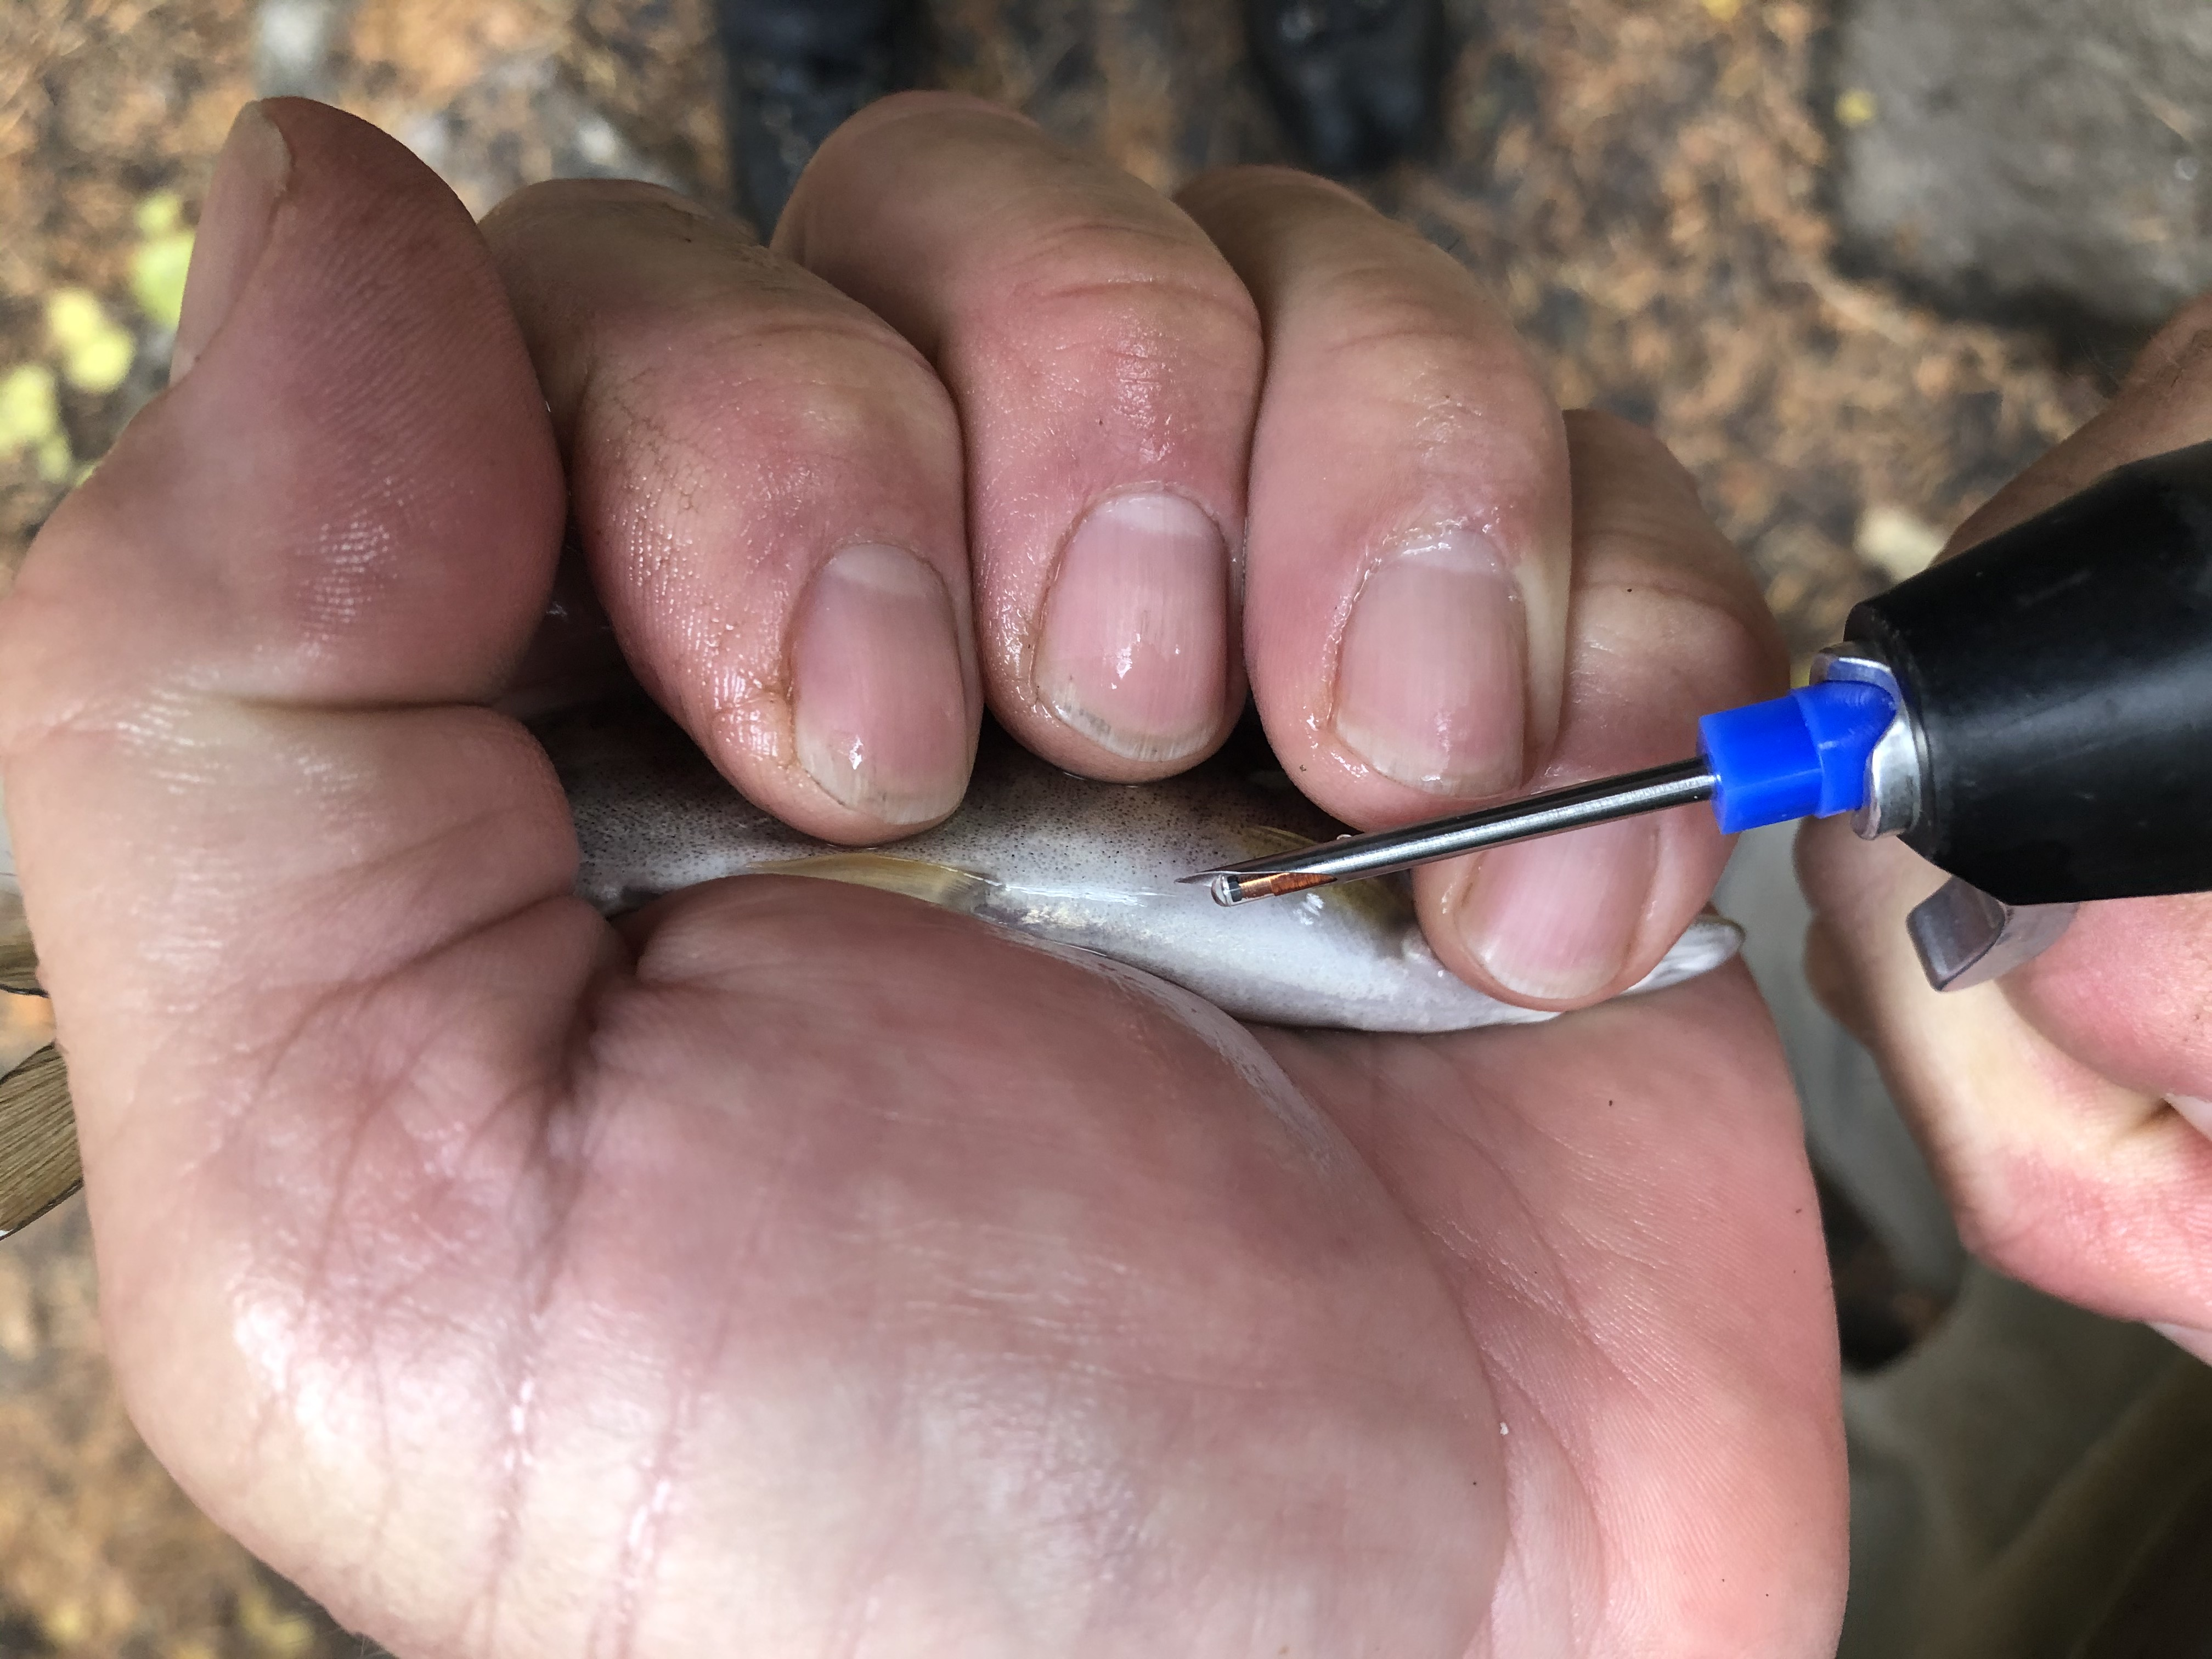
Background IV
This study: PIT tag juvenile chinook, release into the separator at different time intervals before a drawdown, monitor recaptures for time between detections and survival
Additionally: gather environmental and operational data, model together with these response variables

Slide 6
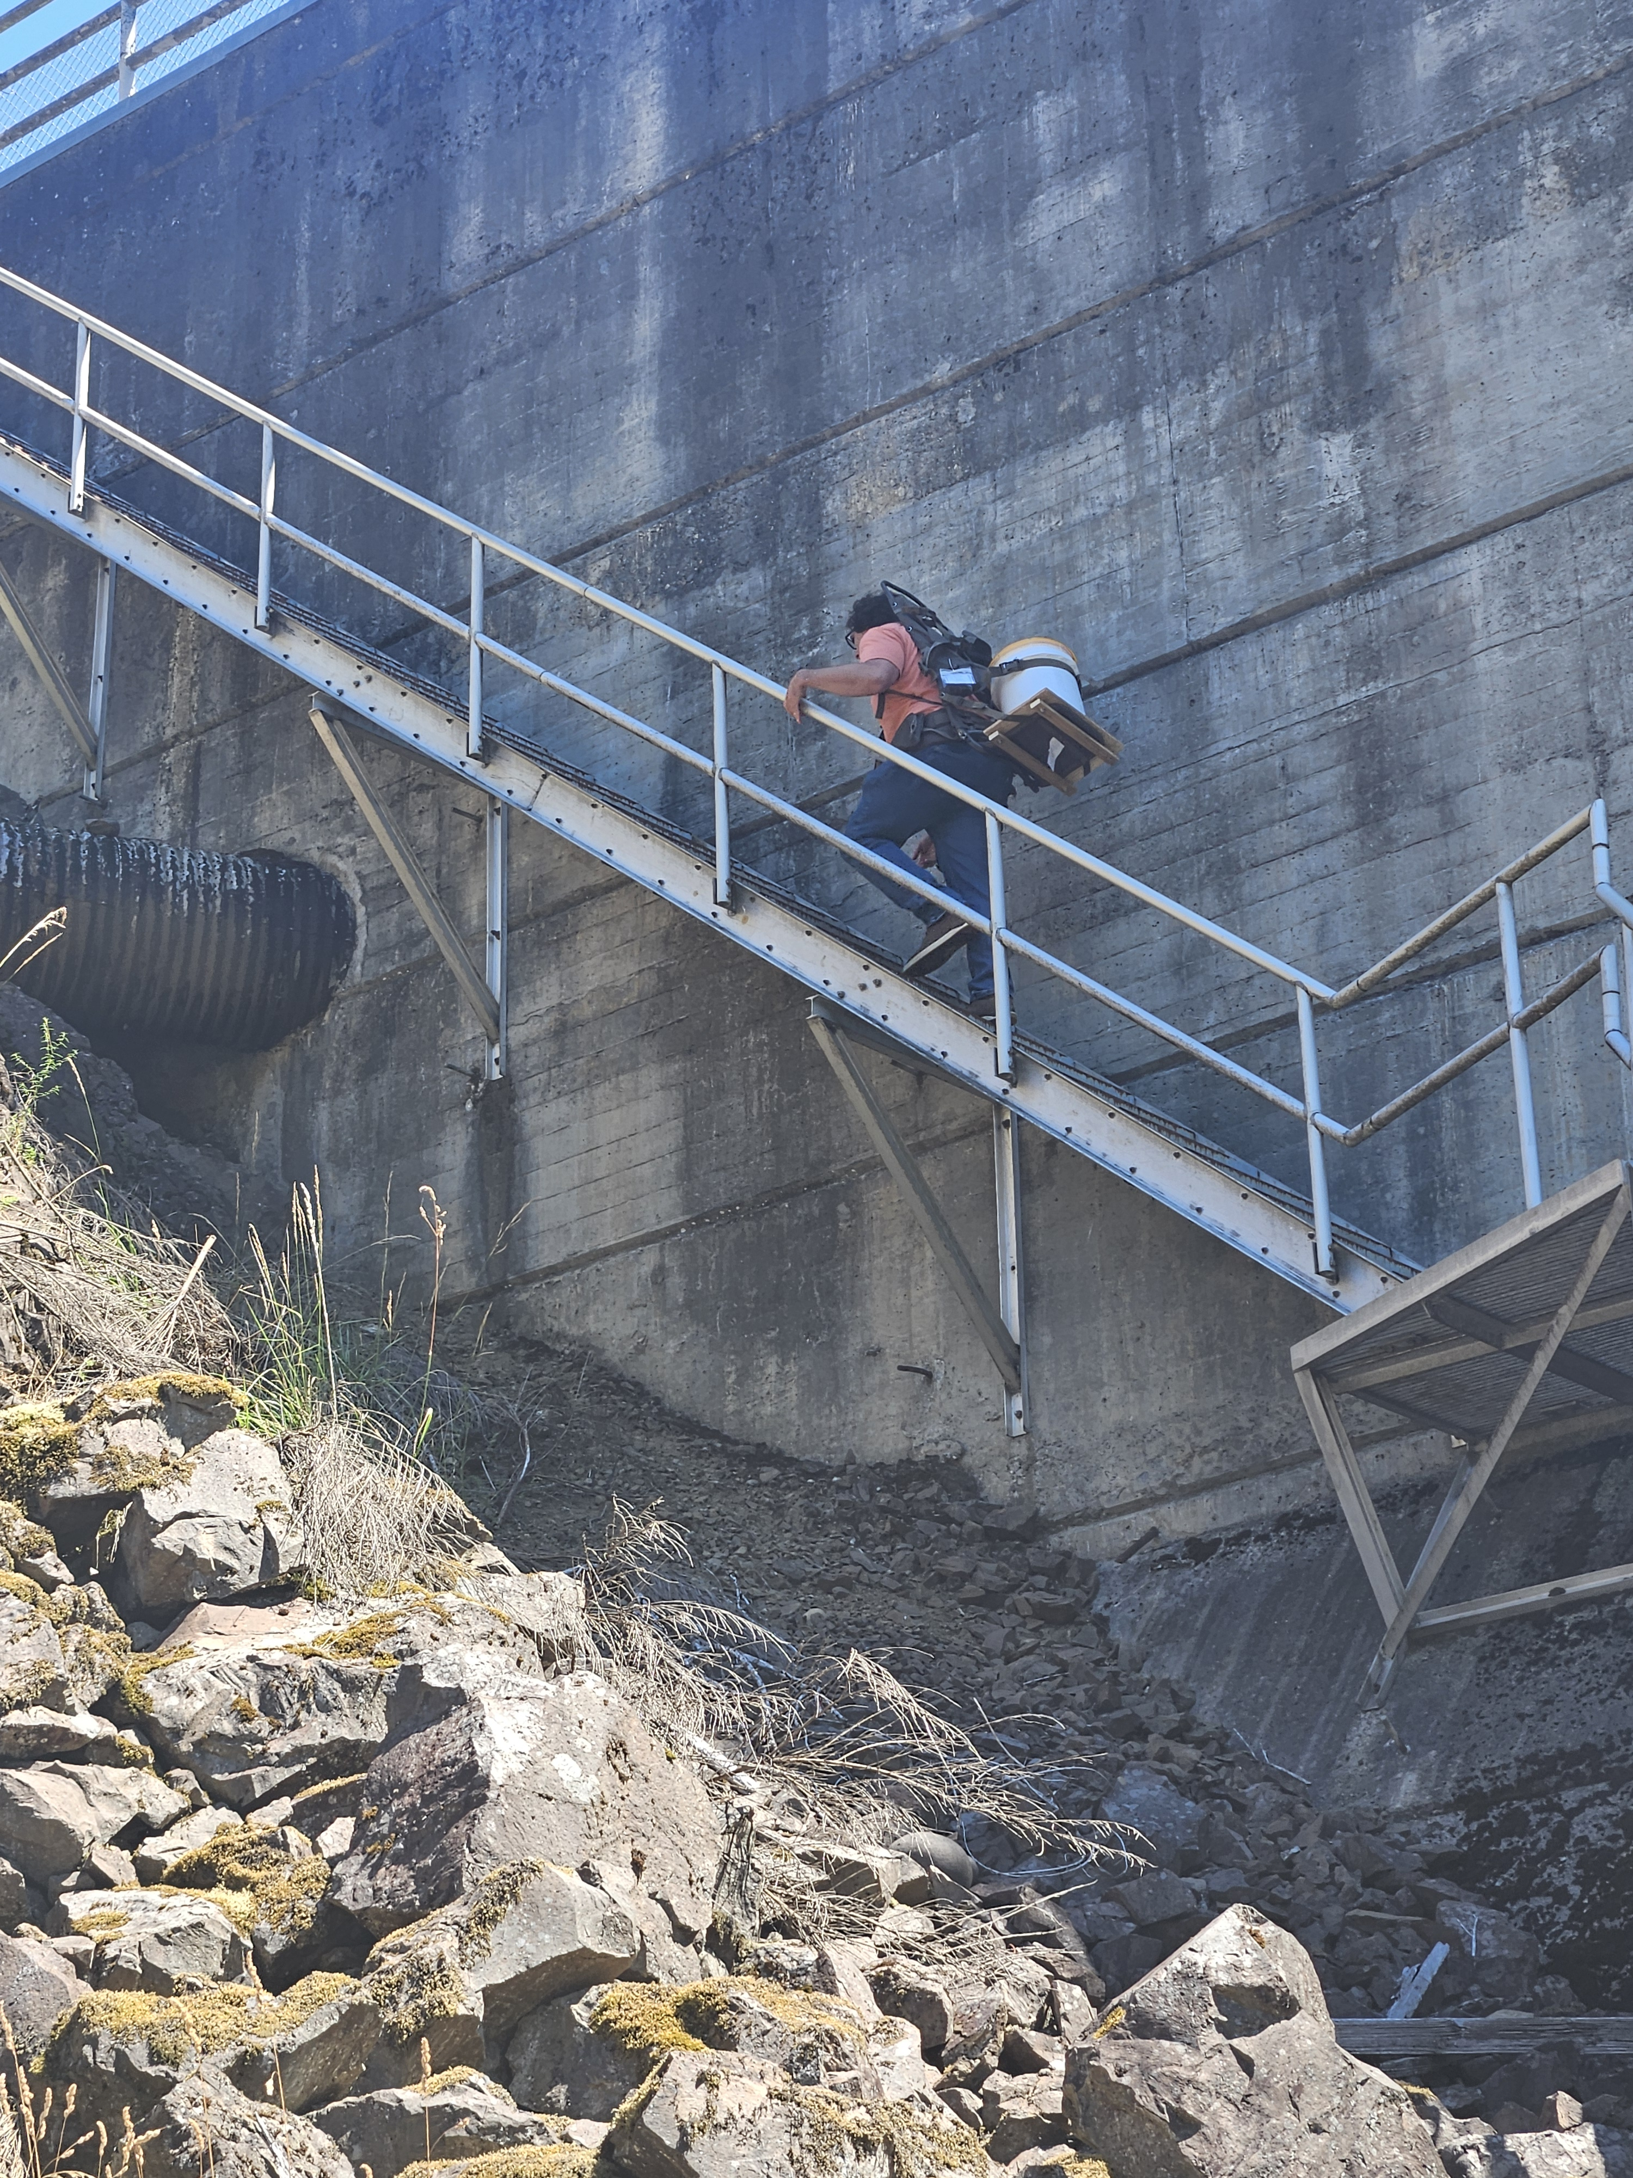
Methods I
PIT tag juvenile Chinook, hold for 24H recovery period, release directly into secondary separator
All Chinook encountered at the counting house after releases were scanned for PIT tags
All Chinook mortalities were also scanned
Both subyearlings and yearlings used to represent outmigration of fish
Many more subyearlings than yearlings – typical of Tilton origin Fall Chinook

Slide 7
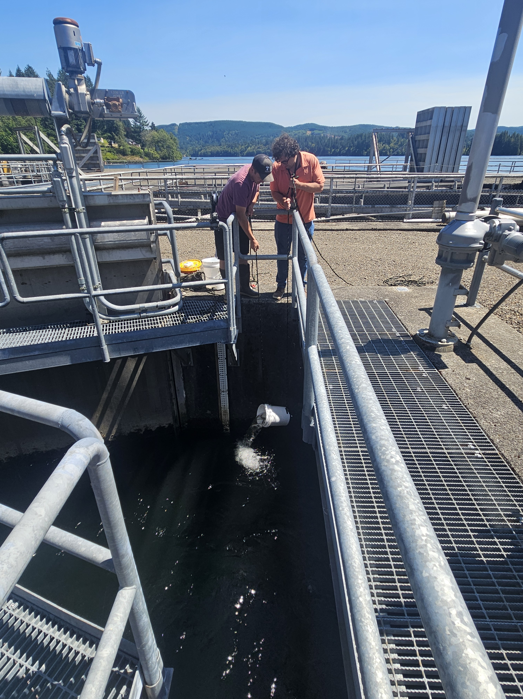
Methods II
Tag and release two groups of 60 fish directly into the secondary separator per week:
Control (1 hour before drawdown operation)
1 day, 2 days, or 5 days before drawdown, assigned randomly once per week

Slide 8
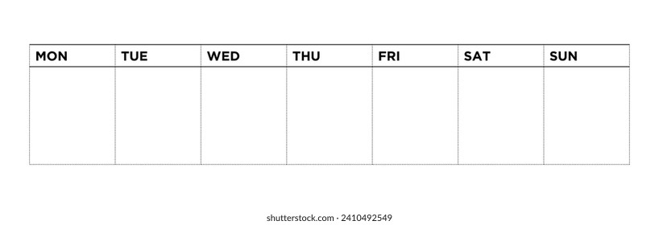
5 Day Release
1 Day Release
Control
Release
Drawdown
Drawdown
2 Day Release

Slide 9
Methods III
Also collect data on environmental and operational covariates
Hydrolab DS5 directly in secondary separator
SEEQ – established data collection for operational data
Pathology data gathered for out-migrating fish – already gathered
Data on other species within the separator
Covariates Made Available to Models
Release Type
Condition Factor
DO
Temperature
Flow
Tubidity
Residence Time
Lifestage
Density of Chinook at release
Density of Chinook at recapture
Density of Predators at release
Density of Predators at Recapture
Weekly Average of Parasite Load

Slide 10
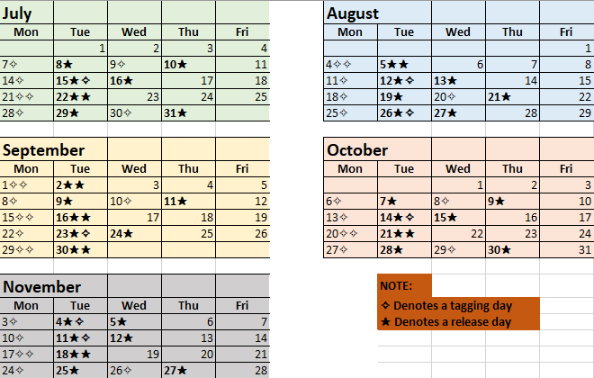
Methods IV
Planned for July – November
However, there was a drop-off of Chinook in October and sample size became too low to continue tagging
Continued scanning of fish until December, when spill event caused a need to move water quality SONDE for TDG monitoring in the tailrace

Slide 11
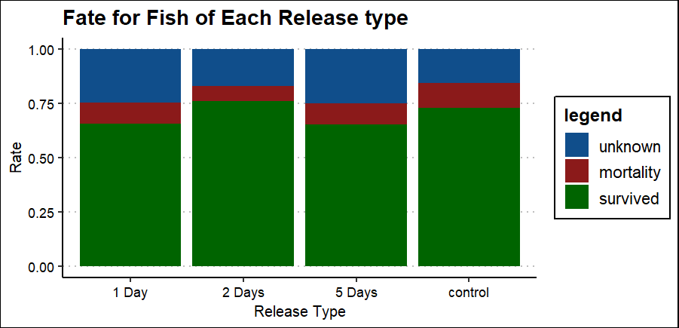
Results I

Slide 12
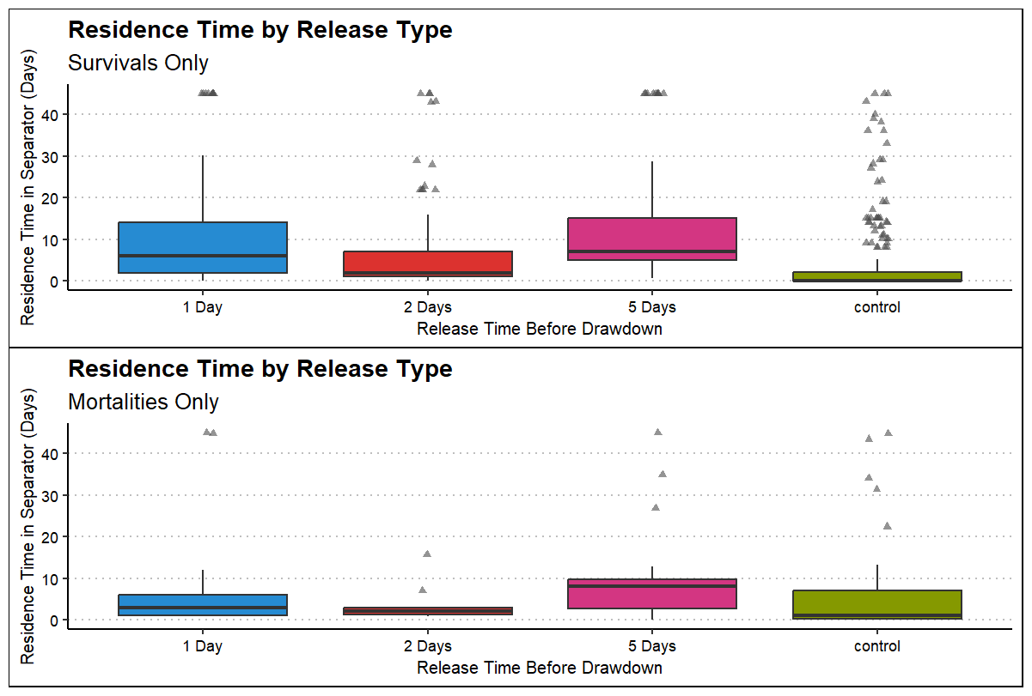
Results II
n = 823
n = 116

Slide 13
Results III
Three models:
Multinomial model of fates with unknowns included
Binomial model of fates with unknowns removed
Linear model of “residence time”
Models allowed access to all available covariates, then reduced using a stepwise approach. Best models compared with AIC

Slide 14
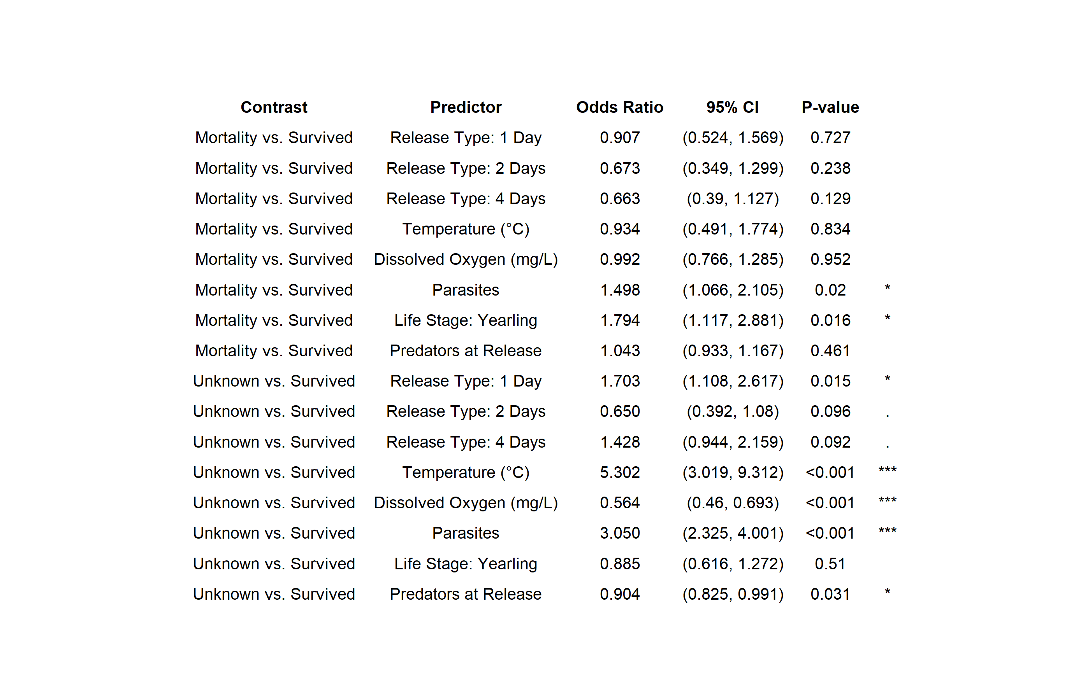
Fate Model – With Unknown Fish
Significant predictors: Release type, Temperature, DO, Average Weekly Parasites, Lifestage, and predators at release
McFaddens
Psuedo R² = 0.086

Slide 15
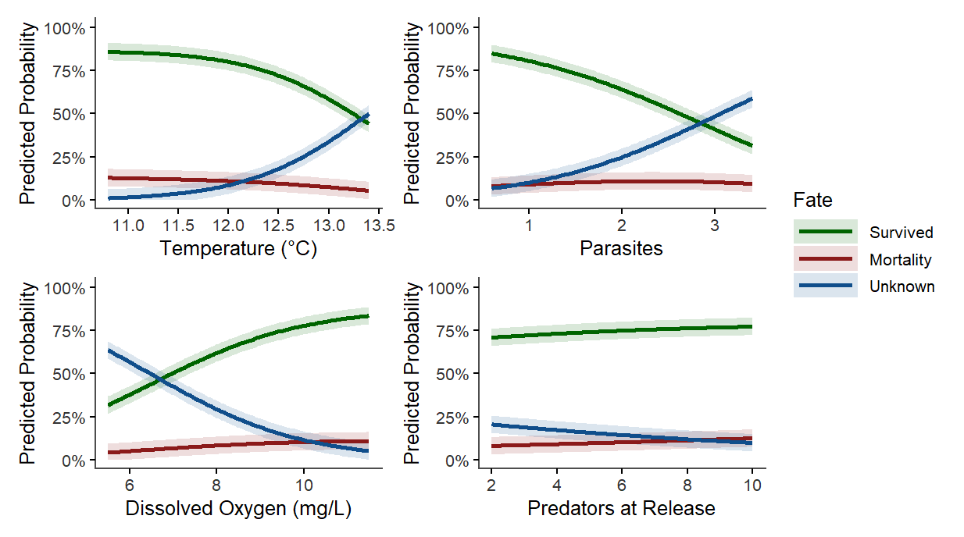
Fate Model – With Unknown Fish

Slide 16
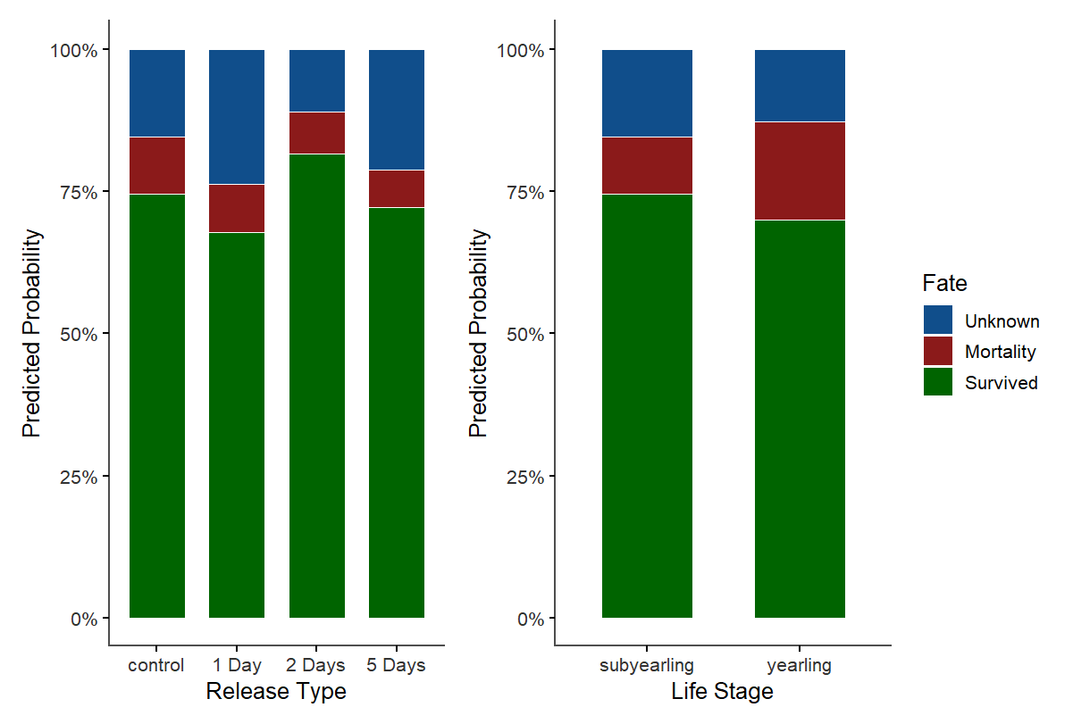
Fate Model – With Unknown Fish

Slide 17
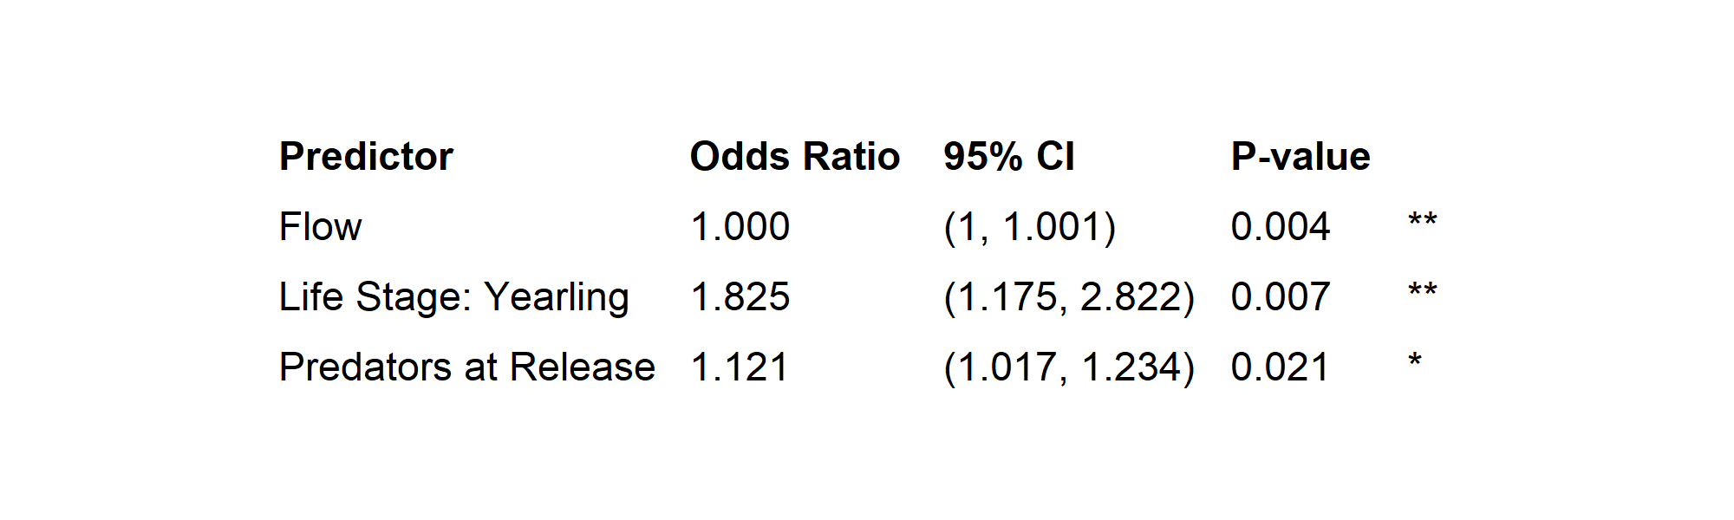
Fate Model – Without Unknowns
Limiting to only mortalities and survivals significantly simplified the model:
It is interesting to note: this eliminated release type from the model, ie time before drawdown at release is not a significant predictor for survival vs mortality
Nagelkerke
Psuedo R² = 0.054

Slide 18
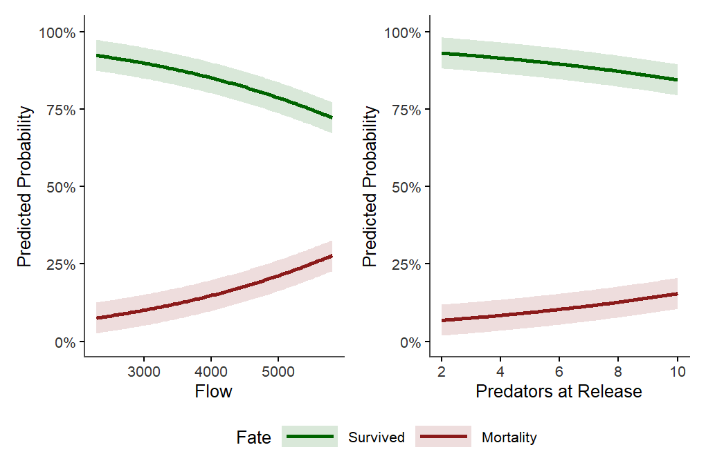
Fate Model – Without Unknowns

Slide 19
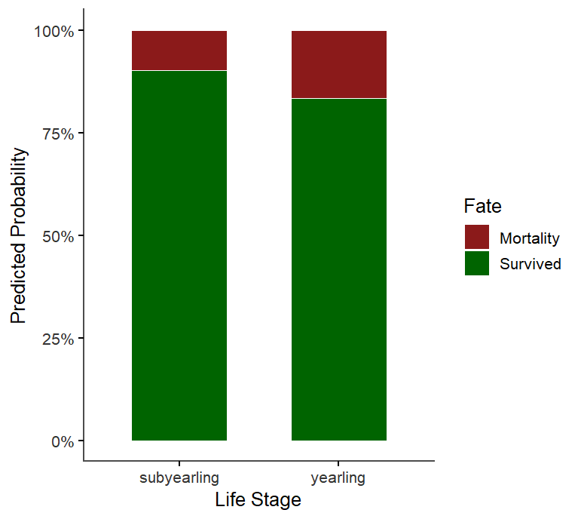
Fate Model – Without Unknowns

Slide 20
Discussion I
When unknowns considered in the fate model – many covariates are significant
When unknowns are removed, significantly less predictors
Worth noting – ~70% survival for all release groups
Both models had low predictive ability (low pseudo R²) so definitely other factors affecting fate
With Unknowns:
McFaddens R² = 0.086
Without Unknowns:
Nagelkerke R² = 0.054

Slide 21
Discussion II
Previous study – residence time in the secondary separator = significant predictor of mortality for juvenile chinook
TPU has been drawing down the separator since 2016 in an effort to reduce residence time
No difference among time intervals between drawdowns for survival (control - 5 days)
Indicates that the current drawdown cadence may be adequate for optimizing survival in the system

Slide 22
Discussion III
Unknowns represented ~ 20% of all fish tagged for this study
Potential fates – tag shed, predations, non-detections, potential outmigration from system
No significant number of tag sheds were observed in 24H post tagging holding
Testing of detection system did not indicate significant non-detections
Outmigration from system unlikely – significant velocities of water from the pipes leading into the separator, and long travel time
Predators are present in the system – potential for impact!

Slide 23
Discussion IV
Future studies will need to address predation in a meaningful way – direct study on predation rates on juvenile chinook, or scanning predators
Additional PIT attenaes would also be useful – particularly one downstream of the separator, but upstream of the counting house to avoid biasing residence time results

Slide 24
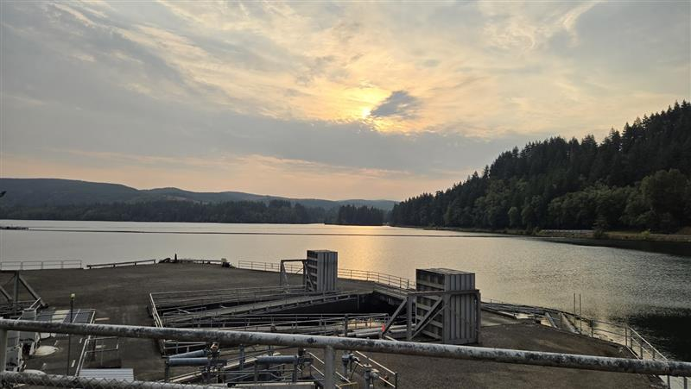
Questions? Comments? Concerns?
Thank you for your time!

