Slide 1
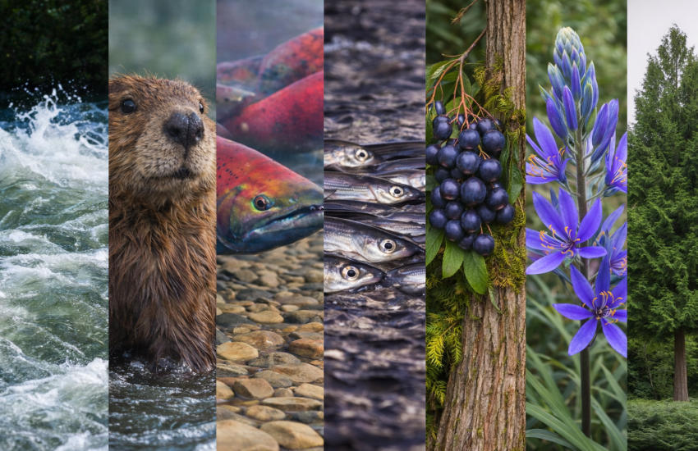
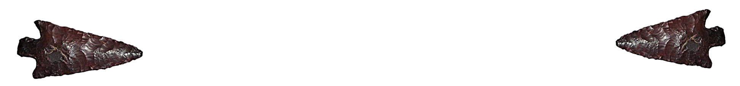
Cowlitz Science Conference
Cultural Resources and the Cowlitz River Basin
Presented by Dylan Henderson, M.A., and Sina Stennes, B.A.
Tacoma Public Utilities
April 22, 2026
Notes:
Introduction –Dylan Dylan – archaeologist, Tacoma Power’s Cultural Resource Coordinator, Sina – archaeologist, Tacoma Power, NR field tech

Slide 2
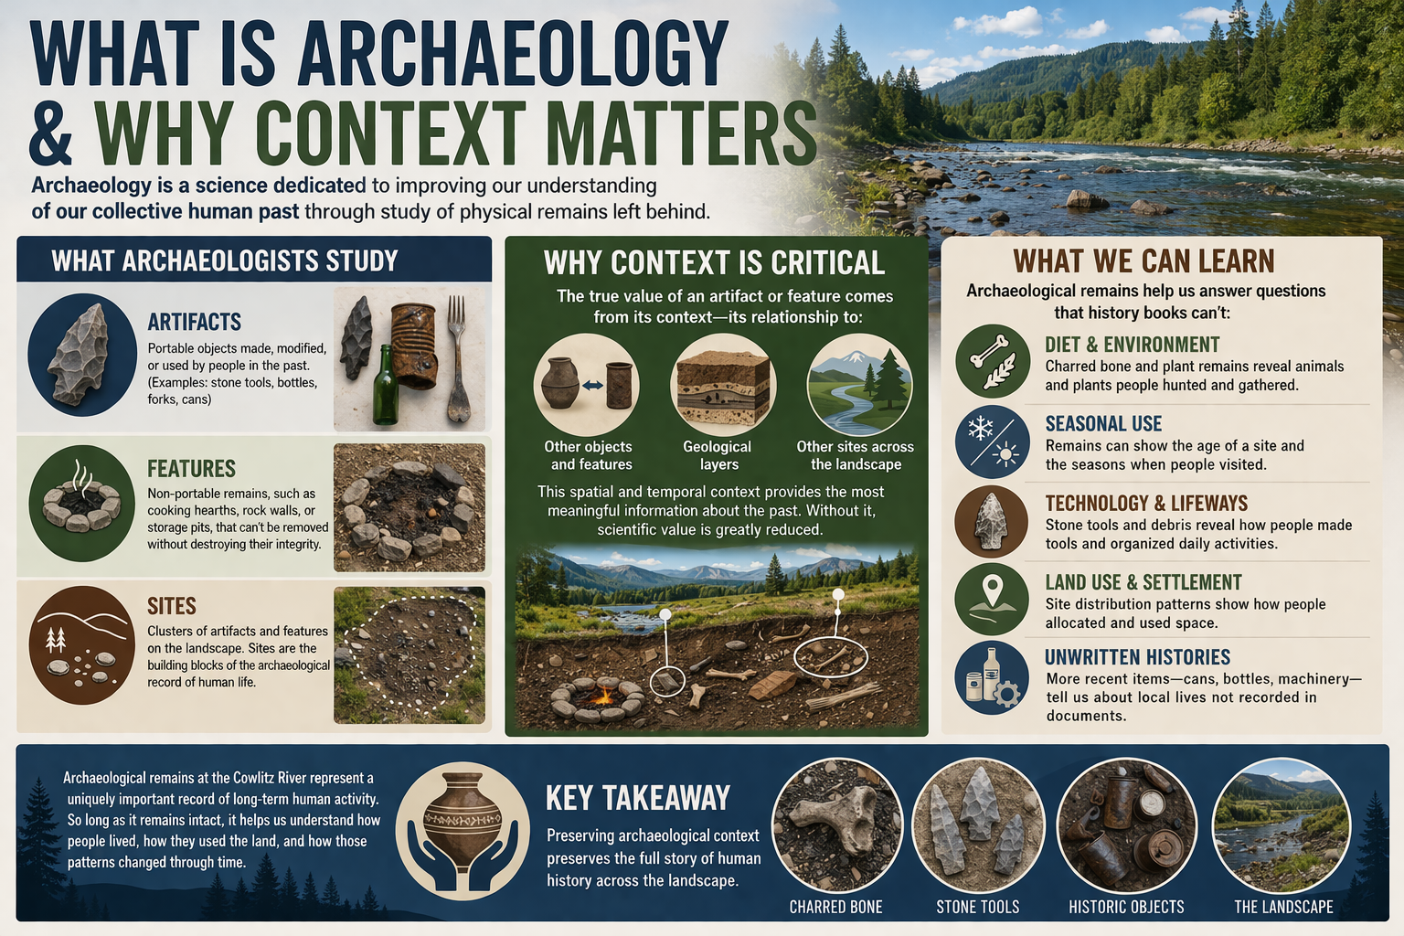
Notes:
-Sina - Archaeology is the study of the human past through the material culture that is left behind. On the Cowlitz, we study artifacts, features, and other artifact clusters known as sites, their spatial and temporal context provides critical information about the past. Through archaeological investigation, we learn a great deal about lifeways, technology, seasonal use patterns, land use and settlements, and unwritten histories. Preserving archaeological context preserves the story of human history across the landscape. Passing it back to Dylan to share what we do as archaeologists at Tacoma Public Utilities.

Slide 3

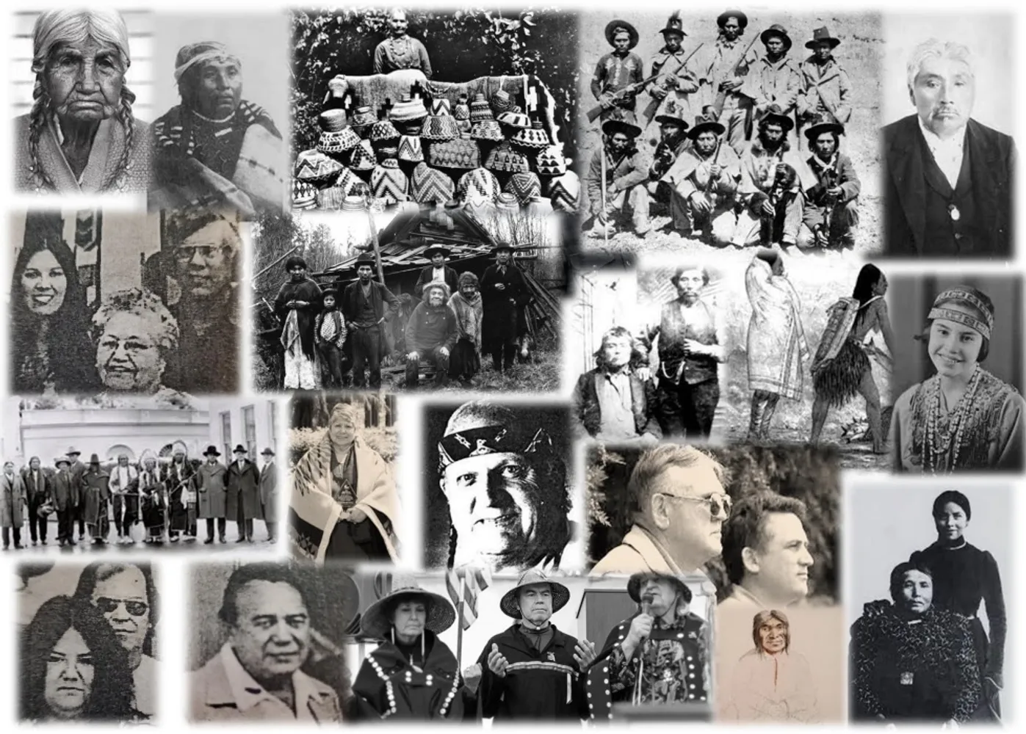
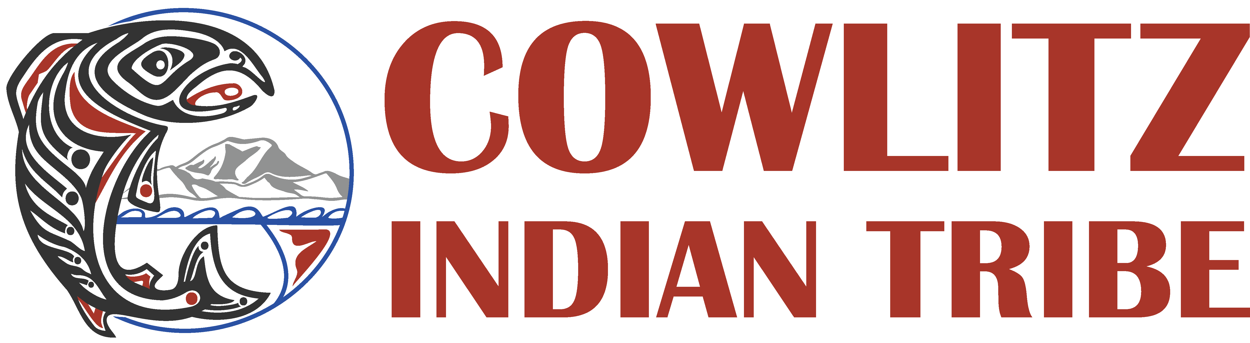
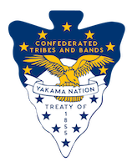
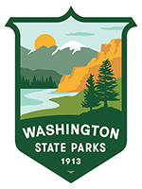
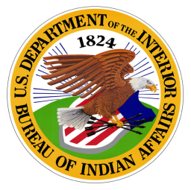
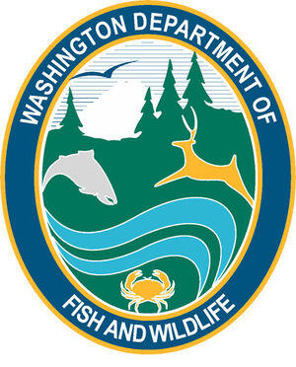
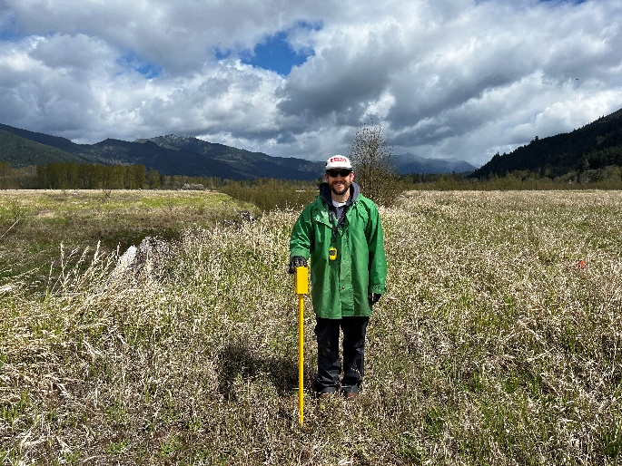
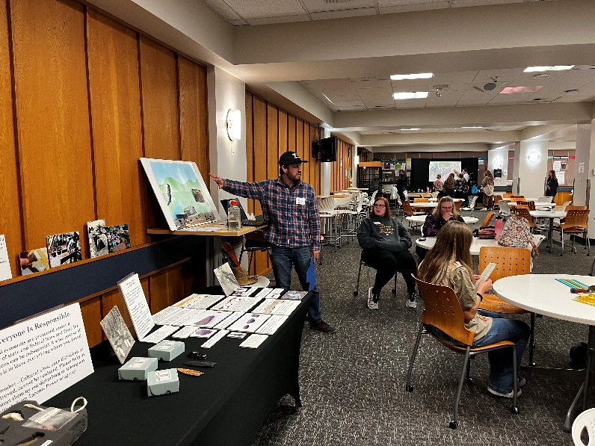
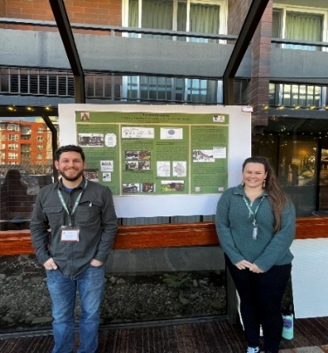
What do TPU’s Archaeologists do?
Regulatory Compliance
Project Evaluations
Field Surveys and Monitoring
Mitigation Strategies
Consultation
Historic Preservation
Notes:
Dylan - Archaeologists are essential on FERC-licensed projects to ensure compliance under the National Historic Preservation Act of 1966. Specifically, Section 106 mandates that federal project that have the potential to impact on historical, cultural, and tribal resources are identified, evaluated, and mitigated. Tacoma Power’s cultural resource team consults with State, Federal, & tribal agencies as project impacts are identified and evaluated. To better understand this, we’re going to better understand how people arrived and flourished in the America’s .

Slide 4
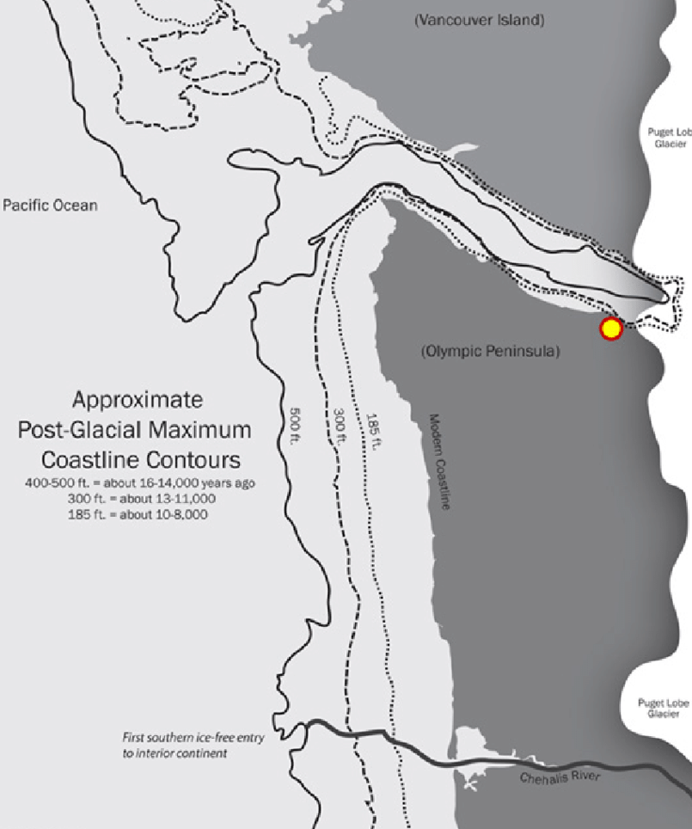
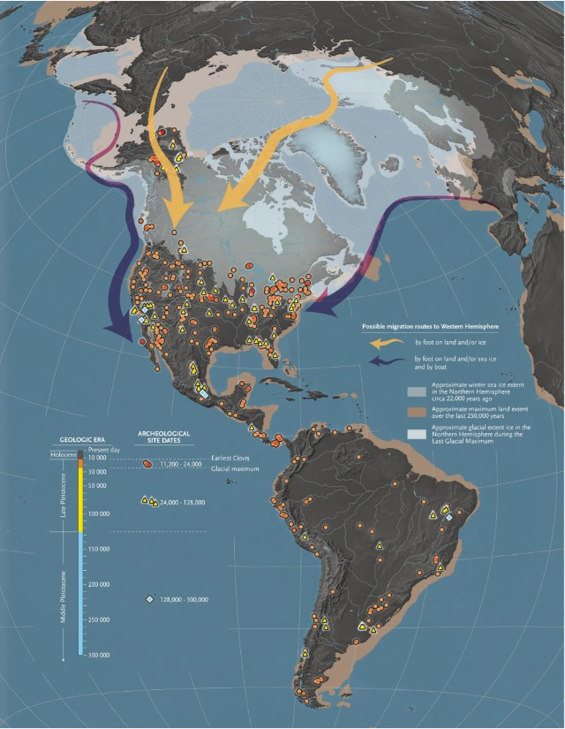

Cowlitz Basin 17,000 – 12,500 (YBP)
Peopling of the Americas
Glacial Retreat + Missoula Flood effects = river system reset
Notes:
To understand fisheries here, we want to share how the river itself formed. During the late Pleistocene, alpine glaciers filled the valleys of the upper basin. The image on the left is a depiction of ice sheets receding, showing much larger costliness, resulting in dramatically reshaped valleys with outwash sands and gravels being deposited across the basin. The rivers reworked the deposits into alluvial terraces and floodplains, creating gravel beds, which are ideal spawning habitat for salmonids. These geomorphic events shaped the Cowlitz River Basin as a foundation for the future cultural fisheries landscape. As access is opening along the coast, the image on the right depicts possible routes that the earliest hunter-gatherer humans could have taken to reach the coastal and interior north and central landmass via the Beringia land bridge. Back to the image on the left, the post-glacial maximum coastlines show the Chehalis River mouth outline in green, draining the melting Puget Lobe Glacier, forming interior Lake Russell. The red and yellow dots show the location of the Manis mastodon site, which dates the hunting of mastodons to 13,800 years ago. These were the pre-Clovis and Clovis peoples. This was also during the time period that the Missoula flood was carving out the Columbia River gorge and much of eastern Travis. Idaho and Montana.

Slide 5
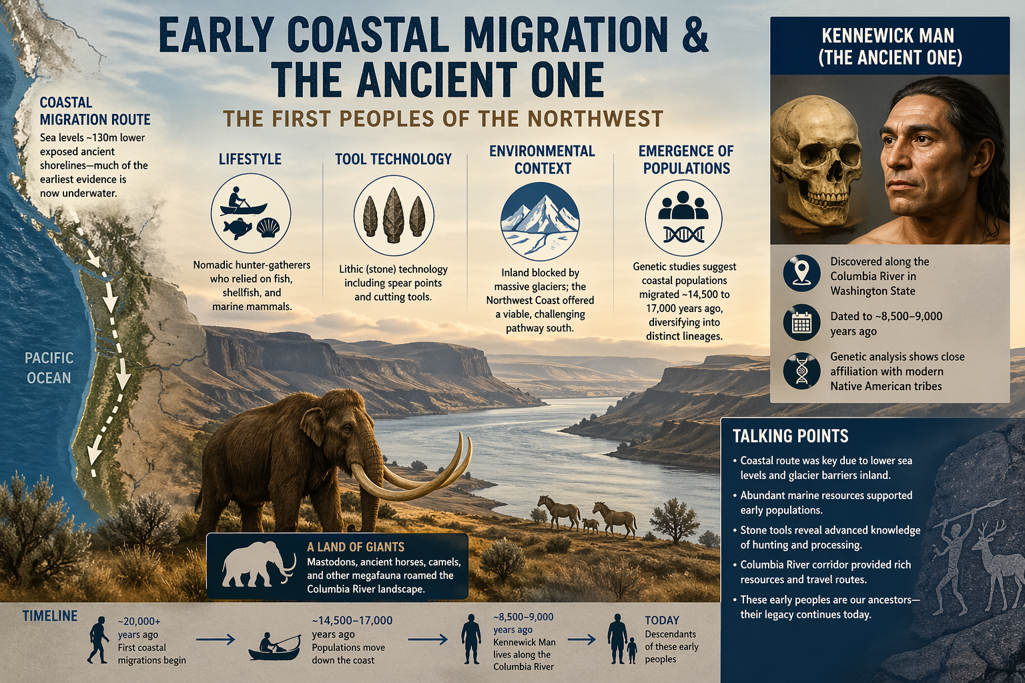
Cowlitz Basin *time period*
Notes:
Dylan- 10,000 – Mid-1800’s summary about people on the landscape transitioning from highly mobile -nomadic hunter-gatherer social groups chasing the megafauna, like the mammoths, giant sloths, and giant horse to as the landscape changes, reduction in those large land mammals’ changes, to smaller more the social -reginal groups started to mobilize into smaller areas, more people, more resources, etc. This coincides with increased populations of salmon, elk, deer, buffalo, and other game.

Slide 6
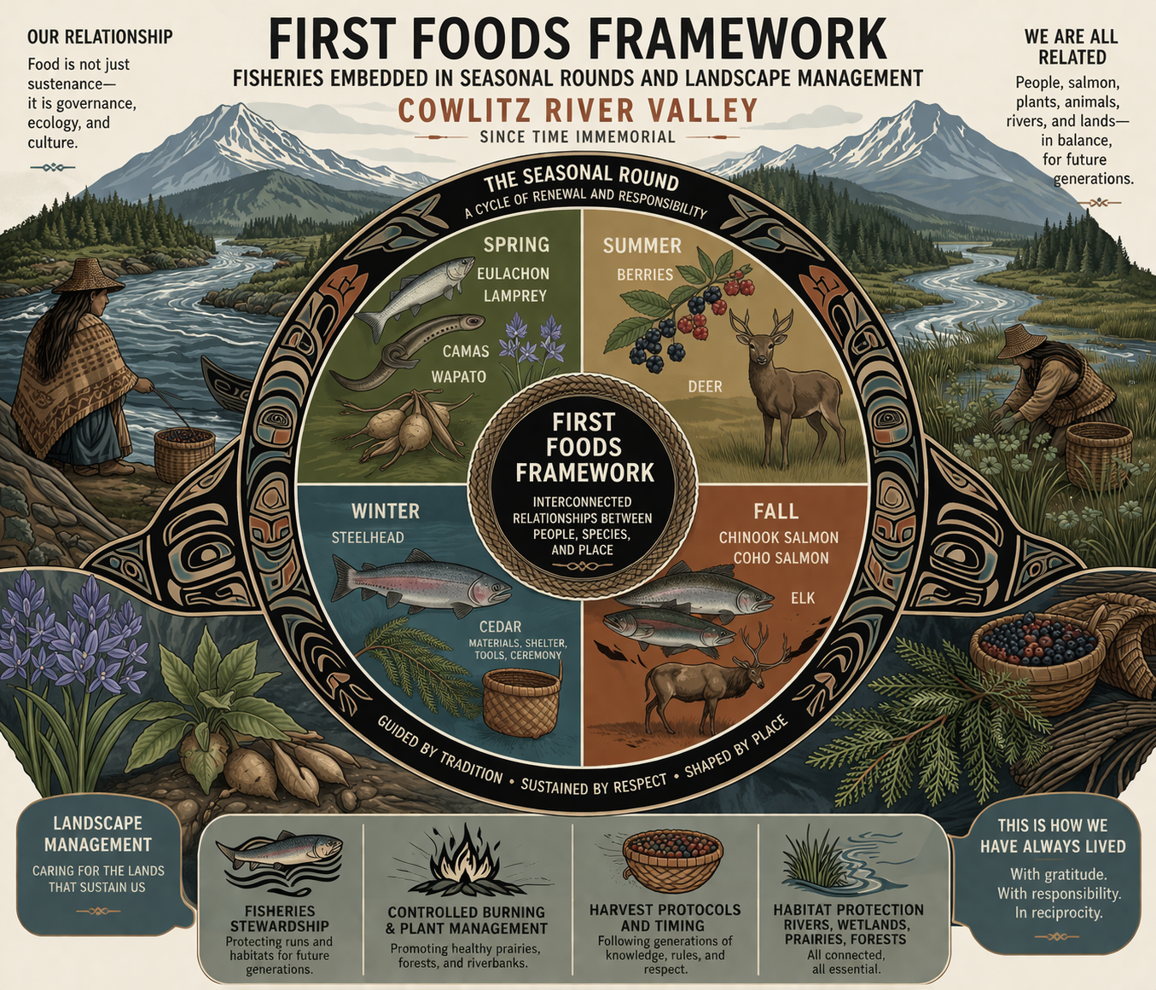
Notes:
Dylan - With humans on the landscape and abundant resources to fuel their bodies, we start to see how people become highly adapted to the environment, they would move around the seasonal “clock” for resource gathering and develop social and ceremonial patterns and a culture based on these resources. Pre-contact villages were located along tributaries where rivers provided transportation, food resources, and materials.

Slide 7
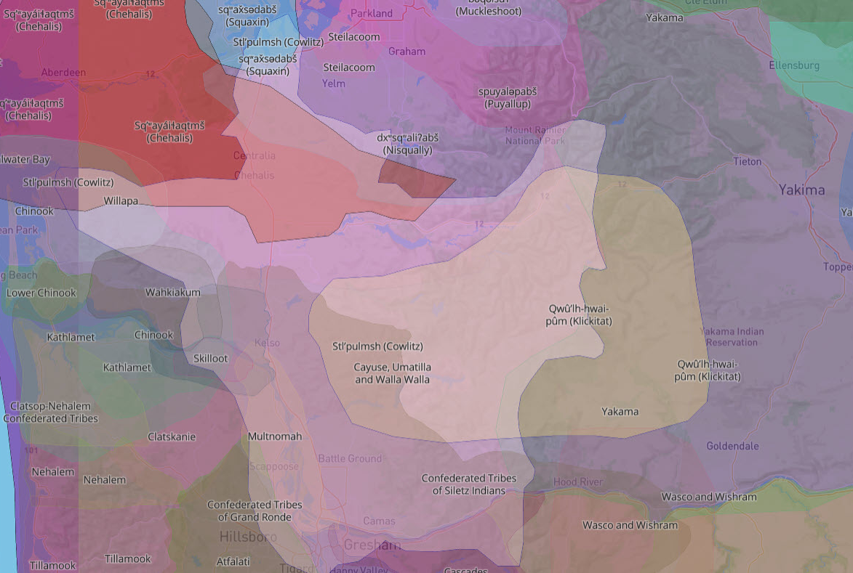








Stl’pulmsh (Cowlitz) Territory Map
Kwalhiokwa Cowlitz (Mountain Cowlitz)
Upper Cowlitz
Lower Cowlitz
Lewis River Cowlitz
https://native-land.ca/
Notes:
Sina- Here we see the Cowlitz land use area, outlined in yellow. Two additional groups, the Lewis River Cowlitz and Mountain Cowlitz spanned to the west and south of the Cowlitz River. This map was provided by Native Land Digital, an indigenous-led Canadian non-profit, with a mission map indigenous territories, treaties, and languages globally to support education, awareness, and research while respecting Indigenous data sovereignty with hopes to strengthen the spiritual bonds that people have with the land, its people, and its meaning. While the Cowlitz Indian Tribe is unified through geography, intermarriage, and customs, there are two main groups – the Taidnapam, or Upper Cowlitz, and the Lower Cowlitz.

Slide 8
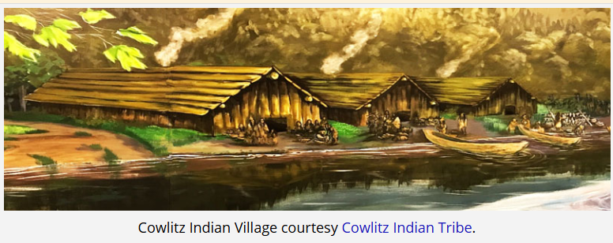
Cowlitz River Peoples
The Lower Cowlitz
*Coast Salish Speakers
The Upper Cowlitz (Taitnapam)
*Sahaptin Speakers
Cowlitz Indian Tribe
The Forever People
Notes:
Sina-: The Upper Cowlitz were known as mountain dwellers who lived in the upper meadows and prairies. They were adept at hunting mountain goats, skilled weavers, and their lineage shows patterns of intermarriage between Salish speaking Cowlitz and Sahaptin speaking Yakama, this group became known as the Taidnapaum, a bilingual ground within the upper Cowlitz. The Lower Cowlitz occupied 30-40+ villages along the Cowlitz River, from present-day Mossyrock to within a mile or two of the Columbia River, this group reflected Salish lifeways with stylized canoes, custom basket weaving, harvested lamprey and sturgeon, and were adept at river weirs and nets. In the winter, they lived in long-term residential structures along the river, with 20-50 people in one home, then in the spring, summer, fall people would move around the landscape, living in seasonal camps, to follow the seasonal resource harvests.

Slide 9
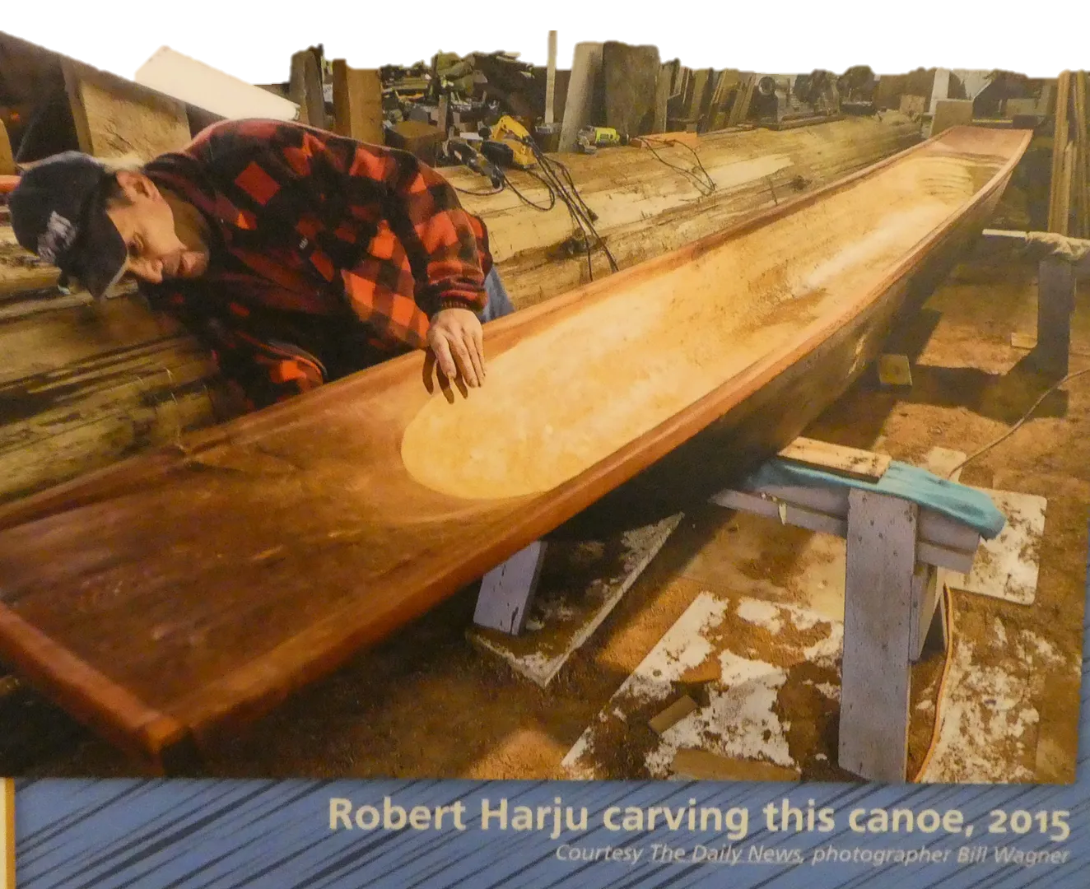
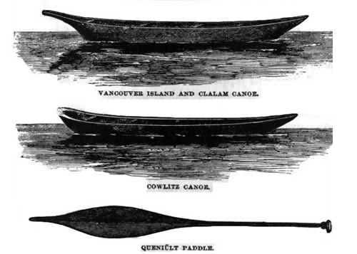
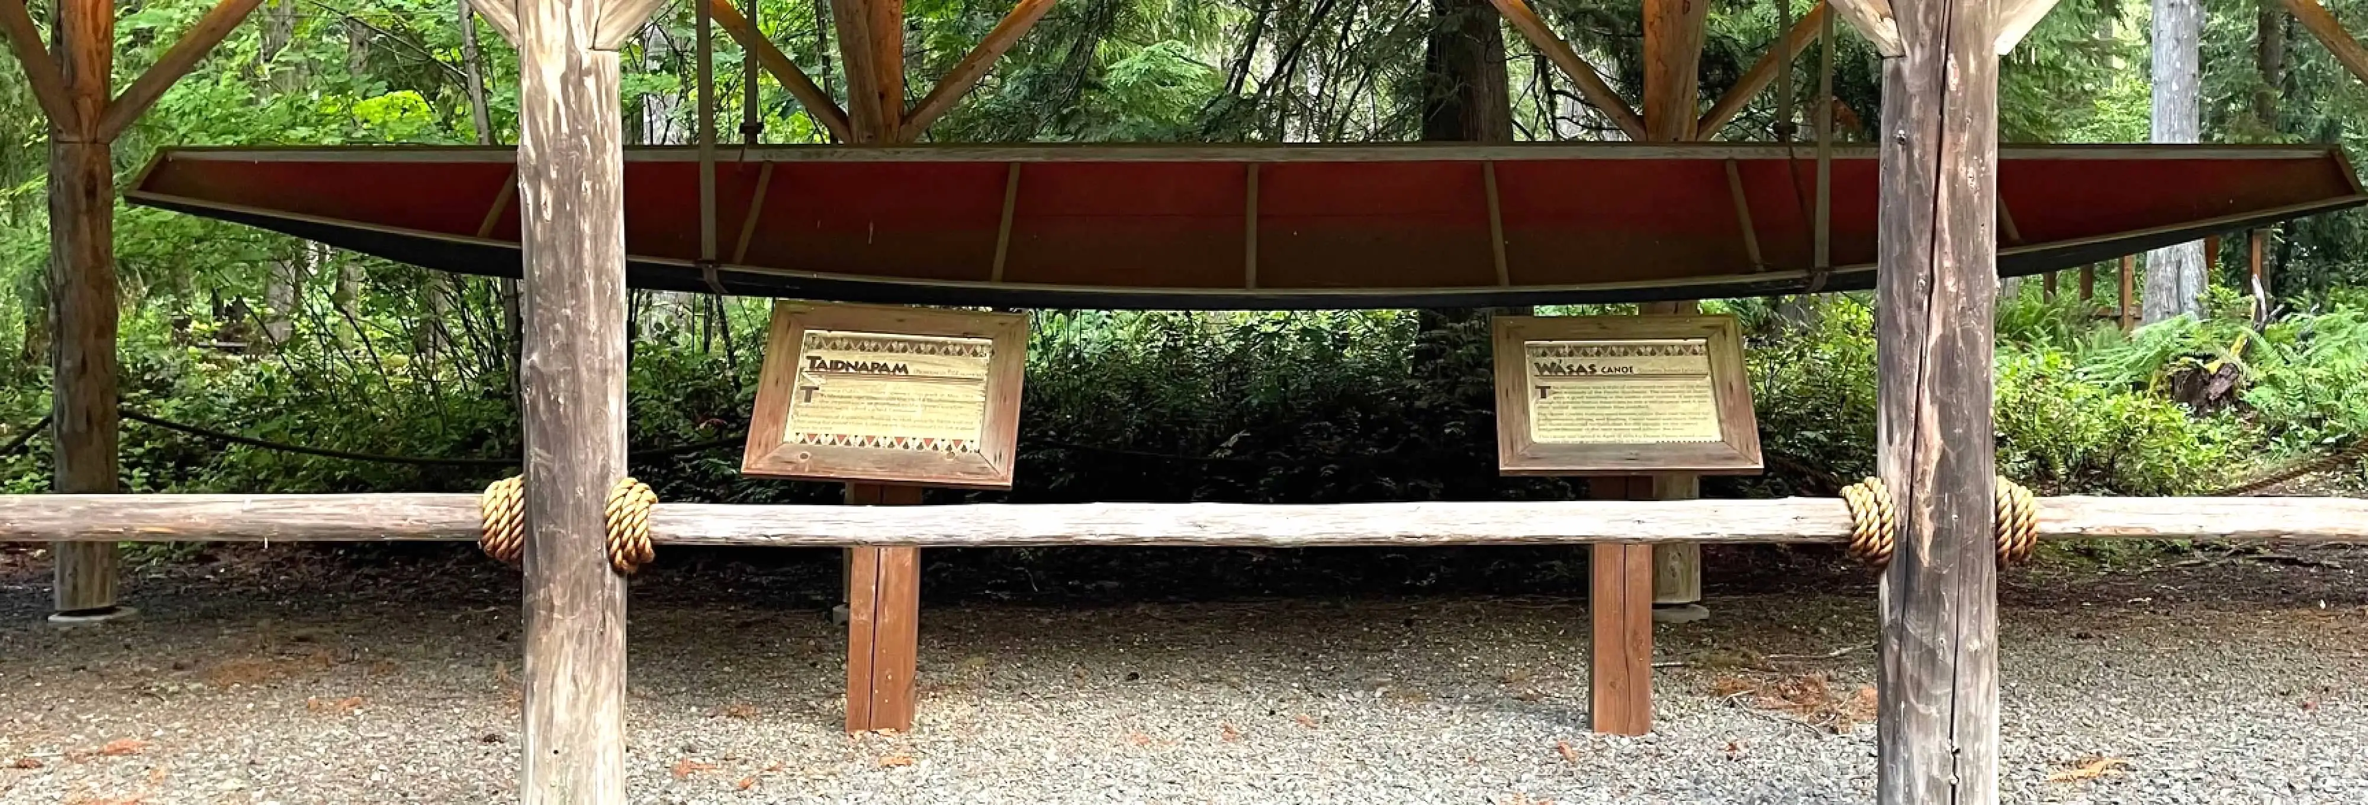
Early fishing techniques – river transportation
Notes:
-Sina-: One of the modes of transportation was their blunt-nosed canoe, designed for the diverse river system that was often tree-blocked and had rapids. The felled wester red cedar was shaped with stone tools and fire, the broad bow allowed better stability and for the use of both paddle and pole, to push themselves through the rapids because the river used to be deeper and much faster than now. The lower left photo is a replica canoe on display at Taidnapam Park.

Slide 10
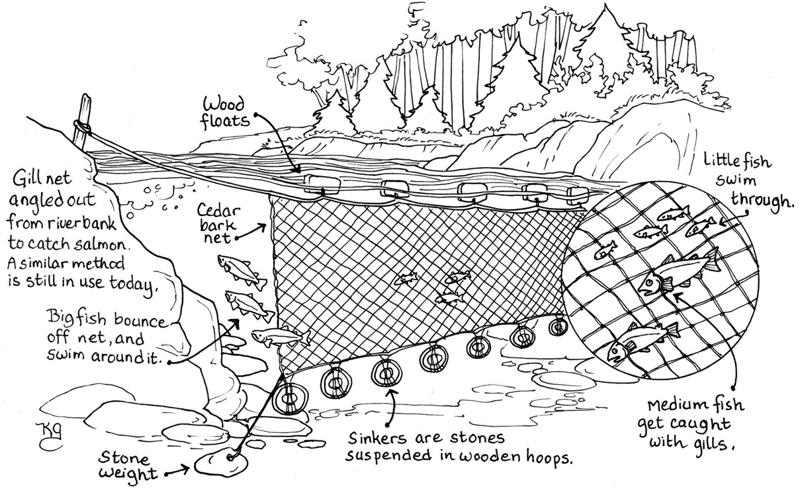
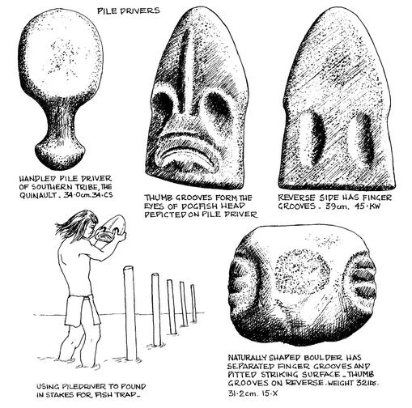
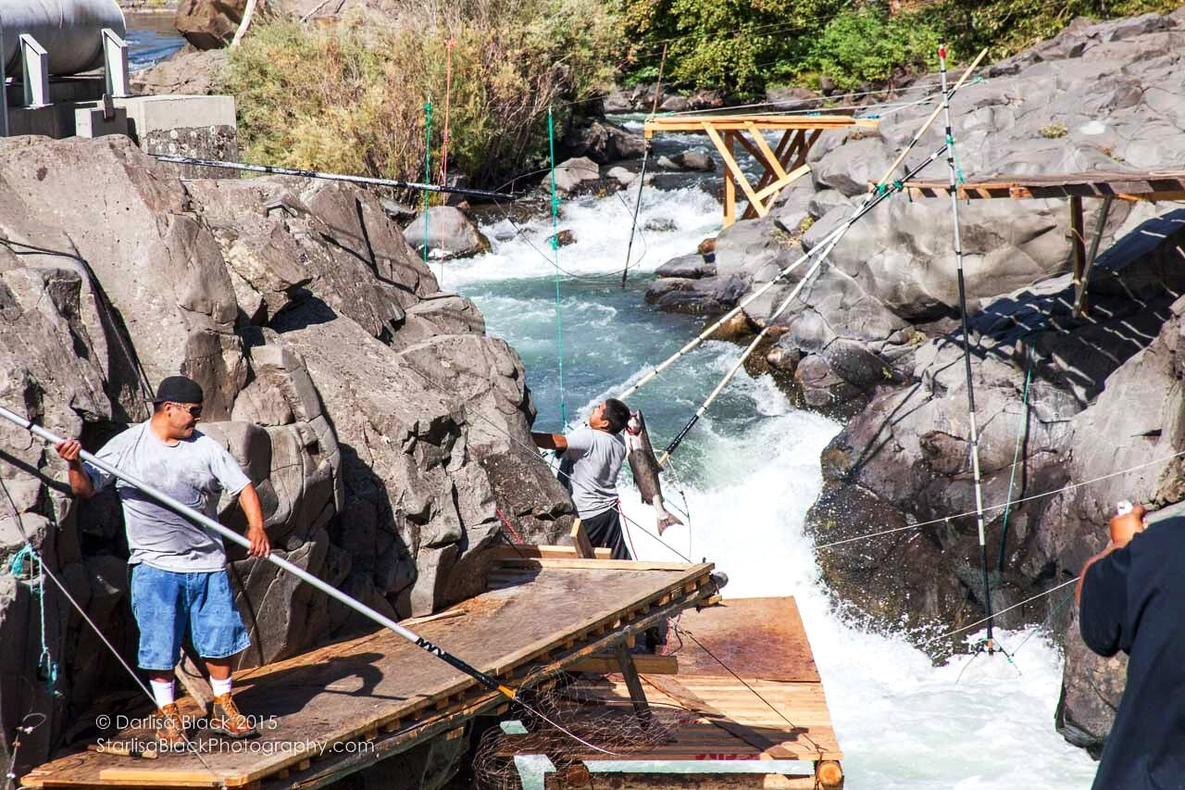
Early fishing techniques Dip Nets / Netting
Notes:
-Sina- With salmon as the tribe’s principle food, steelhead, eulachon and lamprey were also harvested and different harvesting techniques were employed. Here we see examples of dip nets and netting. Dip nets would be utilized at bedrock pinch points where returning fish concentrate and are easier to catch. River cobbles and shaped rock tools like net weights, choppers, wedges, hammers, pestles are part of the material culture we see in the archaeological record, as the net cordage would be made from cedar, nettles, sometimes hemp often didn’t preserve well.

Slide 11
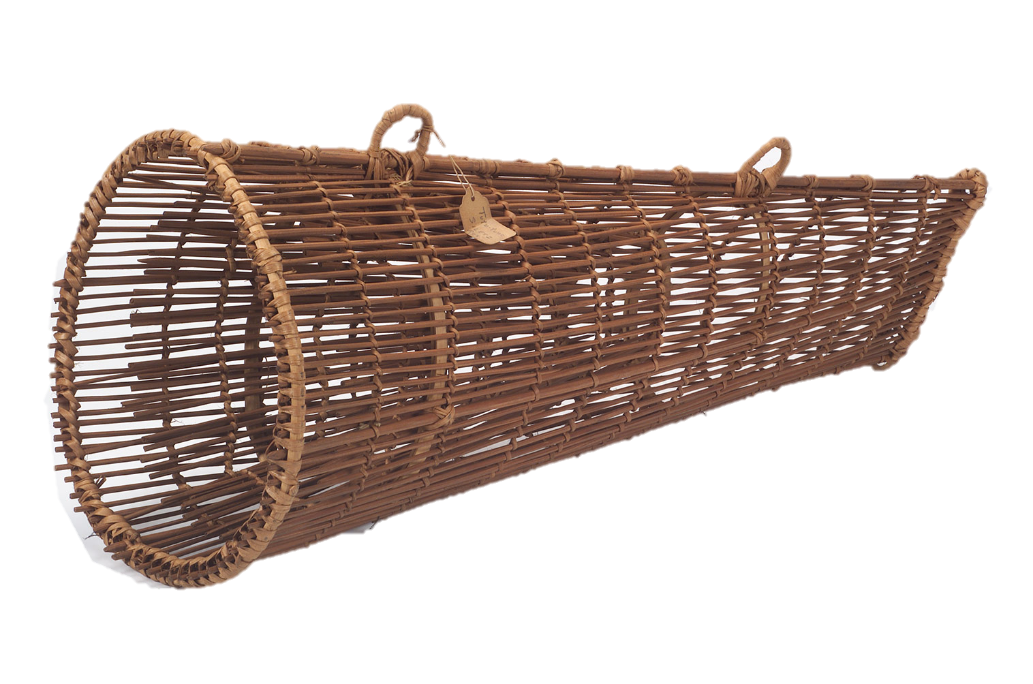
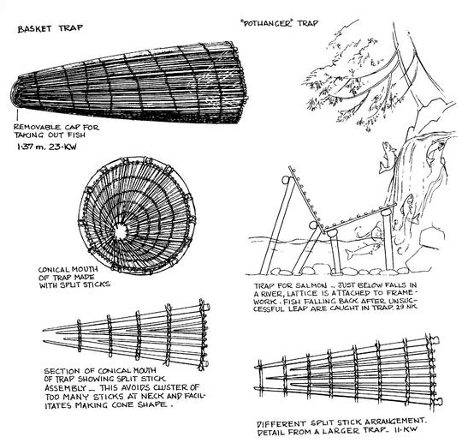
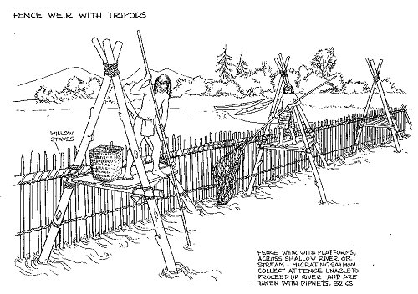
Early fishing techniques – in river harvest
Notes:
Sina- The last couple of harvesting tools would be the fishing weirs, basket traps, and the pothanger trap. Weirs were essential, using wooden stakes and netting to trap salmon for food, preservation, and inland trade. These fishing basket traps were woven from cedar strips in a cone shape that would capture fish as they moved against the current. The fish could enter easily, but couldn’t exit the trap. The pothanger trap, upper right, was a wooden lattice structure that would catch salmon as they attempted to migrate upstream; those that didn’t make it would fall back and be trapped on the framework below. These types of traps would allow for selective harvest with the ability to release what wasn’t needed or was too small.

Slide 12
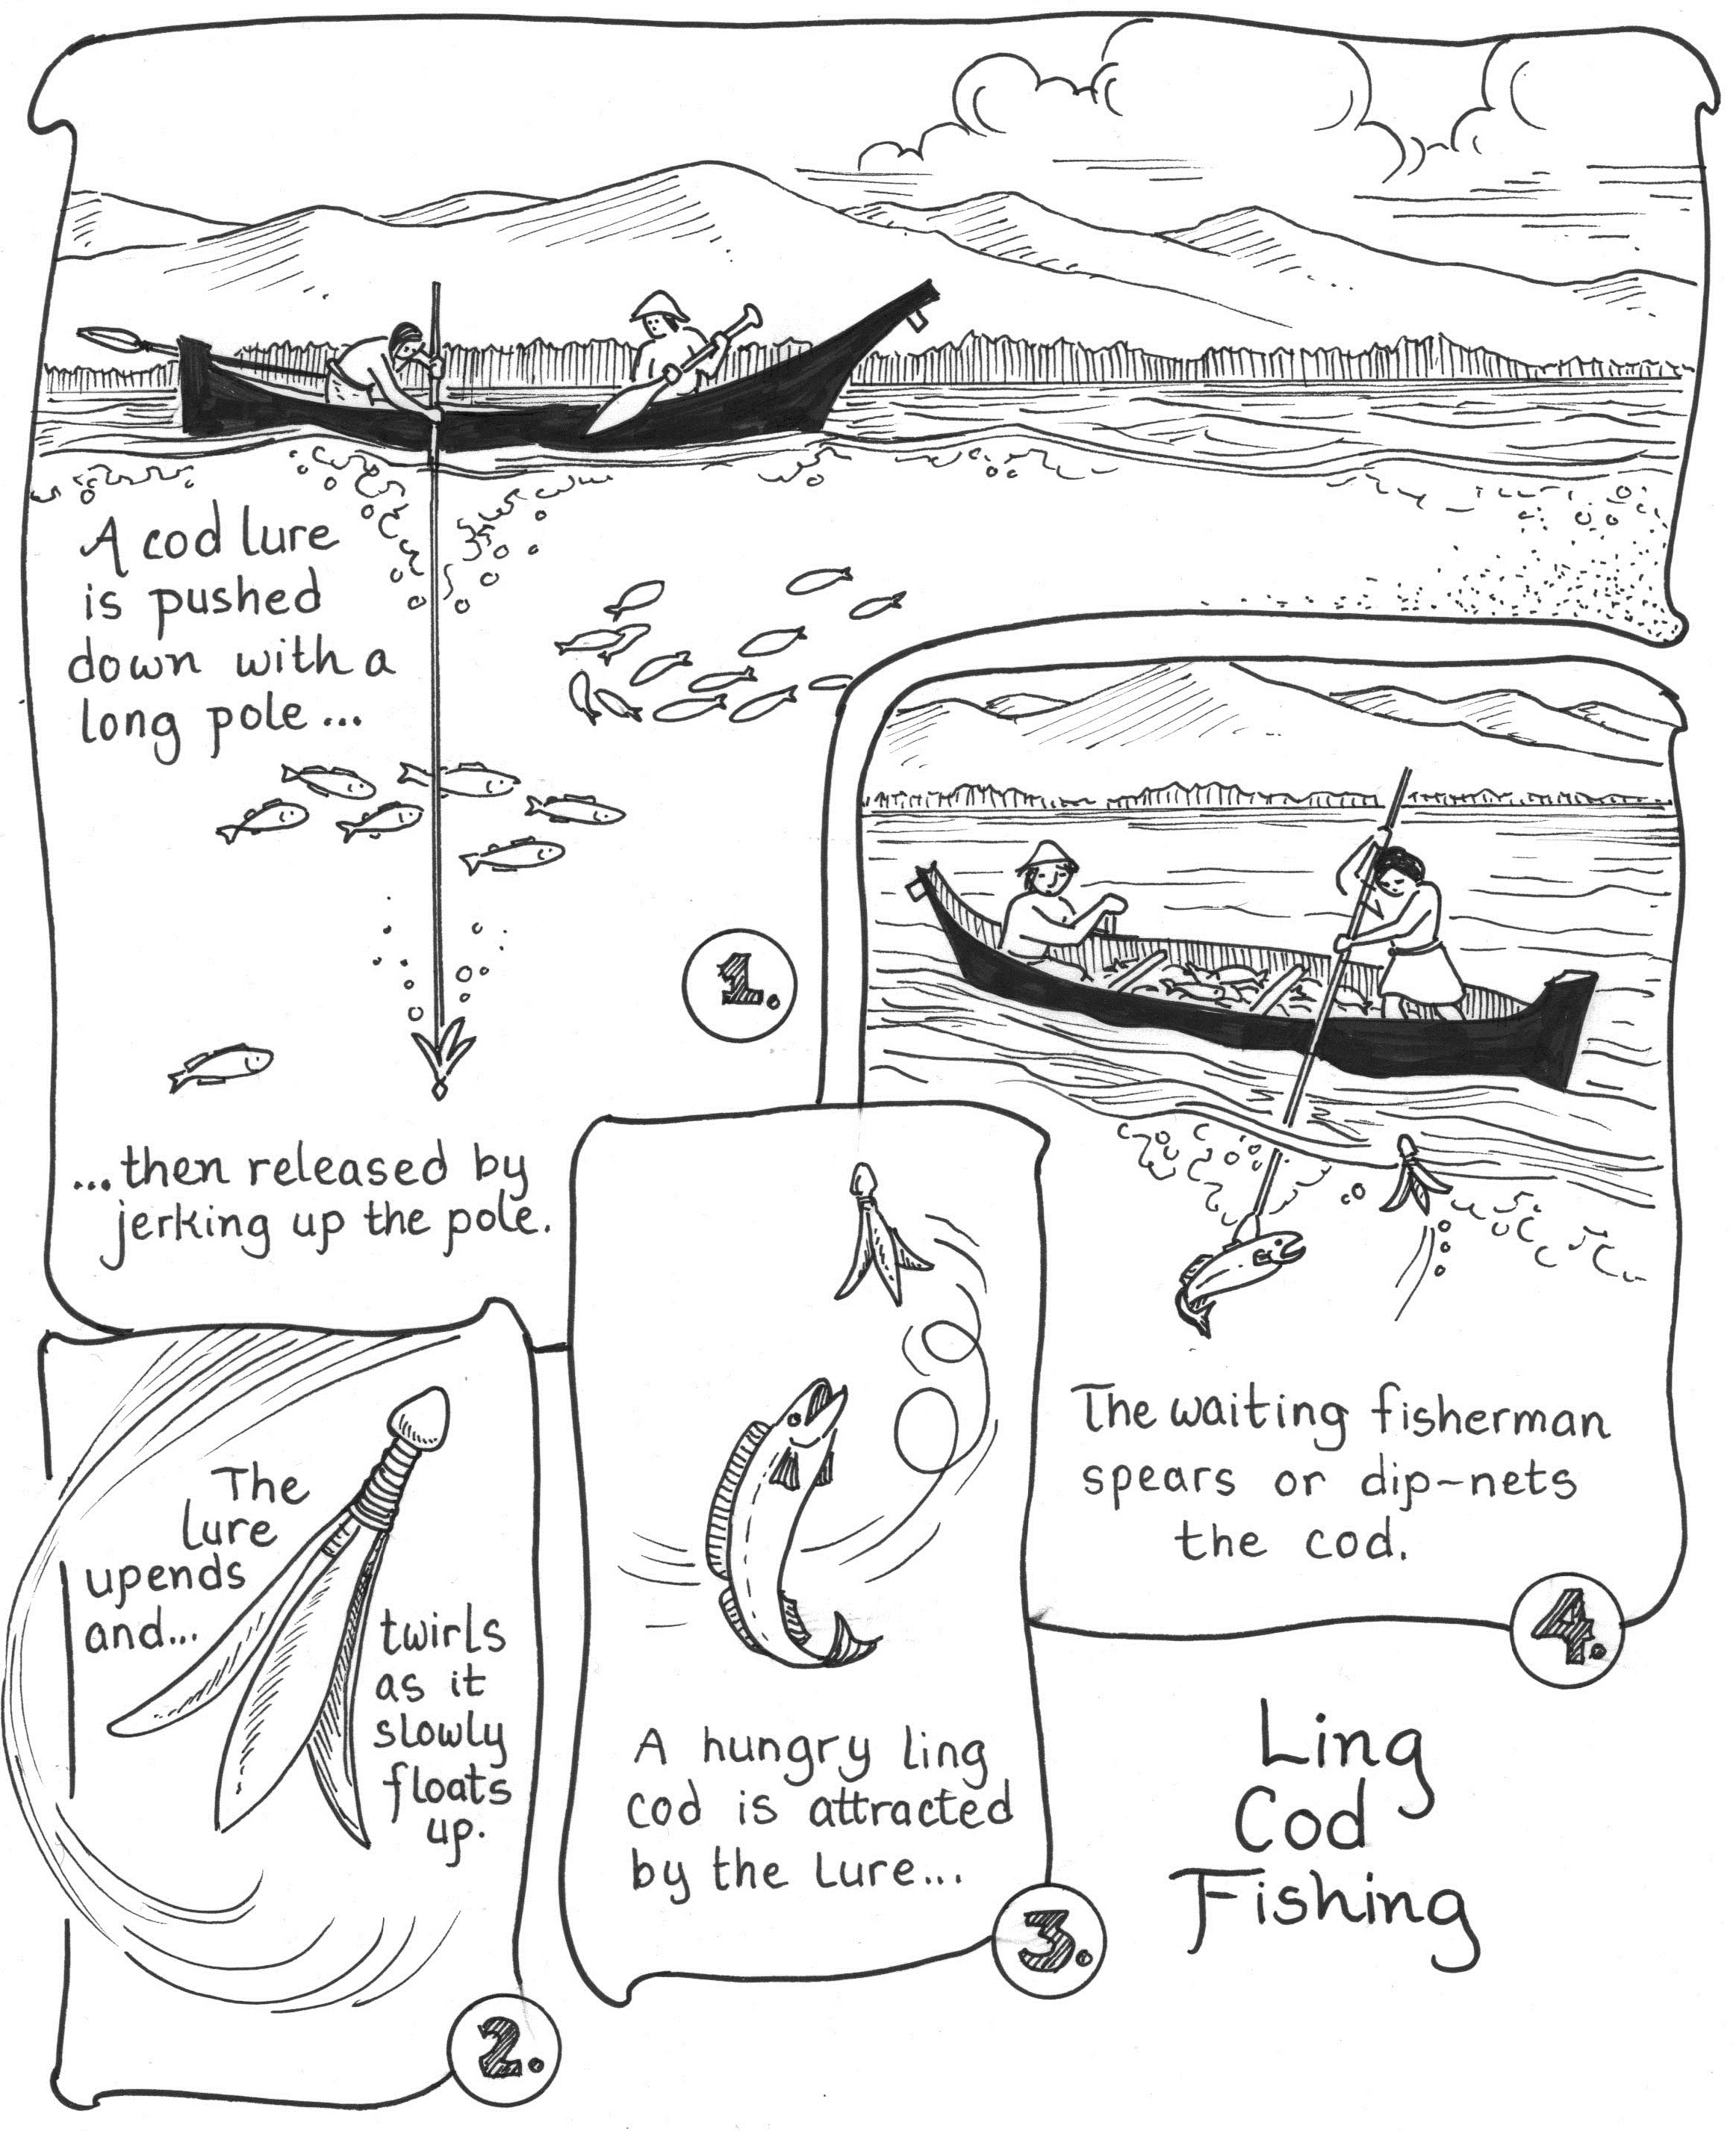
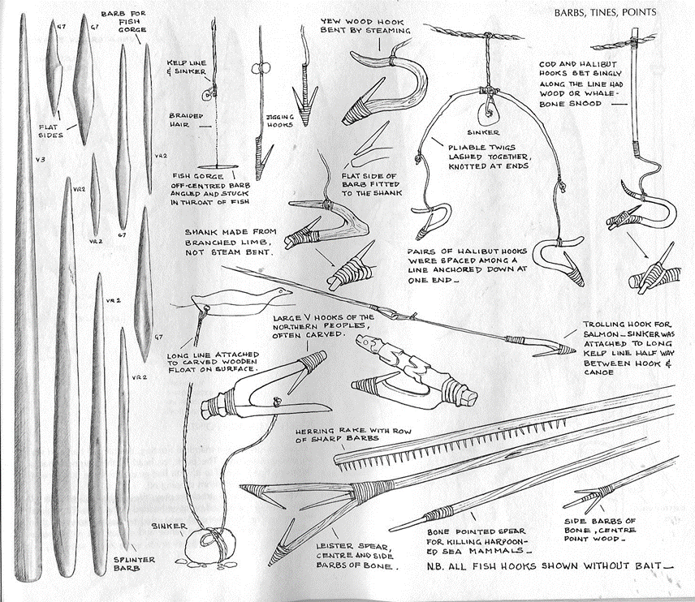
Early fishing techniques – Hooks, lures, spears, harpoons
Notes:
Sina- Anglers today have a diverse toolkit, the same way early fishing communities did as well. Here we see some examples of that tool kit with spear points that were fixed to longer poles and worked best with small species of salmon, the art of just enough power to impale the fish but not too much to break the gear has been a long-standing human experience. Bone or wooden hooks, often yew, were well adapted for halibut and the cod pole on the right depicts the versatility of fishing technique and species harvest for indigenous groups in the area.

Slide 13
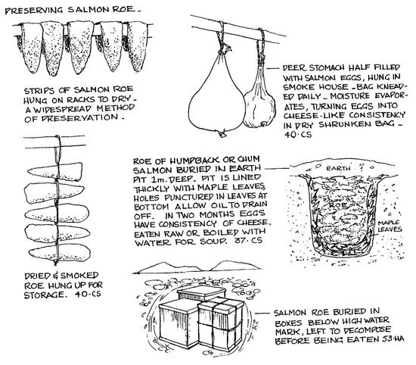
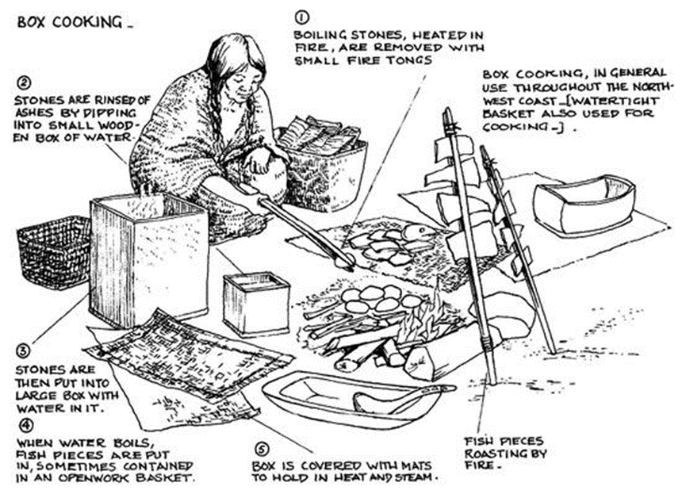
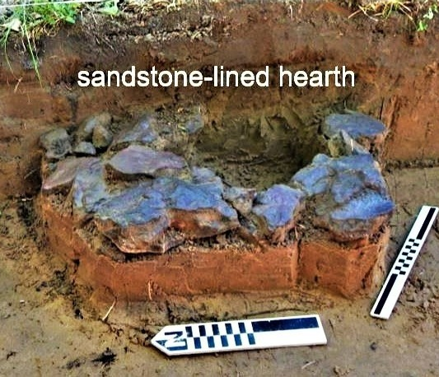
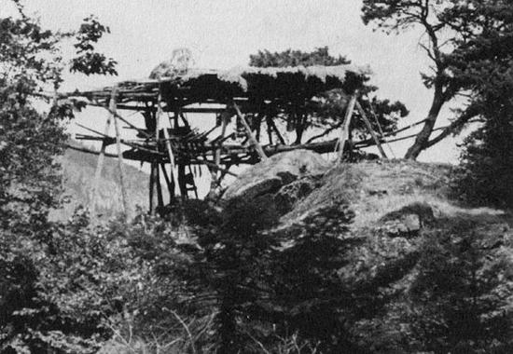
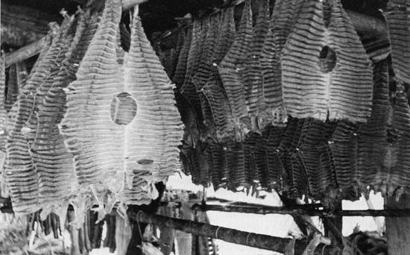
After the harvest: preservation and cooking
Notes:
Sina - Of course once the fish were harvested, the cooking and preservation took place. This goes back to the seasonality of the ecosystems, species were targeted during the times when they are most plentiful, much like today, with the added understanding of taking what the group needed to sustain themselves and to trade with others. In the upper right, we see an example of box cooking, or sometimes a waterproof basket, that was set near the fire. Heated rocks, picked up with tongs, were dipped into a small box of water to rinse off the ashes, then put into the bentwood box partially filled with water. When the water came to a boil, the food was added, and the lid put on the box. Prolonged cooking or simmering was maintained by replacing the cooled rocks with freshly heated ones. Other ingredients could be added to the box to make stew. When ready, the food was either ladled out or lifted out with a strainer. What wasn’t cooked needed to be preserved, typically through drying or smoking, like the black and white images on the bottom of the slide. On the right, an example of a rock “oven” was used for baking fish and other staple foods, and remains of these are found in archaeological excavations.

Slide 14
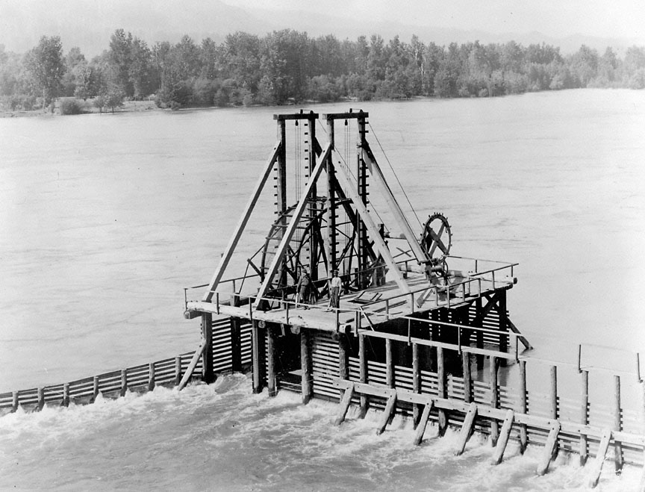
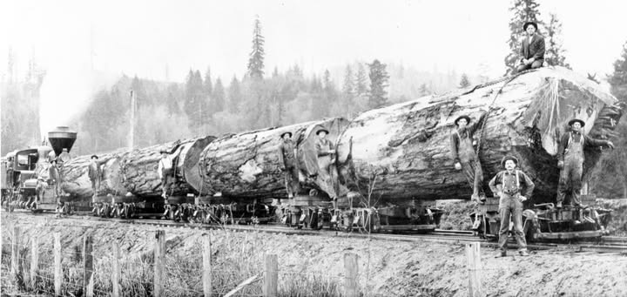
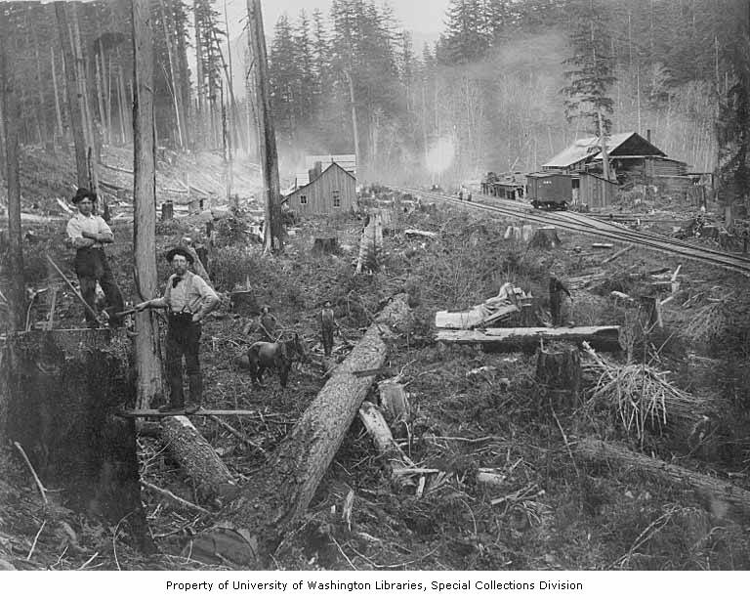
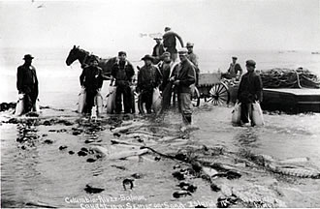
Industrial Revolution: Resource Extraction Boom Washington State (1888-1960)
Notes:
-Dylan-Now that we’ve covered the pre-contact tribal land use and important natural resources to their lifeways, let’s transition forward in time to the early 18-1900’s s when the Homestead Act, Donation Land Claim, Dawes Act, allowed new settlers the opportunity of claim hundreds of acres. Settler’s started moving into the area after decades of white explorers and traders paved the way. Many of them from Appalachia, They coined this area Big Bottom, The Valley of Opportunity. The first white people were Willaima Packwood and James Longmire. Tw familiar names. Across the nation, the industrial revolution was taking hold, bringing an economic boom to those in power, while the federal government was relocating vast numbers of indigenous people away from their traditional lands. Here in Washington, a landscape rich and diverse natural resources from the dense forests to the fresh and saltwater ecosystems, there were large-scale resource extractions taking place in every natural space. These actions were human led, with an influx of human occupation, the infrastructure to support them and moving the natural goods rapidly expanded. Large-scale timber harvests, railroad expansion, fish harvests, mineral extraction, redirection of natural waterways, and the rapid expansion with little oversight or long-term planning created ecological impacts that are still present in the natural environment today. Treaty Rights, the Bolt Act, and co-management is in play today, with emphasis on co-stewardship and restoration efforts

Slide 15
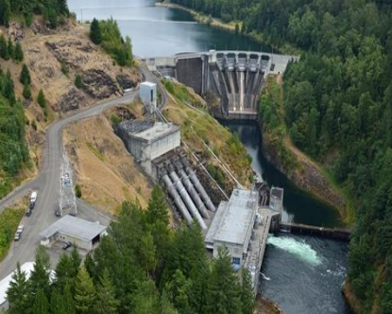
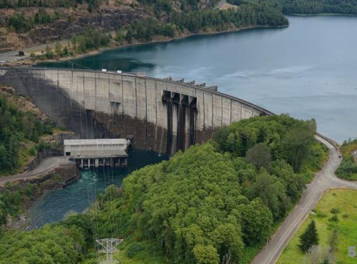
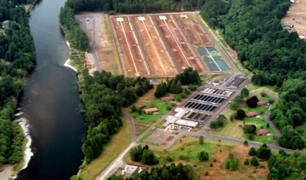
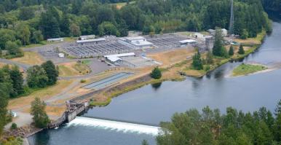
Cowlitz River Hydroelectric Project
Notes:
-Dylan- For the Cowlitz River, the creation of hydroelectric dams while intended to support the growing power needs of Tacoma and surrounding towns, these actions flooded the river basin, inundated four longstanding towns, displaced community members and ultimately altered salmon migration and blocked spawning habitat. In 1968, when Mossyrock and Mayfield Dams were completed, the Cowlitz Salmon Hatchery and Cowlitz Trout Hatchery opened to provide a healthy environment for early life stages of hatchery fish and to help increase the number of adult fish that return to spawn.

Slide 16
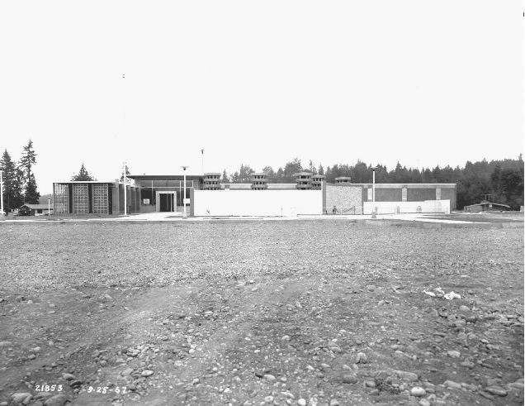
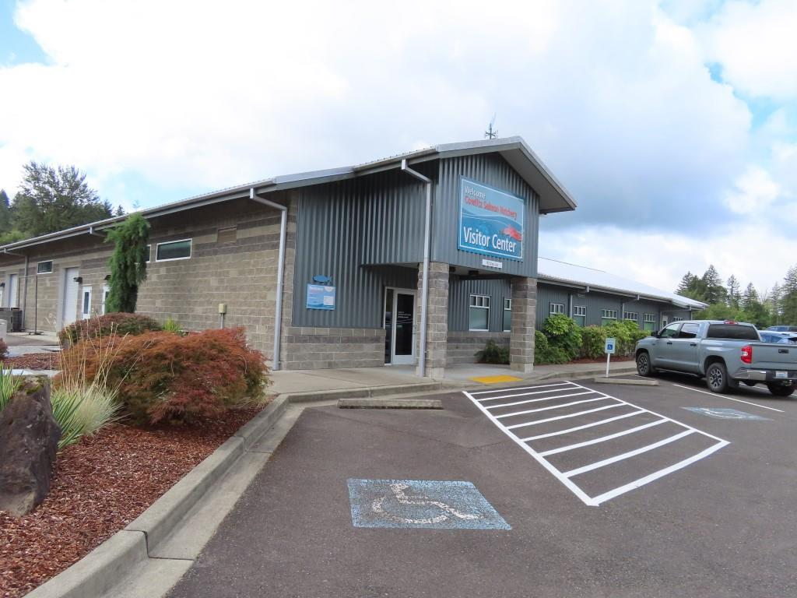
Cowlitz Trout Hatchery
Built in 1967 as a solution to decades-long debate between electricity providers, recreationalists, regulators, lawyers, and Tribal groups about how to manage fish passage on the Cowlitz River (HRA 2024).
Built from 1966 - 1968 as a solution to fish passage constraints and repopulate depleted salmon runs within the Cowlitz River. As of 2024, the hatchery releases “approximately 7.5 million spring chinook, fall chinook, and coho salmon each year” (HRA 2024).
Notes:
Dylan- Tacoma Power contracted with Historical Resource Associates, Ltd. (HRA) in 2024 to evaluate the historic structures throughout the Cowlitz River Hydroelectric Project as many of the buildings reached the 50-year age threshold for review in eligibility on the National Register of Historic Places (NRHP). These structures include Mossyrock Dam, Mayfield Dam, the Salmon and Trout hatcheries and their associated features. This work incorporated past evaluations and resulted in a comprehensive report. HRA identified 12 historic-period, built-environment resources associated with the Cowlitz Trout Hatchery. Survey and inventory identified 9 resources possessing sufficient significance and integrity to qualify either individually or collectively as part of an NRHP-eligible historic district. Over at the Cowlitz Salmon Hatchery, HRA identified a total of 21 historic-period, built-environment resources, survey and inventory identified 11 resources possessing sufficient significance and integrity to qualify individually for listing in the NRHP or as functionally related units to NRHP-eligible resources. Now in 2026, we’re working towards updating our management plans to incorporate these historic features.

Slide 17
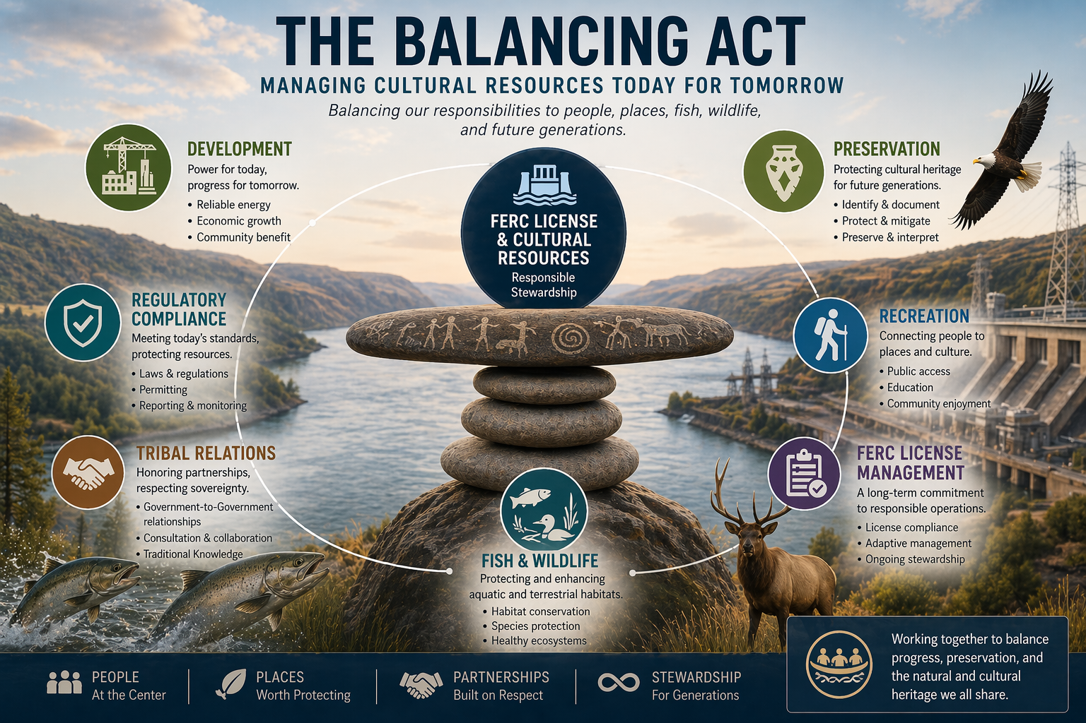
Notes:
Dylan - This graphic represents the balancing active of creating clean renewable power, while managing cultural resources under a FERC license. Every decision requires people, places, and long-term relationships and stewardship- while balancing them all simultaneously. We’re managing not just for today, but for the future generations and the continued cultural to the natural world.

Slide 18
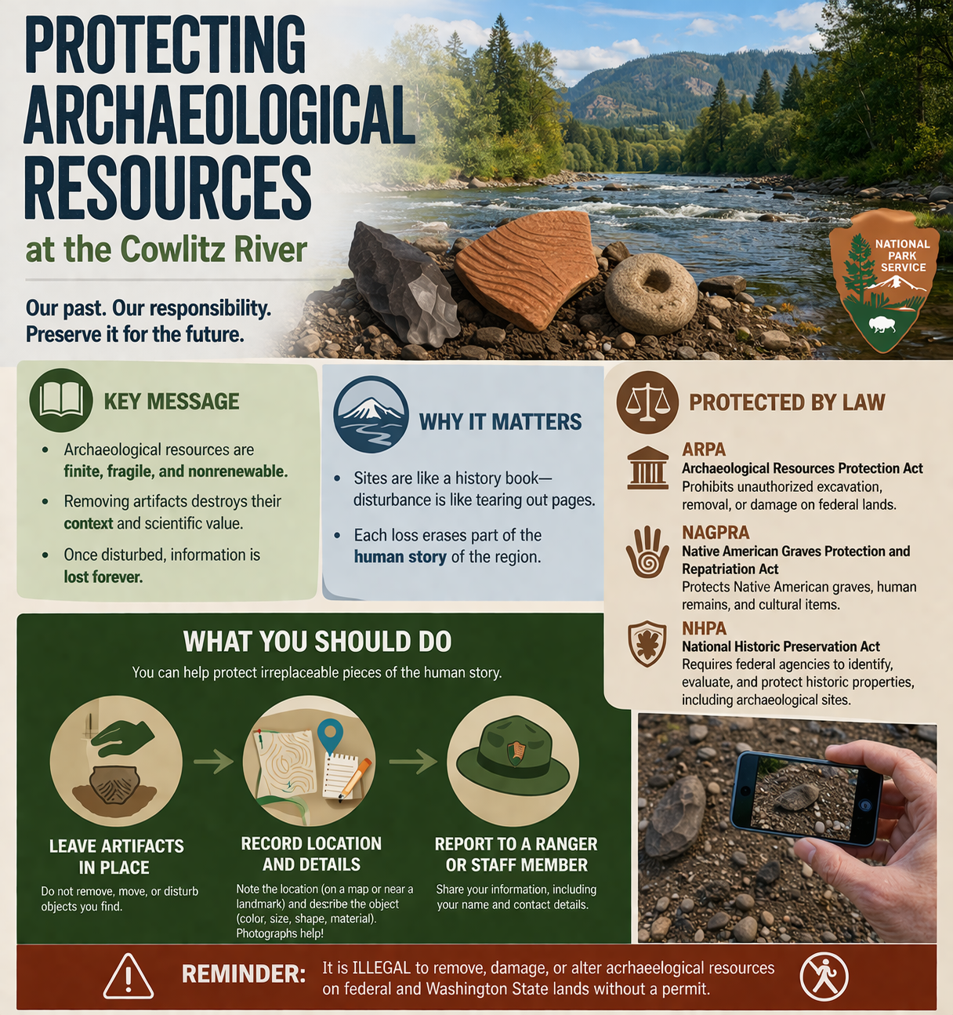
It is ILLEGAL to remove, damage or alter archaeological resources on federal
and Washington State lands without a permit.
Notes:
-Sina In 2026, our message is this: archaeological resources are finite, fragile, and non-renewable. We ask that when you’re out recreating, and you think you see an artifact, a site, or historic feature; please leave it where you find it. You can contact a park staff member with the details of your observation and together we can protect the stories of those that lived here before us.

Slide 19

Any questions? References:
Presented by Dylan Henderson, M.A., and Sina Stennes, B.A.
Tacoma Public Utilities
Notes:
Sina Thank you for your time today, we know we covered about 17,000 years of history in 20 minutes, to do this we had to have a pretty high level approach. Are there any questions?

