Slide 1
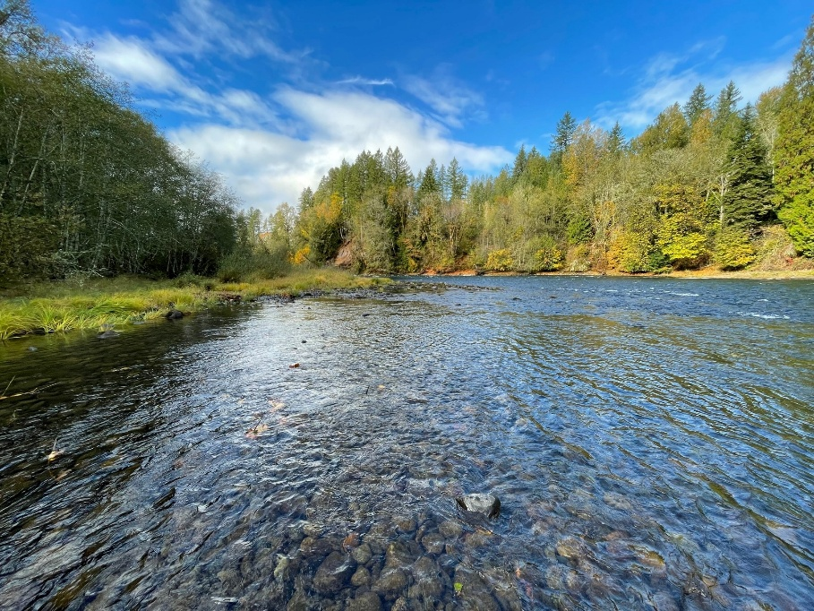
2025 Hydrology and Hydro Project Operations
Cowlitz Annual Program Review and Science Conference
April 22, 2026
Melora Shelton,
NR Water Resources Biologist

Slide 2
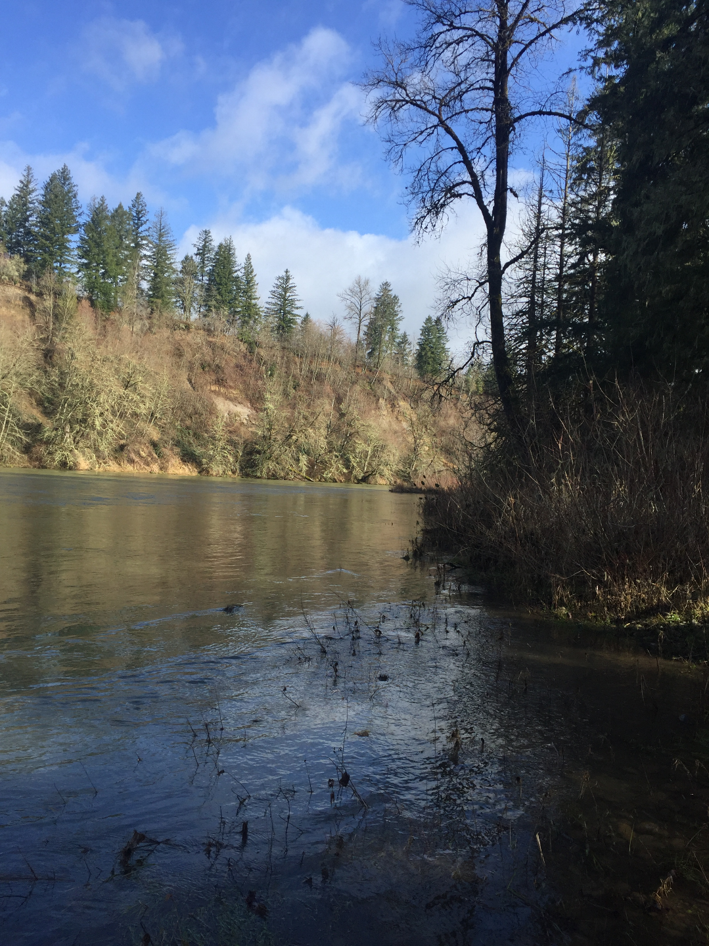
Overview
Physical setting
Review Water Year 2025 & 5-year context
Inflows: Rain and runoff
Reservoir elevations
Instream flow at Mayfield

Slide 3
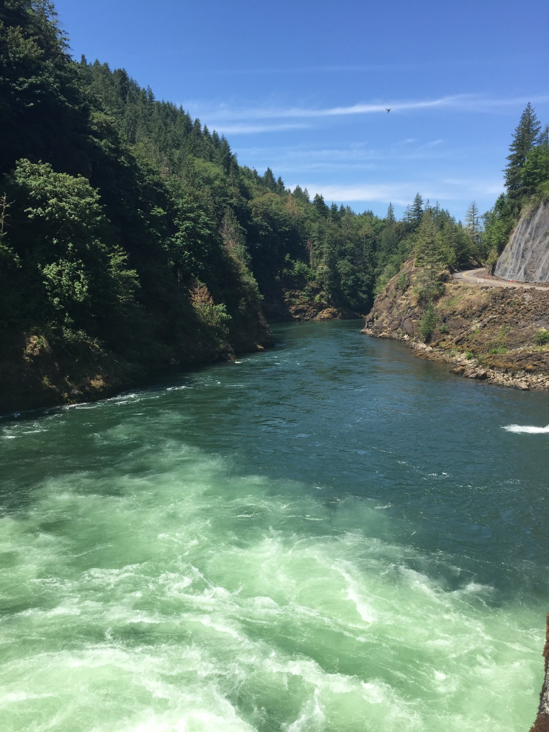
Stewardship of the Cowlitz River
Public Safety
Environment
Grid Reliability
Recreation
Power Production
Flood Control
Notes:
Always with hydro operations: safety first, and also balancing the rest.

Slide 4
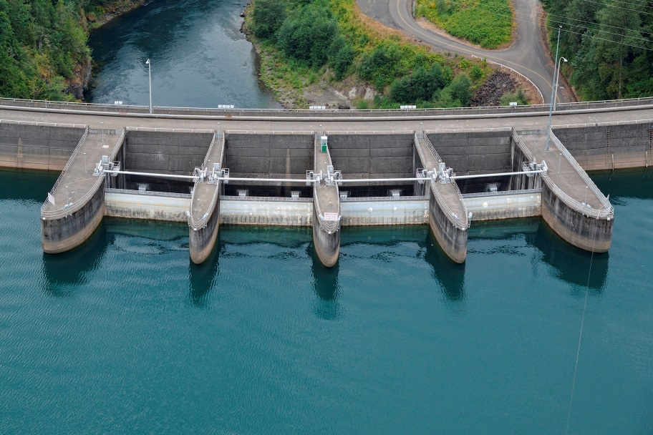
Stewardship of the Cowlitz River
Modified operations at Riffe Lake
Notes:
Since 2017, operating 29 ft below 778.5 ft full pool in response to updated seismicity and spillway pier concerns. What this looks like – max operating elevation of 749 ft except as needed for temporary storage during water management – coordinated through Dam Safety and US Army Corps. Low reservoir challenges include managing Kosmos Site clean up, vegetation and cultural resources issues, all of which make planning water management additionally complex.

Slide 5
Watershed and Subbasins
Notes:
Physical setting for the day. Cowlitz watershed from headwaters, focus on areas influencing or influenced by our operations. Generally excludes Toutle/Coweeman, focus on mainstem below Mayfield.

Slide 6
Watershed and Subbasins
Notes:
Above Cowlitz Falls:. High elevation headwaters for Cowlitz and Cispus River, draining flanks of Mt Rainier and Mt Adams. Strong snow/glacial influence. LCPUD’s backwater at Lake Scanewa influences hydrology into the lower upper Cowlitz and Cispus rivers.

Slide 7
Watershed and Subbasins
Notes:
Tilton subbasin. Mid-elevation, some snow but largely rain influenced. Both major reservoirs are in this subbasin. The Tilton flows in Mayfield Reservoir, which has limited storage capacity.

Slide 8
Watershed and Subbasins
Notes:
Lower Cowlitz Subbasin the lowest elevation, is generally rain-influenced. At Mayfield, flow is almost entirely a function of operations, further downstream tributary sideflows have a greater influence.

Slide 9
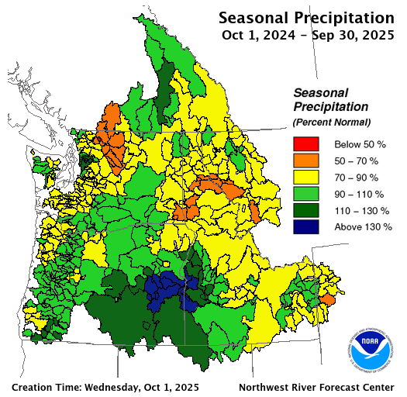
2025 Inflows: Rain and Runoff
Cowlitz Basin:
83% of average
https://www.nwrfc.noaa.gov/water_supply/wy_summary/wy_summary.php?date=10/01/2025&tab=1
Notes:
Lower than average precipitation, 83% of average (1991-2020). Variable by month: typical or above normal in November, December, February, March, and August, otherwise low or very low.

Slide 10
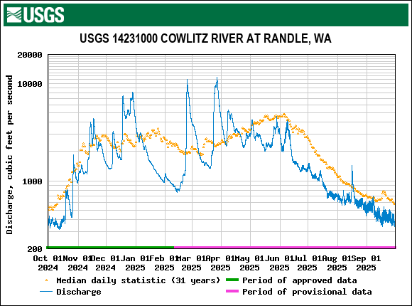
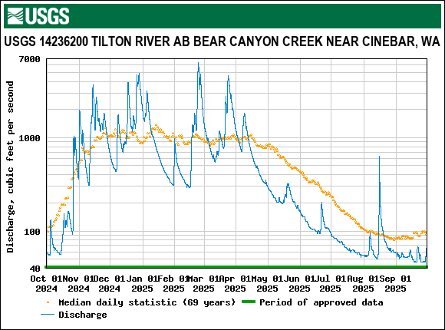
2025 Inflows: Rain and Runoff
upper elevation
middle elevation
Notes:
Variability shows up in annual streamflows. You see a typical increase through the fall, a cold period with very low stream flow in midwinter. Streamflow picked up in late February and late March, but by April was consistently well below normal except for one August rain event. Although there were a number of precipitation events, there were not any major storms

Slide 11
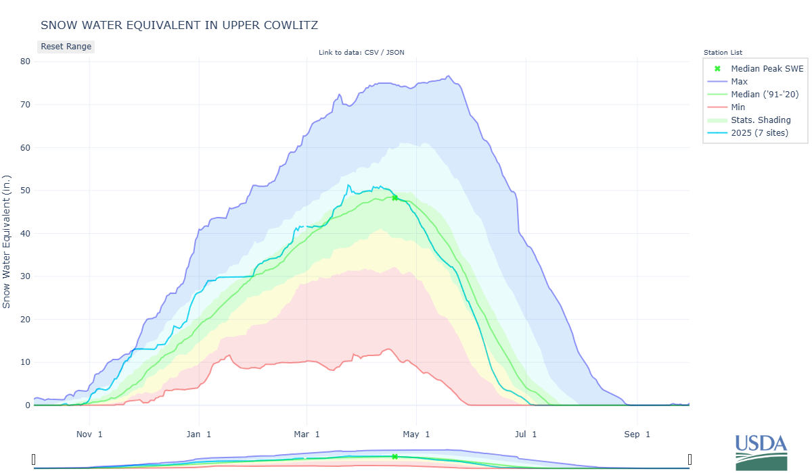
2025 Inflows: Snowpack
Statistical shading percentiles are calculated from period of record (POR) data, excluding the current water year. Percentile categories range from: minimum to 10th percentile , 10th - 30th , 30th - 70th , 70th - 90th , and 90th - maximum. For more information visit: 30-Year Hydroclimatic Normals
Notes:
The Natural Resource Conservation Service SWE estimate for the entire upper Cowlitz Basin, based on 7 Snotels including White Pass, shows early snowpack building into March but a precipitous decline from April consistent with an early runoff. Dry

Slide 12
2025 Inflows: By Month
Notes:
Looking at everything above Mayfield on monthly basis, inflows were below normal except for December and March, both which were higher precipitation months, and April which was low precipitation but included snow melt and runoff from late March rains. Cold conditions in December and February helped contribute to snowpack instead of runoff. However, even with relatively normal snowpack, precipitation was low after April that there was no snowmelt runoff signal, and inflows were extremely low from May through the rest of the water year.

Slide 13
2025 Inflows: 5-Year Context
Notes:
5-year context for between-year variability. What stands out? In all other years there is at least one “big” inflow month where was 2025’s “peak” march inflow was relatively small. The consistent decline from March to September, with near record low inflows from May through September are also notable compared to every other year having at least some snowmelt runoff signal after March.

Slide 14
2025 Reservoir Elevations
Notes:
The reservoir shows some fill in December and March, consistent with those somewhat higher inflows, but otherwise was generally drafting (like during cold and low flow January/February) or stable. Resource operations held the reservoir much higher than typical after March rains and as snowpack declined in April. The reservoir started drafting in June as inflows dropped below 5,000 cfs lost 8 ft for near record lows on July 1. The summer draft stayed at near record lows most of the summer into the fall.

Slide 15
2025 Reservoir Elevations, 5 years
Notes:
Overall, the 2025 reservoir was most similar to 2024. Both years drafted relatively low through the fall, had some fill and draft in the winter before holding higher than normal springtime elevations to offset low snowpack. Other years show more active drafting ahead of anticipated snowmelt runoff. However, the spring to summer transition was more similar to 2023 where there was substantial drafting in June and then record or near record low summer elevations. Also notable is that there was no significant storm management in the last 5 years.

Slide 16
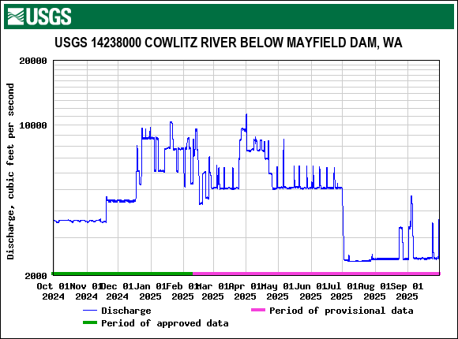
2025 Outflows
Notes:
Discharge at Mayfield illustrates operations as well as seasonal flow.

Slide 17
2025 Outflows
Cooler weather, increasing inflows
Notes:
Discharge increased in December. Fall increases are typical as fall rain comes in and temperatures decrease. Winter discharge did not include any periods sustained high discharge.

Slide 18
2025 Outflows
Increased inflows, water management
Notes:
March rains contributed to some increased discharge for water management, otherwise spring flows were typically close to the minimum with weekly fish transport flows.

Slide 19
2025 Outflows
Max. Discharge: 11,300 cfs
Notes:
Maximum generation during this water year occurred in early April those March rains.

Slide 20
2025 Outflows
Near minimum flow
Notes:
In July we transitioned immediately to near minimum flows, typical of the summer operating basement for most of the rest of the water year.

Slide 21
2025 Outflows by Month
Notes:
Consistent with low precipitation and low inflow year, discharge by month was below average throughout the water year, except during April when higher reservoir and March/April rains required water management.

Slide 22
2025 Outflows: 5-Year Context
Notes:
With the 5-year context, 2025 was the third year in a row with relatively low discharge for all or most of the water year, except for during water management in April 2025 and June 2024. This is in contrast with 2022, which was generally water rich.

Slide 23
2025 Outflows: 5-Year Context
3,500**
* Absolute minimum if no 5-day consecutive average >3,500 cfs during reset period
** Minimum can adjust up to 5,000 cfs based on consecutive 5-day averages
Notes:
Adding overlay for simple min flow. April 2023 is the only period when monthly flows were below the minimum, resulting from a spring flow reduction to support reservoir refill during adverse water conditions experienced that year. There was also a brief reduction in 2021 that doesn’t show up on a monthly time scale.

Slide 24
Key Points, 2025 Highlights
Overall drier than typical.
Except for December and March, precipitation and inflows were low.
No spill.
Cold weather helped build snowpack, but spring inflows were still low due to lack of precipitation.
Except for April, discharge by month was below average low all year.

Slide 25
Key Points, 5-Year Context
Ongoing constraints related to reservoir capacity.
2025 notable for near-record low inflows after April.
Spring flow reductions in 2021 (brief) and 2023.
By month, highest flow periods above and below the Project were in 2021 and 2022 (November and/or January). Brief spill in 2022 only.
Generally, 2022 was the wettest year (overall inflows/discharge) and 2023 was the driest followed by 2025.

Slide 26

Any Questions?

