Slide 1
2026 Cowlitz Annual Program Review
Eric Shoblom / Cowlitz Fish Facilities Manager Tacoma Power
April 22, 2026
Notes:
Hello all and welcome to the 2026 Annual Program Review…. Affectionately referred to as the APR!
Before I get started, I just wanted to remind you about the little blue cards available for asking questions, capturing comments, or passing notes. We’ll read any provided to us and try to respond today if appropriate. I want to remind folks that all comments at the end of this presentation should be expressly related to the APR. We want to ensure we document relevant comments as part of this process without bogging them down with unrelated content that we can discuss at another time.

Slide 2

Annual Program Review (APR)
Intent – develop population management strategy for the coming season
Steps
Update key metrics
Update status and trends
Annual Program Review – set annual management targets
Annual Operating Plan
Notes:
So what is the APR? It’s the Annual Program Review.
It’s a review of our hatchery programs on the Cowlitz with the end of the process resulting in setting the next years production levels.
For any of those that aren’t familiar with Tacoma’s obligations, part of that process is coming up with a suite of program options that fit beneath a cap of 650k lbs. So all APR programs need to total 650k lbs or less. So that’s the frame we’re working in.
The APR involves several steps from updating our data from the previous year, evaluating that data and creating an annual operating plan or AOP for the coming year. We still have some work to do to create the AOP’s but we do have documents like WDFW’s future brood document and adult collection AOP’s that provide the necessary detail already. The AOP’s will likely consolidate all the detailed information of a program for easier reference. As I said, those are yet to come as the M&E group works on higher priority items.

Slide 3
Overview
Fisheries and Hatchery Management Plan (FHMP)
Transition Plans
Bioprogramming
Annual Program Review Process
Implementation
Notes:
All of these steps are guided by the FHMP, or Fisheries and Hatchery Management Plan. We also have transition plans. These are more focused plans detailing triggers, steps, or HOW we’re going to implement the FHMP.
Then we use hatchery rearing information like space and water availability or “bioprogramming” in combination with the APR process to set our annual targets for fish handling and production.
So what exactly goes into the “APR” process? Well, much like the work that went into the creating the Transition Plans, we have many inputs. We consider fish passage performance, habitat condition, angling opportunity and impact, natural population performance, and again, hatchery capacity. Each of these metrics are being investigated through various efforts throughout the year and as data is collected, we weigh it against our goals in the Transition Plans to determine if a change is needed in the hatchery programs. This is done through monitoring evaluation and fish facility operations. The FTC subgroups like the M&E Subgroup, the technical work group (TWG) and the Hatchery Operations and Maintenance (HOM) work group all provide inputs to ensure we’re on a trajectory that aligns with our overarching goals as described in the FHMP or Transition Plans.

Slide 4
Hatchery Program Constraints
What keeps us from raising 1 billion fish?
Hatchery constraints
Space
Water
Brood
Population constraints
ESA
Competition
Residualization
Habitat
Harvest
Notes:
I added this slide a sort of reminder or perhaps for some a window into how we’re able to size and shape our fish programs.
Basically, what our constraints are when determining program size and timing.
We first need to look at our space and water constraints within the hatchery. This is called bioprogramming as I mentioned earlier. We obviously need to have proper rearing conditions for the proposed program.
We also need to consider how many adults are available for broodstock vs. our recovery goals… especially for integrated programs, which most of our programs are.
Then we need to consider ESA constraints to ensure we’re not putting too many hatchery fish on top of natural origin fish in the river. This is what we refer to as the proportion of hatchery origin spawners, or pHOS.
Then there are a whole host of other considerations when determining program size, release size and timing.
Do the hatchery fish we release have a strong likelihood of competing with NOR outmigrants? Are they going to be prone to residualize? How does the available habitat impact how many fish we should release? And finally, will these fish contribute to harvest? Well then we’d better mark them and monitor them appropriately. This means choosing a mark or tag type that isn’t being used by another program and that will be effective for our goals. With so many mark/tag types in our Basin, this can be challenging.
These are just a few examples of things that go into shaping a fish program.

Slide 5
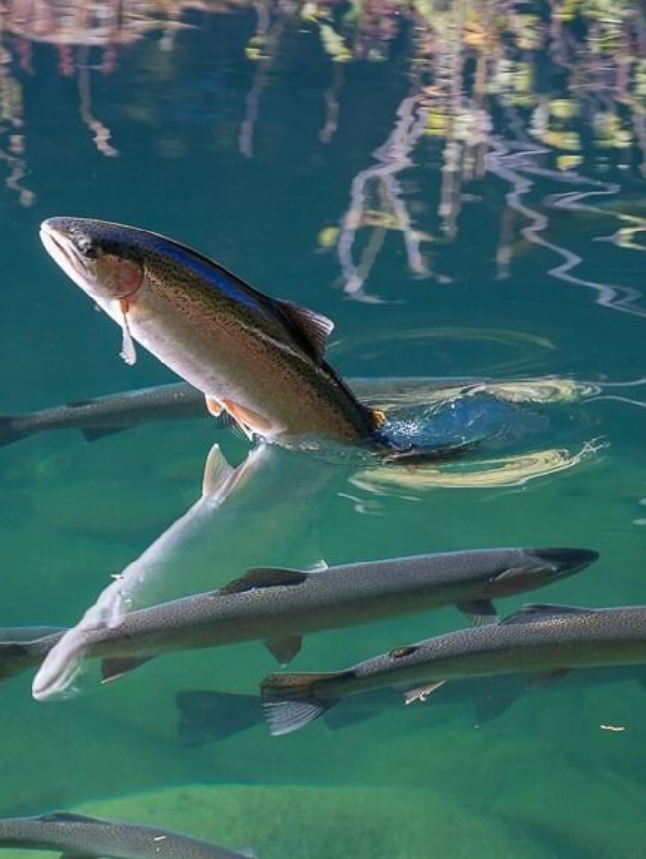
Winter Steelhead
3 Programs:
Lower Cowlitz: 308,500
Segregated
Tilton: 100,000
Integrated
Upper Cowlitz: 236,000
Integrated
Total: 644,500
Notes:
So, what are we proposing for this year? –
For Winter Steelhead: Spoiler alert…no change.
4 years ago we introduced a rebalancing of the 3 winter steelhead populations as called for in the Transition Plans.
We essentially shifted a significant amount of the production from the Lower Cowlitz to the Upper programs. That has been going well so far.
You can see here that the Lower program is a segregated program at 308,500, the Tilton program is an integrated program at 100k and the Upper Cowlitz is also an integrated program and that one is at 236k
Another shift called for in the transition plans was to begin collecting the lower stock, earlier.
In the Last 4 yrs, 100% of our brood was collected before previous collection dates had even started.
We continue to see early success in this program with a notable shift to earlier returning adults as I’ve described many times in our facility updates.
So, once again, we’re not proposing any changes to this program.

Slide 6
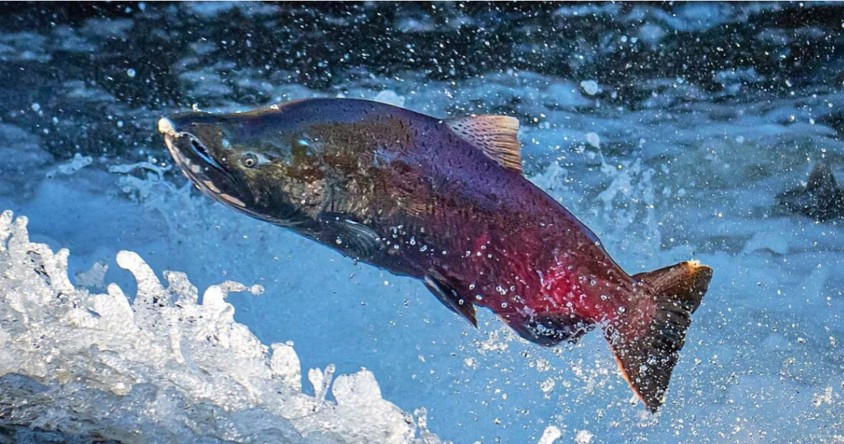
Fall Chinook
Tilton
Integrated
3,500,000
Notes:
For fall chinook:
The FHMP and associated Transition Plans called for a single, integrated hatchery population of Fall Chinook derived from Tilton broodstock – rather than the lower population, below barrier dam. We initiated the fully integrated program a few years ago and propose to continue it.
That program size was set for 3.5 million released and we propose to continue with this program.
I will say that gaining a better understanding of the pressures on this program is a high priority for us and our M&E team is working on creating a limiting factors analysis and we hope to have an action plan as a result.

Slide 7
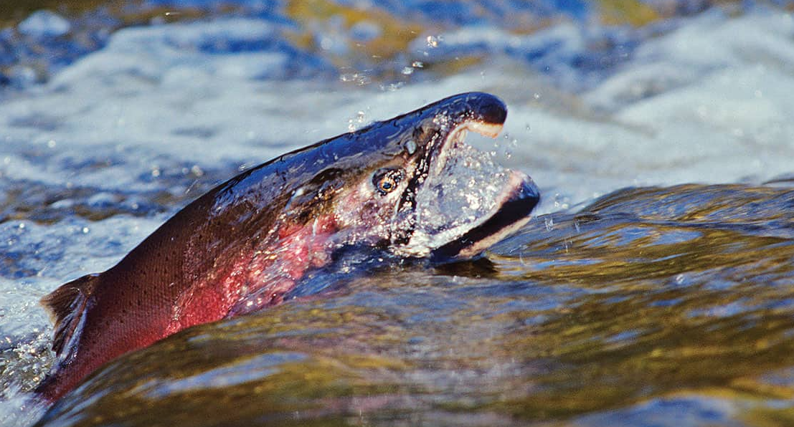
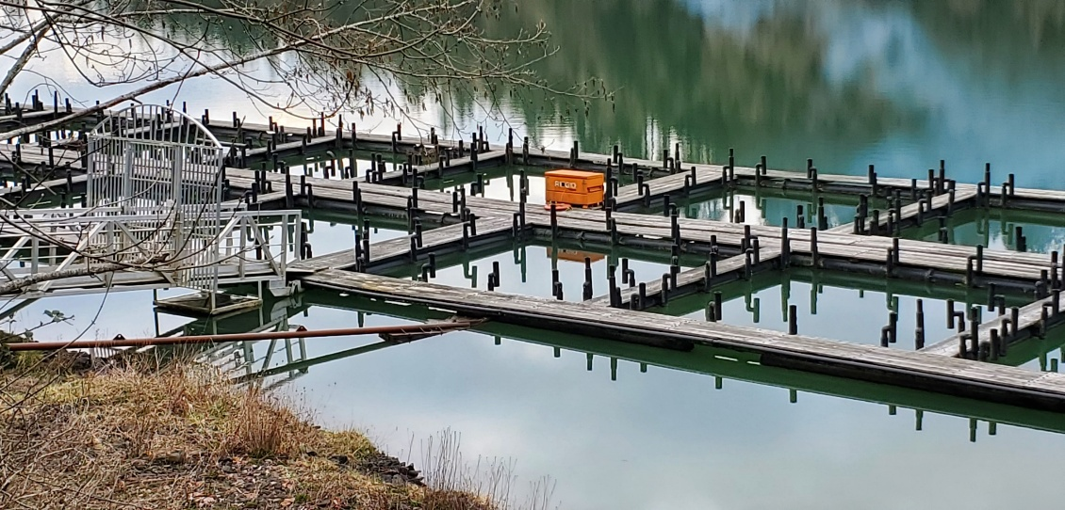
Coho
Upper Cowlitz
Integrated
Total basin release: 2,178,000
Mayfield Net Pens
Satellite Rearing facility
250,000 (or one pond) from above total taken offsite to allow for additional spring Chinook growth to 5fpp.
Notes:
Coho:
We’ve had One integrated program for several years now
The only change to this program in recent years was to shift one pond, or approximately 250k from the hatchery to the net pens.
That program is now in it’s phase two with a scheduled release of April 27th. And I’d say that given the early success of this program (and we’re assuming phase 2 is a success given it’s performance to date), Tacoma will continue this program. And this facility is now designated as a satellite rearing facility.
I’ll add a Note that once the coho are transferred out of the hatchery, all future growth (poundage) gained, clear to release will not be counted against the 650k lb cap.
As a reminder, the purpose of this effort was to benefit the spring Chinook program which I’ll discuss on the next slide.

Slide 8
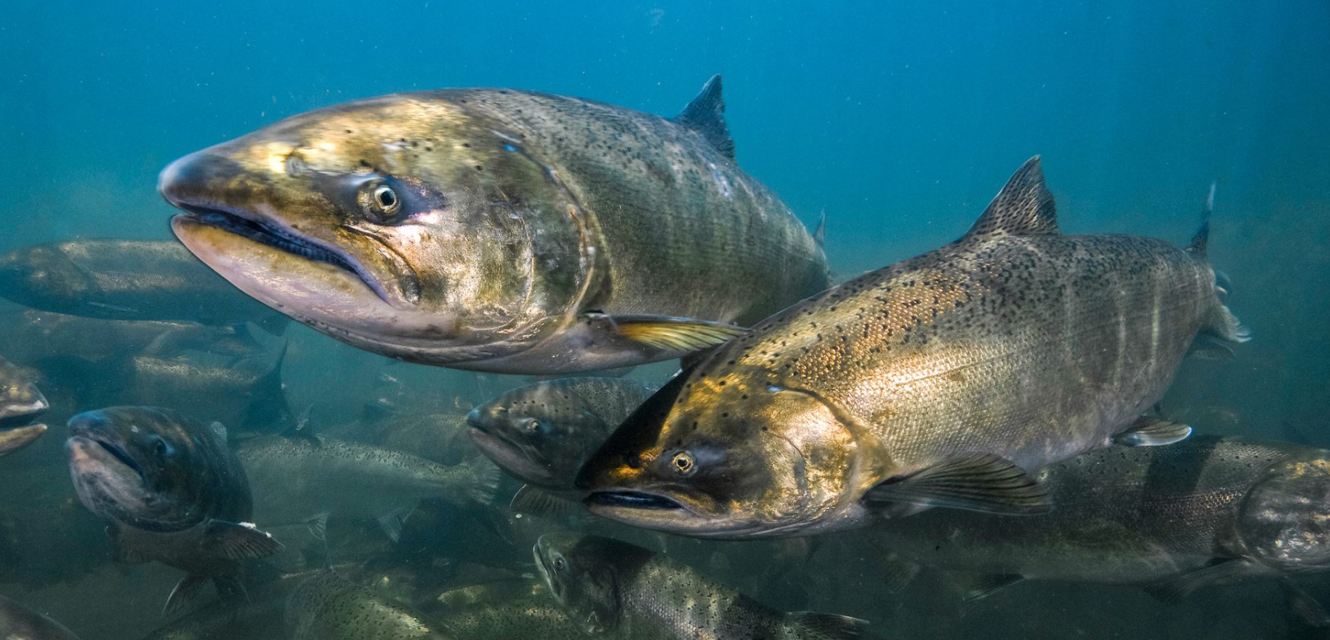
Spring Chinook
Upper Cowlitz
Segregated
3 Programs
537k @ 12fpp
420k @ 8fpp
700k @ 5fpp
Plus…
50k from 8fpp group, listed above, shipped to Cfalls to rear up to 5fpp @ Cowlitz Falls
Satellite Rearing facility
Total Basin Release: 1,657,000
Notes:
Last APR, we shifted some release sizes and dates of our spring Chinook to focus on increasing SAR’s. Since this was a recent move, we’re proposing to keep these programs the same for this year with one exception.
A few years ago we made the decision to shift some coho to the Mayfield net pens in order to make space to raise some of the 12fpp springer release group up to 5fpp. Similarly, now that Cowlitz Falls has been approved for a Satellite Rearing program, we’re transferring another 12fpp release group up there to be raised to 5fpp as well. Water temperature may limit our growth rates at Cowlitz Falls so we’ll have to see what size we can actually achieve. That said, the potential benefits of being raised in the upper basin is pretty exciting to me. We’ll tag each of these fish and begin to understand those benefits over time.
Just as a side note, and just like the coho satellite rearing program: Once the chinook are transferred out of the hatchery, all future growth (poundage) gained through release will not be counted against the 650k lb cap.

Slide 9
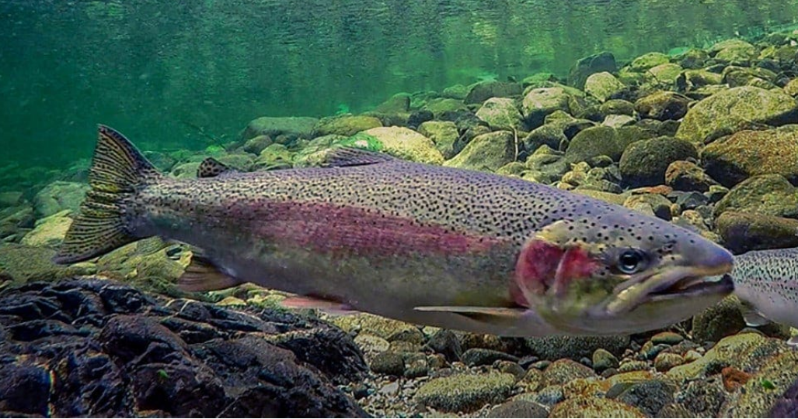
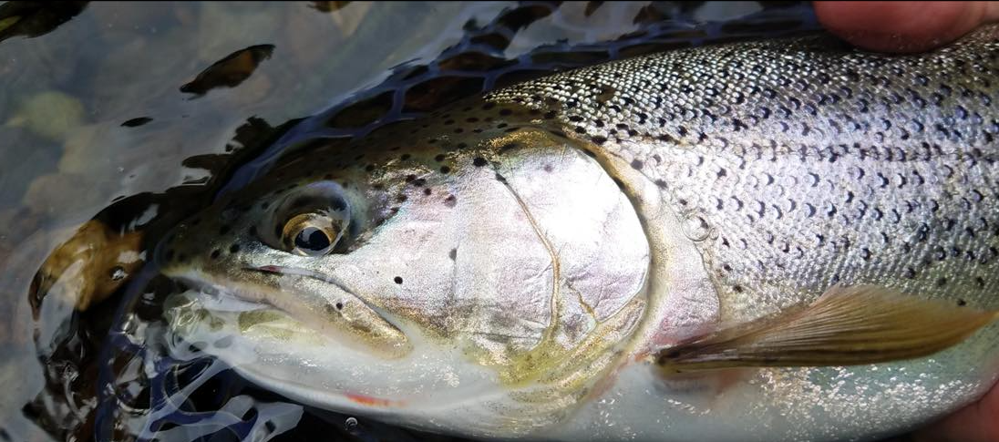
Summer Steelhead and Cutthroat
Summer Steelhead
Segregated
650,000
Plan: 25k to net pens
Cutthroat Trout
Segregated
100,599
Plan: 10k to net pens
4.4 release size if programs are projected to exceed 650k lb cap.
Notes:
The FHMP and therefore Transition Plans recommended no modifications to the Summer Steelhead or Cutthroat Trout programs.
So these programs have remained unchanged for several years at the 650k release for the summers and about 100k for the Cutthroat.
Notably, this is the first year in quite a while since we’ve sent fish to the Friends of the Cowlitz Net Pens in Toledo. They received 25k summers and 10k cutts this year. We’re looking forward to seeing the results of this program as time goes on. Thank you to Fred Ming and the FOC support group for continuing this program.
On another note: Due to the shuffling of spring chinook around the hatchery in an attempt to maximize their size and fish health, we discovered that the overall poundage programmed was exceeding the 650K lb cap by 2079 lbs. Rather than cutting any of our programs, we are proposing to reduce the planned release size of the Cutthroat trout from 4fpp to 4.4fpp to balance the overall complex poundage under the 650k lb cap. We would only enact this reduction if we anticipate to exceed our cap. Recent years we’ve unfortunately been quite short on our Fall Chinook releases and beyond those years we were short on Spring Chinook. Given that fall Chinook projections aren’t fantastic, we’ll likely have room to continue to release the cutthroat at their historic release size. Although, I’ll point out that we have had several years in the past where the proposed cutthroat release size was well within the actual release size range so this is a relatively minor change…if at all…and if it actually occurs.

Slide 10
2025 Hatchery Production Plan
Table 2: 2026 APR Details
Hatchery | Species | Seg/Int | Program | Total | FPP | Pounds
Trout Hatchery | Summer Run Steelhead | SEG | 625,000 | 650,000 | 5.5 | 113,636
 | Summer Run Steelhead (FOC)* | SEG | 25,000 |  | 5.5 | 4,545
 | Cutthroat Trout (FOC)*¹ | SEG | 10,599 | 100,599 | 4.4 | 2,409
 | Cutthroat Trout¹ | SEG | 90,000 |  | 4.4 | 20,455
 | Lower Winter Steelhead | SEG | 308,500 | 644,500 | 7 | 44,071
 | Tilton Winter Steelhead | INT | 100,000 |  | 7 | 14,286
 | Upper Cow Winter Steelhead | INT | 236,000 |  | 7 | 33,714
Salmon Hatchery | Spring Chinook | SEG | 700,000 | 1,657,000 | 5 | 140,000
 | Spring Chinook | SEG | 420,000 |  | 8 | 52,500
 | Spring Chinook | SEG | 487,000 |  | 12 | 40,583
 | Spring Chinook to Cowlitz Falls | SEG | 50,000 |  | 12 | 4,167
 | Fall Chinook | INT | 3,500,000 | 3,500,000 | 80 | 43,750
 | Coho | INT | 1,928,000 | 2,178,000 | 15 | 128,533
 | Coho to Net Pens | INT | 250,000 |  | 35 | 7,143
 |  |  |  |  | Total | 649,793
Satellite Rearing² | Species | Seg/Int | Program | Total | FPP | Pounds
Mayfield Net Pens | Coho | INT | 250,000 | Included above | 15 | 9,524
Cowlitz Falls Rearing | Spring Chinook | SEG | 50,000 | Included above | 5 | 5,833
 |  |  |  |  | Total | 15,357
¹ Denotes that: Cutthroat trout will be adjusted, in season, to a release size of up to 4fpp if program shortages within the complex are projected to be below the 650K cap.
² Denotes that: Satellite rearing growth is above and beyond the 650k lb cap.
Notes:
This is the table that is included in the APR Decision Document. We began including this more detailed table to provide transparency into what the details of each program are and where the poundage is coming from. I know it’s hard to read here but we’ll distribute this presentation and like I said, it’s captured in the DD. IF anyone would like me to zoom in or have questions regarding these specifics, I’m happy to dive in further.

Slide 11
2025 Hatchery Production Plan
Species | 2021 APR Goal | 2022 APR Goal | 2023 APR Goal | 2024 APR Goal | 2025 APR Goal | 2026 APR Proposal
Fall Chinook | 3,500,000 | 3,500,000 | 3,500,000 | 3,500,000 | 3,500,000 | 3,500,000
Spring Chinook | 1,738,529 | 1,738,529 | 1,678,000 | 1,678,000 | 1,657,000 | 1,657,000
Coho | 2,178,000 | 2,178,000 | 2,178,000 | 2,178,000 | 2,178,000 | 2,178,000
Winter Steelhead | 647,000 | 647,000 | 644,500 | 644,500 | 644,500 | 644,500
Summer Steelhead | 650,000 | 650,000 | 650,000 | 650,000 | 650,000 | 650,000
Cutthroat | 100,599 | 100,599 | 100,599 | 100,599 | 100,599 | 100,599
Notes:
You’ll likely notice in this table that we’ve had no changes in total release in recent years save the Spring Chinook. And I highlighted some of the other types of changes by program earlier.
While it looks like we’re going backwards from a number perspective, the size and release date changes of the springers have much better survival estimates and should more than offset the reduction of numbers.
Let’s move on to your feedback opportunities.

Slide 12
Next Steps
Receive Feedback at FTC (Mar 3)
Receive Feedback at FTC (Apr 7)
APR Meeting (Apr 22)
Finalize APR at FTC
(May 5)
Notes:
So to walk backwards a little and discuss the process…
The APR process involves a series of public meetings intent on receiving stakeholder input to help shape our hatchery programs. We’ve also made all of our FTC meetings public as well, which really helps give context to our programs throughout the year. However, it’s in the APR process where we consider changes to the hatchery program and poundage distribution across our Complex.
So today we’re at the APR meeting which is the third square you see up here. We’d like your comments following this slide.
Then, we’ll introduce the FINAL decision document for consideration on the May 5th FTC meeting where we’ll solidify our program goals.

Slide 13

Public Comment
Notes:
So now I’ll open it up to questions or comments related to the APR process or our hatchery programs specifically.
Please remember to keep your comments brief and specifically related to this APR process.
Now I’ll turn this time over to Jennifer to help us make sure everyone is heard and we capture APR comments for the record.

