Slide 1
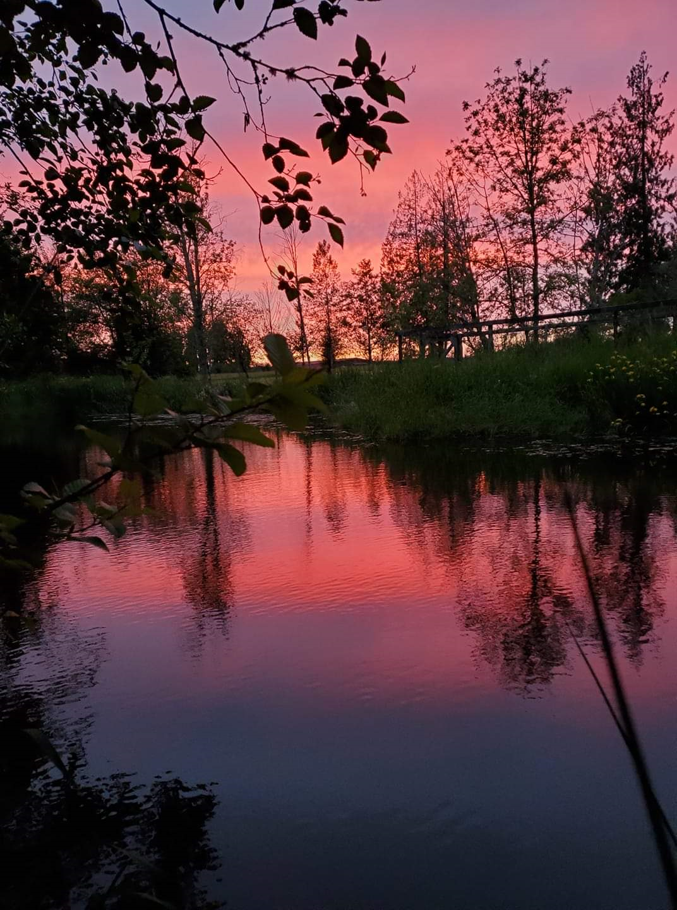
Cowlitz Trout Hatchery Steelhead Release Estimates Scott Gibson/Tacoma Power Cowlitz River Fisheries and Watershed Science Annual Conference April 22, 2026

Slide 2
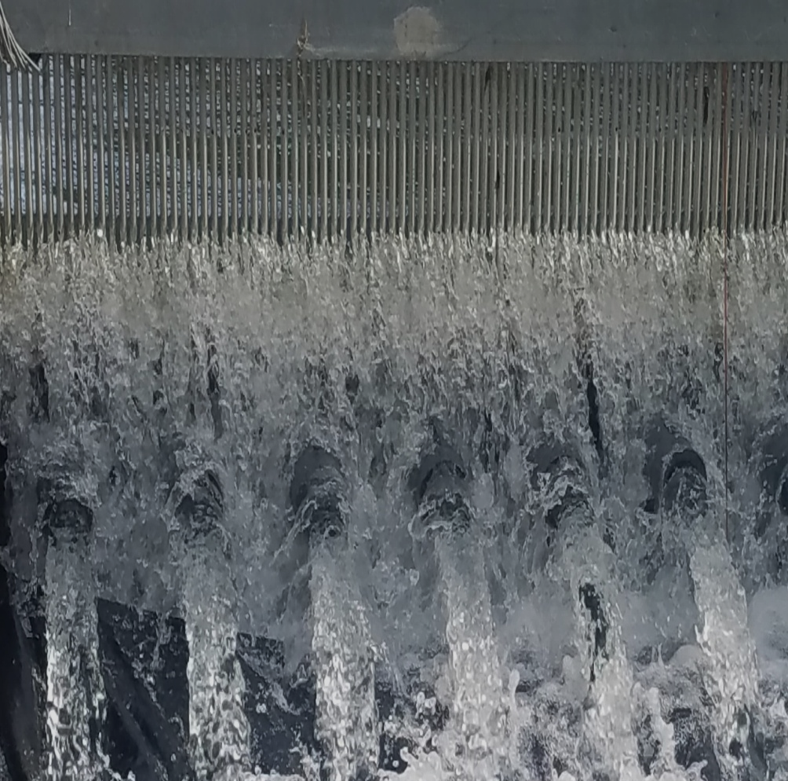
Overview
Project location
Production goals
Past practices
Challenges
Current approach
Results
What have we learned?
Questions

Slide 3
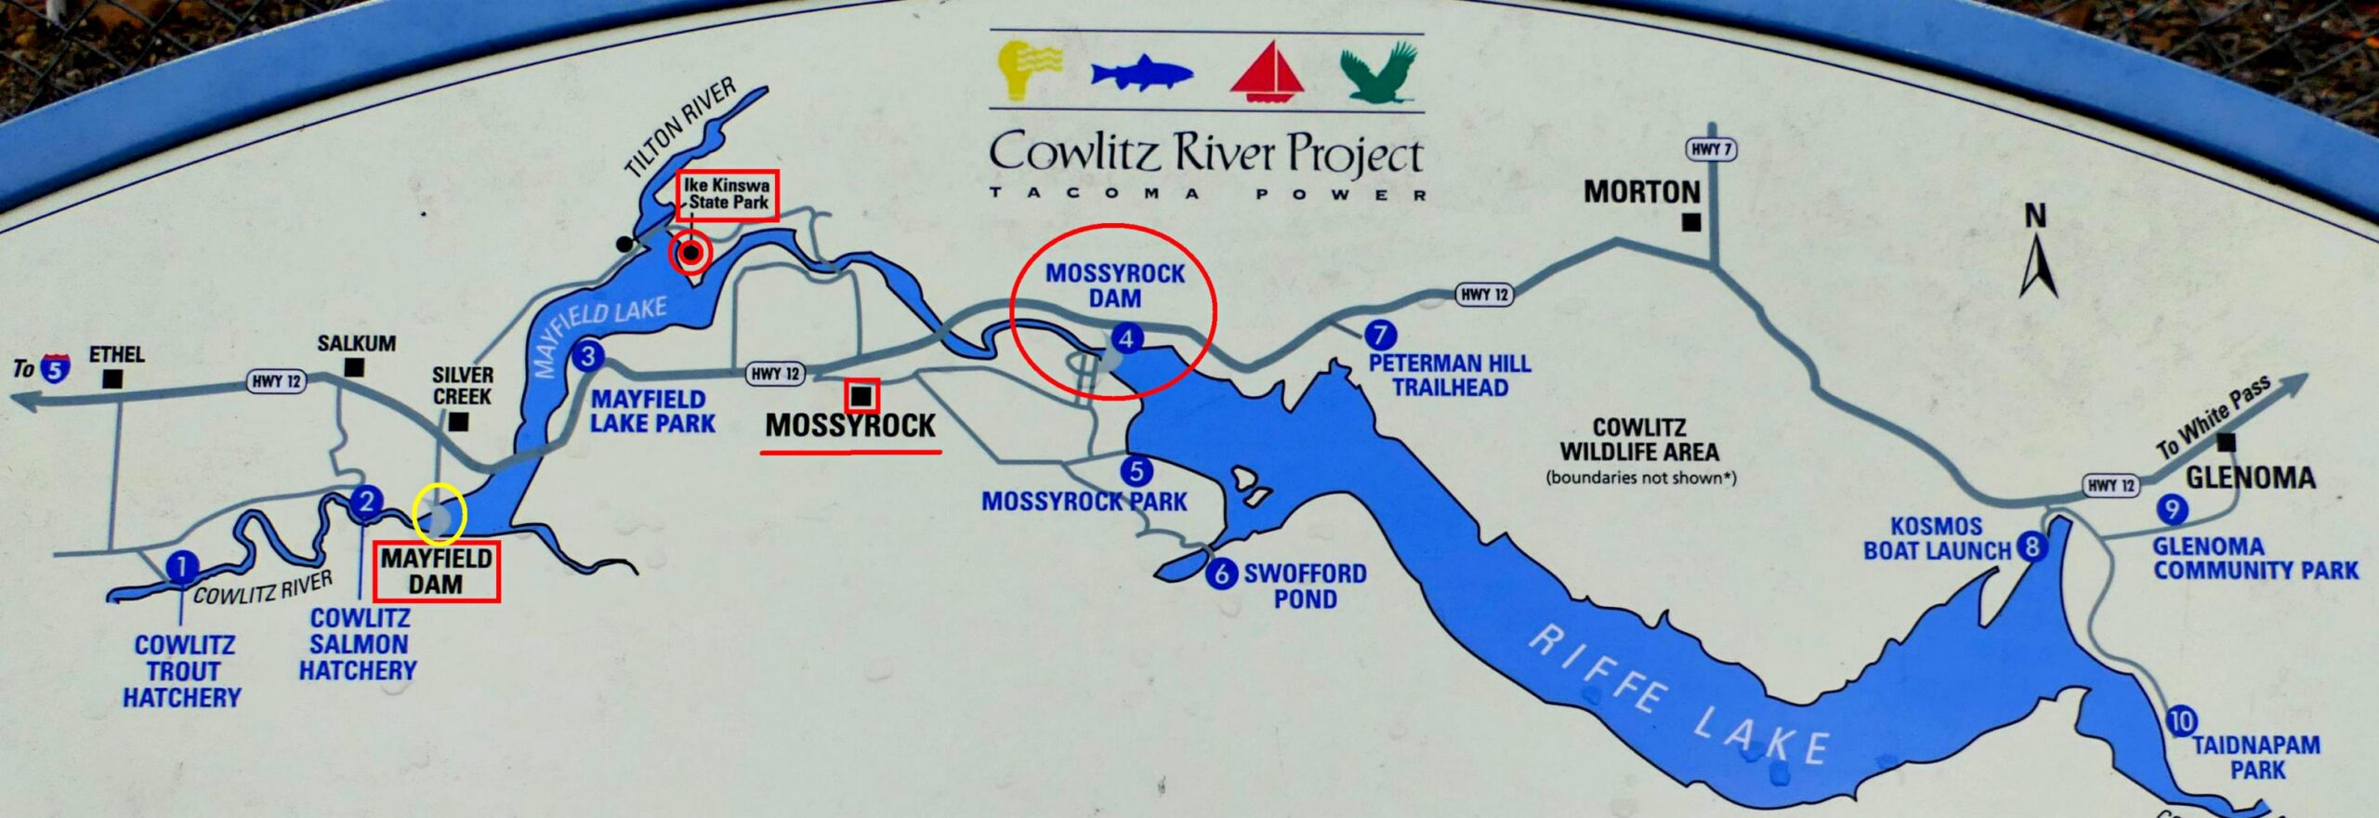
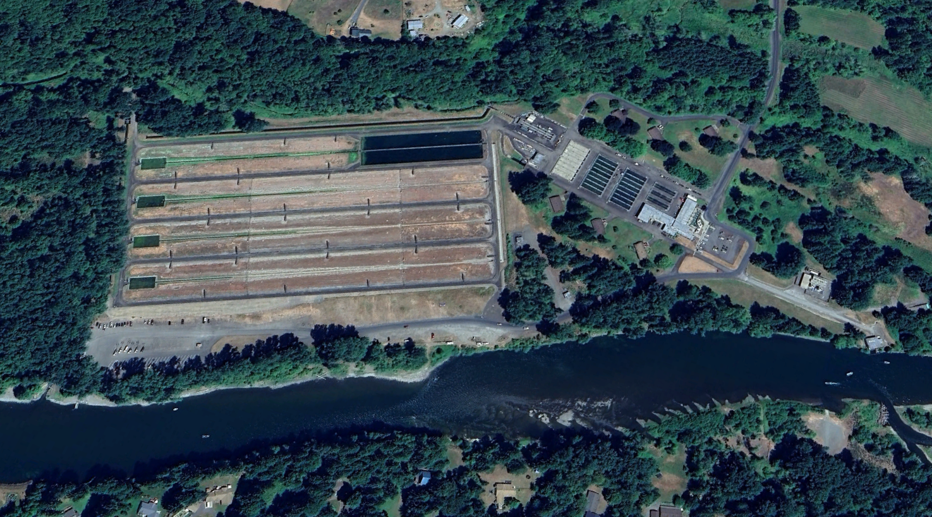
Project Location

Slide 4
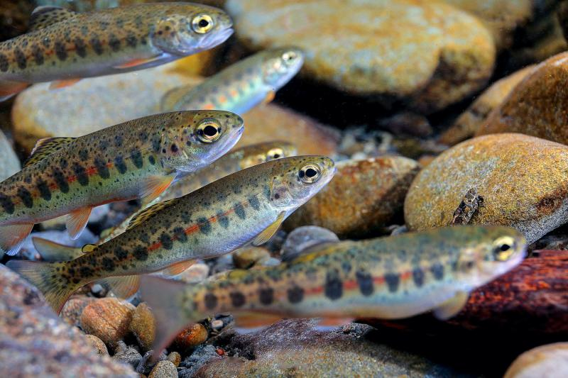
Steelhead Production Goals
Lower Cowlitz Winter Segregated
308,500
Tilton River Winter Integrated
100,000
Upper Cowlitz Winter Integrated
236,000
Lower Cowlitz Summer Segregated
650,000

Slide 5
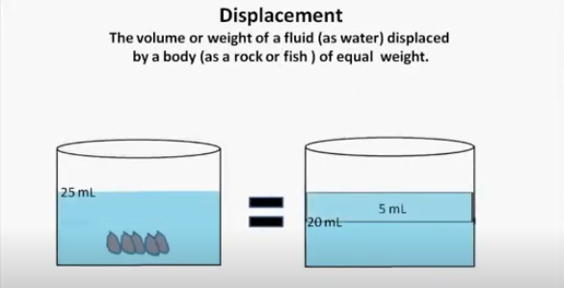
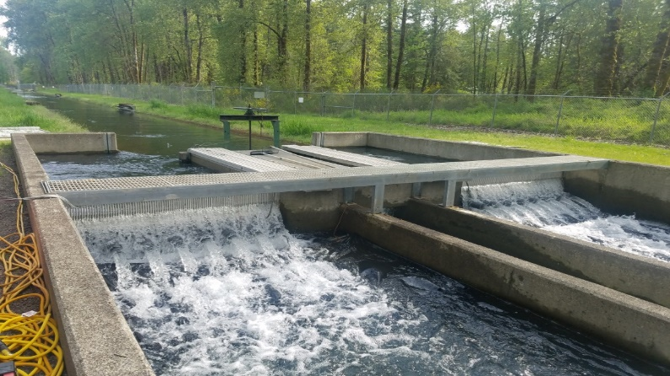
Past practices
Volumetric enumeration
Populate rearing lakes
Release
Conductance counts
Force out
Final count

Slide 6
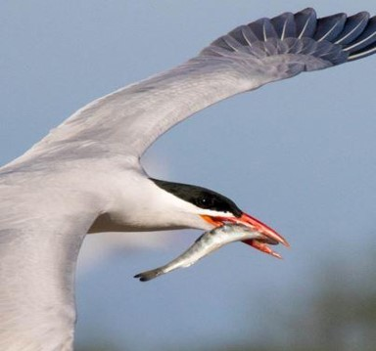
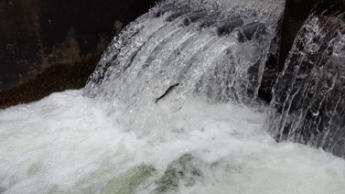
Challenges
Predation
Mortality tracking
Partition of stocks
Precision of release estimates

Slide 7
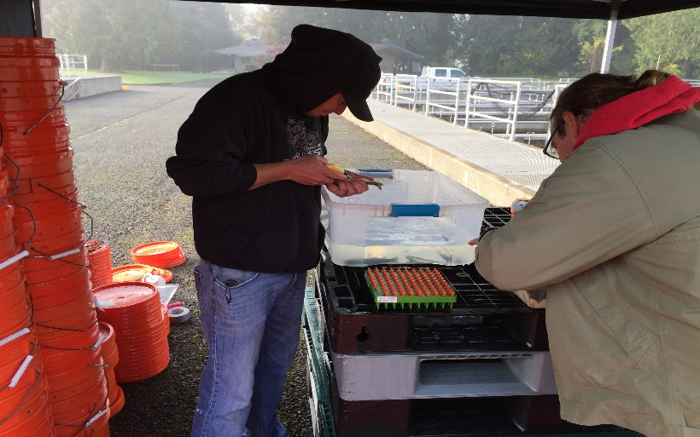
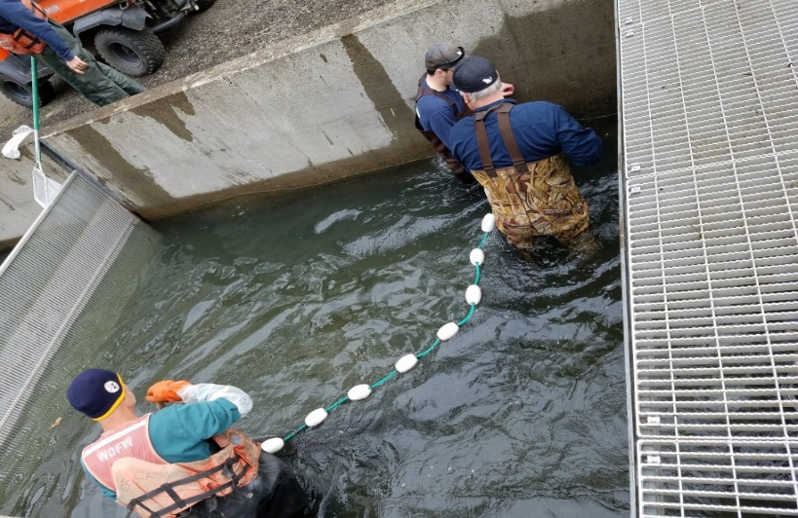
Current approach
Developed CJS mark-recapture model
Installed PIT array
PIT tag summer and winter steelhead
Separate rearing lakes by population
Conduct weekly calibration checks
Spread out releases to minimize overlap
of populations
Compartmentalizing stocks
Increased bird hazing effort

Slide 8
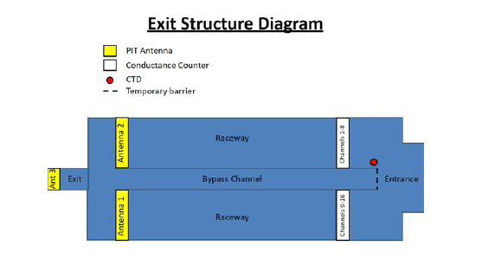
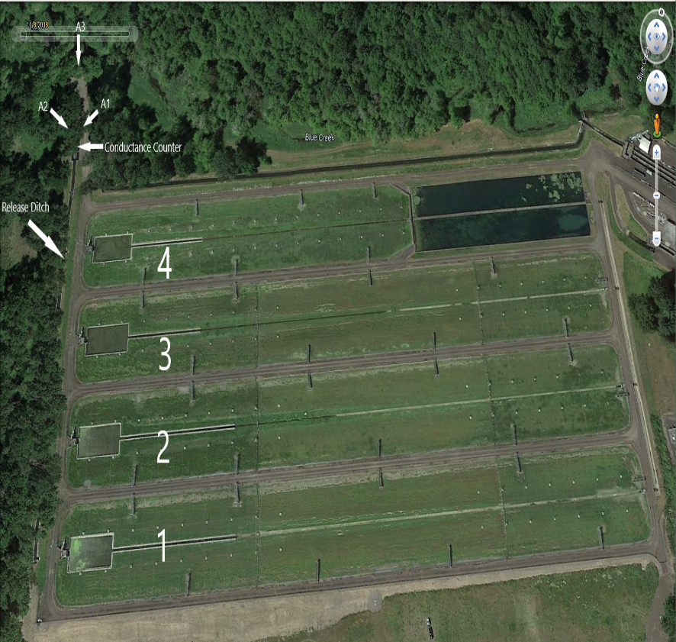
Current approach

Slide 9
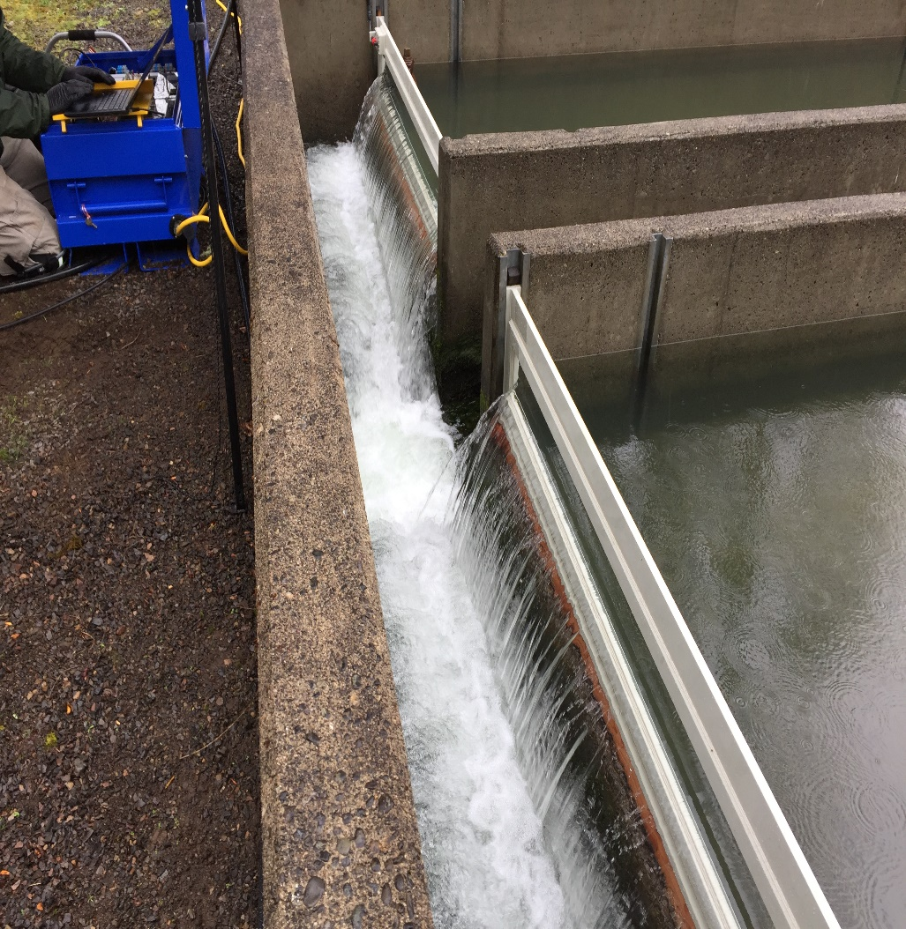
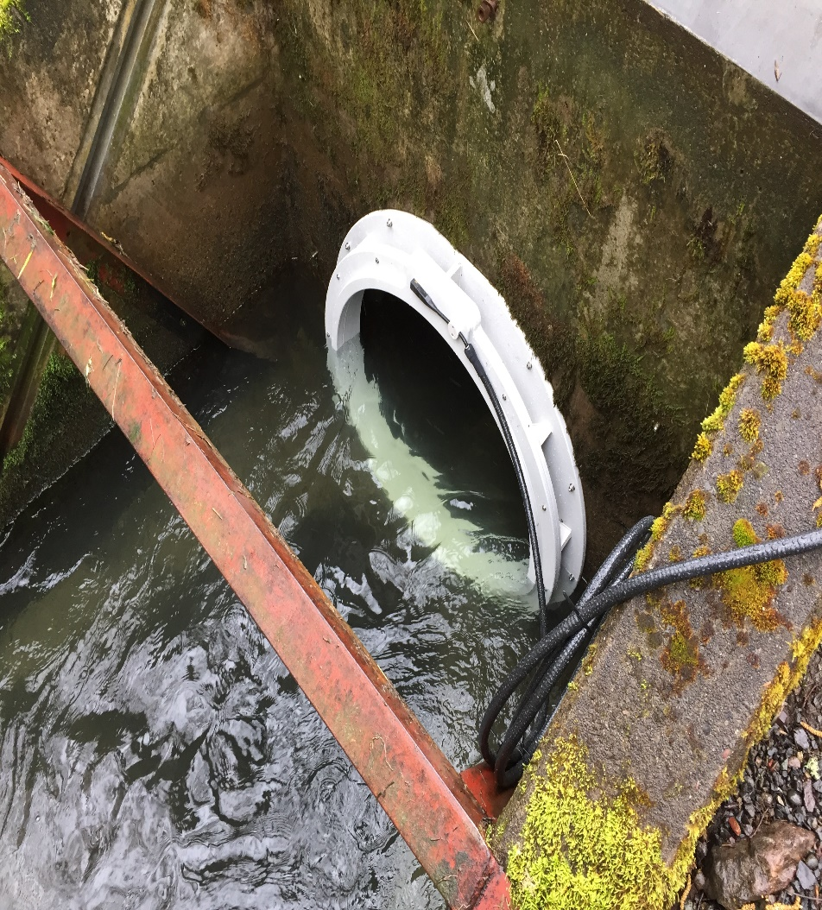
Current approach

Slide 10
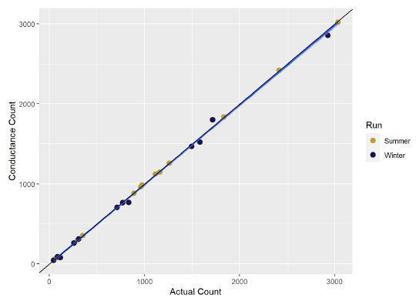


Conductance counter results

Slide 11

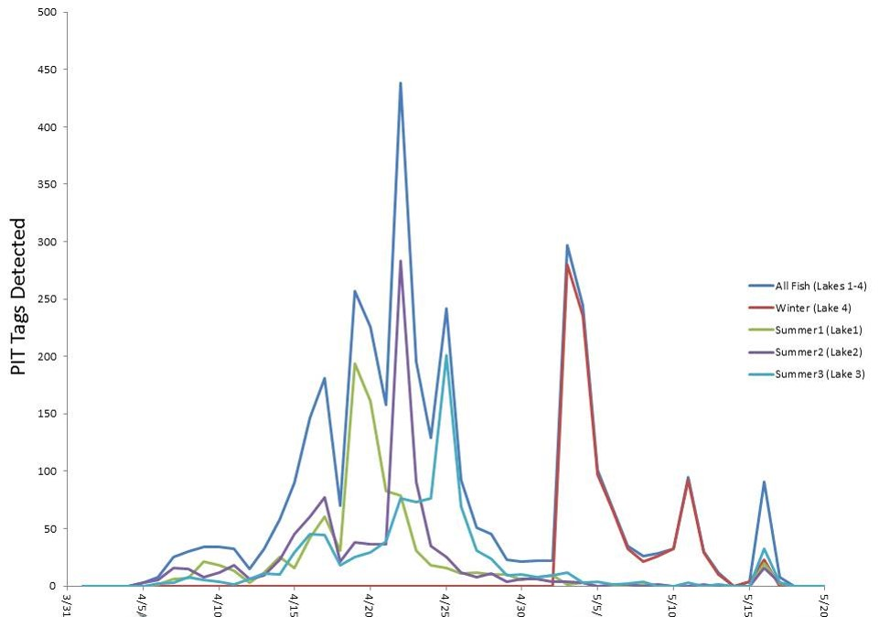
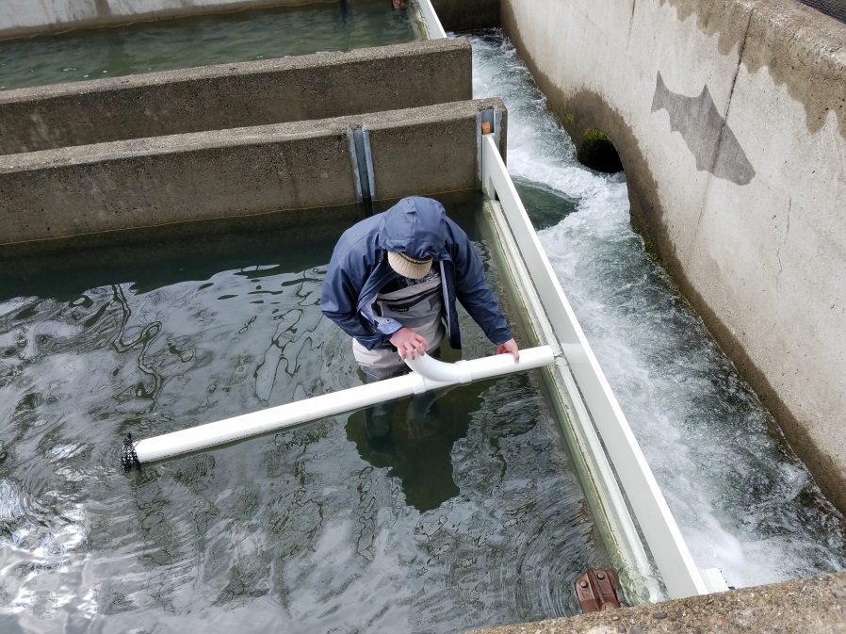
PIT array results

Slide 12
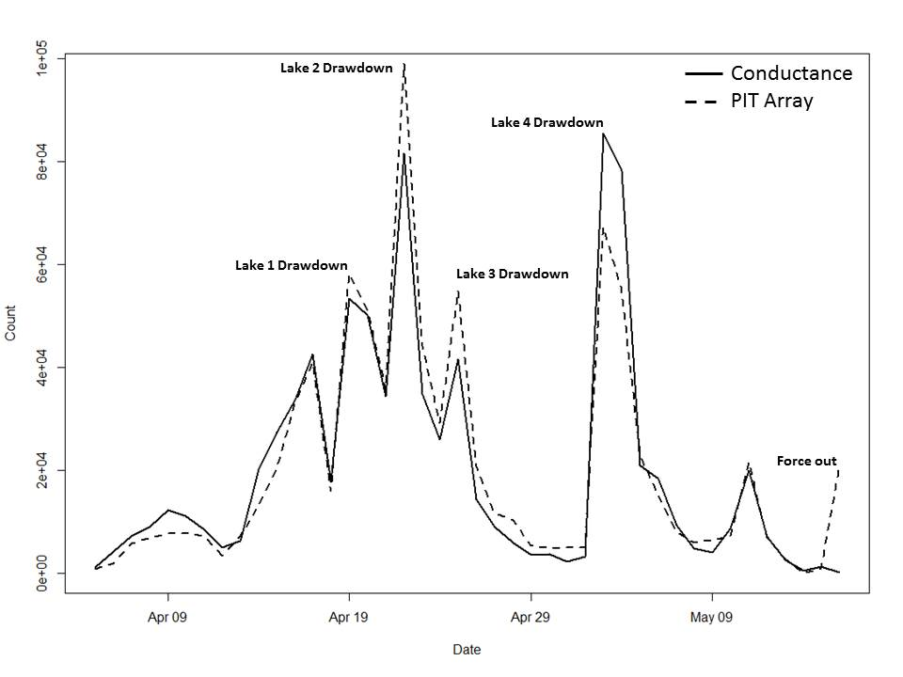

Final release estimate

Slide 13
What have we learned?
High and similar rates of survival across ponds and runs
Changes in practices have led to an improved ability to estimate fish exiting the facility
PIT array has high detection efficiency and both methodologies yielded similar results

Slide 14
Acknowledgements
Four Peaks
Greg Mackey, Peter Stevens and Jacob Usinowicz
Anchor QEA
John Skalski, John Ferguson, and Rich Townsend
Tacoma Power
Eric Shoblom, Matt Bleich, Tim Hoffnagle, Matt Peter, Jamie Murphy, Missy Baier, Josh Ankeny and Trevor Johnson
Washington Department Fish and Wildlife
Dan Rawding, Clint Fitch, John Serl, Bryce Glaser, Phil Sandstrom and Mara Zimmerman and Thomas Buehrens

Slide 15
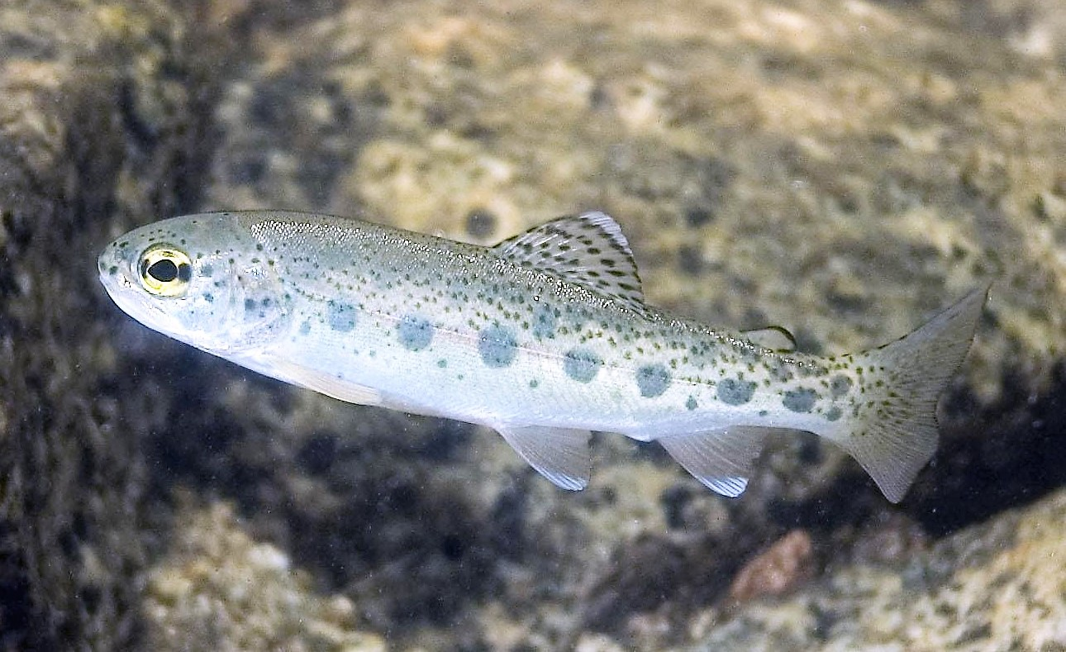
Questions?

