Slide 1
Coho Net Pens – a Satellite Rearing Strategy
Phase II
Cowlitz River Science Conference | Annual Program Review
April 22, 2026

Slide 2
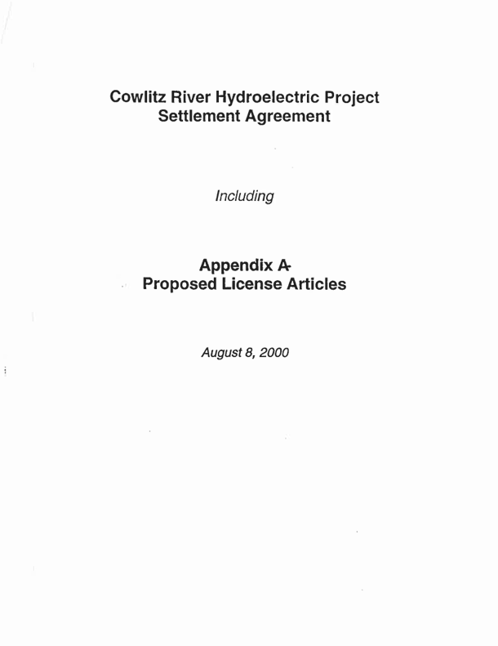
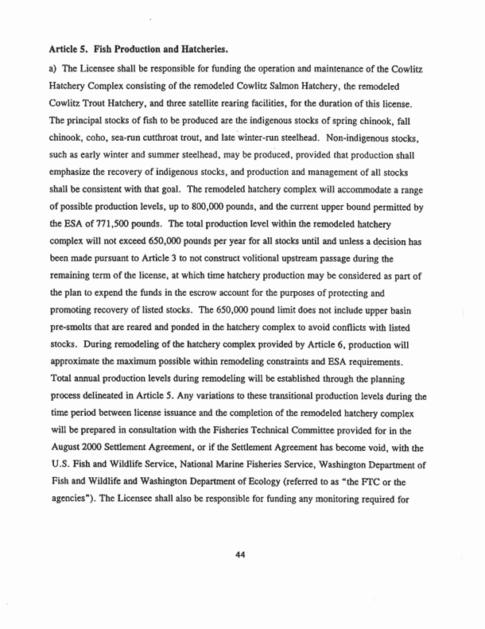
Background – Satellite Rearing
Article 5 of the Cowlitz SA - implementation of three satellite rearing opportunities.
These rearing facilities were intended to help promote recovery of wild salmon runs to harvestable levels.
Adaptive management is a core tenant of this directive.
Notes:
Art 5 Cowlitz SA calls for the implantation of 3 sat rearing opportunities to promote the recovery of wild salmon runs.
The net pens are 1 of 3 components of satellite rearing portfolio. Sam G spoke about this last month so we’re all at least somewhat familiar with that whole story – took ~24 years to get it through but thanks to Sam, Eric, Matt, etc, we have FTC approval and are moving forward. –NEXT SLIDE—
Famously vague

Slide 3
Background – Satellite Rearing
Cowlitz Falls extended operation
Cowlitz Falls rearing (spring Chinook)
  Raise 50k spring Chinook from 12 FPP to ~5 FPP
  Potential for increased survival (larger size at release)
  Potential imprinting benefit for UCR fish
Mayfield net pens (coho)
  One raceway of coho (~250k) moved at 35 FPP to the net pens
  Frees up space for additional spring Chinook rearing
  Raised to ~15 FPP
  Two phase performance testing
Notes:
Read through them.
It was decided that a two-phase study assessing performance was necessary for the net pens ((RELATIVE TO HATCHERY)).

Slide 4
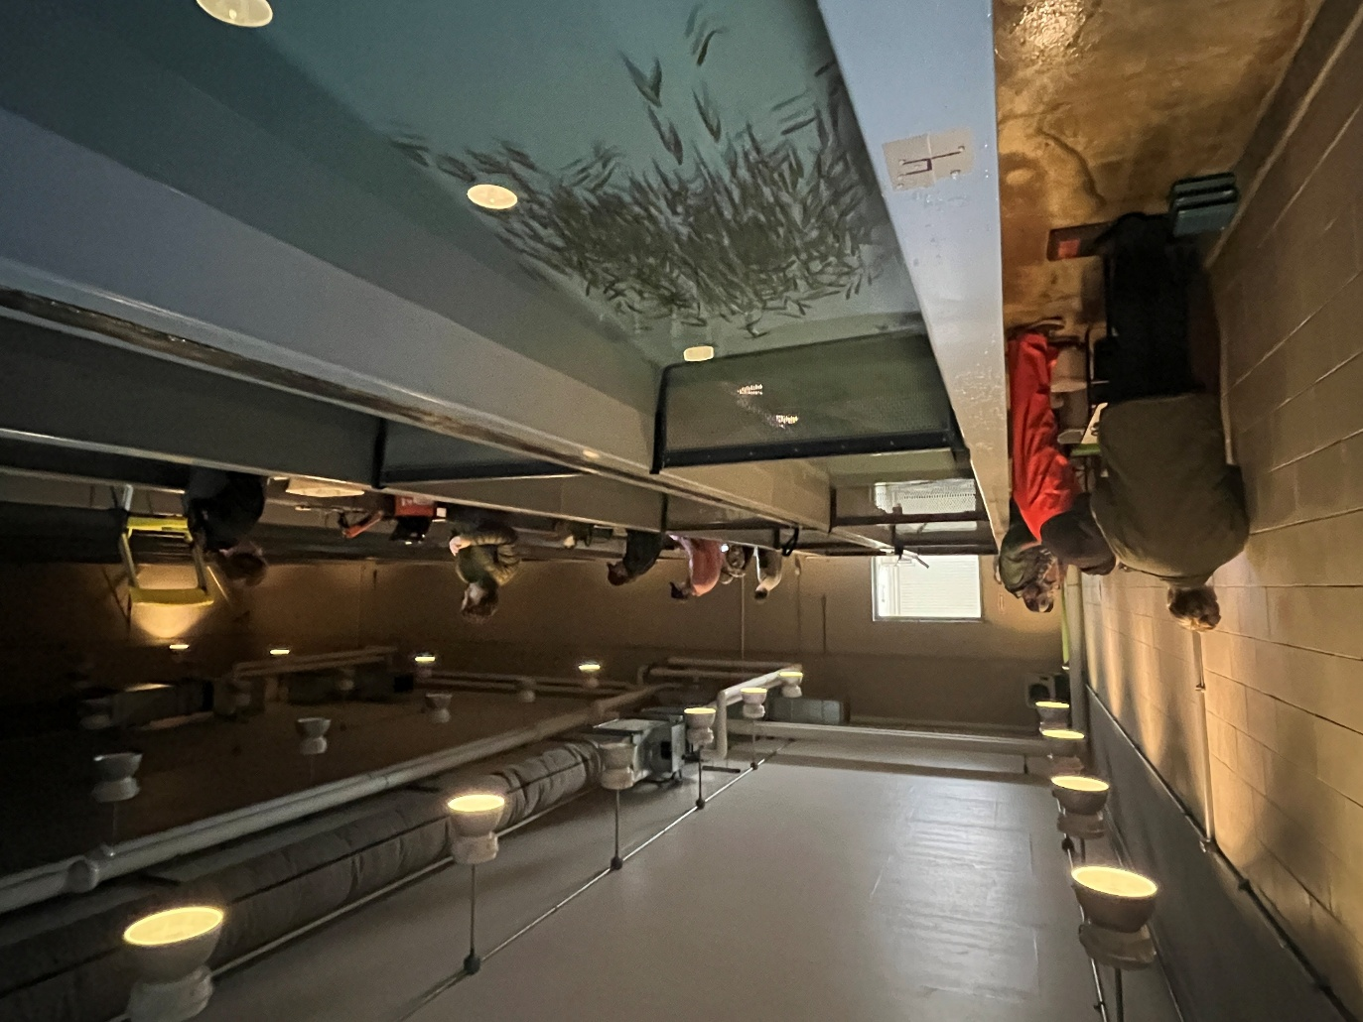
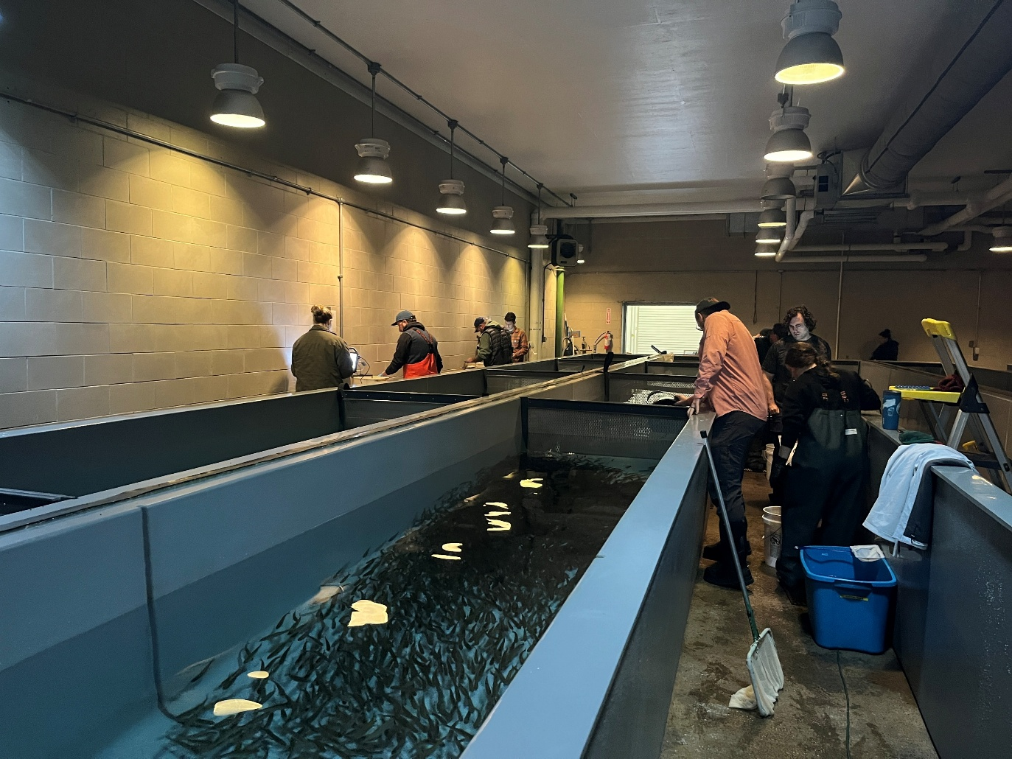
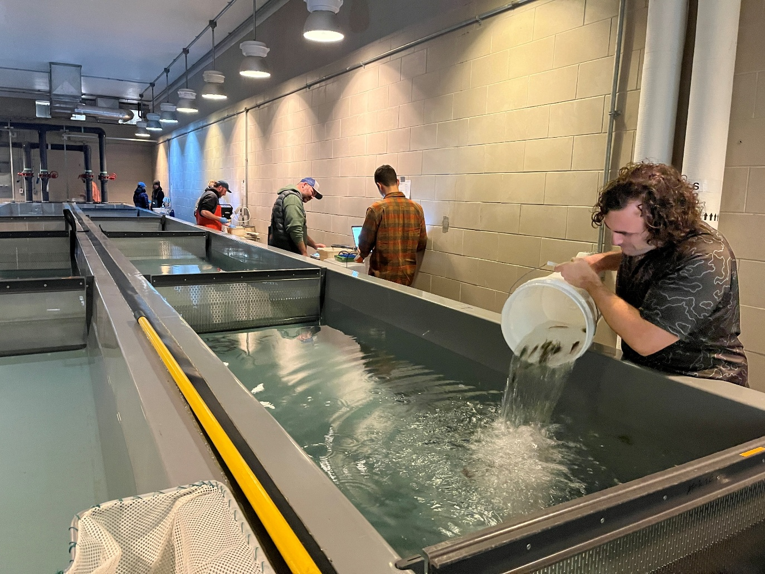
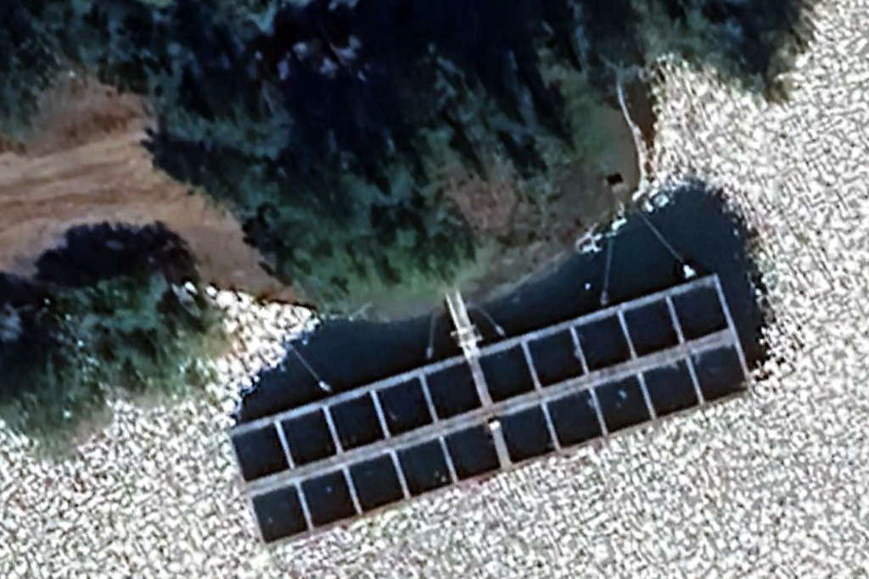
Coho Net Pen Phase II Summary
1
6
2
7
3
8
4
source
2
1
4
3
7
8
5
5
6
Notes:
Dec 1-2 - tagging
Dec 2-3 – transport
Source tank
8 treatment tanks
Corresponds to 8 net pens
Random tagging design

Slide 5
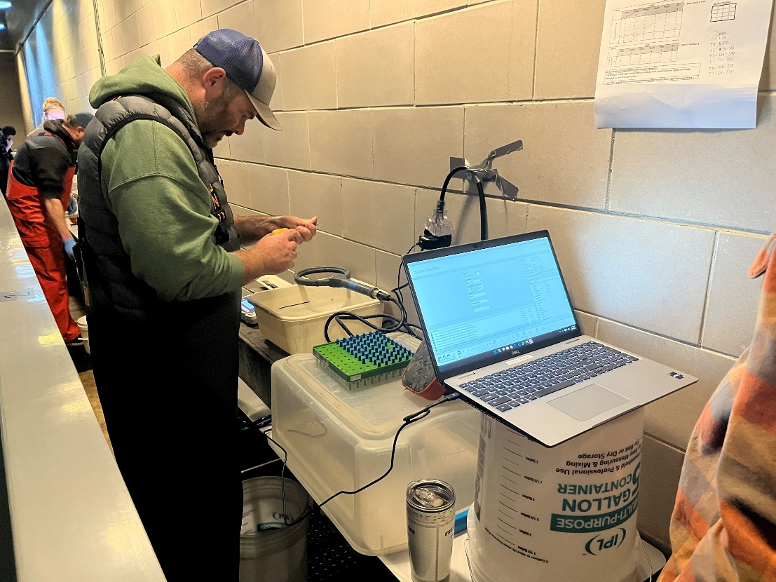
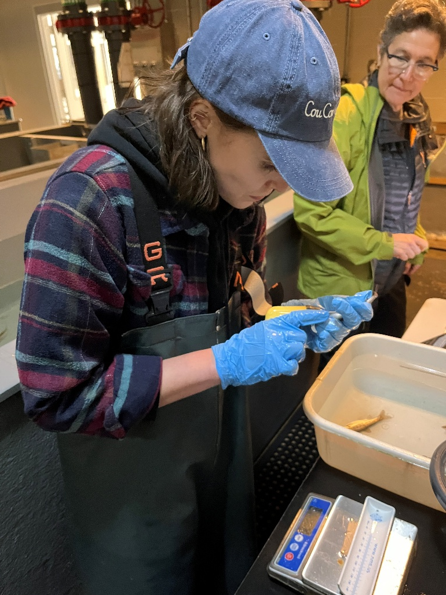
Tagging
Net Pen | Number Tagged
1 | 500
2 | 500
3 | 500
4 | 499
5 | 499
6 | 491
7 | 509
8 | 501
Total NP | 3,999
Control | 61
Notes:
Pre-anesthesia (222) bath that each group could pull from.
Recovery bath.
DO was checked and recovery water refreshed
Fish were hand delivered in batches to their respective trough segment.

Slide 6
Tag shed & mortality
There were 4 mortalities and 4 shed tags from the treatment fish
Of the 3,999 initially tagged, 3,991 were delivered to the net pens
Zero mortalities or shed tags from the tag retention trial.
Net Pen | Number Tagged | Less tag shed/mort
1 | 500 | 499
2 | 500 | 500
3 | 500 | 498
4 | 499 | 499
5 | 499 | 497
6 | 491 | 490
7 | 509 | 507
8 | 501 | 501
Total NP | 3,999 | 3,991
Control | 61 | 61
Notes:
Tag retention trial
4060 tagged. 0.1% tag shed.

Slide 7
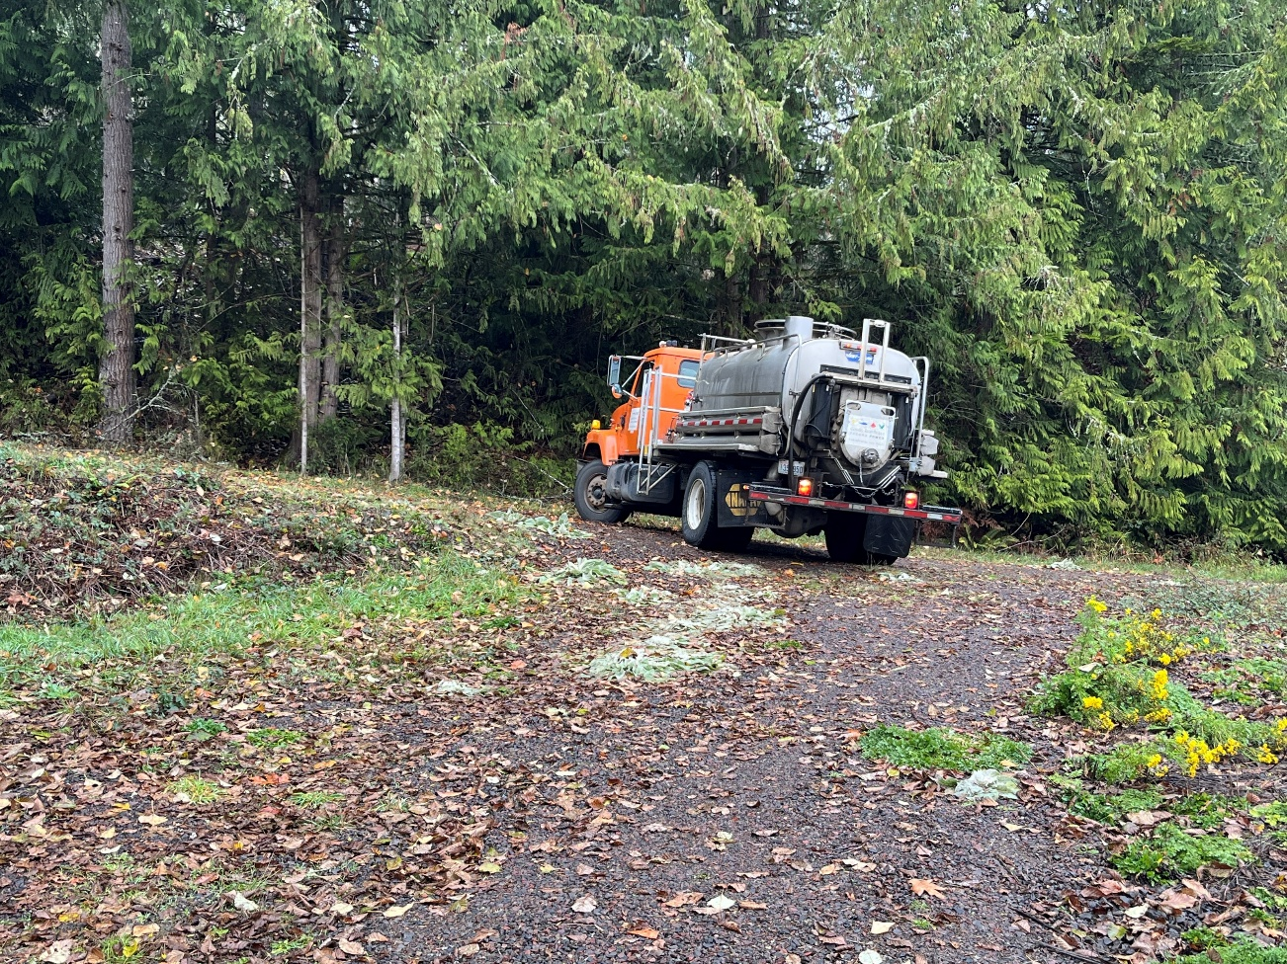
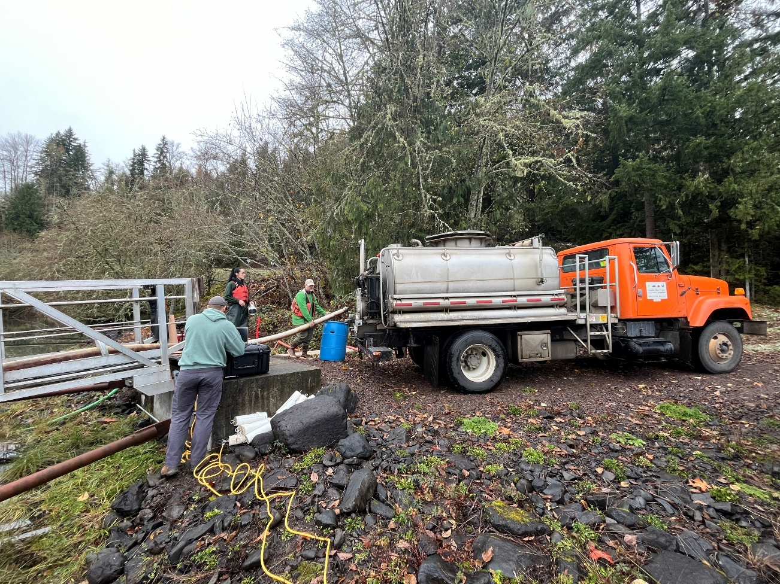
Fish transport

Slide 8
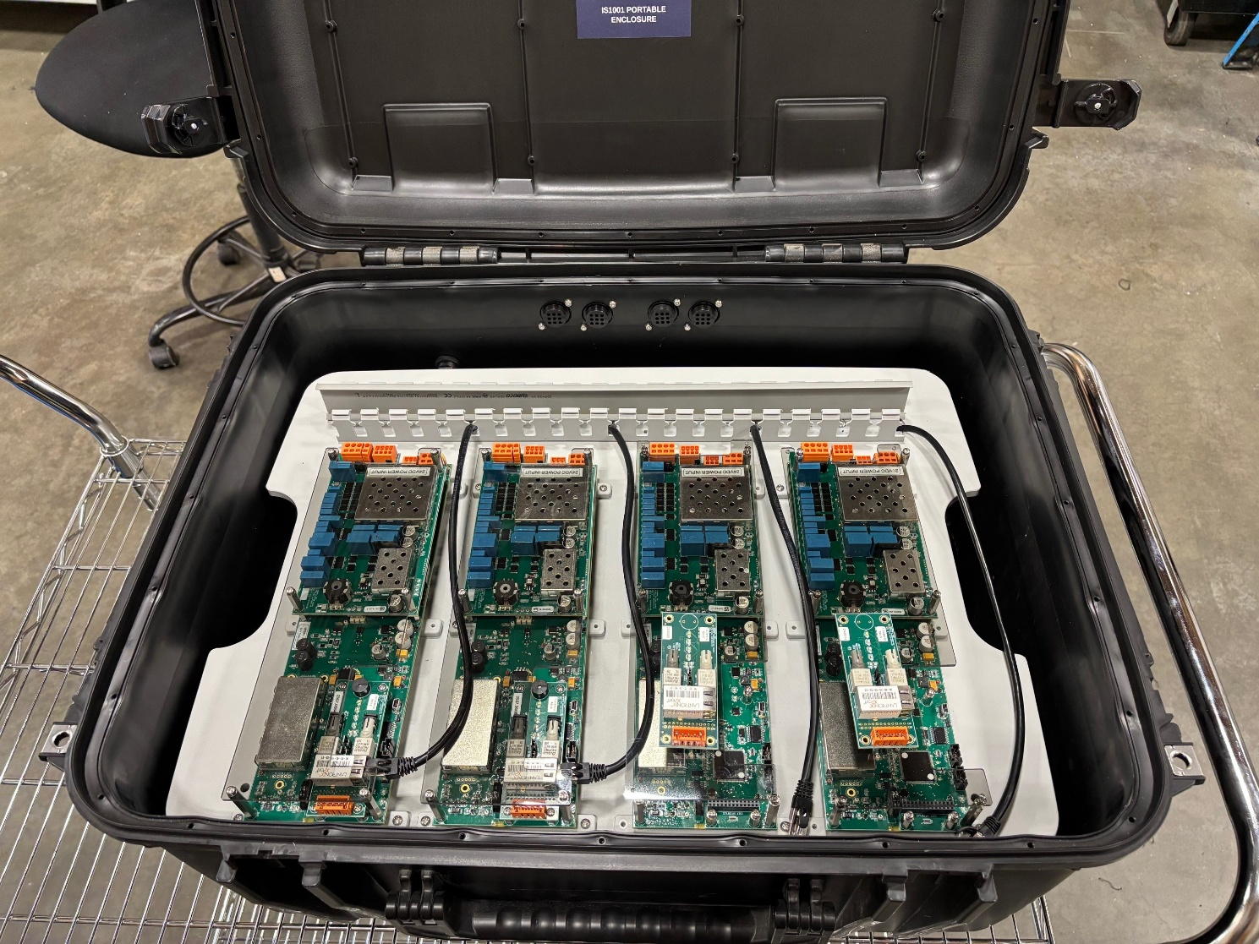
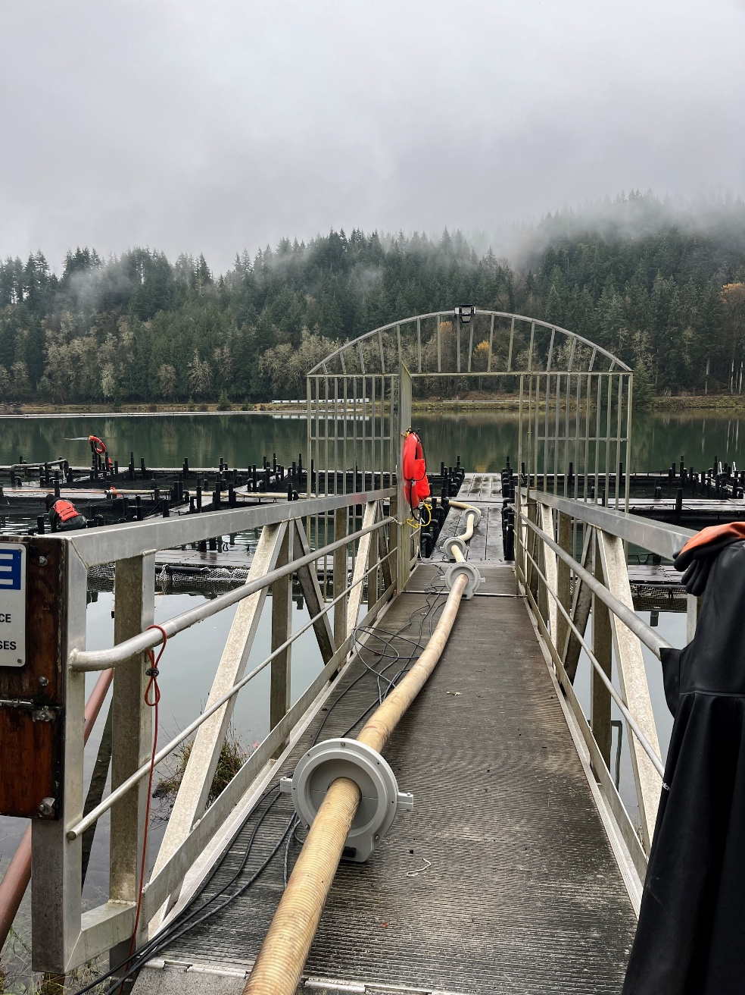
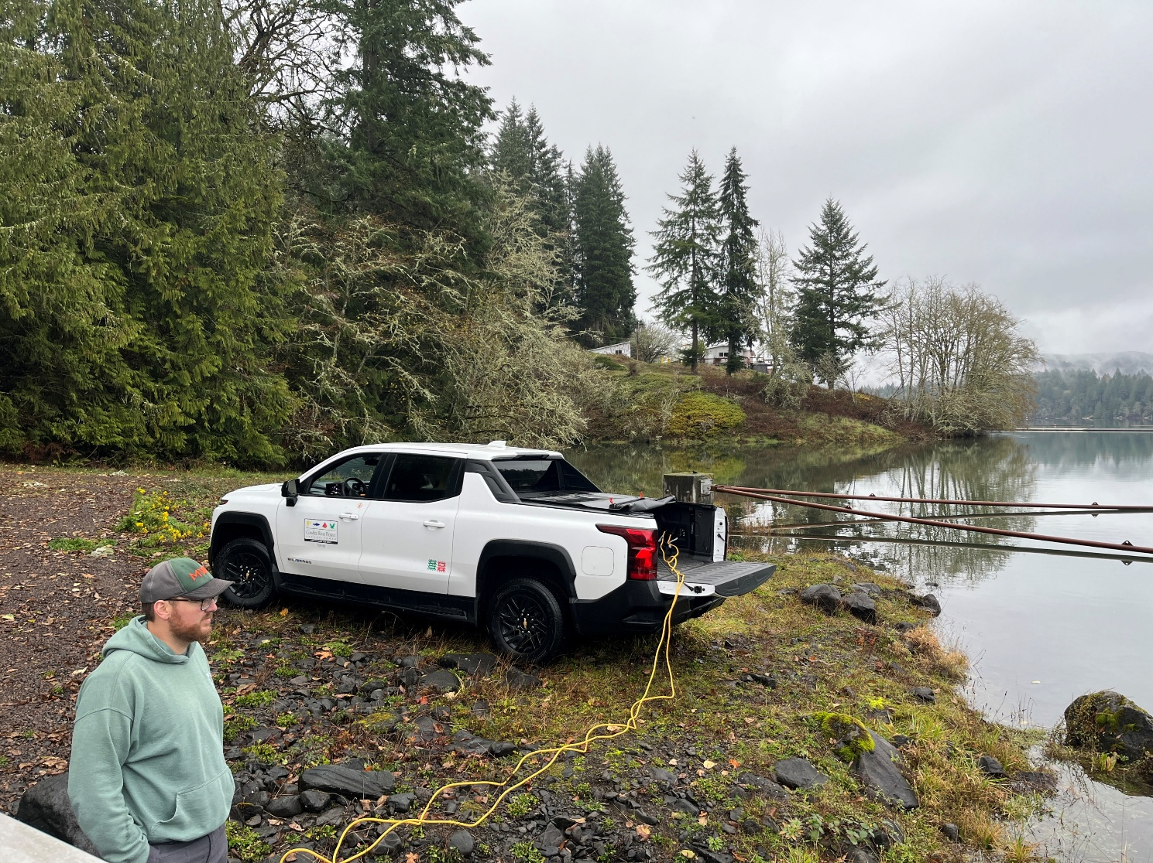
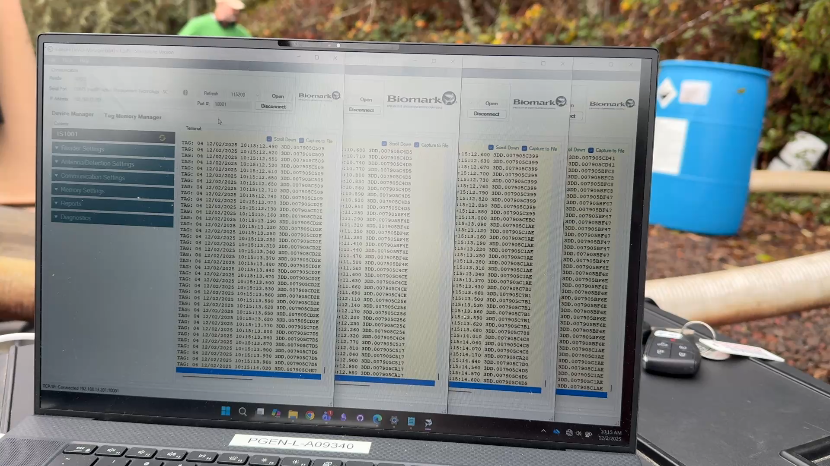
Tag detection efficiency
Of the 3,991 PIT tagged fish that were delivered to the net pens, 3,909 were detected through the array (97.9%).
Notes:
Biomark IS1001 (high frequency PIT antennas)

Slide 9

Detection efficiency
3,909 of the 3,991 fish that were transported were detected = 98%
Net Pens
3,523
(88.3%)
3,112
276
(6.9%)
2,703
98
(2.5%)
3,036
12
(0.3%)
3,110
Notes:
3909 tags were detected at least once.
These rates of tag capture become very important in our overall survival estimates which is the most crucial part of this study.

Slide 10
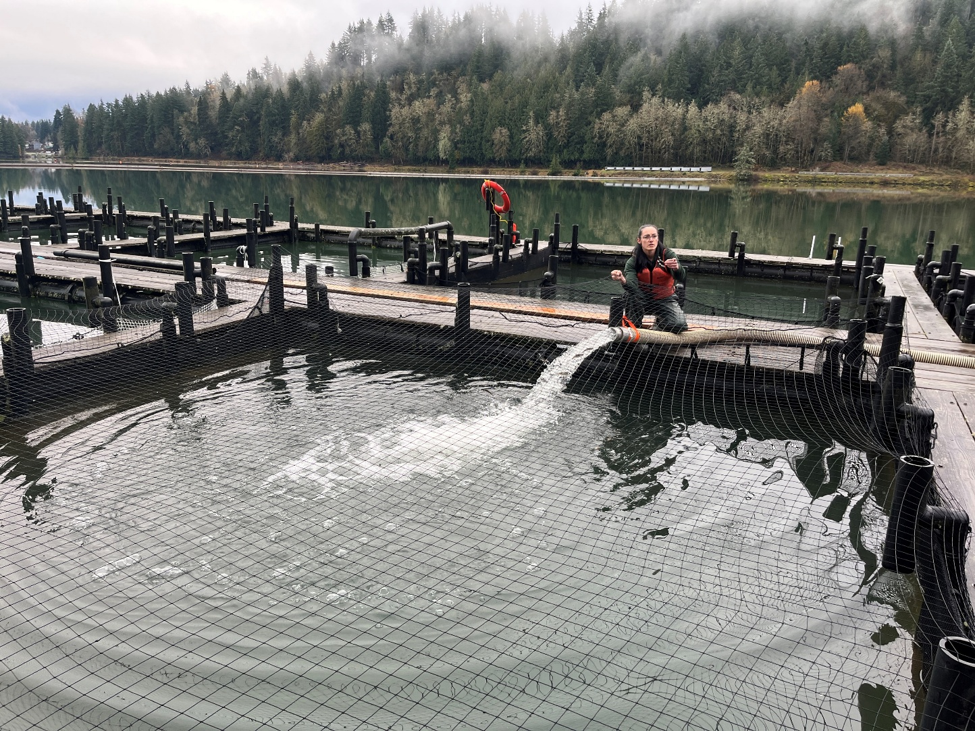
Initial net pen loadings
Net Pen | Loading | Tagged fish
1 | 32,026 | 499
2 | 32,008 | 500
3 | 33,377 | 498
4 | 33,307 | 499
5 | 32,671 | 497
6 | 32,818 | 490
7 | 34,154 | 507
8 | 19,728 | 501
Total | 250,089 | 3,991

Slide 11
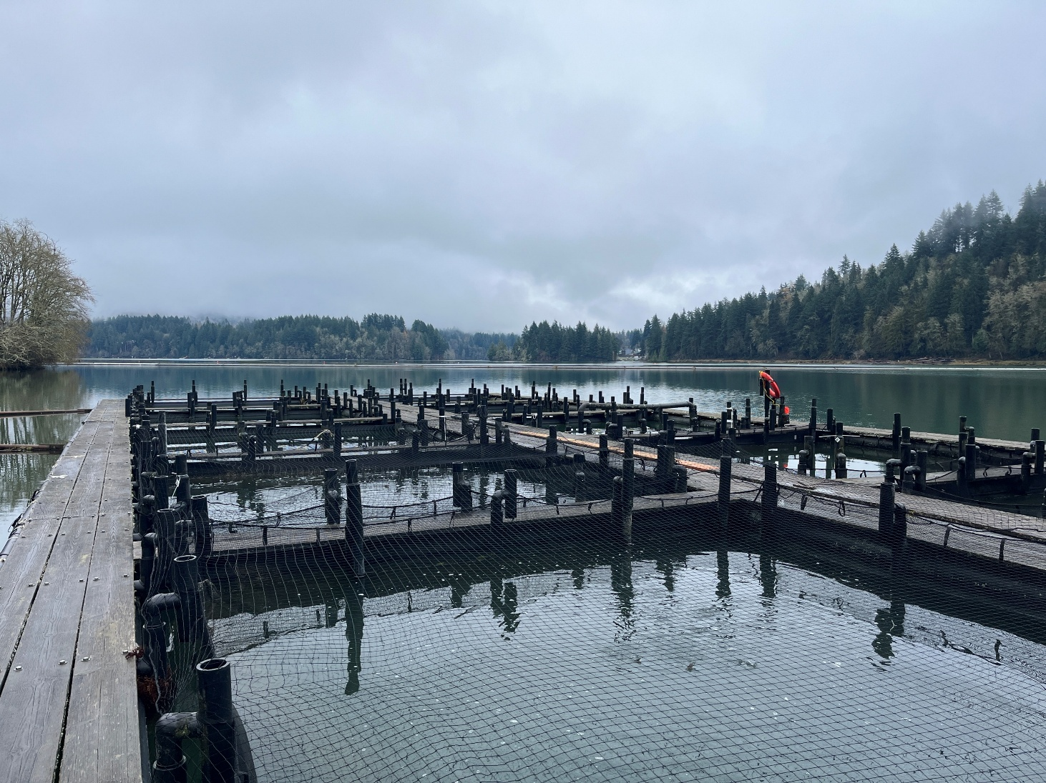
Routine net checks
Feeding/mortality check = multiple per week
Qualitative – predator evidence, net condition, fish injury, etc.
Weight check = once per week
CV check = once per month (~200/pen)
Notes:
So, now that our fish are in their new homes for the next 5 months…
Read through.
CV checks = ensuring that growth is adequate and keeping up with hatchery growth as well as making sure that growth is consistent within and between nets.

Slide 12
Study evaluation
Treatment comparison (net pen vs hatchery)
  Survival
  Growth
  Size variance
  Condition factor
  Pathology
  Adult return*
Notes:
Read through list.
*Adult return is not a core goal of the study, but we can ascertain additional benefit. 4k PIT tags plus 250k CWTs (50k & 200k split). – certainly potential for analyzing downstream effects of rearing treatment.

Slide 13
What is success?
Net pen survival estimate (Cormack-Jolly-Seber) is adequate compared to hatchery survival.
Net pen fish are growing to 15 FPP at an adequate pace comparable to the hatchery and with similar variance.
Health anomalies are comparable to hatchery fish.
Results should be held relative to both effort and benefits to the program.
Notes:
Read through these…
#4 = success should be held relative to both effort and benefits to the program

Slide 14
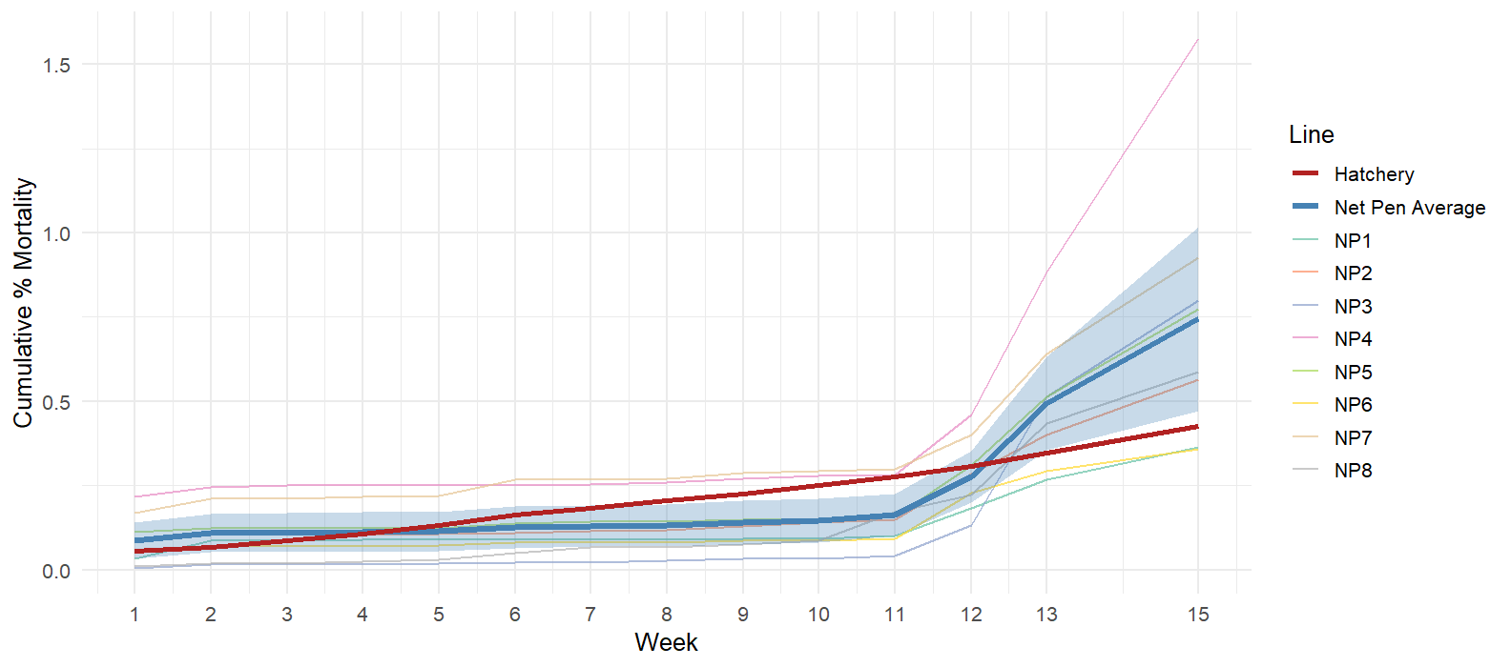
no
data
Notes:
Data as of April 1st.
Scaled to zero to account for mortality within the hatchery prior to net pen fish moving out
Net pen starts slightly higher (handling stress; expected)
Spike in net pen mort towards the end is likely due to some combination of increase in predator evidence, some light evidence of escape and smoltification*.
Phase I saw a 0.52% loss through the study. Hatchery has been in the 1-3% loss over the last few years (reminder, the graph doesn’t show the full hatchery picture).

Slide 15
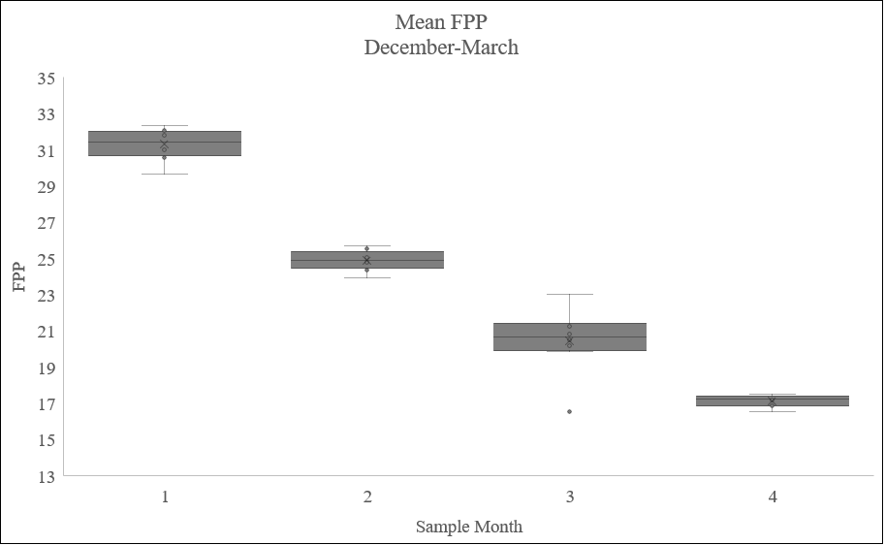
Dec
Jan
Feb
Mar
Notes:
These box plots were made using the averages across all 8 net pens for each CV sample month (Dec-March).
FPP is a little tricky since FPP is inherently an average measurement, so this plot in particular is the average of the averages.
You’ll notice this graph, along with the next few are a little light in terms of comparisons made with the hatchery. While some hatchery data exists, it doesn’t exist at the same scale that we were collecting data on the net pens and I wasn’t able to access it in time to include.
However, if we think back to our “what is success” slide, we remember that success for this effort is defined as *survival comparison* which we can sort of do now (last slide) but will really only be able to do in earnest once the fish are released and we can run the CJS *AND* ensuring that fish are growing to their target release weight at a reasonable pace and with reasonable variance and this graph reflects just that.
Red line is 15 FPP release target.
&&Low outlier in month #3 is from NP8.

Slide 16
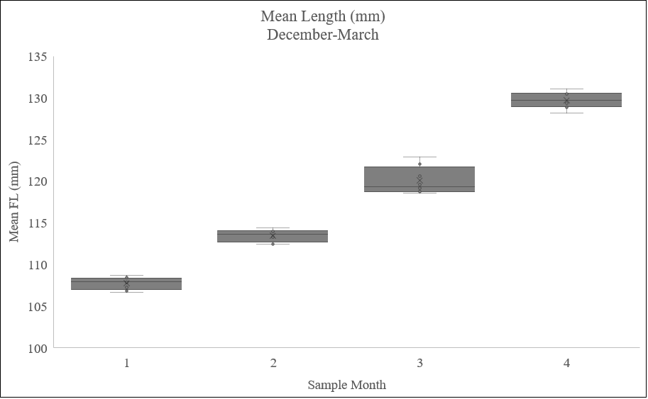
Dec
Jan
Feb
Mar
Notes:
This plot is the average length across all measured fish (~200) for each net.

Slide 17
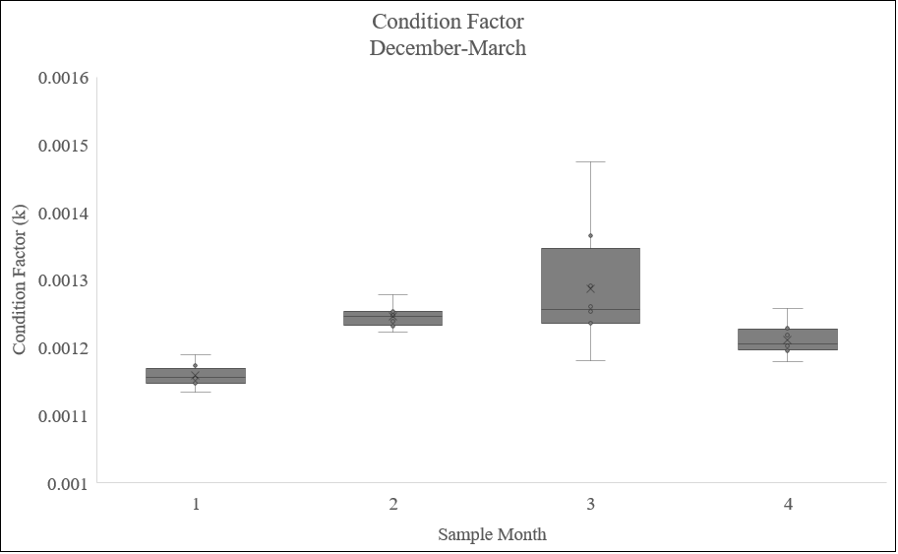
a
ab
b
c
Dec
Jan
Feb
Mar
Notes:
Condition factor has been shown to be a rough proxy for smoltification. So I was curious if we were able to see that process happening through the data we have.
However, because we have individual length data but only mean weight data, K could only be calculated here using mean net pen lengths and weights.
Ran an ANOVA and Kruskal-Wallis for a pairwise comparison to see if we were seeing an inflection point towards the end with smoltification.

Slide 18
Fish release
April 27-28 release target
Fish will be pumped into transport trucks
Released directly into the Cowlitz River at the CSH boat launch through the detection array

Slide 19

Survival estimate
Cormack-Jolly-Seber M/R
  Estimates apparent survival and detection probability
  Uses a series of 0s and 1s to denote observation status across a time series at tagging and through the detection antennas at stocking and release
110110011
$φ$₁ $φ$₂ $φ$₃ $φ4$ $φ$₅ $φ$₆ $φ7$ $φ8$
1 1 0 1 1 0 0 1 1
p₂ p₃ p₄ p₅ p₆ p₇ p₈ p₉
Notes:
Survival = apparent survival ;; notably does not differentiate between mortality and loss to the study (emigration & predation).
A CJS model is necessary because multiple indistinguishable loss processes are possible (predation, unobserved mortality, emigration).
It is the probability that a tagged individual survives and remains in the study area and has a chance of being recaptured.
**Walk through slide, then--
The program will count up the frequency of occurrence across the 256 catch possibilities that each tag could have and the model will determine apparent survival (converted into %mort).

Slide 20
Next steps
Releasing fish next week (April 27-28)
Run the CJS model for survival estimate
Compile any comparison data deemed necessary
Final recommendation will be presented to the FTC this summer
Notes:
Science conference presentation – opportunity to incorporate growth data comparisons

Slide 21
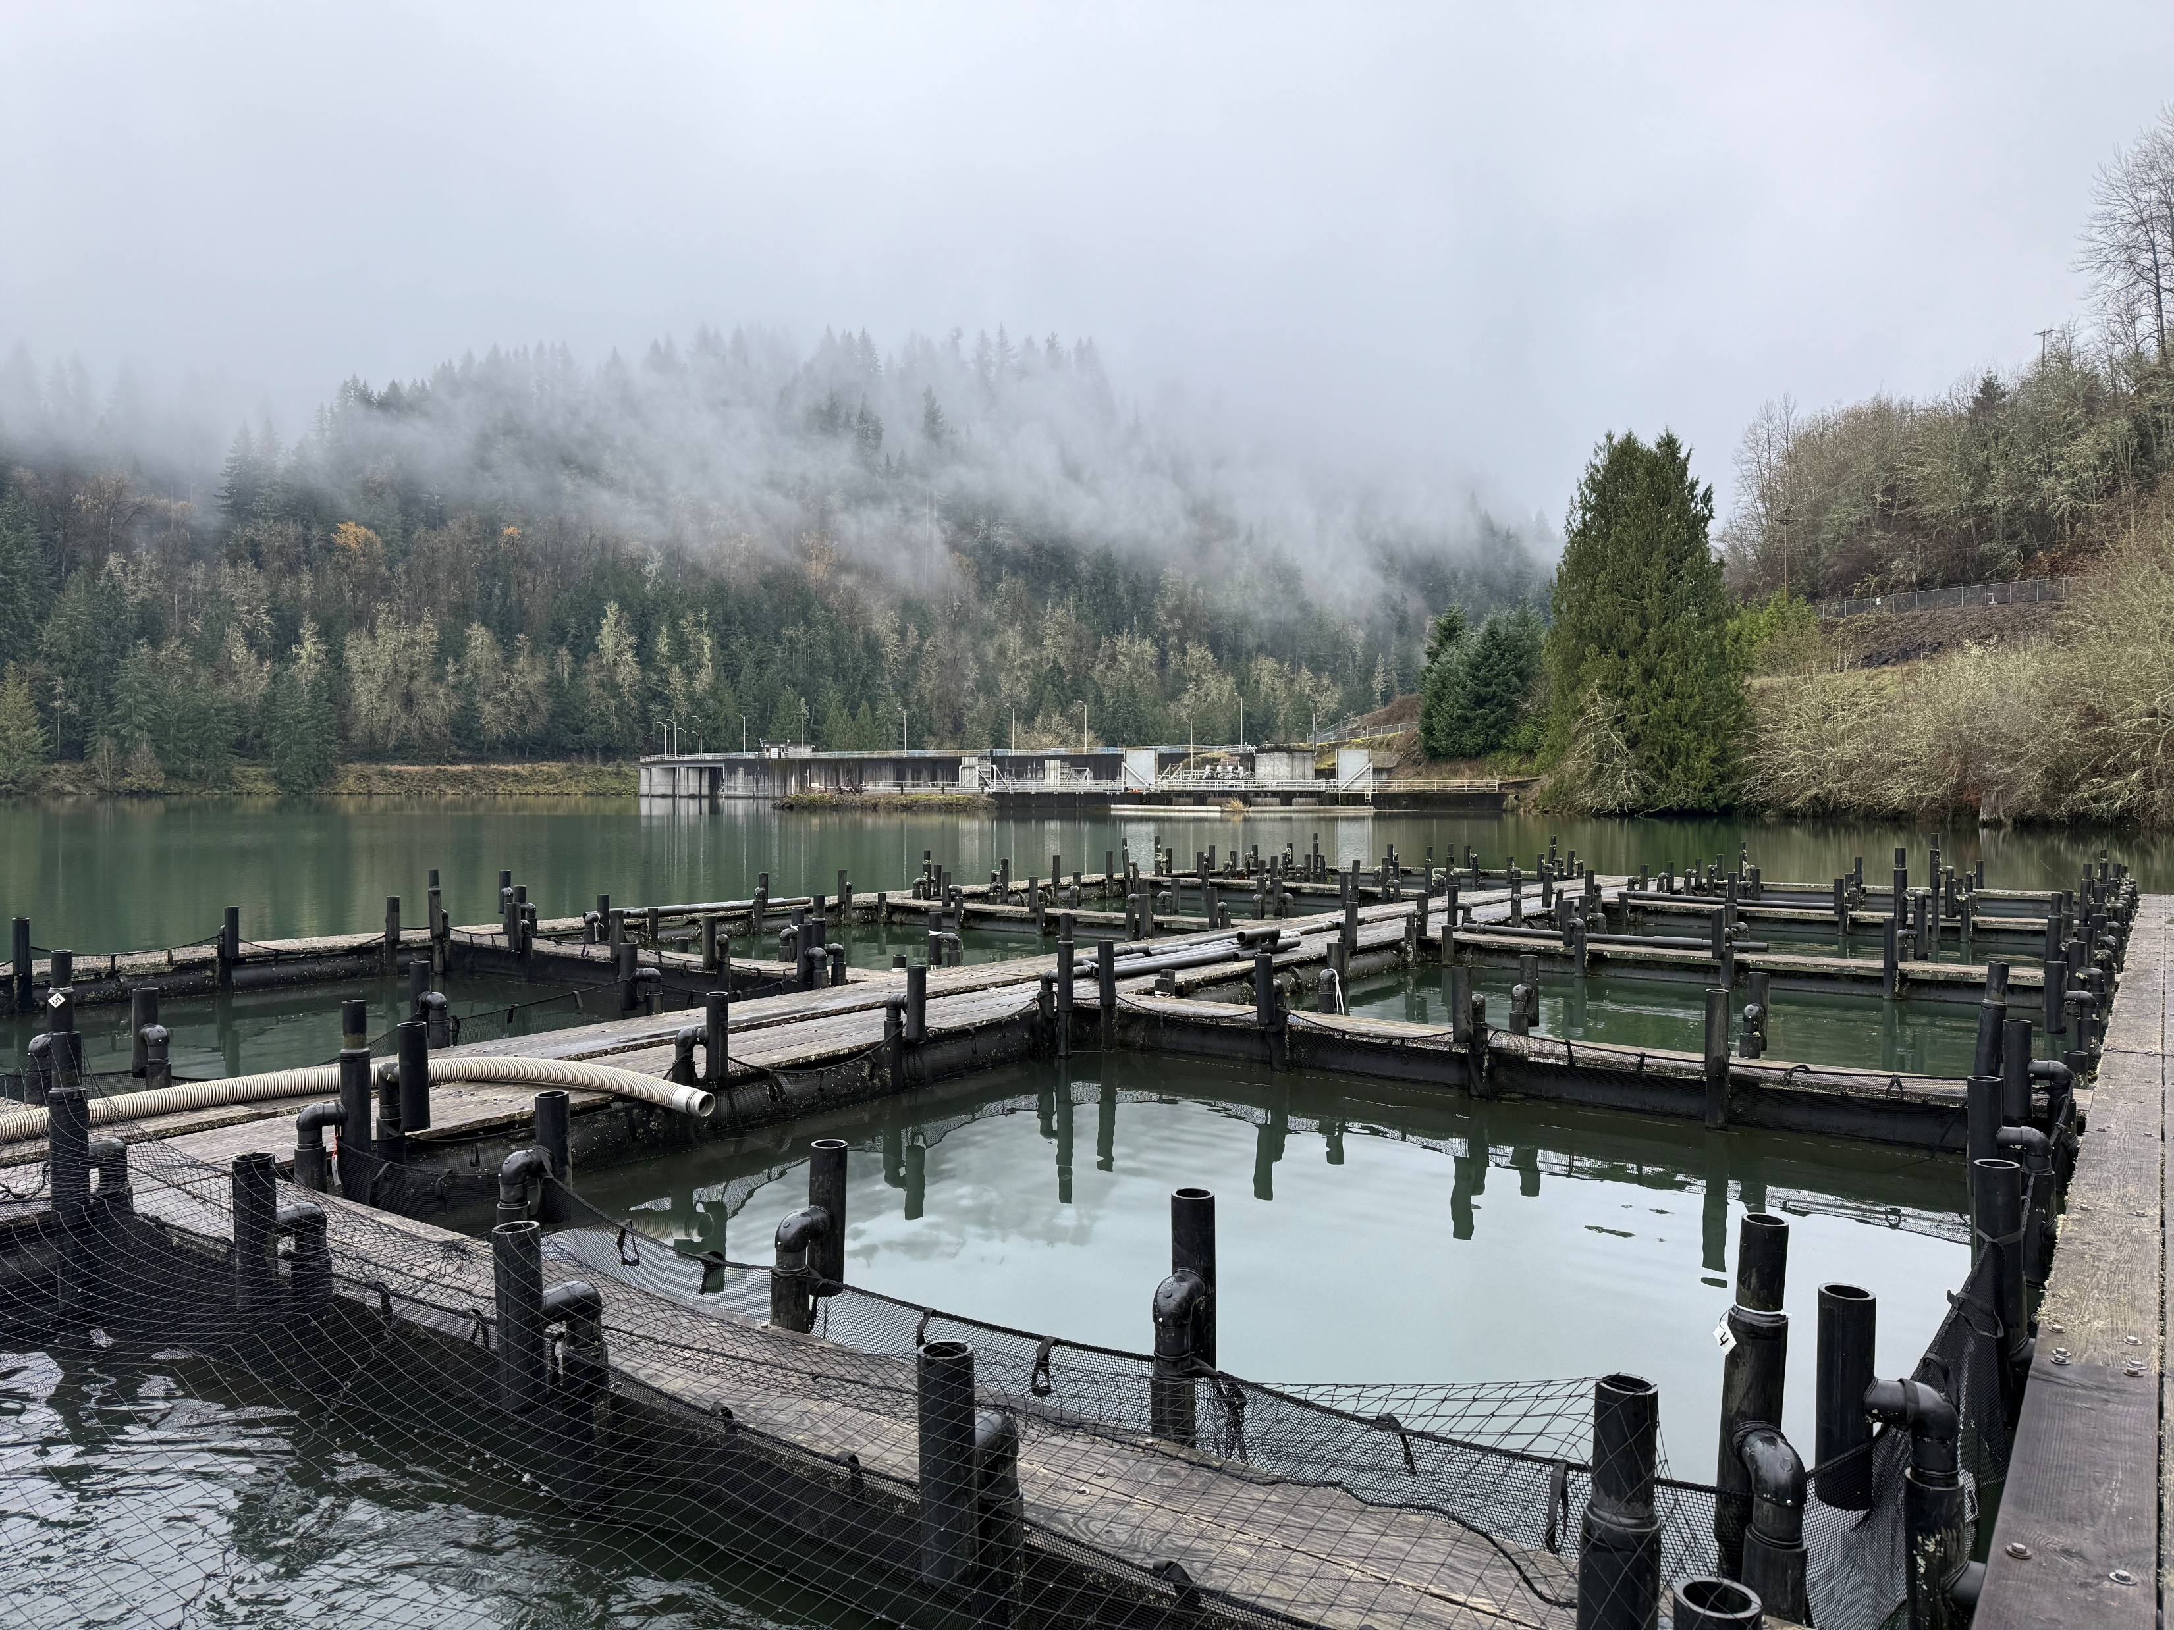


Acknowledgements
Tacoma Power:
  Natural Resources
  Cowlitz Project Staff
WDFW:
  Kris Warner
  Larona Newhouse
  Brian Gail
  Cowlitz Salmon Hatchery staff
Notes:
While this may not be the most technical study, it certainly involved a ton of coordination and for that I am super grateful for everyone involved.

Slide 22
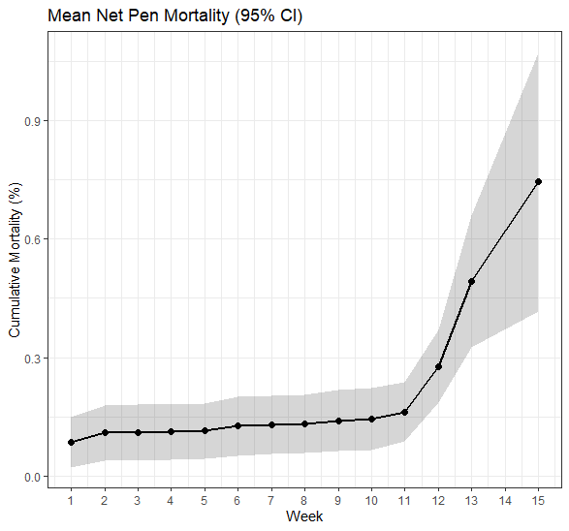
Delete?
Notes:
Scaled to zero to account for mortality within the hatchery prior to net pen fish moving out
Net pen higher start on graph (handling stress; expected)
5% mortality threshold but also looking at performance relative to hatchery
Phase I saw a 0.52% loss through the study. Hatchery has been in the 1-3% loss over the last few years (reminder, the graph doesn’t show the full hatchery picture).

