Slide 1
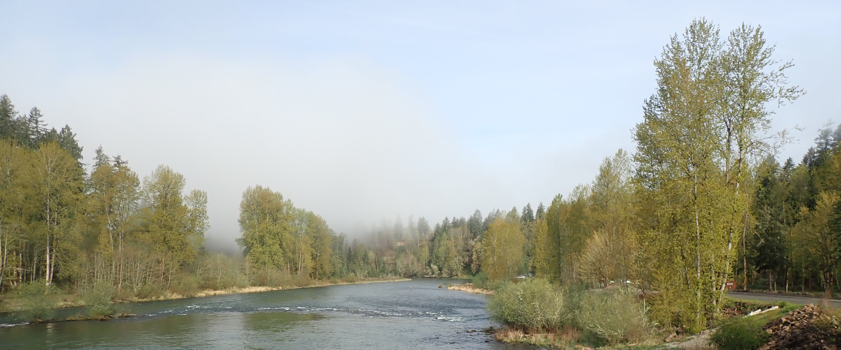
2026 Cowlitz Science Conference and Annual Program Review
Jenise Bauman, PhD Tacoma Power
April 22, 2026

Slide 2


Slide 3
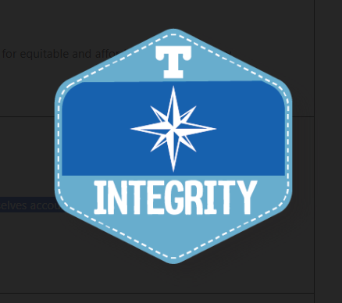
Extending a Values Moment:
Integrity: We hold ourselves accountable to the things we do and say. This includes:
Data we report
On the committees that we serve
In the watersheds that we work
Together, we create a team of individuals who are striving for the same goal: the environmental recovery of the Cowlitz Watershed.

Slide 4
The Subcommittees We Represent:
Cowlitz Restoration and Recovery (CRR) Hatchery-Associated Production (HAP) Subcommittee: operates as a recommending body to the FTC on implementation of the HAP elements of the CRR program.
Monitoring and Evaluation (M&E) subcommittee: at the direction of the FTC, M&E advises and make recommendations on matters related to Tacoma Power’s implementation of activities under the settlement agreement (SA) for the Cowlitz River Hydroelectric Project
Downstream Passage Technical Working Group (TWG): to improve the Fish Passage Survival of anadromous salmonid juveniles at or near Cowlitz Falls Dam and Mayfield Dam. This includes identifying facility or operational changes to improve smolt FCE and passage.

Slide 5
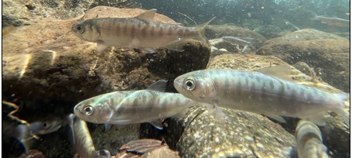
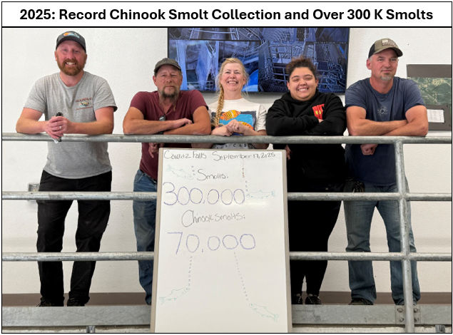
TWG Fish Passage Progress 2025:
First year of Acoustic Telemetry CFNSC
Modeling Covariates for Fish Collection and Survival
Secondary Separator Survival Study
TWG Charter Approved
Methods comparison – CFFF and Mayfield
Adult Handling Facility Database
Coho Parr passed at Cowlitz Falls
Record Spring Chinook Collection Numbers at CFNSC

Slide 6
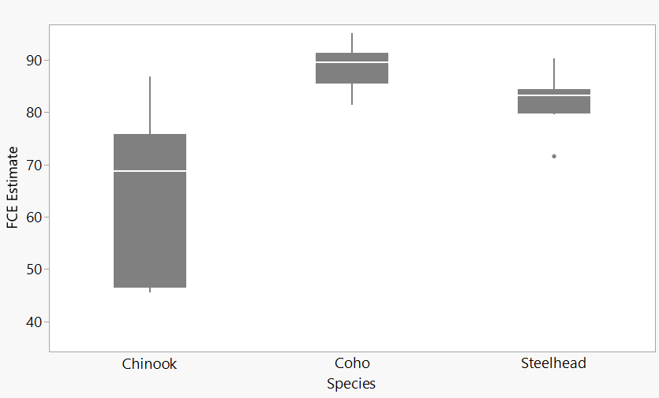
Fish Collection Efficiency (FCE): 2025 Estimates
88.6%
82.2%
64.9%

Slide 7
Fish Collection Efficiency (FCE): 2025 Weekly Estimates

Slide 8
Fish Passage Survival 2017- 2025:

Slide 9
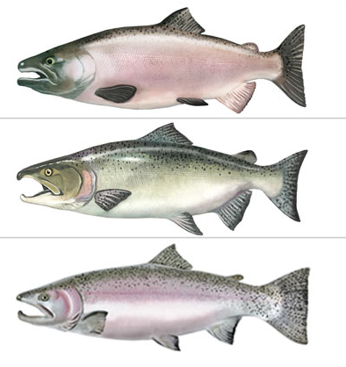
TWG Priorities 2026:
Second year of Acoustic Telemetry CFNSC
Modeling Covariates and Model Comparisons
Upper Cowlitz Coho Parr Assessment
Coho Aging Comparison – Cowlitz vs Mayfield
DAMP Revision
Spring Chinook Fallbacks
Extended collection and FPS

Slide 10
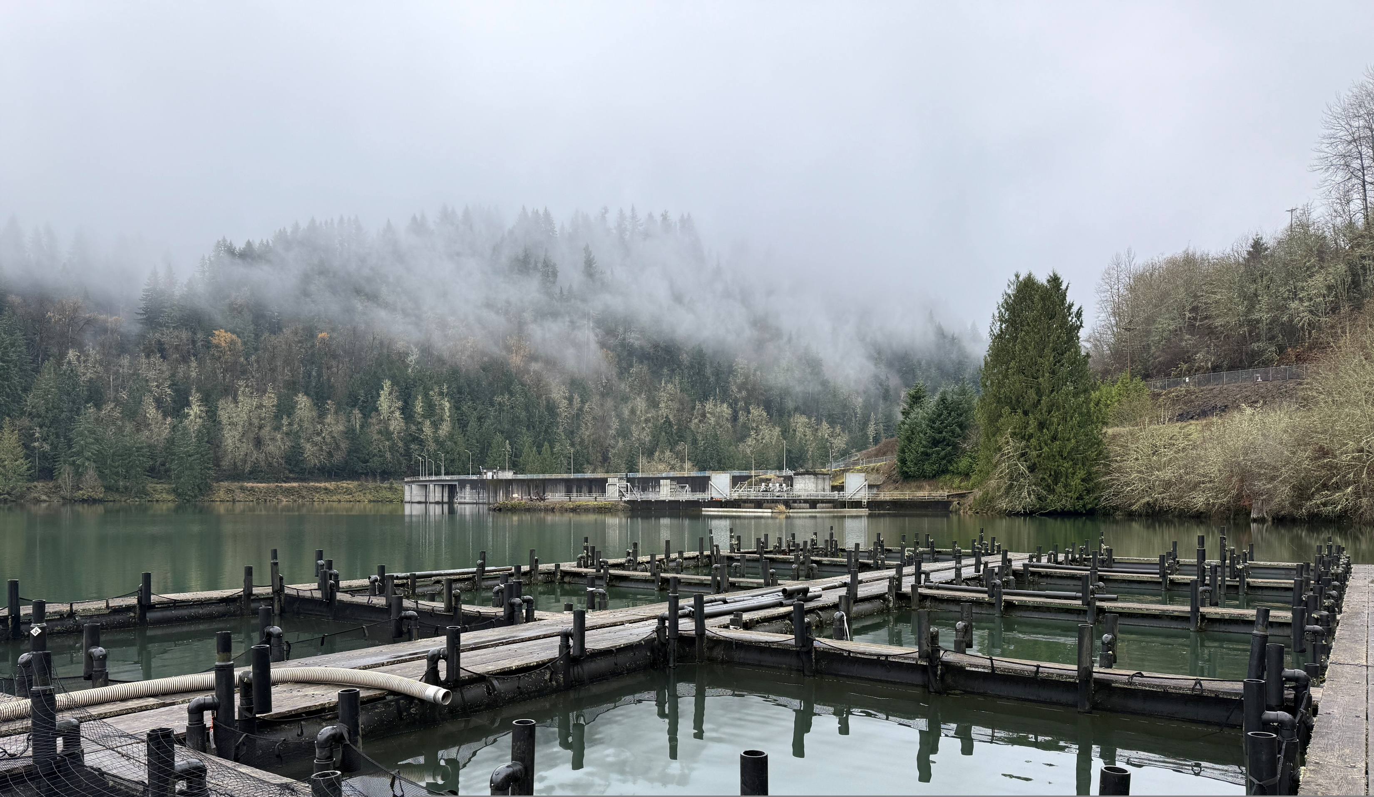
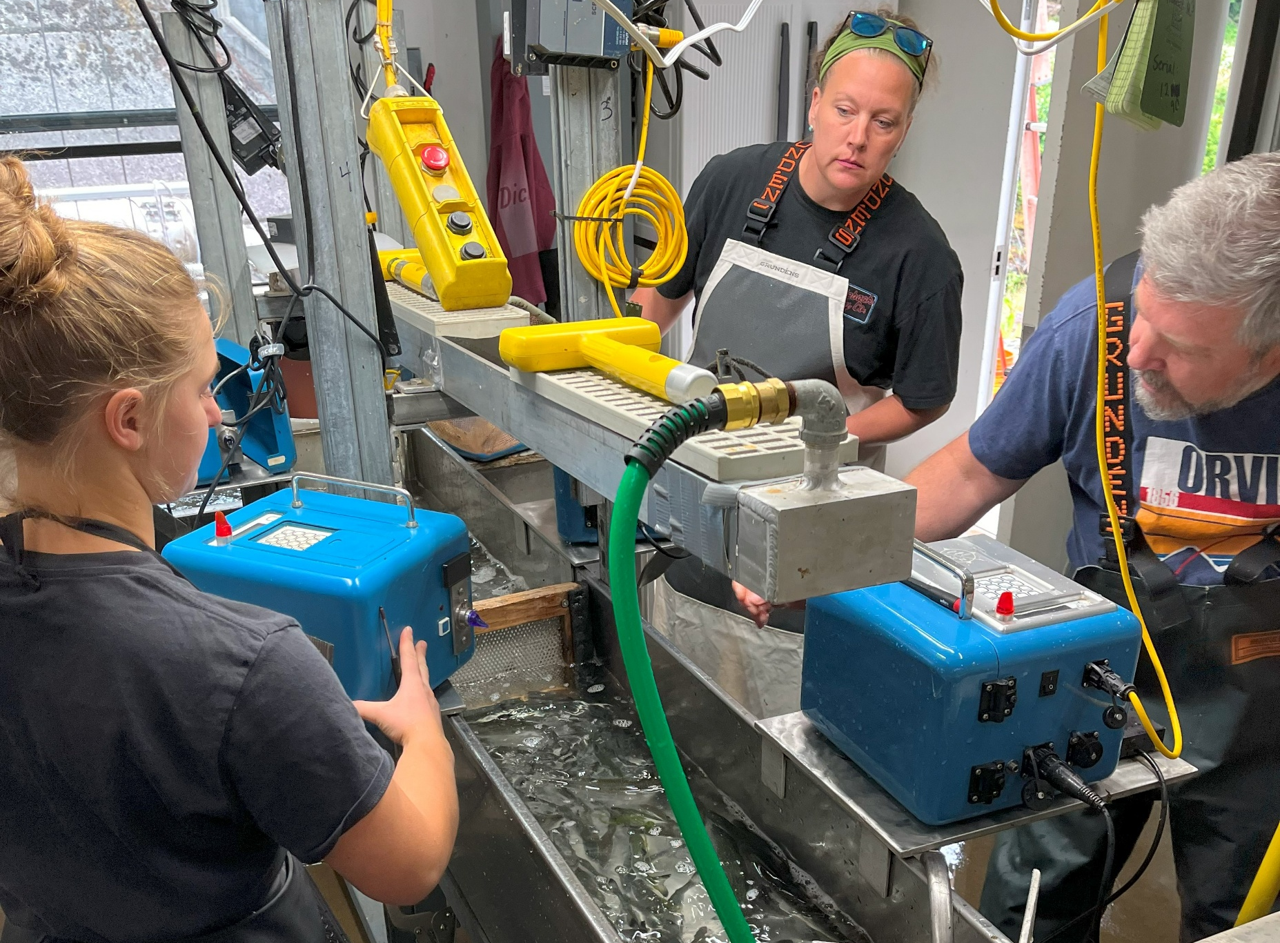
M&E Progress 2025:
Coho Net Pens Phase II
Satellite Rearing
M&E Charter Approved
Transition Talks to FTC – Chinook, Steelhead, Coho
Shared WDFW and Tacoma NR Database
Life-Cycle Model – Upper Cowlitz Winter Steelhead
Fall Chinook Four-step approach

Slide 11
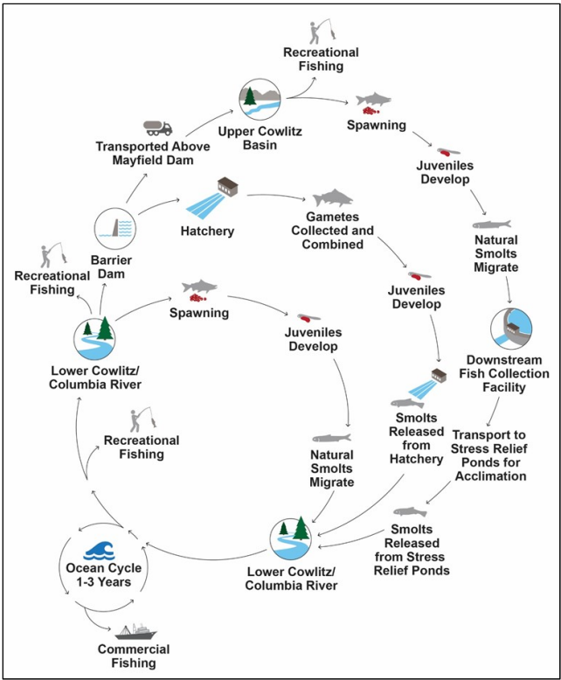
Four-step approach for Fall Chinook:
Step 1: Comprehensive SAR analysis on the new tagging strategy at Mayfield.
Step 2: Data gaps: Evaluation of Chinook arriving at the Cowlitz Separator Facility
– Lower Cowlitz or Tilton
– Spring or Fall
Step 3: Life-cycle modeling
Step 4: Assess models and implement adaptive management

Slide 12
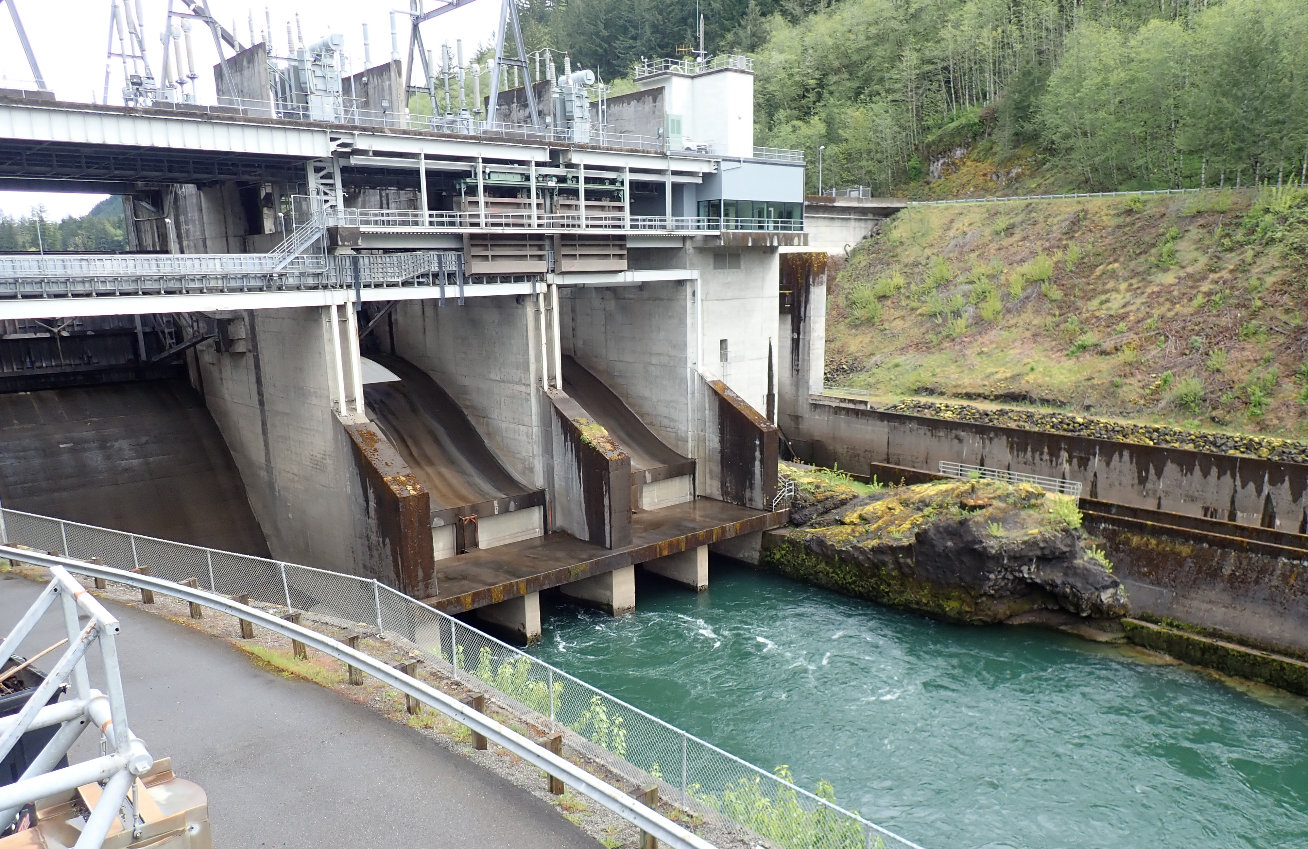
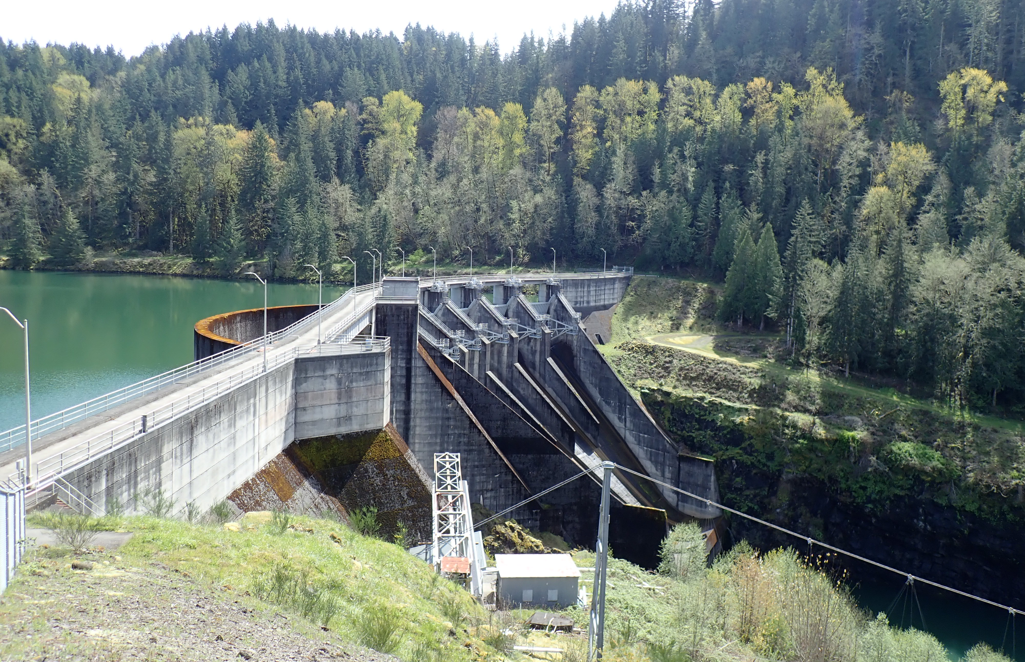
Satellite Rearing:
Mayfield Net Pens
250,000 coho juveniles to 15 fpp
Cowlitz Falls Fish Facility Extended Operations
March 15- December 23, 2026
Cowlitz Falls Fish Facility Rearing
Raise up to 50,000 segregated spring Chinook yearlings to 5 fpp

Slide 13
M&E Priorities 2026:
Transition Phase Review – Lower Fall Chinook
Provide Transition Plans Quarterly
Life-Cycle Model – Upper Cowlitz Winter Steelhead
Expand shared WDFW and Tacoma Data Base
Scales, DNA and Otolith Analysis – Data analysis
Analysis of Spring Chinook release groups
Limiting Factor Analysis – Fall Chinook

Slide 14
Reflections of where we have been:
What stands out to you?

Slide 15

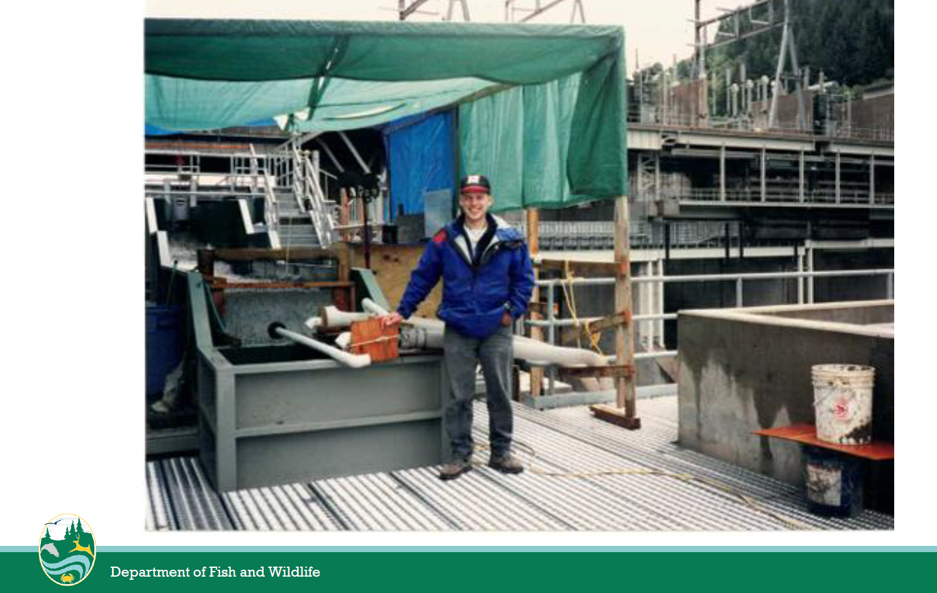
Celebrating 30 years – 1996 – 2026

Slide 16
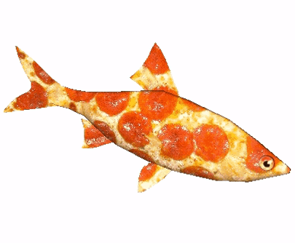
2026 Agenda Review:

Slide 17
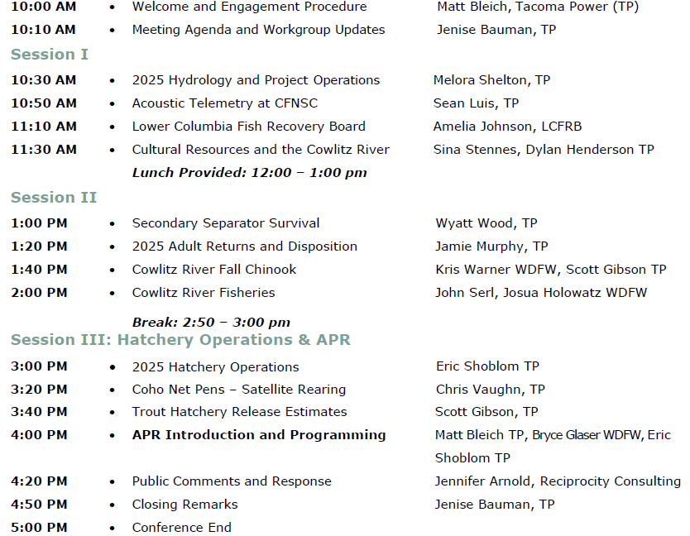
Conference Logistics:
Safety check:
Review Exits
Power Chords
Bathrooms – downstairs during talks
APR Comment Cards are available at the table at the font entrance
Please sign-in
Enjoy the day!

Slide 18
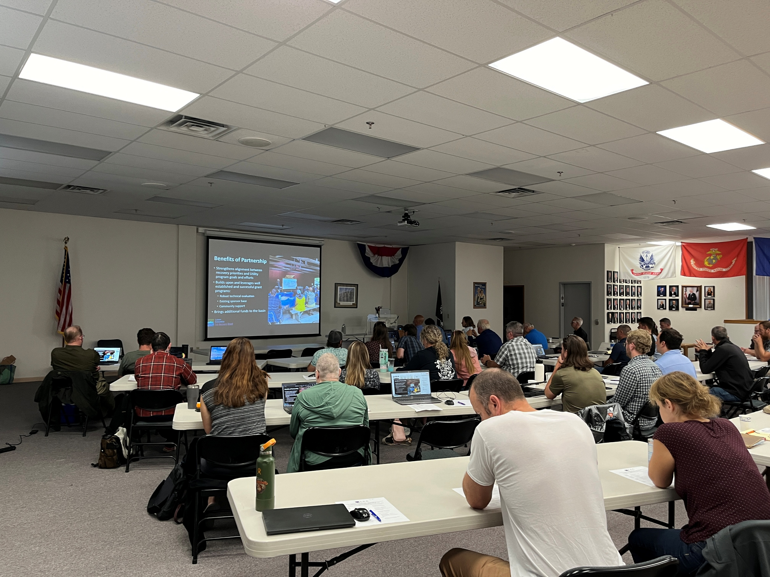
Extending FTC Meeting Norms:
Begin and end on time
Online participants: please mute audio
All voices are heard
Confidentialities are respected
No interruptions or sidebars
Cell phones “ on stun”
Have fun!

Slide 19
Thank you!
April 22, 2026

